Slide 1
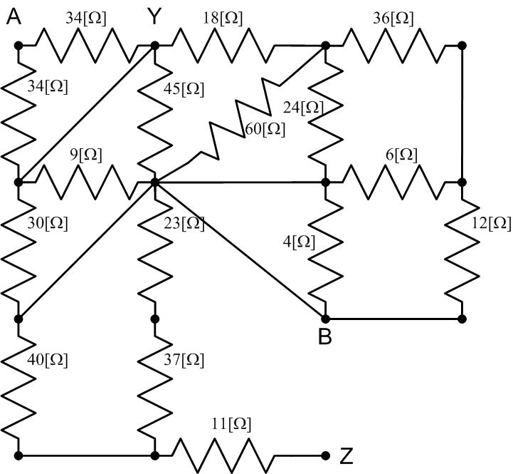
1. Referring to the figure below
Calculate the equivalent resistance seen on the terminals A and B shown.
Calculate the equivalent resistance seen on the terminals Y and Z shown.

Slide 2
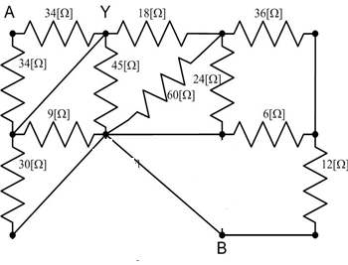
Q1
A) Find the resistance seen from A-B

Slide 3
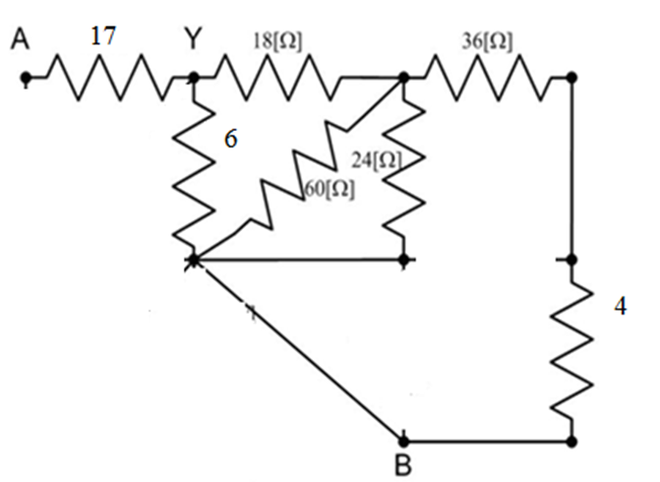
=17
6||12=4
=6

Slide 4
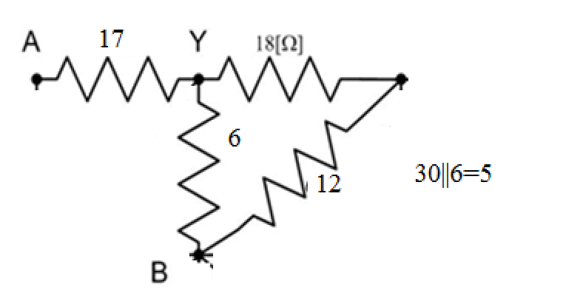
40|| 24 || 60
40|| 60 || 24 = 24|| 24 =12
R_{AB}=17+5=22 [Ω]

Slide 5
B) Calculate the equivalent resistance seen on the terminals Y and Z shown.

Slide 6
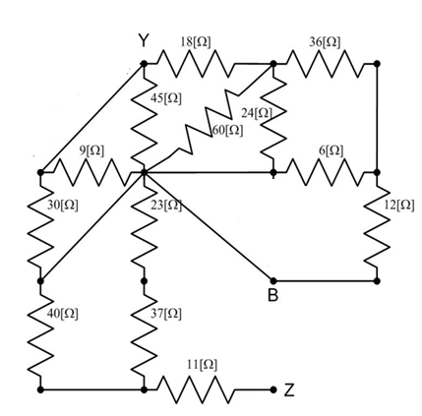
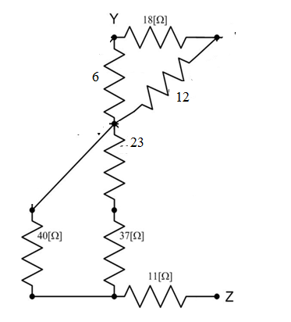
=6
(4+36)|| 24 || 60= 12 [ohm]
30||6=5
R_{YZ}= 5+ (40||60) +11
=5+24+11= 40 [ohms]

Slide 7
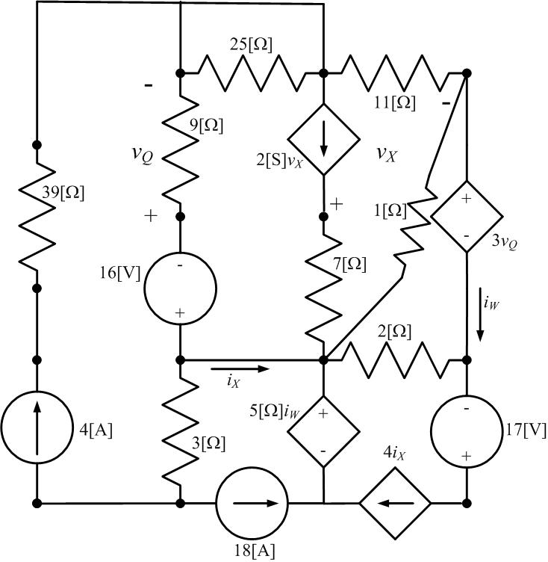
2) NVM: Use the node with most connections as the reference (ground) node.

Slide 8
2) Use the node-voltage method to write a complete set of equations that could be used to solve the circuit below. Define all variables. Do not attempt to simplify the circuit. Do not attempt to simplify or solve the equations. When applying the node-voltage method, use the node with most connections as the reference (ground) node.

Slide 9
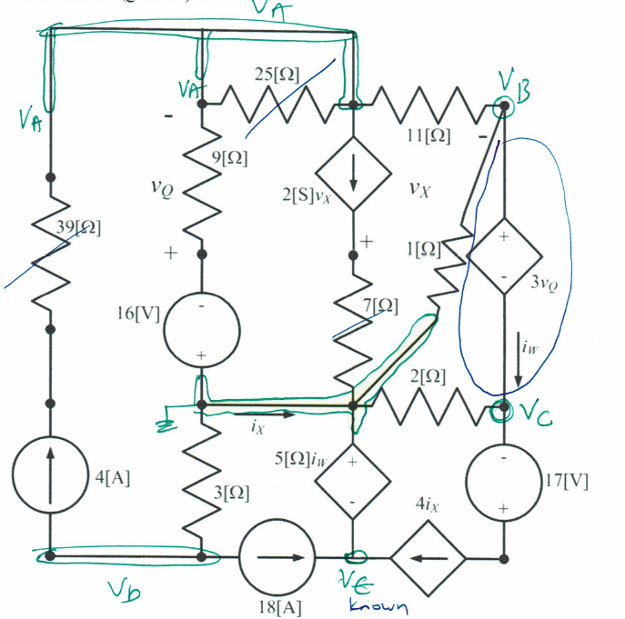
One more equation:

Slide 10
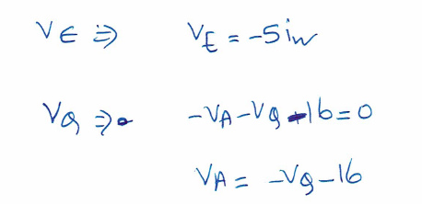
v_{Q}= -v_{A}-16
Dependent variables?

Slide 11
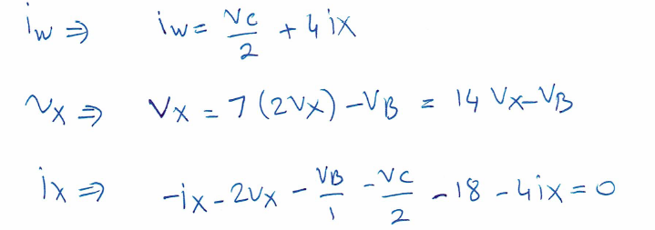
i_{x}- (V_{A}-(-16))/9- V_{D}/3=0

Slide 12
3) Referring to the circuit below (30 pts):
a) Calculate the power supplied by the dependent current source (10 pts)
b) Calculate the power supplied by the 3V voltage source (10 pts)
c) Find the value of v_{Q} voltage (dependent variable) shown (10 pts)

Slide 13
The power supplied by the dependent current source and the 3V voltage source .
I defined the v in supplying direction

Slide 14
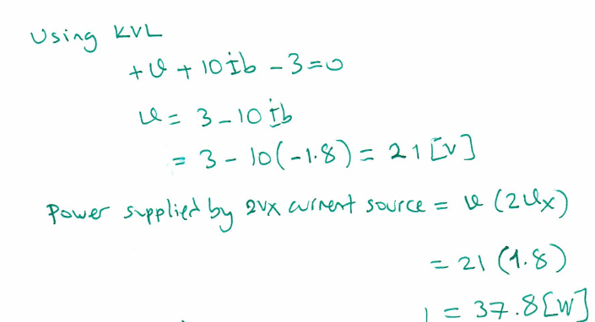
For the dependent current source, we define a voltage v across this course and write a KVL
[A]

Slide 15
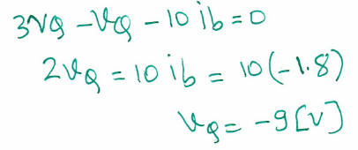
To find a v_{Q}, we do a KVL in this closed path

