Slide 1
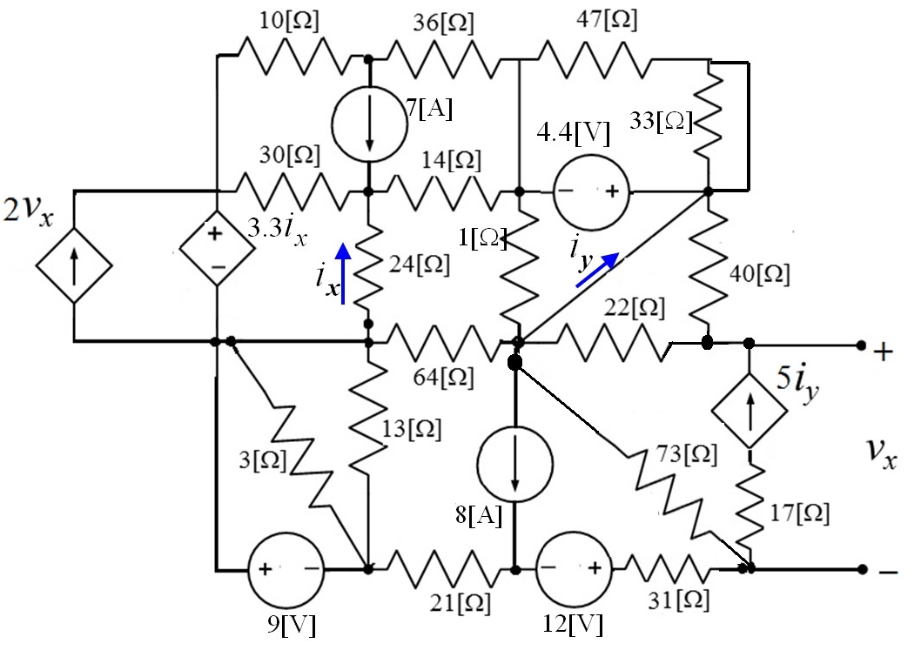
Use the node-voltage method to write a complete set of equations that could be used to solve the circuit below. Define all variables. Do not attempt to simplify the circuit. Do not attempt to simplify or solve the equations. When applying the node-voltage method, use the node with most connections as the reference (ground) node.

Slide 2
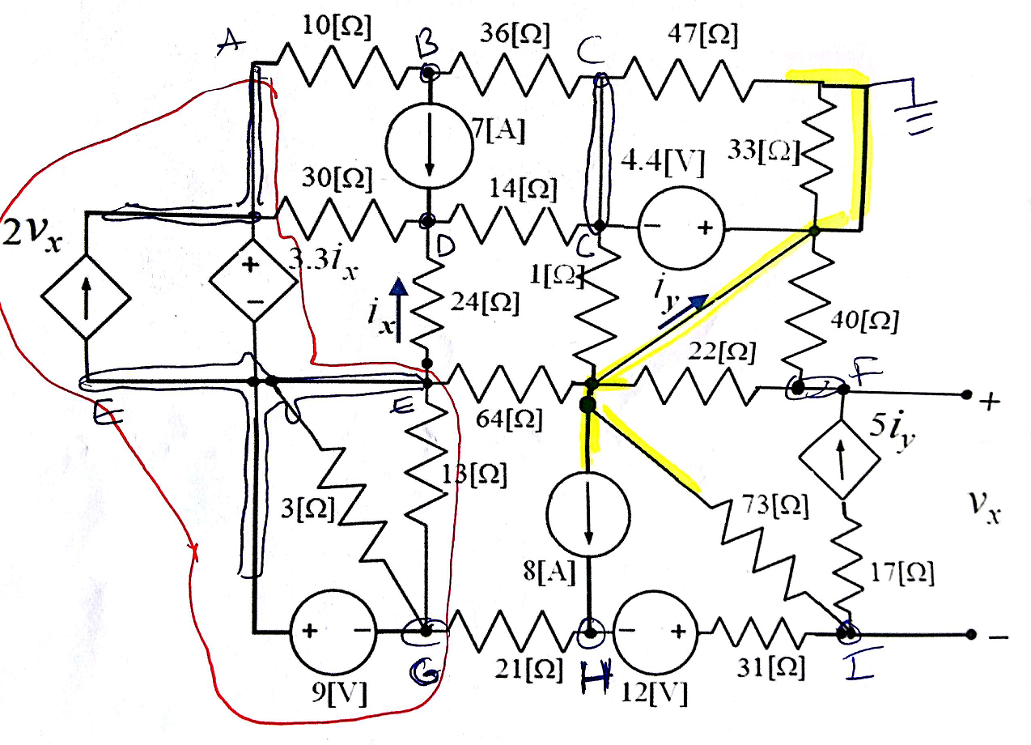
supernode
Do we have any node voltage known?

Slide 3
Vc= - 4.4 [V]

Slide 4
A+E+G
(1)
WE NEED TWO MORE EQUATIONS SINCE WE HAVE 3 NODES

Slide 5
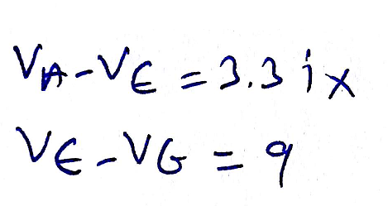
(2)
(3)

Slide 6
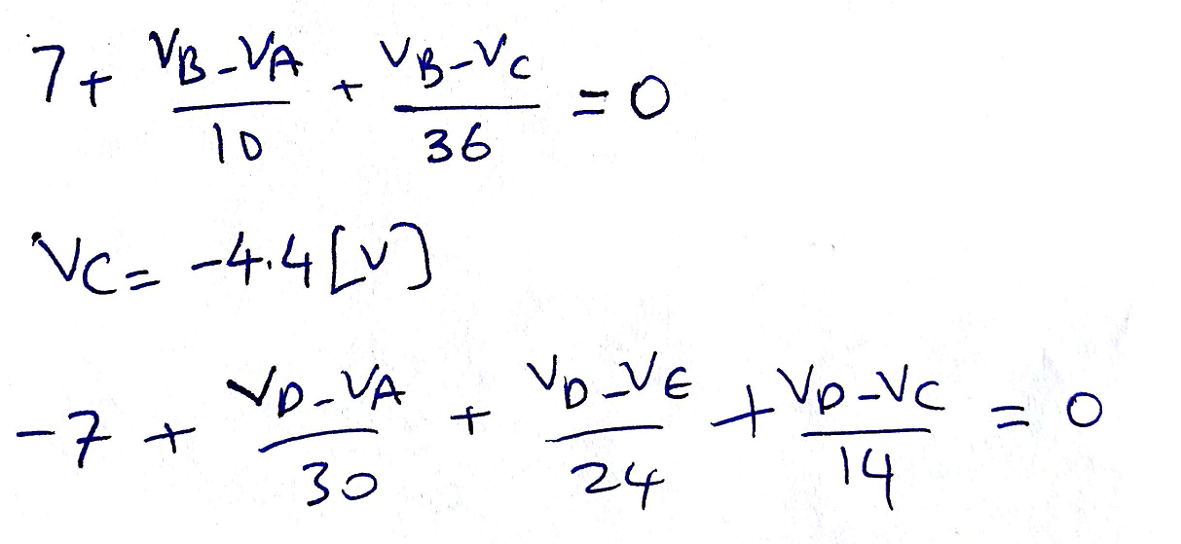
B
(4)
C
(5)
(6)
D

Slide 7
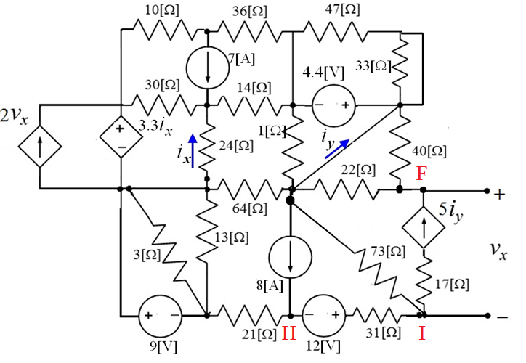
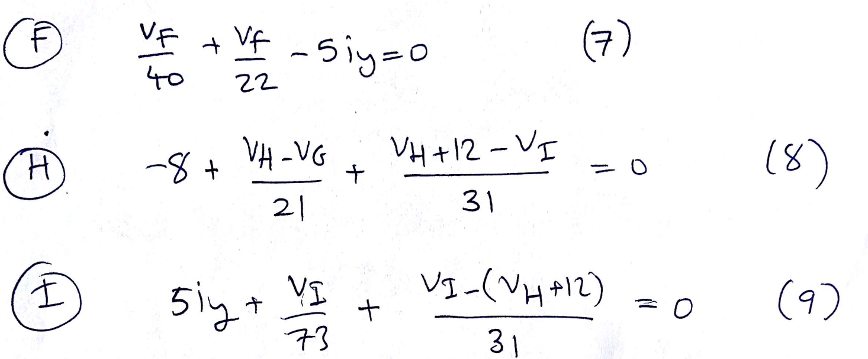

Slide 8
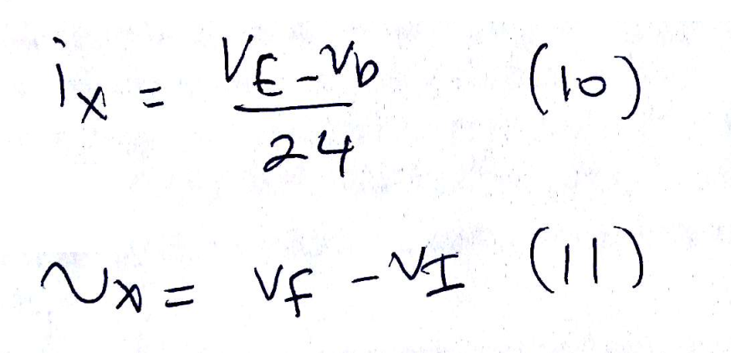
D
E
Dependent variables ix, vx and iy

Slide 9
