Slide 1
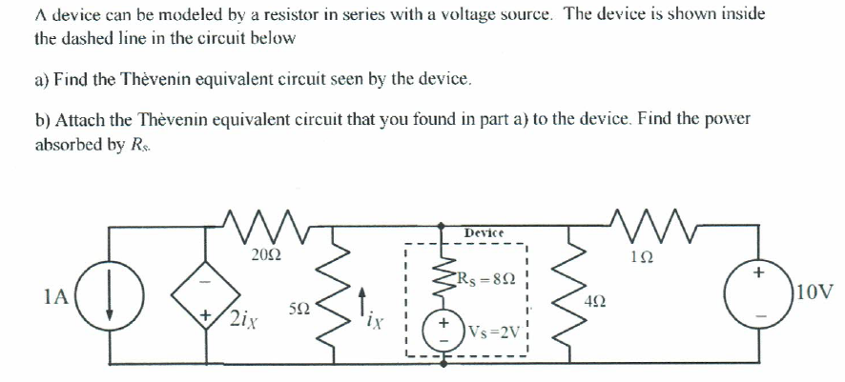
1-

Slide 2
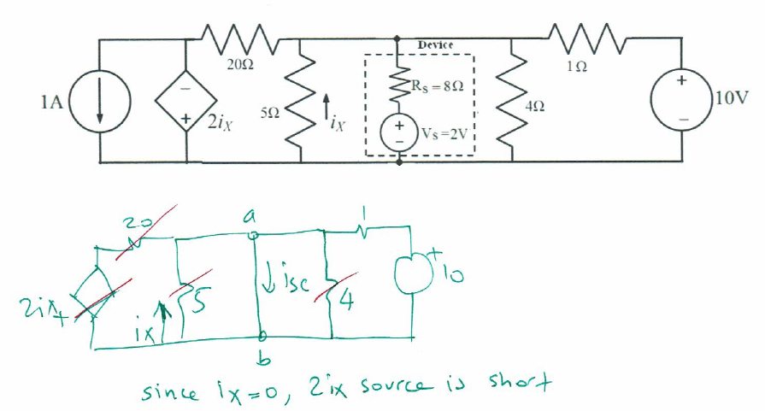
First let’s get i_{sc}
i_{sc} = 10/1=10[A]

Slide 3
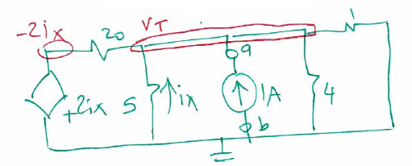
Getting Rth:
Remove device and attach a test source after killing independent sources

Slide 4
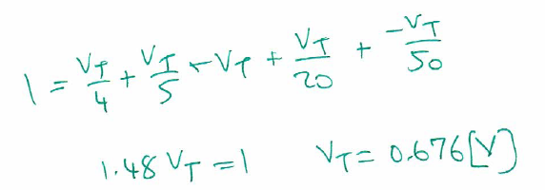

Slide 5
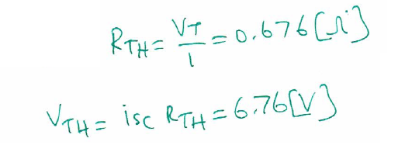

Slide 7
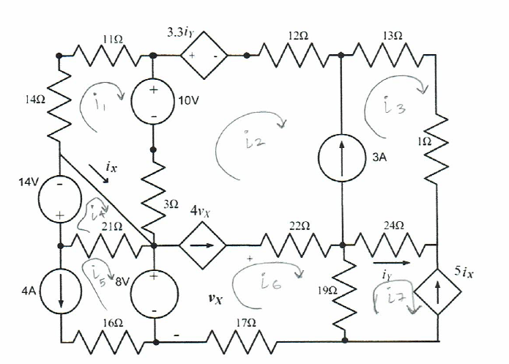

Slide 10
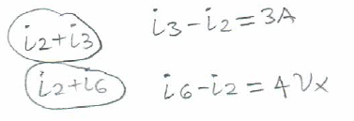

Slide 11
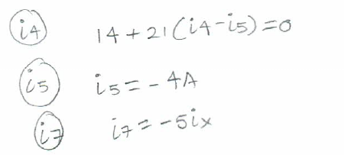

Slide 12
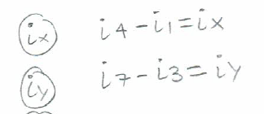

Slide 13
V_{x}
-V_{x}+22(i₆-i₂)+19(i₆-i₇)+17i₆=0

