Slide 1
ECE 2201
Circuit Analysis
Lecture Set #3
Equivalent Circuits
Series, Parallel, Delta-to-Wye,
Voltage Divider and
Current Divider Rules
Version 28
Dr. Dave Shattuck
Associate Professor, ECE Dept.

Slide 2
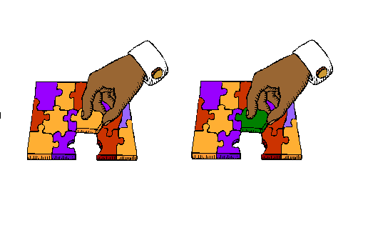
Series, Parallel, and other Resistance Equivalent Circuits

Slide 3
Overview
Series, Parallel, and other Resistance Equivalent Circuits
In this lecture set, we will cover the following topics:
Equivalent circuits
Definitions of series and parallel
Series and parallel resistors
Delta-to-wye transformations
Notes:
You can click on the links to jump to the subject that you want to learn about now.

Slide 4
Equivalent Circuits – The Concept
Equivalent circuits are ways of looking at or solving circuits. The idea is that if we can make a circuit simpler, we can make it easier to solve, and easier to understand.
The key is to use equivalent circuits properly. After defining equivalent circuits, we will start with the simplest equivalent circuits, series and parallel combinations of resistors.

Slide 5
Equivalent Circuits:
A Definition
Imagine that we have a circuit, and a portion of the circuit can be identified, made up of one or more parts. That portion can be replaced with another set of components, if we do it properly. We call these portions equivalent circuits.
Two circuits are considered
to be equivalent if they behave
the same with respect to the
things to which they are
connected. One can replace
one circuit with another circuit,
and everything else cannot
tell the difference.
We will use an analogy for equivalent circuits here. This analogy is that of jigsaw puzzle pieces. The idea is that two different jigsaw puzzle pieces with the same shape can be thought of as equivalent, even though they are different. The rest of the puzzle does not “notice” a difference. This is analogous to the case with equivalent circuits.

Slide 6
Equivalent Circuits:
A Definition Considered
Two circuits are considered
to be equivalent if they behave
the same with respect to the
things to which they are
connected. One can replace
one circuit with another circuit,
and everything else cannot
tell the difference.
In this jigsaw puzzle, the rest of the puzzle cannot tell whether the yellow or the green piece is inserted. This is analogous to what happens with equivalent circuits.

Slide 7
Equivalent Circuits:
Defined in Terms of Terminal Properties
Two circuits are considered
to be equivalent if they behave
the same with respect to the
things to which they are
connected. One can replace
one circuit with another circuit,
and everything else cannot
tell the difference.
We often talk about equivalent circuits as being equivalent in terms of terminal properties. The properties (voltage, current, power) within the circuit may be different.

Slide 8
Equivalent Circuits:
A Caution
Two circuits are considered
to be equivalent if they behave
the same with respect to the
things to which they are
connected. The properties (voltage, current, power) within the circuit may be different.
It is important to keep this concept in mind. A common error for beginners is to assume that voltages or currents within a pair of equivalent circuits are equal. They may not be. These voltages and currents are only required to be equal if they can be identified outside the equivalent circuit. This will become clearer as we see the examples that follow in the other parts of this lecture set.
Go back to Overview slide.

Slide 9
Series Combination:
A Structural Definition
A Definition:
Two parts of a circuit are in series if the same current flows through both of them.
Note: It must be more than just the same value of current in the two parts. The same exact charge carriers need to go through one, and then the other, part of the circuit.

Slide 10
Series Combination:
Hydraulic Version of the Definition
A Definition:
Two parts of a circuit are in series if the same current flows through both of them.
A hydraulic analogy: Two water pipes are in series if every drop of water that goes through one pipe, then goes through the other pipe.

Slide 11
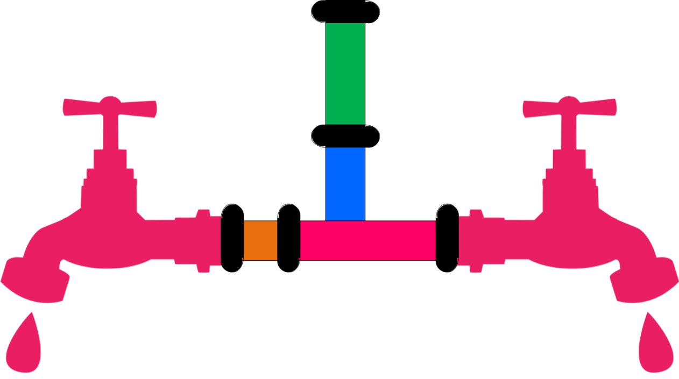
Series Combination:
A Hydraulic Example
A Definition:
Two parts of a circuit are in series if the same current flows through both of them.
A hydraulic analogy: Two water pipes are in series if every drop of water that goes through one pipe, then goes through the other pipe.
In this picture, the green
part and the blue part of the
pipes are in series, but the
blue part and the orange part
are not in series.

Slide 12
Parallel Combination:
A Structural Definition
A Definition:
Two parts of a circuit are in parallel if the same voltage is across both of them.
Note: It must be more than just the same value of the voltage in the two parts. The same exact voltage must be across each part of the circuit. In other words, the two end points must be connected together.

Slide 13
Parallel Combination:
Hydraulic Version of the Definition
A Definition:
Two parts of a circuit are in parallel if the same voltage is across both of them.
A hydraulic analogy: Two water pipes are in parallel the two pipes have their ends connected together. The analogy here is between voltage and height. The difference between the height of two ends of a pipe, must be the same as that between the two ends of another pipe, if the two pipes are connected together.

Slide 14
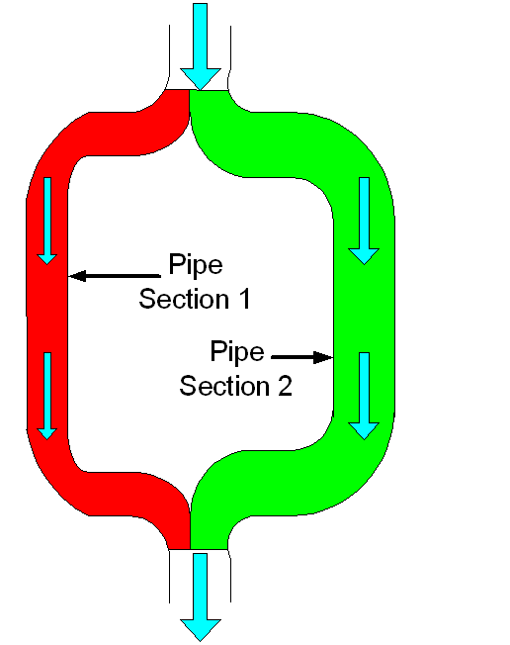
Parallel Combination:
A Hydraulic Example
A Definition:
Two parts of a circuit are in parallel if the same voltage is across both of them.
A hydraulic analogy: Two water pipes are in parallel if the two pipes have their ends connected together. The Pipe Section 1 (in red) and Pipe Section 2 (in green) in this set of water pipes are in parallel. Their ends are connected together.
Go back to Overview slide.

Slide 15
Series Resistors Equivalent Circuits
Two series resistors, R₁ and R₂, can be replaced with an equivalent circuit with a single resistor R_{EQ}, as long as

Slide 16
More than 2 Series Resistors
This rule can be extended to more than two series resistors. In this case, for N series resistors, we have

Slide 17
Series Resistors Equivalent Circuits: A Reminder
Two series resistors, R₁ and R₂, can be replaced with an equivalent circuit with a single resistor R_{EQ}, as long as
Remember that these two equivalent circuits are equivalent only with respect to the circuit connected to them. (In yellow here.)

Slide 18
Series Resistors Equivalent Circuits: Another Reminder
Resistors R₁ and R₂ can be replaced with a single resistor R_{EQ}, as long as
Remember that these two equivalent circuits are equivalent only with respect to the circuit connected to them. (In yellow here.) The voltage v_{R2} does not exist in the right hand equivalent.

Slide 19
The Resistors Must be in Series
R₁ and R₂ are not in series here.
Resistors R₁ and R₂ can be replaced with a single resistor R_{EQ}, as long as
Remember also that these two equivalent circuits are equivalent only when R₁ and R₂ are in series. If there is something connected to the node between them, and it carries current, (i_{X} ≠ 0) then this does not work.

Slide 20
Parallel Resistors
Equivalent Circuits
Two parallel resistors, R₁ and R₂, can be replaced with an equivalent circuit with a single resistor R_{EQ}, as long as

Slide 21
More than 2 Parallel Resistors
This rule can be extended to more than two parallel resistors. In this case, for N parallel resistors, we have

Slide 22
Parallel Resistors
Notation
We have a special notation for this operation. When two things, Thing1 and Thing2, are in parallel, we write
Thing1||Thing2
to indicate this. So, we can say that

Slide 23
Parallel Resistor Rule for 2 Resistors
When there are only two resistors, then you can perform the algebra, and find that
This is called the product-over-sum rule for parallel resistors. Remember that the product-over-sum rule only works for two resistors, not for three or more.

Slide 24
Parallel Resistors Equivalent Circuits: A Reminder
Two parallel resistors, R₁ and R₂, can be replaced with a single resistor R_{EQ}, as long as
Remember that these two equivalent circuits are equivalent only with respect to the circuit connected to them. (In yellow here.)

Slide 25
Parallel Resistors
Equivalent Circuits: Another Reminder
Two parallel resistors, R₁ and R₂, can be replaced with R_{EQ}, as long as
Remember that these two equivalent circuits are equivalent only with respect to the circuit connected to them. (In yellow here.) The current i_{R2} does not exist in the right hand equivalent.

Slide 26
The Resistors
Must be in Parallel
Go back to Overview slide.
R₁ and R₂ are not in parallel here.
Two parallel resistors, R₁ and R₂, can be replaced with R_{EQ}, as long as
Remember also that these two equivalent circuits are equivalent only when R₁ and R₂ are in parallel. If the two terminals of the resistors are not connected together, then this does not work.

Slide 27

Why are we doing this?
Isn’t all this obvious?
This is a good question.
Indeed, most students come to the study of engineering circuit analysis with a little background in circuits. Among the things that they believe that they do know is the concept of series and parallel.
However, once complicated circuits are encountered, the simple rules that some students have used to identify
series and parallel combinations
can fail. We need rules that will
always work.
Go back to Overview slide.

Slide 28
Why It Isn’t Obvious
The problem for students in many cases is that they identify series and parallel by the orientation and position of the resistors, and not by the way they are connected.
In the case of parallel resistors, the resistors do not have to be drawn “parallel”, that is, along lines with the same slope. The angle does not matter. Only the nature of the connection matters.
In the case of series resistors, they do not have to be drawn along a single line. The alignment does not matter. Only the nature of the connection matters.
Go back to Overview slide.

Slide 29
Examples (Parallel)
Some examples are given here.

Slide 30
Examples (Series)
Go back to Overview slide.
Some more examples are given here.

Slide 31
How do we use equivalent circuits?
This is yet another good question.
We will often use these equivalents to simplify circuits, making them easier to solve. Sometimes, equivalent circuits are used in other ways. In some cases, one equivalent circuit is not simpler than another; rather one of them fits the needs of the particular circuit better. The delta-to-wye transformations that we cover next fit in this category. In yet other cases, we will have equivalent circuits for things that we would not otherwise be able to solve. For example, we will have equivalent circuits for devices such as diodes and transistors, that allow us to solve circuits that include these devices.
The key point is this: Equivalent circuits are used throughout circuits and electronics. We need to use them
correctly. Equivalent circuits are equivalent
only with respect to the circuit outside them.
Go back to Overview slide.

Slide 32
Delta-to-Wye Transformations
The transformations, or equivalent circuits, that we cover next are called delta-to-wye, or wye-to-delta transformations. They are also sometimes called
pi-to-tee or tee-to-pi transformations. For these lecture sets, we will call them the delta-to-wye transformations.
These are equivalent circuit pairs. They apply for parts of circuits that have three terminals. Each version of the equivalent circuit has three resistors.
Many courses do not cover these particular equivalent circuits at this point, delaying coverage until they are specifically needed during the discussion of three phase circuits. However, they are an excellent example of equivalent circuits, and can be used in some cases to solve circuits more easily.

Slide 33
Delta-to-Wye Transformations
Three resistors in a part of a circuit with three terminals can be replaced with another version, also with three resistors. The two versions are shown here. Note that none of these resistors is in series with any other resistor, nor in parallel with any other resistor. The three terminals in this example are labeled A, B, and C.

Slide 34
Delta-to-Wye Transformations
(Notes on Names)
The version on the left hand side is called the delta connection, for the Greek letter Δ. The version on the right hand side is called the wye connection, for the letter Y. The delta connection is also called the pi (π) connection, and the wye interconnection is also called the tee (T) connection. All these names come from the shapes of the drawings.

Slide 35
Delta-to-Wye Transformations (More Notes)
When we go from the delta connection (on the left) to the wye connection (on the right), we call this the delta-to-wye transformation. Going in the other direction is called the wye-to-delta transformation. One can go in either direction, as needed. These are equivalent circuits.

Slide 36
Delta-to-Wye Transformation Equations
When we perform the delta-to-wye transformation (going from left to right) we use the equations given below.

Slide 37
Wye-to-Delta Transformation Equations
When we perform the wye-to-delta transformation (going from right to left) we use the equations given below.

Slide 38
Deriving the Equations
While these equivalent circuits are useful, perhaps the most important insight is gained from asking where these useful equations come from. How were these equations derived?
The answer is that they were derived using the fundamental rule for equivalent circuits. These two equivalent circuits have to behave the same way no matter what circuit is connected to them. So, we can choose specific circuits to connect to the equivalents. We make the derivation by solving for equivalent resistances, using our series and parallel rules, under different, specific conditions.

Slide 39
Equation 1
We can calculate the equivalent resistance between terminals A and B, when C is not connected anywhere. The two cases are shown below. This is the same as connecting an ohmmeter, which measures resistance, between terminals A and B, while terminal C is left disconnected.

Slide 40
Equations 2 and 3
So, the equation that results from the first situation is
We can make this measurement two other ways, and get two more equations. Specifically, we can measure the resistance between A and C, with B left open, and we can measure the resistance between B and C, with A left open.

Slide 41
All Three Equations
The three equations we can obtain are
This is all that we need. These three equations can be manipulated algebraically to obtain either the set of equations for the delta-to-wye transformation (by solving for R₁, R₂ , and R₃), or the set of equations for the wye-to-delta transformation (by solving for R_{A}, R_{B} , and R_{C}).

Slide 42
Why Are Delta-to-Wye
Transformations Needed?
This is a good question. In fact, it should be pointed out that these transformations are not necessary. Rather, they are like many other aspects of circuit analysis in that they allow us to solve circuits more quickly and more easily. They are used in cases where the resistors are neither in series nor parallel, so to simplify the circuit requires something more.
One key in applying these equivalents is to get the proper resistors in the proper place in the equivalents and equations. We recommend that you
name the terminals each time, on the
circuit diagrams, to help you get these
things in the right places.
Go back to Overview slide.

Slide 43
Example Problem #1

Slide 44
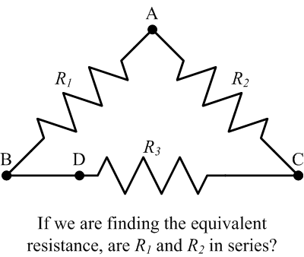
Example Problem #2

Slide 45
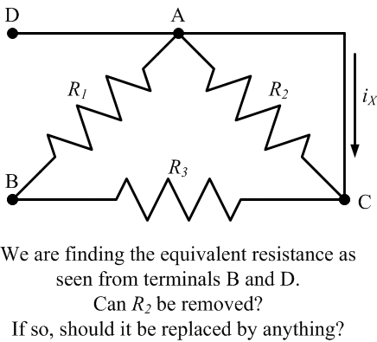
Example Problem #3

Slide 46
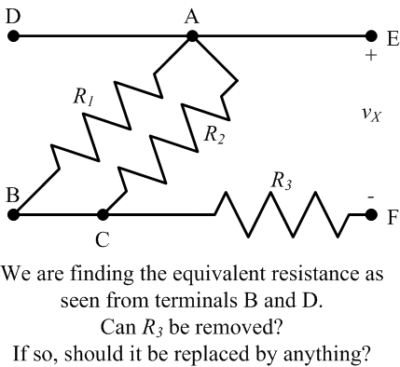
Example Problem #4

Slide 47
Example Problem #5
Find the equivalent resistance as seen from terminals A and B.

Slide 48
Voltage Divider and Current Divider Rules

Slide 49
Overview
Series, Parallel, and other Resistance Equivalent Circuits
In this part, we will cover the following topics:
Voltage Divider Rule
Current Divider Rule
Signs in the Voltage Divider Rule
Signs in the Current Divider Rule
Notes:
You can click on the links to jump to the subject that you want to learn about now.

Slide 50



Voltage Divider Rule –
Our First Circuit Analysis Tool
The Voltage Divider Rule (VDR) is the first of a long list of tools that we are going to develop to make circuit analysis quicker and easier. The idea is this: if the same situation occurs often, we can derive the solution once, and use it whenever it applies. As with any tools, the keys are:
Recognizing when the tool works and when it doesn’t work.
Using the tool properly.

Slide 51
Voltage Divider Rule –
Setting up the Derivation
The Voltage Divider Rule involves the voltages across series resistors. Let’s take the case where we have two resistors in series. Assume for the moment that the voltage across these two resistors, v_{TOTAL}, is known. Assume that we want the voltage across one of the resistors, shown here as v_{R1}. Let’s find it.

Slide 52
Voltage Divider Rule –
Derivation Step 1
The current through both of these resistors is the same, since the resistors are in series. The current, i_{X}, is

Slide 53
Voltage Divider Rule –
Derivation Step 2
The current through resistor R₁ is the same current. The current, i_{X}, is

Slide 54
Voltage Divider Rule –
Derivation Step 3
These are two expressions for the same current, so they must be equal to each other. Therefore, we can write

Slide 55
The Voltage Divider Rule
This is the expression we wanted. We call this the Voltage Divider Rule (VDR).

Slide 56
Voltage Divider Rule –
For Each Resistor
Go back to Overview slide.
This is easy enough to remember that most people just memorize it. Remember that it only works for resistors that are in series. Of course, there is a similar rule for the other resistor. For the voltage across one resistor, we put
that resistor value
in the numerator.

Slide 57


Current Divider Rule –
Our Second Circuit Analysis Tool
The Current Divider Rule (CDR) is the second of a long list of tools that we are going to develop to make circuit analysis quicker and easier. Again, if the same situation occurs often, we can derive the solution once, and use it whenever it applies. As with any tools, the keys are:
Recognizing when the tool works and when it doesn’t work.
Using the tool properly.

Slide 58
Current Divider Rule –
Setting up the Derivation
The Current Divider Rule involves the currents through parallel resistors. Let’s take the case where we have two resistors in parallel. Assume for the moment that the current feeding these two resistors, i_{TOTAL}, is known. Assume that we want the current through one of the resistors, shown here as i_{R1}. Let’s find it.

Slide 59
Current Divider Rule –
Derivation Step 1
The voltage across both of these resistors is the same, since the resistors are in parallel. The voltage, v_{X}, is the current multiplied by the equivalent parallel resistance,

Slide 60
Current Divider Rule –
Derivation Step 2
The voltage across resistor R₁ is the same voltage, v_{X}. The voltage, v_{X}, is

Slide 61
Current Divider Rule –
Derivation Step 3
These are two expressions for the same voltage, so they must be equal to each other. Therefore, we can write

Slide 62
The Current Divider Rule
This is the expression we wanted. We call this the Current Divider Rule (CDR).

Slide 63
Current Divider Rule –
For Each Resistor
Go back to Overview slide.
Most people just memorize this. Remember that it only works for resistors that are in parallel. Of course, there is a similar rule for the other resistor. For the current through one resistor, we put the opposite resistor value in the numerator.

Slide 64
Signs in the Voltage Divider Rule
As in most every equation we write, we need to be careful about the sign in the Voltage Divider Rule (VDR). Notice that when we wrote this expression, there is a positive sign. This is because the voltage v_{TOTAL} is in the same relative polarity as v_{R1}.

Slide 65
Negative Signs in the Voltage Divider Rule
If, instead, we had solved for v_{Q}, we would need to change the sign in the equation. This is because the voltage v_{TOTAL} is in the opposite relative polarity from v_{Q}.

Slide 66
Check for Signs in the Voltage Divider Rule
Go back to Overview slide.
The rule for proper use of this tool, then, is to check the relative polarity of the voltage across the series resistors, and the voltage across one of the resistors.

Slide 67
Signs in the Current Divider Rule
As in most every equation we write, we need to be careful about the sign in the Current Divider Rule (CDR). Notice that when we wrote this expression, there is a positive sign. This is because the current i_{TOTAL} is in the same relative polarity as i_{R1}.

Slide 68
Negative Signs in the Current Divider Rule
If, instead, we had solved for i_{Q}, we would need to change the sign in the equation. This is because the current i_{TOTAL} is in the opposite relative polarity from i_{Q}.

Slide 69
Check for Signs in the Current Divider Rule
Go back to Overview slide.
The rule for proper use of this tool, then, is to check the relative polarity of the current through the parallel resistors, and the current through one of the resistors.

Slide 70
Do We Always Need to
Worry About Signs?
Unfortunately, the answer to this question is: YES! There is almost always a question of what the sign should be in a given circuits equation. The key is to learn how to get the sign right every time. As mentioned earlier, this is the key purpose in introducing reference polarities.
Go back to Overview slide.

Slide 71
Example Problem #6

