Slide 1
ECE 2201
Circuit Analysis
Lecture Set #5
The Node Voltage Method with Voltage Sources
Version 17
Dr. Dave Shattuck
Associate Professor, ECE Dept.

Slide 2
Node-Voltage Method with Voltage Sources

Slide 3
Overview of this Lecture Set
In this lecture set, we will cover the following topics:
Voltage sources in the Node-Voltage Method
Voltage sources in series with an element
Voltage sources between reference node and another essential node
Voltage sources between two non-reference essential nodes
Notes:
You can click on the blue text to jump to the subject that you want to learn about now.

Slide 4
Textbook Coverage
This material is covered in your textbook in the following sections:
Electric Circuits 8th Ed. by Nilsson and Riedel: Sections 4.1 through 4.4
Notes:
You should also read these sections in your text. This material is intended to complement your textbook coverage, not replace it.

Slide 5
The Node-Voltage Method (NVM)
The Node-Voltage Method (NVM) is a systematic way to write all the equations needed to solve a circuit, and to write just the number of equations needed. The idea is that any other current or voltage can be found from these node voltages.
The Node-Voltage Method is a system. And like the sprinkler system here, the goal is be sure that nothing gets missed, and everything is done correctly. We want to write all the equations, the minimum number of equations, and nothing but correct equations.

Slide 6
The Steps in the Node-Voltage Method (NVM)
The Node-Voltage Method steps are:
Find the essential nodes.
Define one essential node as the reference node.
Define the node voltages, the essential nodes with respect to the reference node. Label them.
Apply KCL for each non-reference essential node.
Write an equation for each current or voltage upon which dependent sources depend, as needed.
These steps were explained in detail in the last set of lecture notes.

Slide 7

Voltage Sources and the NVM
The NVM steps are:
Find the essential nodes.
Define one essential node as the reference node.
Define the node voltages, the essential nodes with respect to the reference node. Label them.
Apply KCL for each non-reference essential node.
Write an equation for each current or voltage upon which dependent sources depend, as needed.
A problem arises when using the NVM when there are voltage sources present. The problem is in Step 4. The current through a voltage source can be anything; the current depends on what the voltage source is connected to. Therefore, it is not clear what to write for the KCL expression. We could introduce a new current variable, but we would rather not introduce another variable. In addition, if all we do is directly write KCL equations, we cannot include the value of the voltage source.

Slide 8
Voltage Sources and the NVM – Solution
The NVM steps are:
Find the essential nodes.
Define one essential node as the reference node.
Define the node voltages, the essential nodes with respect to the reference node. Label them.
Apply KCL for each non-reference essential node.
Write an equation for each current or voltage upon which dependent sources depend, as needed.
The solution for what to do when there is a voltage source present depends on how it appears. There are three possibilities. We will handle each of them in turn. The three possibilities are:
A voltage source in series with another element.
A voltage source between the reference node and another essential node.
A voltage source between two non-reference essential nodes.

Slide 9
NVM – Voltage Source in Series with Another Element
As before, it seems to be best to introduce the NVM by doing examples. Our first example circuit is given here. We will go through the entire solution, but our emphasis will be on step 4. Note that here the voltage source v_{S} is in series with the resistor R₂.

Slide 10
NVM – Voltage Source in Series Step 1
The first step is to identify the essential nodes. There are three, marked in red. The fourth node, marked in dark blue, is not an essential node. It only connects two components, not three.

Slide 11
NVM – Voltage Source in Series Step 2
The second step is to define one essential node as the reference node. This is done here. The bottom node is picked since it has four connections.

Slide 12
NVM – Voltage Source in Series Step 3
The third step is to define the node voltages. We have two to define.

Slide 13
NVM – Voltage Source in Series Step 4 – Part 1
The fourth step is to write KCL equations for nodes A and B. The difficult term to write will be for the current going through the voltage source and through R₂. This current is shown with a red current arrow below.

Slide 14
NVM – Voltage Source in Series Step 4 – Part 2
This current shown with a red current arrow below can be expressed using the resistor R₂. The key is to be able to determine the voltage across the resistor in terms of the existing variables.
Note that the voltage v_{TEMP} shown is given by v_{TEMP} = v_{B} – v_{S}. We can show this by writing KVL around the loop shown.

Slide 15
NVM – Voltage Source in Series Step 4 – Part 3
This current shown with a red current arrow below can be expressed using the voltage across the resistor R₂. The current is

Slide 16
NVM – Voltage Source in Series Step 4 – Part 4
Using these results, we can write the two KCL relationships that we wanted.

Slide 17
NVM – Voltage Source in Series Step 4 – Notes
We have written what we wanted, two equations and two unknowns. While we could not write a current expression for the current through the voltage source directly, we were able to write one using the element in series with it.
If the element in series with the voltage source had been a current source, this would have been even easier; the current source determines the value of the current. If the element had been another voltage source, then the two voltage sources can be thought of as one voltage source between two essential nodes, which we handle in the next two cases.
Note that this current is –i_{X}. This term is the current leaving node B, so the red term has a positive sign.

Slide 18
NVM – Voltage Source in Series Step 5
Step 5 is not needed because there are no dependent sources in this circuit. We are done.

Slide 19
NVM – Voltage Source Between the Reference Node and Another Essential Node
Again, it seems to be best to study the NVM by doing examples. Our second example circuit is given here. We will go through the entire solution, but our emphasis will be on step 4. Note that here the voltage source v_{S} is between two essential nodes. We will pick one of them to be the reference node.

Slide 20
NVM – Voltage Source Between the Reference Node and Another Essential Node – Step 1
The first step is to find the essential nodes. There are four of them here. They are shown in red.

Slide 21
NVM – Voltage Source Between the Reference Node and Another Essential Node – Step 2
The second step is to define the reference node. We will choose the bottom node again, because again it has the most connections.

Slide 22
NVM – Voltage Source Between the Reference Node and Another Essential Node – Step 3
The third step is to define the node voltages, and label them. We will also name the nodes at the same time.

Slide 23
NVM – Voltage Source Between the Reference Node and Another Essential Node – Step 4 – Part 1
The fourth step is to write KCL for nodes A, B, and C. We can write KCL equations for nodes A and C using the techniques we have already, but for B we will get into trouble since the current through the voltage source is not known, and cannot be easily given in terms of the node voltages.

Slide 24
NVM – Voltage Source Between the Reference Node and Another Essential Node – Step 4 – Part 2
We can write KCL equations for nodes A and C using the techniques we had already, but for B we will get into trouble. However, we do know something useful; the voltage source determines the node voltage v_{B}. This can be our third equation.

Slide 25
NVM – Voltage Source Between the Reference Node and Another Essential Node – Step 4 – Part 3
This equation indicates that the node-voltage v_{B} is equal to the voltage source. Take care about the signs in this equation. There is no minus sign here, because the polarities of v_{S} and v_{B} are aligned.
We can write the following equations:

Slide 26
NVM – Voltage Source Between the Reference Node and Another Essential Node – Step 5
There are no dependent sources here, so we are done.

Slide 27
NVM – Voltage Source Between Two
Non-Reference Essential Nodes
Again, it seems to be best to study the NVM by doing examples. Our third example circuit is given here. We will go through the entire solution, but our emphasis will be on step 4. Note that here the voltage source v_{S} is between two essential nodes. We will pick yet another essential node to be the reference node.

Slide 28
NVM – Voltage Source Between Two
Non-Reference Essential Nodes – Steps 1, 2, and 3
Since we have done similar circuits already, we have completed steps 1, 2, and 3 in this single slide. We identified four essential nodes, and picked the bottom node as reference, since it has five connections. We named the other three nodes, and labeled the node-voltages for each.

Slide 29
NVM – Voltage Source Between Two
Non-Reference Essential Nodes – Step 4 – Part 1
Now we want to write KCL equations for the three nodes, A, B, and C. However, we will have difficulties writing the equations for nodes B and C, because the voltage source can have any current through it. In addition, we note that v_{S} is not equal to v_{B}, nor is it equal to v_{C}. Thus, we cannot use the nice, simple KVL that we used when we had a voltage source between the reference node and another essential node.

Slide 30
NVM – Voltage Source Between Two
Non-Reference Essential Nodes – Step 4 – Part 2
We are going to take a very deliberate approach to this case, since many students find it difficult. To start, we will assume that we were willing to introduce an additional variable. (We will later show that we don’t have to, but this is just to explain the technique.) We define the current through the voltage source to be i_{X}.

Slide 31
NVM – Voltage Source Between Two
Non-Reference Essential Nodes – Step 4 – Part 3
Now, we can write KCL equations for nodes B and C, using i_{X}.

Slide 32
NVM – Voltage Source Between Two
Non-Reference Essential Nodes – Step 4 – Part 4
Now, remember that we did not want to use the variable i_{X}. If we examine the equations that we have just written, we note that we can eliminate i_{X} by adding the two equations together. We add the B equation to the C equation, and get:

Slide 33
NVM – Voltage Source Between Two
Non-Reference Essential Nodes – Step 4 – Part 5
Next, we examine this new equation that we have titled B+C. If we look at the circuit, this is just KCL applied to a closed surface that surrounds the voltage source. The correspondence between currents and KCL terms is shown with colors.

Slide 34
NVM – Voltage Source Between Two
Non-Reference Essential Nodes – Step 4 – Part 6
The large closed surface that includes the voltage source is called a Supernode. We will call the KCL equation that we write for this closed surface a Supernode Equation.
Supernode
Supernode Equation

Slide 35
NVM – Voltage Source Between Two
Non-Reference Essential Nodes – Step 4 – Part 7
The Supernode Equation is fine, but it is not enough. With the equation for node A, we still only have two equations, and three unknowns. We need one more equation.
Supernode
Supernode Equation

Slide 36
NVM – Voltage Source Between Two
Non-Reference Essential Nodes – Step 4 – Part 8
We need one more equation. We now note that we have not used the value of the voltage source, which we expect to influence the solution somehow. Note that the voltage source determines the difference between v_{B} and v_{C}.

Slide 37
NVM – Voltage Source Between Two
Non-Reference Essential Nodes – Step 4 – Part 9
The voltage source determines the difference between v_{B} and v_{C}. We can use this to write the third equation we need. Using KVL around the dark blue loop in the circuit below, we write the following equation.

Slide 38
NVM – Voltage Source Between Two
Non-Reference Essential Nodes – Step 4 – Part 10
To complete the set of equations, we write the KCL equation for node A. That gives us three equations in three unknowns.

Slide 39
NVM – Voltage Source Between Two
Non-Reference Essential Nodes – Step 4 – Part 11
To summarize our approach then, when we have a voltage source between two non-reference essential nodes, we:
write one equation applying KCL to a supernode around the voltage source, and
write a KVL using the voltage source to relate the two node voltages.

Slide 40
NVM – Voltage Source Between Two
Non-Reference Essential Nodes – Step 4 – Part 12
We write:
one equation applying KCL to a supernode around the voltage source, and
one KVL using the voltage source to relate the two node voltages.
Supernode Equation
Constraint Equation

Slide 41
NVM – Voltage Source Between Two
Non-Reference Essential Nodes – Step 5
We write:
one equation applying KCL to a supernode around the voltage source, and
one KVL using the voltage source to relate the two node voltages.
Supernode Equation
Constraint Equation
Step 5 is not needed in this problem since we do not have any dependent sources.

Slide 42

How many node-voltage equations do we need to write?
This has not changed. The presence or absence of voltage sources does not change the rules about the number or equations. In addition, it does not matter whether the voltage sources are dependent or independent.
The fundamental rule is this: If there are n_{e} essential nodes, you need to write n_{e}-1 equations. Remember that one essential node is the reference node, and we do not write a KCL equation for the reference node.
If there are dependent sources present, then the number of equations has to increase. In general, each dependent source introduces a variable which is unknown. If v is the number of variables that dependent sources depend on, then you need to write n_{e} -1+v equations.
Go to next notes slide.
Go back to Overview slide.

Slide 43
What do we do when we have voltage sources?
Our steps when we have voltage sources depend on how the voltage sources appear.
If the voltage source is in series with another element, we use that series element to come up with an expression for the current.
If the voltage source is between the reference node and another essential node, we set that node voltage equal to the voltage source, being careful about the polarity.
If the voltage source is between two non-reference essential nodes, we
  write a supernode equation using a closed surface around the source (supernode equation), and
  write a KVL using the voltage source and the two node voltages (constraint equation).
Go back to Overview slide.

Slide 44
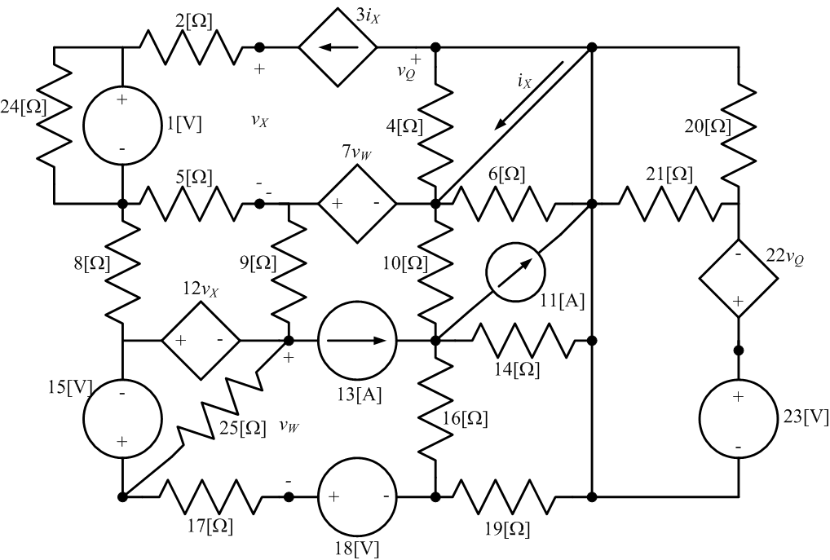
Example Problem: Use the node-voltage method to write a set of equations that could be used to solve the circuit below. Do not attempt to simplify the circuit. Do not attempt to solve the equations.

