Slide 1
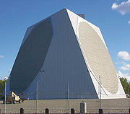
ECE 3317
Applied Electromagnetic Waves
Prof. David R. Jackson
Fall 2023
Notes 1 Introduction
Adapted from notes by Prof. Stuart A. Long

Slide 2
Why study electromagnetic waves?
Motivation:
Most basic of all ECE courses: Electromagnetics provides the foundation for all electrical sciences and engineering. All of circuit theory and power engineering is a special case (low frequency, where dimensions are small relative to a wavelength).
Electromagnetics explains physical phenomena: What is light? How do electric and magnetic fields behave?
Important to know about EM: It is extremely important for areas such as wireless communications, microwave engineering, RF design. It is also very important for power engineering and micro/nano-electronics. It is also good to know for all areas of ECE.

Slide 3
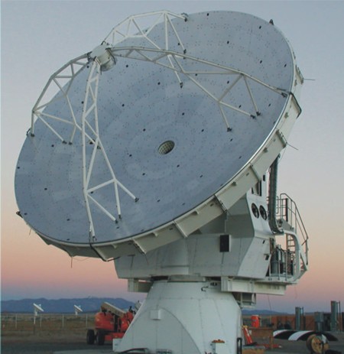
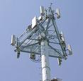
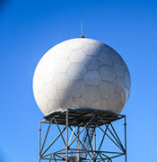
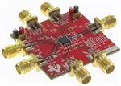
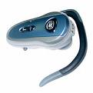
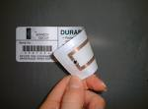
Applications
Antennas
Radar
Wireless Communications
RFID
RF circuits

Slide 4
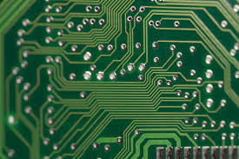
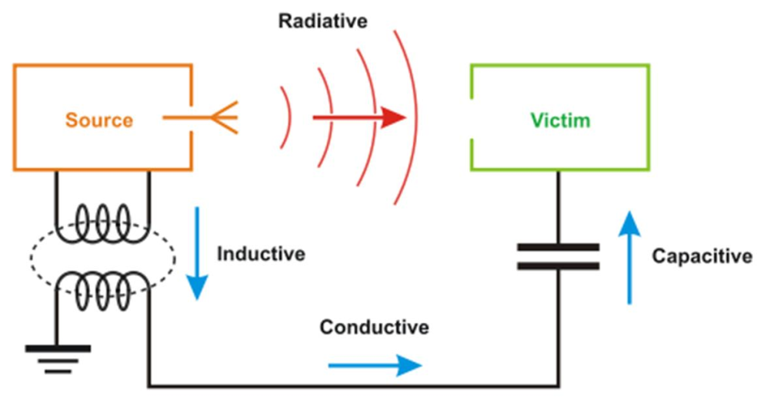
Applications (cont.)
Computer and Electronic Applications:
At higher frequencies transmission line effects issues become more important. It becomes necessary to model the electromagnetic performance of the system (simple circuit theory is no longer adequate).
Electromagnetic Compatibility (EMC) and Electromagnetic Interference (EMI) also become important at high frequency due to radiation and coupling effects.

Slide 5
Course Theme
In ECE 3318, you become familiar with static fields. You also become familiar with vector calculus.
In ECE 3317, we will deal with time-varying fields.
More specialized courses (these require ECE 3317):
ECE 5317: Microwave Engineering Prereq: ECE 3317. Transmission lines, waveguides, microstrip circuits, microwave circuit theory, scattering matrices, impedance transformers, resonators, and filters.
ECE 5318: Antenna Engineering Prereq: ECE 3317. Antenna concepts, linear wire antennas, linear arrays, aperture and horn antennas, microstrip antennas, dielectric resonator antennas, frequency-independent antennas, and measurement techniques.

Slide 6
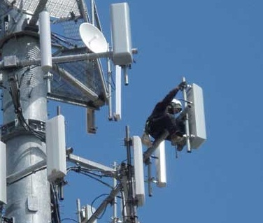
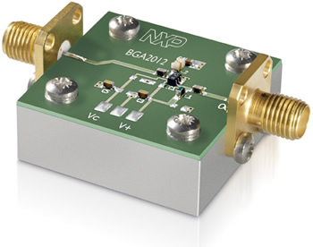
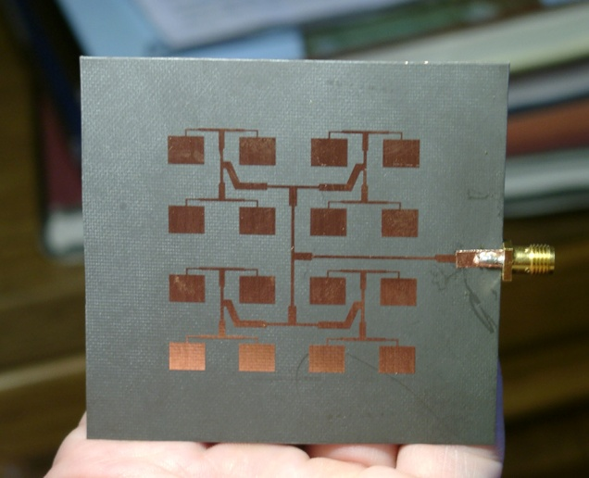
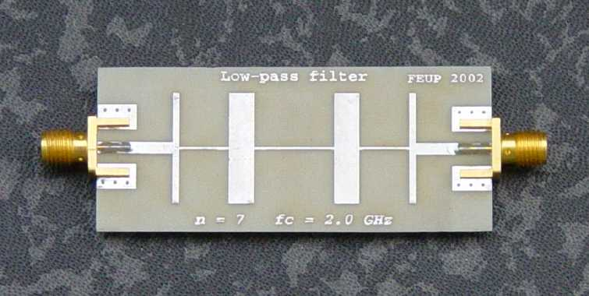
Course Theme (cont.)
ECE 3317 (ECE 5317, ECE 5318)
High Frequency
A microwave integrated circuit.
A cell-phone base-station antenna.
A microstrip antenna array.
A microwave filter constructed from microstrip.

Slide 7
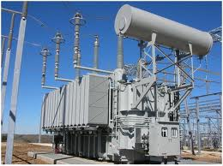
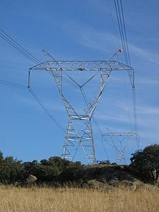
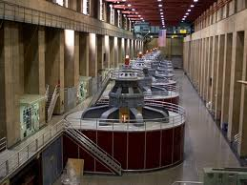
Course Theme (cont.)
ECE 3318
Power buses in a substation.
A transformer in a substation.
Low Frequency
Overhead high-voltage power lines
Large AC generators at Hoover Dam.

Slide 8
Homework
Homework is normally assigned once per week. It is due at the beginning of class on the due date (submitted in class).
Homework will be distributed via the class Canvas site.
Please staple it, fold it (vertically), and write on the outside the following: the class number (ECE 3317), the name of instructor (Prof. Jackson), and the homework assignment number (e.g., HW 1).
No late homework is accepted.

Slide 9
Announcements
All important announcements will be placed on the class Canvas site in the “Announcements” section. It is your responsibility to check this often.
Sometimes emails will be sent to the class, so it is your responsibility to make sure that your university email is working properly.

Slide 10
Announcements (cont.)
Please read the syllabus carefully! You are responsible for everything on it! (It is on the Canvas site.)
Please read the UH Academic Honesty Policy in the online version of the UH Student Handbook (the website is in the syllabus).
Fill out the Academic Honesty and Syllabus Form, sign it, and return it by the deadline indicated (Aug. 31, 2023) or else you may be dropped. The form is on the Canvas site.

Slide 11
Announcements (cont.)
Class attendance is required
Class attendance will be taken.
If you have three unexcused absences, you may be dropped at any time (even at the end of the semester) or fail the course.
To have an absence excused, you must get permission from the instructor before class begins.

Slide 12
Class Notes
The class notes are on the class Canvas website (both pptx and pdf versions).
If you have trouble reading the equations in the pptx version, you are most likely having a font problem due to missing MathType fonts or the Handscript SF font (used to represent time-domain vector fields).
Here is what you can do:
Use the pdf version of the class notes.
Install MathType (see next slide).
Download the Handscript SF font (placed on Canvas site under “Handouts”).

Slide 13
MathType
In order to obtain a free license, please fill out and submit the form that is found at the link below:
https://forms.office.com/r/sd0agNuawV
For more information about MathType, please see:
https://www.egr.uh.edu/sites/ccoe.egr.uh.edu/files/files/mathtype_for_making_and_managing_equations.pdf

Slide 14
Reading Assignments
Reading assignments are posted on the Canvas site from both of the recommended texts.
Please follow along with the class notes and read the corresponding sections in the book(s).
Ideally, it would be good to read the appropriate sections in the book before and after seeing the lecture.

