Slide 1
ECE 3317
Applied Electromagnetic Waves
Prof. David R. Jackson
Fall 2023
Notes 12 Transmission Lines (Smith Chart)

Slide 2
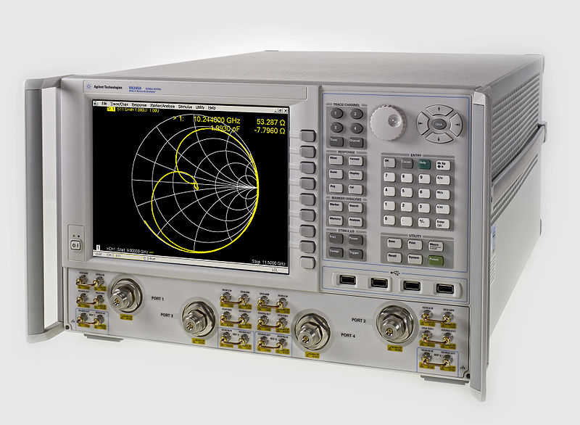
Smith Chart
The Smith chart is a very convenient graphical tool for analyzing transmission lines and studying their behavior.
A network analyzer (Agilent N5245A PNA-X) showing a Smith chart.

Slide 3
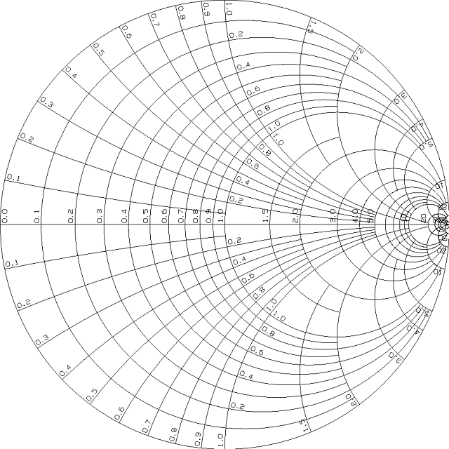
Smith Chart (cont.)
From Wikipedia:
Phillip Hagar Smith
(April 29, 1905–August 29, 1987) was an electrical engineer, who became famous for his invention of the Smith chart.
Smith graduated from Tufts College in 1928. While working for RCA, he invented his eponymous Smith chart. He retired from Bell Labs in 1970.
Phillip Smith invented the Smith Chart in 1939 while he was working for The Bell Telephone Laboratories. When asked why he invented this chart, Smith explained: “From the time I could operate a slide rule, I've been interested in graphical representations of mathematical relationships.”
In 1969 he published the book Electronic Applications of the Smith Chart in Waveguide, Circuit, and Component Analysis, a comprehensive work on the subject.

Slide 4
Smith Chart (cont.)

Slide 5
Smith Chart (cont.)
The Smith chart is really a complex Γ plane:
Recall:
Note:
We rotate clockwise as we go from the load towards the generator (z becomes more negative).

Slide 6
Smith Chart (cont.)
Denote:
(complex variable)
so
Real part:
Imaginary part:

Slide 7
Smith Chart (cont.)
Two equations:
Goal: Eliminate the reactance.
From the second one we have
Substituting into the first one, and then multiplying by (1-x), we have
Multiply by 1-x

Slide 8
Smith Chart (cont.)
Algebraic simplification:
Simplify the right-hand side.
Expand the (1-x)² term, collect terms.
Take the third term across the equal sign.
Divide by the term in parenthesis.

Slide 9
Smith Chart (cont.)
Complete the square.
Put the right-hand side terms over a common denominator.
Simplify the right-hand side.

Slide 10
Smith Chart (cont.)
This defines the equation of a circle:
Note:
Center:
(All circles go through (1,0).)
Radius:

Slide 11
Smith Chart (cont.)
Next, we eliminate the resistance from the two equations.
From the second one we have:
Substituting into the first one, we have

Slide 12
Smith Chart (cont.)
Algebraic simplification:
Multiply by y.
Cancel xy terms, collect y terms.
Divide by X_{in}^{N}

Slide 13
Smith Chart (cont.)
Complete the square
Note:
(All circles go through (1,0).)
This defines the equation of a circle:
center:
radius:

Slide 14
Smith Chart (cont.)
Note:

Slide 15
Smith Chart (cont.)
Actual Smith chart:

Slide 16
Smith Chart (cont.)
Important points on chart:
S/C
Perfect Match
O/C

Slide 17
Smith Chart (cont.)
As we move along the transmission line, we stay on a circle of constant radius.
To generator
Generator
Transmission Line
Load
+
-
Angle change = 2βd
To generator

Slide 18
Smith Chart (cont.)
We go completely around the Smith chart when
Recall: The impedance repeats every half of a wavelength.

Slide 19
Smith Chart (cont.)
In general, the angle change on the Smith chart as we go towards the generator is:
or
so
The angle change is twice the electrical length change on the line: Δθ = 2(β d).

Slide 20
Smith Chart (cont.)
Scales:
The Smith chart already has wavelength scales on the perimeter for your convenience (so you don’t need to measure angles).
The “wavelengths towards generator” scale is measured clockwise, starting (arbitrarily) at zero here.
The “wavelengths towards load” scale is measured counterclockwise, starting (arbitrarily) at zero here.

Slide 21
Reciprocal Property
The normalized impedance at B is the normalized admittance at A.
Go half-way around the Smith chart:

Slide 22
Normalized Voltage
We slide the complex number “1” to the left so we can add the two complex numbers using the “tip to tail rule”.
Normalized voltage
Slide
We can use the Smith chart as a crank diagram!

Slide 23
SWR
Recall:
(whichever one is larger than one)
On the positive real axis:
SWR value
The SWR is read off from the normalized resistance value on the positive real axis.

Slide 24
Example
Given:
Use the Smith chart to plot the magnitude of the normalized voltage, find the SWR, and find the normalized load admittance.
(a) Plot voltage magnitude
Find V_{max} position:
1.571

Slide 25
Example (cont.)
(b) Find SWR

Slide 26
Example (cont.)
(c) Find normalized load admittance
“Wavelengths toward generator reading”

Slide 27
Smith Chart as an Admittance Calculator
The Smith chart can also be used as an admittance calculator instead of an impedance calculator.
Hence
or
where

Slide 28
Admittance Calculator (cont.)
Compare:
They have the same mathematical form!
Conclusion: If we interpret the Smith chart as being the complex Γ′ plane instead of the complex Γ plane, then the R circles become G circles and the X circles become B circles.

Slide 29
Admittance Calculator (cont.)
Example
What is the admittance at the blue dot?
At the given blue dot:

Slide 30
Comparison of Charts
Impedance Calculator
Inductive region
S/C
O/C
Capacitive region

Slide 31
Comparison of Charts (cont.)
Admittance Calculator
Capacitive region
O/C
S/C
Inductive region

Slide 32
Using the Smith chart for Impedance
and Admittance Calculations
We can use the same Smith chart for both impedance and admittance calculations.
The Smith chart is then either the Γ plane or the Γ′ plane, depending on which type of calculation we are doing.
For example:
We can convert from normalized impedance to normalized admittance, using the reciprocal property (go half-way around the smith chart).
We can then continue to use the Smith chart on an admittance basis.

Slide 33
Example
Given:
Find the normalized admittance d = λ_{d} / 8 away from the load.

Slide 34
Example (cont.)
Wavelengths towards generator scale:
0.437+ 1/8 – 0.5 = 0.0620
Note:
The scale jumps by 0.5 here.
Wavelength towards generator
Wavelengths towards generator scale: 0.437
Note:
You can also use the angle scale on the outside of the Smith chart to go 90º if you wish.
Answer:

Slide 35
Appendix: Summary of Formulas

