Slide 1
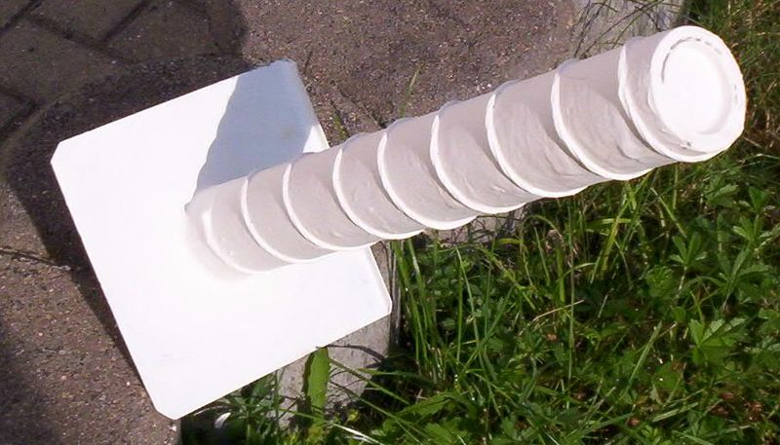
ECE 3317
Applied Electromagnetic Waves
Prof. David R. Jackson
Fall 2023
Notes 17
Polarization of Plane Waves

Slide 2
Polarization
The polarization of a plane wave refers to the direction of the electric field vector in the time domain.
We assume here that the wave is traveling in the positive z direction.

Slide 3
Polarization (cont.)
Consider a plane wave with both x and y components
Phasor domain:
Assume:

Slide 4
Polarization (cont.)
Time Domain:
Depending on b/a and β, three different cases arise:
Linear polarization
Circular polarization
Elliptical polarization

Slide 5
Polarization (cont.)
Power Density:
From Faraday’s law:
Hence
Assume lossless medium (η is real):
or
Notes:
5

Slide 6
Linear Polarization
At z = 0:

Slide 7
Linear Polarization (cont.)
This is simply a “tilted” plane wave.
(shown for β = 0)

Slide 8
Circular Polarization
At z = 0:
Note: The top sign is always for β = +π /2.

Slide 9
Circular Polarization (cont.)

Slide 10
Circular Polarization (cont.)
IEEE convention
Your thumb is in the direction of propagation, and the fingers are in the direction of the rotation in time.
LHCP
RHCP
Note:
The mechanical angular velocity is the same as the electrical radian frequency ω.

Slide 11
Circular Polarization (cont.)
Rotation in space vs. rotation in time
Examine how the field varies in both space and time:
Phasor domain
Time domain
There is opposite rotation in space and time, due to the minus sign.

Slide 12
Circular Polarization (cont.)
A snapshot of the electric field vector, showing the vector at different points.
Notice that the rotation in space matches the left hand!
RHCP

Slide 13
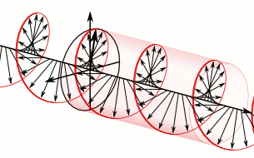
Circular Polarization (cont.)
Animation of LHCP wave
(Use pptx version in full-screen mode to see motion.)
http://en.wikipedia.org/wiki/Circular_polarization

Slide 14
Circular Polarization (cont.)
Circular polarization is often used in wireless communications to avoid problems with signal loss due to polarization mismatch.
Misalignment of transmit and receive antennas
Reflections off of buildings
Propagation through the ionosphere
Receive antenna
CP wave
The receive antenna will always receive a signal, no matter how it is rotated about the z axis.
However, for the same incident power density, an optimum linearly-polarized wave will give the maximum output signal from this linearly-polarized receive antenna (3 dB higher than from an incident CP wave). The linear receive antenna “throws away” half of the incident signal.
Notes:
14

Slide 15
Circular Polarization (cont.)
Two ways in which circular polarization can be obtained:
Method 1)
Use two identical antennas rotated by 90º, and fed 90º out of phase.
Antenna 2
Antenna 1
-
-
+
+
This antenna will radiate a RHCP signal in the positive z direction, and LHCP in the negative z direction.
Notes:
15

Slide 16
Circular Polarization (cont.)
Realization of method 1 using a 90º delay line
Antenna 2
Antenna 1
Signal
Feed line
Notes:
16

Slide 17
Circular Polarization (cont.)
An array of CP antennas
Notes:
17

Slide 18
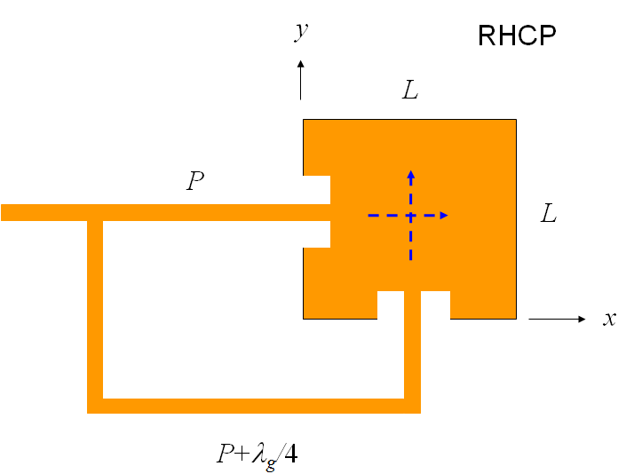
Circular Polarization (cont.)
The two antennas can realized by using two different modes of a single microstrip or dielectric resonator antenna.
P₁ = length of path 1
Notes:
18

Slide 19
Circular Polarization (cont.)
Method 2) Use an antenna that inherently radiates circular polarization.
Helical antenna for WLAN communication at 2.4 GHz
http://en.wikipedia.org/wiki/Helical_antenna
Notes:
19

Slide 20
Circular Polarization (cont.)
Helical antennas on a GPS satellite
Notes:
20

Slide 21
Circular Polarization (cont.)
Other Helical antennas
Notes:
21

Slide 22
Circular Polarization (cont.)
An antenna that radiates circular polarization will also receive circular polarization of the same handedness, and be blind to the opposite handedness.
(The proof is omitted.)
Note:
It does not matter how the receive antenna is rotated about the z axis.
Antenna 2
RHCP Antenna
(radiates RHCP in the +z direction)
Antenna 1
The two signals add in phase.
Signal
Feed line
RHCP wave
Notes:
22

Slide 23
Circular Polarization (cont.)
Summary of Possible Polarization Scenarios
1) Transmit antenna is LP, receive antenna is LP
Simple, works good if both antennas are aligned.
The received signal is less if there is a misalignment.
2) Transmit antenna is CP, receive antenna is LP
Signal can be received no matter what the alignment is.
The received signal is 3 dB less then for two aligned LP antennas.
3) Transmit antenna is CP, receive antenna is CP (of the same handedness)
Signal can be received no matter what the alignment is.
There is never a loss of signal, no matter what the alignment is.
The system is now more complicated.
Notes:
23

Slide 24
Elliptic Polarization
Includes all other cases that are not linear or circular
The tip of the electric field vector stays on an ellipse.
(This is proved in Appendix A.)

Slide 25
Elliptic Polarization (cont.)
Rotation Property
RHEP
LHEP
(This is proved in Appendix B.)

Slide 26
Rotation Rule
Here we give a simple graphical method for determining the type of polarization (left-handed or right handed).

Slide 27
Rotation Rule (cont.)
First, we review the concept of leading and lagging sinusoidal waves.
Two phasors: A and B
Note:
We can always assume that the phasor A is on the real axis (zero degrees phase) without loss of generality, since it is only the phase difference between the two phasors that is important.
Note:
A lagging sinusoidal wave will appear shifted to the right (later time) on an oscilloscope trace.

Slide 28
Rotation Rule (cont.)
Now consider the case of a plane wave.
Observation:
The electric field vector rotates in time from the leading axis to the lagging axis.
Leading axis
Lagging axis
LHEP

Slide 29
Rotation Rule (cont.)
Observation:
The electric field vector rotates in time from the leading axis to the lagging axis.
RHEP
Lagging axis
Leading axis

Slide 30
Rotation Rule (cont.)
The rule works in both cases, so we can call it a general rule:
Rotation Rule:
In time, the electric field vector rotates from the leading axis to the lagging axis.

Slide 31
Rotation Rule (cont.)
Example
What is this wave’s polarization?

Slide 32
Rotation Rule (cont.)
Example (cont.)
Therefore, in time the wave rotates from the z axis to the x axis.

Slide 33
Rotation Rule (cont.)
Example (cont.)
Your thumb is in the direction of the power flow.
LHEP or LHCP
Note: and
(so this is not LHCP)

Slide 34
Rotation Rule (cont.)
Example (cont.)
Conclusion:
LHEP

Slide 35
Axial Ratio (AR) and Tilt Angle (τ)
τ = tilt angle
τ
Note: In dB we have

Slide 36
Axial Ratio (AR) and Tilt Angle (τ ) Formulas
These formulas assume that the wave has E_{x} and E_{y} components, and the power is flowing in the +z direction.
Axial Ratio and Handedness
Tilt Angle
Note:
The tilt angle τ is ambiguous by the addition of ± 90º.

Slide 37
Note on Tilt Angle
The title angle τ is zero or 90º if:
Tilt Angle:

Slide 38
Example
Find the axial ratio and tilt angle.
LHEP
Note:
In order to use the formulas for tilt angle and axial ratio, we need to relabel to coordinate system so that the wave has E_{x} and E_{y} components, and the power is flowing in the +z direction.
Re-label the coordinate system:
Note: The new coordinate system needs to be a valid right-handed coordinate system:

Slide 39
Example (cont.)
LHEP
Normalize:
or

Slide 40
Example (cont.)
Hence
LHEP

Slide 41

Example (cont.)
Results:
LHEP

Slide 42


Example (cont.)
Note: We are not sure which choice is correct:
LHEP
We can make a quick time-domain sketch to be sure.

Slide 43
Example (cont.)
Summary
Given:
LHEP
Results:

Slide 44
Appendix A
Here we give a proof that the tip of the electric field vector must stay on an ellipse.
so
or
Squaring both sides, we have

Slide 45
Appendix A (cont.)
Collecting terms, we have
or
This is in the form of a quadratic expression:

Slide 46
Appendix A (cont.)
Discriminant:
(determines the type of curve)
so
Hence, this is an ellipse.
(This follows from analytic geometry.)

Slide 47
Appendix B
Here we give a proof of the rotation property.
Rotation property:
RHEP
LHEP

Slide 48
Appendix B (cont.)
Take the derivative:
Hence
The term in square brackets is always positive.
(proof complete)

