Slide 1
ECE 3317
Applied Electromagnetic Waves
Prof. David R. Jackson
Fall 2023
Notes 18
Reflection and Transmission of Plane Waves

Slide 2
General Plane Wave
Consider a plane wave traveling in an arbitrary direction in space.
We call the axis of propagation z′.
Denote:
(This function ψ tells us how the plane wave varies in space.)
(direction of power flow)
so

Slide 3
General Plane Wave (cont.)
Hence
Note:
or
(wavenumber equation)

Slide 4
General Plane Wave (cont.)
We define the wavevector:
The k vector tells us which direction the wave is traveling in.

Slide 5
TM_{z} and TE_{z} Plane Waves
There are two fundamental polarizations possible.
Transverse Magnetic (TM_{z}) H_{z} = 0
Transverse Electric (TE_{z}) E_{z} = 0
Note: The word “transverse” means “perpendicular to.”

Slide 6
Reflection and Transmission
As we will show, each type of plane wave (TE_{z} and TM_{z}) reflects differently (and independently) from a material interface.
Reflected
Incident
#1
#2
Transmitted
Note: We assume that the Poynting vector of the incident plane wave lies in the xz plane (φ = 0). This is called the plane of incidence. There is then no variation of the fields in the y direction (k_{y} = 0).

Slide 7
Boundary Conditions
Here we review the boundary conditions at an interface (from ECE 3318).
General BCs:
++++
Note: The unit normal points towards region 1.
No sources on interface:
The tangential electric and magnetic fields are continuous.
(The normal electric and magnetic flux densities are also continuous.)

Slide 8
Reflection at Interface
Assume that the Poynting vector of the incident plane wave lies in the xz plane (φ = 0). This is called the plane of incidence.
We first consider the (x, z) variation of the fields.
(We will worry about the polarization later.)
Note:
The plus sign for the exponent term in the reflected wave is chosen because this wave is traveling in the negative z direction.

Slide 9
Reflection at Interface (cont.)
Phase matching condition:
This follows from the fact that the fields must match everywhere at the interface (z = 0).

Slide 10
Law of Reflection
(This comes from the first part of the phase matching condition.)
Incident and reflected waves:
Law of reflection

Slide 11
Snell’s Law
(This comes from the second part of the phase matching condition.)
Incident and transmitted waves:
We define the index of refraction:
Snell's law
Note: The wave is bent towards the normal (z axis) when entering a more optically "dense" region (a higher index of refraction).

Slide 12
Snell’s Law (cont.)
The bending of light (or EM waves in general) is called refraction.
Reflected
Acrylic block
Normal
Incident
Transmitted
http://en.wikipedia.org/wiki/Refraction

Slide 13
Example
Given:
Find the transmitted angle.
Air
Water
Note that in going from a less dense to a more dense medium, the wavevector is bent towards the normal.
Note:
If the wave is incident from the water region at an incident angle of 32.1º,
the wave will exit into the air region at an angle of 45º.
Note:
At microwave frequencies and below, the relative permittivity of pure water is about 81. At optical frequencies it is about 1.7689.

Slide 14
Critical Angle
The wave is incident from a more dense region onto a less dense region.
Incident
Reflected
#1
#2
Transmitted
Incident
Reflected
At the critical angle:
#1
Transmitted
#2

Slide 15
Critical Angle (cont.)
Example
Find the critical angle.
Water
Reflected
Incident
#1
#2
Air
Transmitted

Slide 16
Critical Angle (cont.)
Example: "fish-eye" effect
Air
Water
The critical angle explains the “fish eye” effect
that you can observe in a swimming pool.
A fish can see everything above the water by only looking no farther than 49º from the vertical!

Slide 17
Critical Angle (cont.)
At the critical angle:
Reflected
Incident
#1
#2
Transmitted
There is no vertical variation of the field in the less-dense (transmitted) region.
There are still fields in the less dense region, however.

Slide 18
Critical Angle (cont.)
Beyond the critical angle:
Incident
Reflected
#1
#2
Exponential decay
There is an exponential decay of the field in the vertical direction in the less-dense region.

Slide 19
Critical Angle (cont.)
Beyond the critical angle:
Incident
Reflected
#1
#2
The power flows completely horizontally in the lower region.
No power crosses the boundary and enters into the less dense region.
This must be true from conservation of energy, since the field decays exponentially in the lossless region 2.

Slide 20
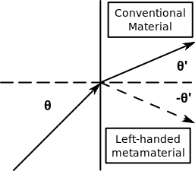
Exotic Materials
Artificial “metamaterials” that have been designed that have exotic permittivity and/or permeability performance.
https://en.wikipedia.org/wiki/Metamaterial
Negative index metamaterial array configuration, which was constructed of copper split-ring resonators and wires mounted on interlocking sheets of fiberglass circuit board. The total array consists of 3 by 20×20 unit cells with overall dimensions of 10×100×100 mm.
(over a certain bandwidth of operation)

Slide 21
Exotic Materials (cont.)
The Duke cloaking device masks an object at one microwave frequency.
Image courtesy Dr. David R. Smith.
Cloaking of objects is one area of research in metamaterials.
https://en.wikipedia.org/wiki/Metamaterial_cloaking

Slide 22
TE_{z} Reflection
#1
#2
Note that the electric field vector is in the y direction.
(The wave is polarized perpendicular to the plane of incidence.)

Slide 23
TE_{z} Reflection (cont.)

Slide 24
TE_{z} Reflection (cont.)
Recall that the tangential component of the electric field must be continuous at an interface.
Boundary condition at z = 0:

Slide 25
TE_{z} Reflection (cont.)
We now look at the magnetic fields.

Slide 26
TE_{z} Reflection (cont.)
Recall that the tangential component of the magnetic field must be continuous at an interface (no surface currents).
Boundary condition at z = 0:
Hence, we have:

Slide 27
TE_{z} Reflection (cont.)
Enforcing both boundary conditions, we have:
The solution is:

Slide 28
TE_{z} Reflection (cont.)
Transmission Line Analogy
Incident

Slide 29
TM_{z} Reflection
#1
#2
Note that the electric field vector is in the xz plane.
(The wave is polarized parallel to the plane of incidence.)
Word of caution: The notation used for the reflection coefficient in the TM_{z} case is different from what is in the Shen & Kong book. (We use reflection coefficient to represent the reflection of the tangential electric field, not the tangential magnetic field.)

Slide 30
TM_{z} Reflection (cont.)

Slide 31
TM_{z} Reflection (cont.)
We now look at the electric fields.
Note that Γ_{TM} is the reflection coefficient for the tangential electric field (E_{x}).

Slide 32
TM_{z} Reflection (cont.)
Boundary conditions:
Enforcing both boundary conditions, we have
The solution is:

Slide 33
TM_{z} Reflection (cont.)
Transmission Line Analogy
Incident

Slide 34
TM_{z} Reflection (cont.)
Summary of Transmission Line Modeling Equations
Incident

Slide 35
Power Reflection

Slide 36
Power Reflection Beyond Critical Angle
Incident
Reflected
#1
#2
(“reactive load”)
All of the incident power is reflected.

Slide 37
Example
Given:
#1
#2
Find:
% power reflected and transmitted for a TM_{z} wave
% power reflected and transmitted for a TE_{z} wave
Snell’s law:
Recall:

Slide 38

Example (cont.)
First look at the TM_{z} case:
Note that these values do not depend on frequency for a lossless material!

Slide 39
Example (cont.)
Summary for TM_{z} Case

Slide 40
Example (cont.)
Next, look at the TE_{z} case:
Note that these values do not depend on frequency for a lossless material!

Slide 41
Example (cont.)
Summary for TE_{z} Case

Slide 42

Example
The lower region is now lossy.
Given:
#1
#2
Sea water
Find:
% power reflected and transmitted for a TM_{z} wave
% power reflected and transmitted for a TE_{z} wave

Slide 43
Example (cont.)
Given:
We avoid using Snell's law now, since it will give us a complex angle θ_{t} in region 2!
Recommendation: Work with the wavenumber k_{zt} only (avoid using θ_{t}).

Slide 44
Example (cont.)
First look at the TM_{z} case:
(This is difficult to work with!)
(at 1.0 [GHz])
The reflection coefficient now depends on frequency.

Slide 45
Example (cont.)
Summary for TM_{z} Case

Slide 46
Example (cont.)
Next, look at the TE_{z} case:
(at 1.0 [GHz])
The reflection coefficient now depends on frequency.

Slide 47
Example (cont.)
Summary for TE_{z} Case

Slide 48
Example (cont.)
Now consider an incident RHCP Wave
RHCP Wave
Given:
Assume incident power density is 1 [W/m²].
The reflected power is 69.6% of the incident power
The reflected wave has 47.4% of its power in the TM polarization.

Slide 49
Brewster Angle
Assume TM_{z} polarization
Assume lossless regions
Set
Matched load!

Slide 50
Brewster Angle (cont.)
Hence, we have:

Slide 51
Brewster Angle (cont.)
Assume μ₁ = μ₂:

Slide 52
Brewster Angle (cont.)
Geometrical angle picture:
θ _{i}
Hence

Slide 53
Brewster Angle (cont.)
This special angle is called the Brewster angle θ_{b}.
For non-magnetic media (μ = μ₀), only the TM_{z} polarization (parallel polarization) has a Brewster angle.
A Brewster angle exists for any material contrast ratio (it doesn’t matter which side is optically denser).

Slide 54
Brewster Angle (cont.)
Example
Light goes from air to water.
Air
Water

Slide 55
Brewster Angle (cont.)
Polaroid Sunglasses
Polarizing filter
(blocks TE_{z})
TM_{z}+TE_{z}
TE_{z}
Eye
“Glare”
Sunlight
Puddle of water
The reflection from the puddle of water (the “glare”) is reduced.

Slide 56
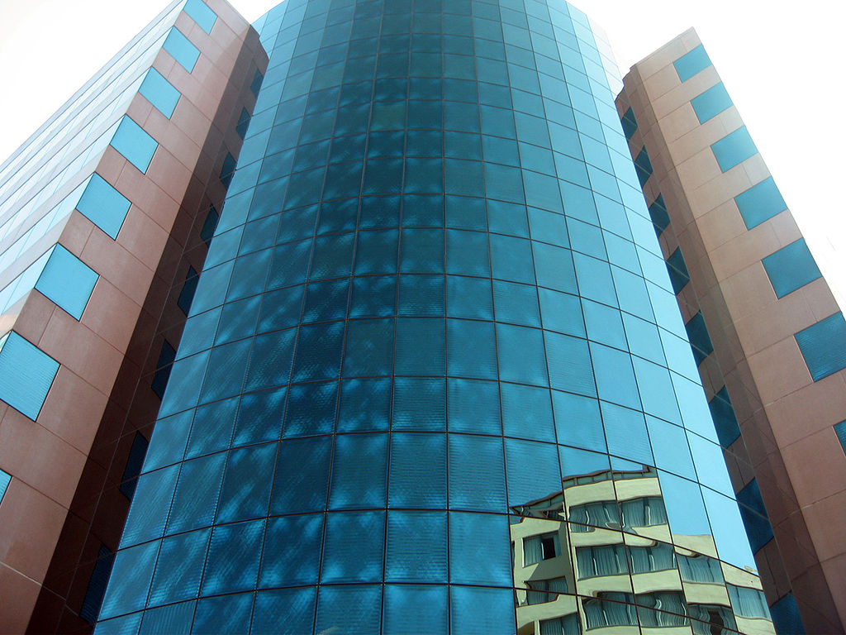
Polarization Effects
A building seen through polaroid sunglasses
https://en.wikipedia.org/wiki/Polaroid_(polarizer)
By Jason7825 at English Wikipedia

Slide 57
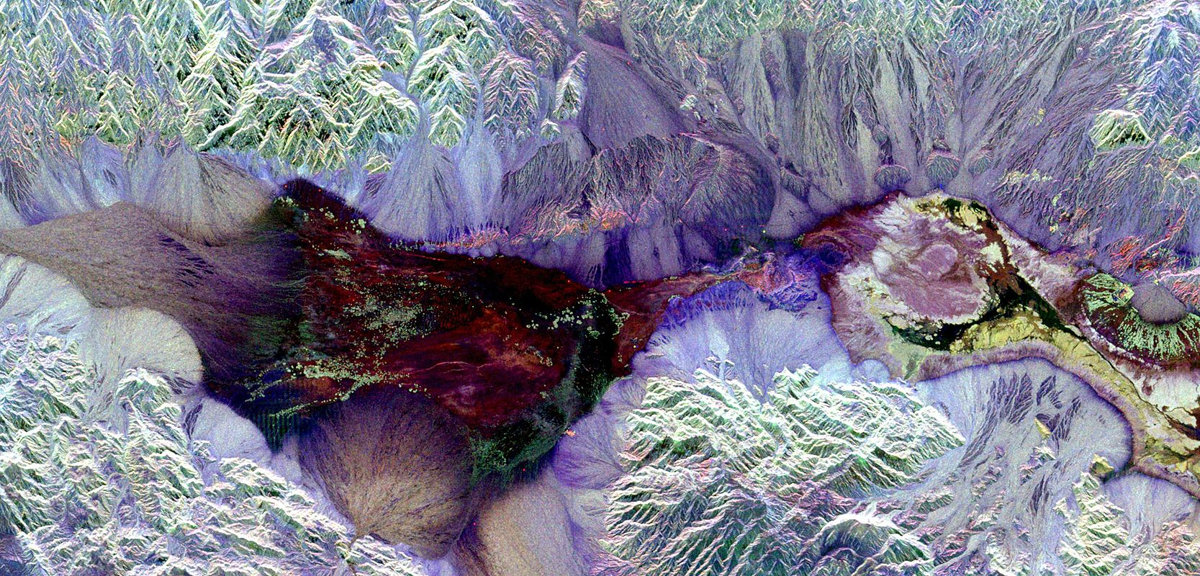
Polarization Effects (cont.)
“Polarimetry is the measurement and interpretation of the polarization of transverse waves, most notably electromagnetic waves, such as radio or light waves. Typically polarimetry is done on electromagnetic waves that have traveled through or have been reflected, refracted or diffracted by some material in order to characterize that object.”
https://en.wikipedia.org/wiki/Polarimetry
Synthetic aperture radar image of Death Valley colored using polarimetry.

