Slide 1
ECE 3317
Applied Electromagnetic Waves
Prof. David R. Jackson
Fall 2023
Notes 20
Rectangular Waveguides

Slide 2
Rectangular Waveguide
Rectangular Waveguide
Cross section
We assume that the boundary is a perfect electric conductor (PEC).
No TEM_{z} mode can exist!

Slide 3

Rectangular Waveguide (cont.)
Why is there no TEM_{z} mode?
TEM_{z} mode:

Slide 4
Rectangular Waveguide (cont.)
Rectangular Waveguide
Two types of modes can exist independently:
TM_{z}: E_{z} only
TE_{z}: H_{z} only

Slide 5
Rectangular Waveguide (cont.)
Rectangular Waveguide
Cross section
We analyze the problem to solve for E_{z} or H_{z} (all other fields come from these).
TM_{z}: E_{z} only
TE_{z}: H_{z} only

Slide 6
TM_{z} Modes
(Helmholtz equation)
(PEC walls)
Guided-wave assumption:

Slide 7
TM_{z} Modes (cont.)
Define:
We then have:
Note that k_{c} is an unknown at this point.
Dividing by the exp(-j k_{z} z) term, we have:
We solve the above equation by using the method of separation of variables.
Please see Appendix A for the solution.

Slide 8
TM_{z} Modes (cont.)
Solution from separation of variables method:
TM_{mn} mode
Note: If either m or n is zero, the entire field is zero.

Slide 9
TM_{z} Modes (cont.)
Cutoff Frequency for Lossless Waveguide
Note:
Cutoff frequency only has a clear meaning in the lossless case (k is real).
We start with
Set
This defines the cutoff frequency.

Slide 10
TM_{z} Modes (cont.)
Summary of TM_{z} Solution: TM_{mn} mode
Note: If either m or n is zero, the entire field is zero.
(lossless waveguide)

Slide 11
TE_{z} Modes
We now start with
Guided-wave assumption:
Define:
Please see Appendix B for the solution.

Slide 12
TE_{z} Modes (cont.)
Summary of TE_{z} Solution: TE_{mn} mode
(lossless waveguide)
Note: Same formula for cutoff frequency as the TM_{z} case!

Slide 13
Summary for Both Modes
TM_{mn}
TE_{mn}
same formula for both modes
same formula for both modes
(lossless waveguide)
TM_{z}
TE_{z}

Slide 14
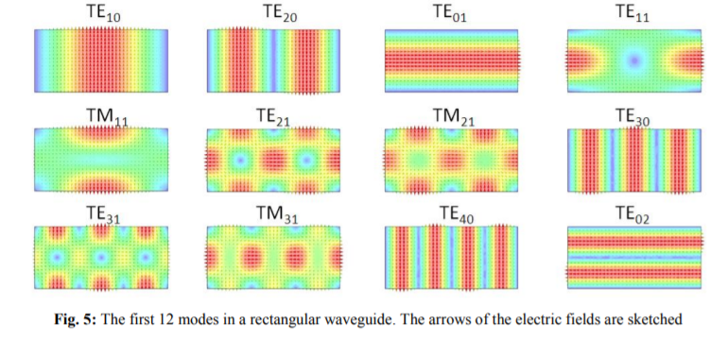
Field Plots
Color denotes magnitude, arrows show direction of electric field.

Slide 15
Wavenumber
TM_{z} or TE_{z} mode:
with
Note: The (m,n) notation is suppressed here on k_{z}.
Lossless waveguide:
Above cutoff:
Below cutoff:

Slide 16
Wavenumber Plot
“Light line”

Slide 17
Guided Wavelength
Recall: The guided wavelength λ_{g} is the distance z that it takes for the wave to repeat itself.
(This assumes that we are above the cutoff frequency – otherwise guided wavelength makes no sense.)
After some algebra (see next slide):
(lossless waveguide)

Slide 18
Guided Wavelength (cont.)
Derivation of wavelength formula (lossless waveguide):

Slide 19
Dominant Mode
The "dominant" mode is the one with the lowest cutoff frequency.
Assume b < a
(lossless waveguide)
Lowest TM_{z} mode: TM₁₁
TE_{z}
Lowest TE_{z} mode: TE₁₀
TM_{z}
The dominant mode is the TE₁₀ mode.

Slide 20
Dominant Mode (cont.)
Summary (TE₁₀ Mode)

Slide 21
Dominant Mode (cont.)
Fields of the Dominant TE₁₀ Mode
Find the other fields from these equations (Appendix A of Notes 19):

Slide 22
Dominant Mode (cont.)
Summary of fields for TE₁₀ mode:
where

Slide 23
Dominant Mode (cont.)
TE₁₀ Mode
Length of arrows denotes magnitude of field
Color denotes magnitude of field
Spacing between arrows denotes magnitude of field

Slide 24
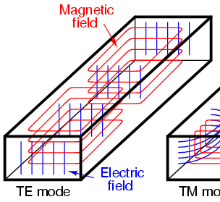
Dominant Mode (cont.)
TE₁₀ Mode
3D View

Slide 25
Dominant Mode (cont.)
What is the mode with the next highest cutoff frequency?
Assume b < a / 2
Then the next highest is the TE₂₀ mode.
A 2:1 operating band!
(lossless waveguide)
Useful operating region
TE₀₁
TE₁₀
f_{c}
TE₂₀

Slide 26
Dominant Mode (cont.)
What is the mode with the next highest cutoff frequency?
Assume b > a / 2
(lossless waveguide)
Then the next highest is the TE₀₁ mode.
The useable bandwidth is now lower than before.
Useful operating region
TE₀₁
TE₁₀
f_{c}
TE₂₀

Slide 27
Dominant Mode (cont.)
Power flow in lossless waveguide (f > f_{c}):
(watts flowing down the waveguide)
(The derivation is omitted, but please see the formula box above.)
Note: Above cutoff, there is only watts flowing (no vars). Below cutoff there is no watts flowing (only vars).
Make b larger to get more power flow for a given value of a.
Keep b smaller than a/2 to get maximum bandwidth.
The optimum dimension for b is a/2
(gives maximum power flow without sacrificing bandwidth).

Slide 28
Dominant Mode (cont.)
Plane wave interpretation of TE₁₀ mode
PW #1
PW #2
(E, H)
PW #1
PW #2

Slide 29
Dominant Mode (cont.)
Losses in Waveguide (f > f_{c})
Dielectric loss:
Note:
If we are below cutoff, attenuation is mainly due to evanescence, so we don’t worry about conductor and dielectric loss then.
Conductor loss:
(This is derived in ECE 5317.)

Slide 30

Example
Find the single-mode operating frequency region
for air-filled X-band waveguide.
Standard X-band* waveguide:
a = 0.900 inches (2.286 cm)
b = 0.400 inches (1.016 cm)
Note: b < a / 2
Use
Hence, we have:
X-band waveguide
* X-band: from 8.0 to 12 GHz.

Slide 31
Example (cont.)
Find the phase constant of the TE₁₀ mode at 9.00 GHz.
Find the attenuation in dB/m at 5.00 GHz
Recall:
X-band waveguide
At 9.00 GHz: β = 129.13 [rad/m]
At 5.00 GHz: α = 88.91 [nepers/m]

Slide 32
Example (cont.)
At 5.0 GHz:
Recall:
X-band waveguide
This is a very rapid attenuation!

Slide 33






Waveguide Components
Straight sections
Flexible waveguides
Waveguide bends
Waveguide adapters
Waveguide couplers
Waveguide terminations
https://www.pasternack.com

Slide 34
Waveguide Modes in Transmission Lines
A transmission line normally operates in the TEM_{z} mode, where the two conductors have equal and opposite currents.
At high frequencies, waveguide modes can also propagate on transmission lines.
This is undesirable, and it limits the high-frequency range of operation for the transmission line.

Slide 35
Waveguide Modes in Coax
Dominant waveguide mode in coax (derivation omitted):
Note:
In this notation, the “11” subscript refers to the angular and radial variation.
TE₁₁ mode:
Example: RG 142 coax
This coax cannot be used above 16.8 [GHz]

Slide 36
Appendix A: TM_{z} Modes
We want to solve:
Define:
We then have:
Note that k_{c} is an unknown at this point.
Dividing by the exp(-jk_{z}z) term, we have:
We solve the above equation by using the method of separation of variables.
We assume:

Slide 37
Appendix A (cont.)
Hence
Divide by XY :
Hence
This has the form
Both sides of the equation must be a constant!

Slide 38
Appendix A (cont.)
Denote
General solution:
Boundary conditions:
(1)
(2)

Slide 39
Appendix A (cont.)
From the last slide:
This gives us the following result:
Hence
Now we turn our attention to the Y (y) function.

Slide 40
Appendix A (cont.)
We have
Hence
Denote
Then we have
General solution:

Slide 41
Appendix A (cont.)
Boundary conditions:
(3)
(4)
Equation (4) gives us the following result:

Slide 42
Appendix A (cont.)
The Y(y) function is then
Therefore, we have
New notation:
The E_{z} field inside the waveguide thus has the following form:

Slide 43
Appendix A (cont.)
Recall that
Hence,
Therefore, the solution for k_{c} is given by
Next, recall that
Hence

Slide 44
Appendix B: TE_{z} Modes
We now start with
Using the separation of variables method again, we have
where
and

Slide 45
Appendix B (cont.)
Boundary conditions:
The result is
This can be shown by using the following equations:

Slide 46
Appendix B (cont.)
The H_{z} field inside the waveguide thus has the following form:
Same formula for cutoff frequency as the TE_{z} case!
Note: The (0,0) TE_{z} mode is not valid, since it violates the magnetic Gauss law:

