Slide 1
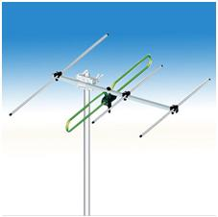
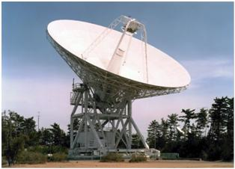
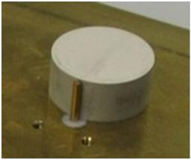
ECE 3317
Applied Electromagnetic Waves
Prof. David R. Jackson
Fall 2023
Notes 21
Introduction to Antennas

Slide 2
Introduction to Antennas
An antenna is a device that is used to transmit and/or receive an electromagnetic wave.
The antenna itself can always transmit or receive, but it may be used for only one of these functions in a particular application.
Examples:
Cell-phone antenna (transmit and receive)
TV antenna in your home (receive only)
Wireless LAN antenna (transmit and receive)
FM radio antenna (receive only)
Satellite dish antenna (receive only)
AM radio broadcast tower (transmit only)
GPS position location unit (receive only)

Slide 3
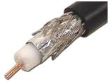
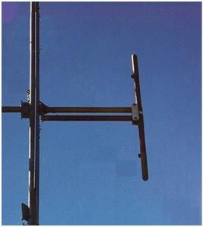
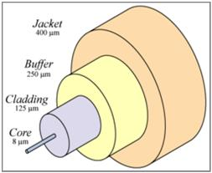
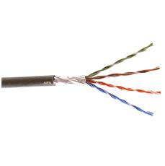
Advantages of Antennas
Antennas are often used for a variety of reasons:
For communication over long distances, to have lower loss (see next slide)
Where waveguiding systems (e.g., transmission lines such as coaxial cable or fiber optic cable) are impractical or inconvenient
When it is desired to communicate with many users at once
Coax
Fiber optic cable
Antenna
Twisted pair (CAT 5 cable)

Slide 4
Antennas vs. Waveguiding Systems
Wireless systems using antennas will always be better (lower loss) than wired (waveguiding) systems for large distances.
Power loss from antenna broadcast:
(always better for large r)
Power loss from waveguiding system:
(α = attenuation constant)
Antenna
A
B
Waveguiding system

Slide 5
Antennas vs. Waveguiding Systems (cont.)
Comparison of Two Functions
r [meters]

Slide 6
Comparison of Waveguiding Systems with Wireless Systems
Attenuation in dB
1 GHz
RG59
Single Mode
Two Dipoles
34m Dish+Dipole
Distance | Coax | Fiber | Wireless | Wireless
1 m | 0.4 | 0.0003 | 28.2 | -
10 m | 4 | 0.003 | 48.2 | -
100 m | 40 | 0.03 | 68.2 | -
1 km | 400 | 0.3 | 88.2 | 39.3
10 km | 4000 | 3 | 108.2 | 59.3
100 km | - | 30 | 128.2 | 79.3
1000 km | - | 300 | 148.2 | 99.3
10,000 km | - | 3000 | 168.2 | 119.3
100,000 km | - | - | 188.2 | 139.3
1,000,000 km | - | - | 208.2 | 159.3
10,000,000 km | - | - | 228.2 | 179.3
100,000,000 km | - | - | 248.2 | 199.3

Slide 7
Main Properties of Antennas
Main properties of antennas:
Radiation pattern
Beamwidth and directivity (how directional the beam is)
Sidelobe level
Efficiency (power radiated relative to total input power)
Polarization (linear, CP)
Input Impedance
Bandwidth (the useable frequency range)

Slide 8
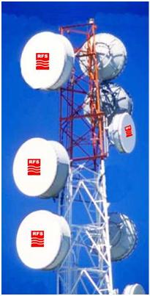
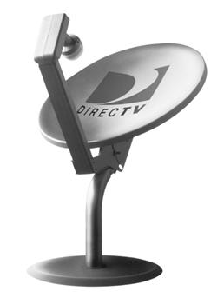

Types of Antennas
Reflector (dish) antenna
Ideally, the dish is parabolic in shape.
Very high bandwidth
High directivity (directivity is determined by the size / wavelength)
Linear or CP polarization (depending on how it is fed)
Works by focusing the incoming wave to a collection (feed) point

Slide 9
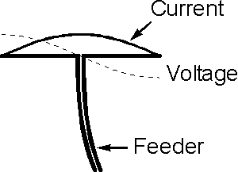
Types of Antennas (cont.)
Dipole Wire Antenna
(resonant)
Current
Very simple
Moderate bandwidth
Low directivity
Omnidirectional in azimuth
Most commonly fed by a “twin-lead” transmission line
Linear polarization (E_{θ} , assuming wire is along z axis)
The antenna is resonant when the length is about one-half free-space wavelength

Slide 10
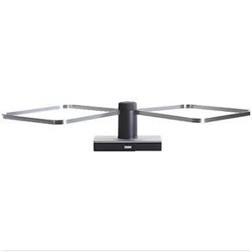
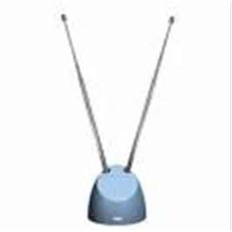

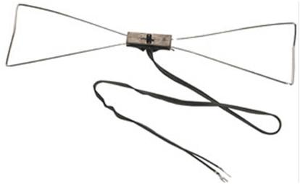
Types of Antennas (cont.)
Dipole Wire Antenna (cont.)
“Rabbit ears”
“Bow-tie” variation (for higher bandwidth)

Slide 11
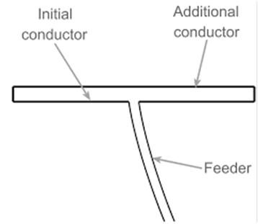
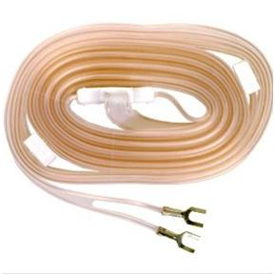
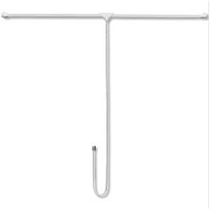
Types of Antennas (cont.)
Folded Dipole Antenna
The folded dipole is a variation of the dipole antenna. It has an input impedance that is 4 times higher than that of the regular dipole antenna.
Compatible with TV twin lead
Matched system:

Slide 12
Types of Antennas (cont.)
Monopole Wire Antenna
h
Feeding coax
This is a variation of the dipole, using a ground plane instead of a second wire.
Similar properties as the dipole
Mainly used when the antenna is mounted on a conducing object or platform
Usually fed with a coaxial cable feed

Slide 13
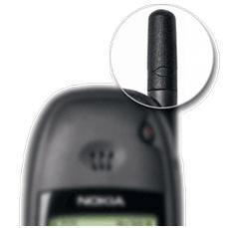
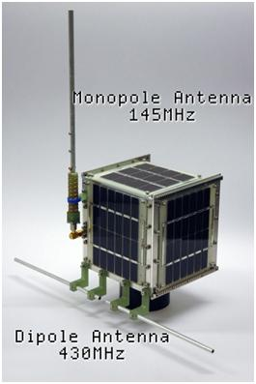
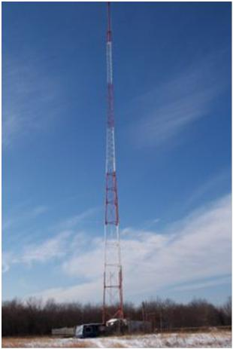
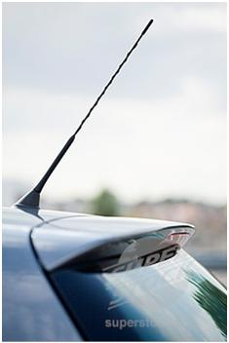
Types of Antennas (cont.)
Monopole Wire Antenna (cont.)

Slide 14
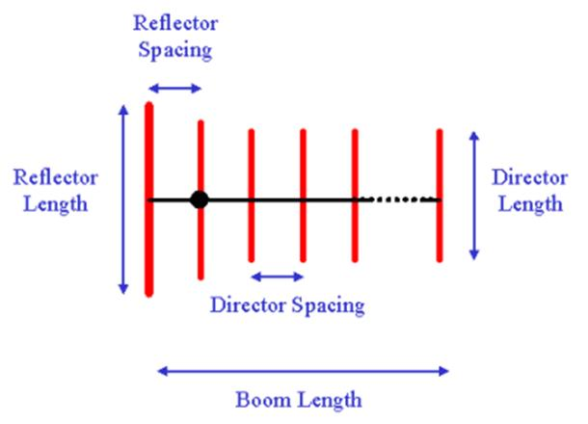
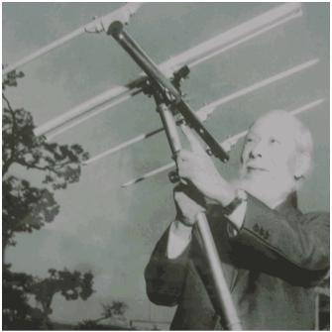
Types of Antennas (cont.)
Yagi Antenna
Excited element
Prof. Yagi
This is a variation of the dipole, using multiples wires (with one “reflector” and one or more “directors” (acting as a lens).
Low bandwidth
Moderate directivity
Commonly used as a UHF TV antenna

Slide 15
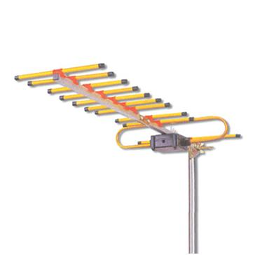
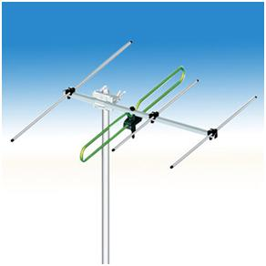
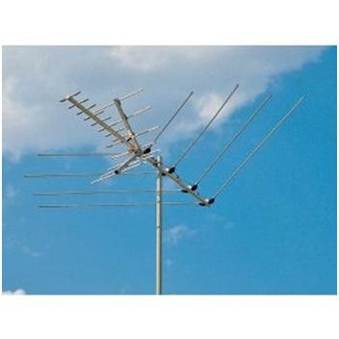
Types of Antennas (cont.)
Yagi Antenna (cont.)
UHF Yagi
UHF Yagi
UHF Yagi
VHF Log-periodic

Slide 16
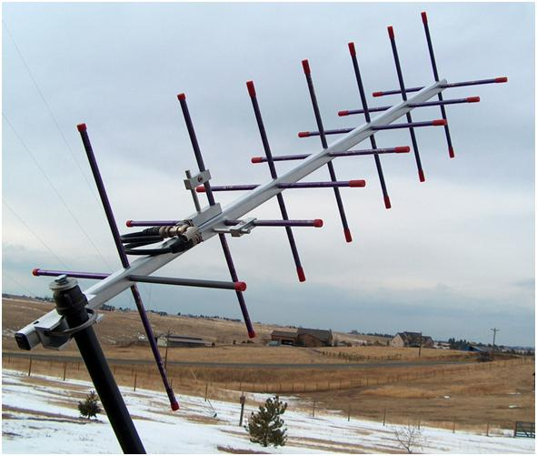
Types of Antennas (cont.)
Yagi of CP Elements
Two perpendicular dipoles fed 90º out of phase.
Used for circular polarization

Slide 17
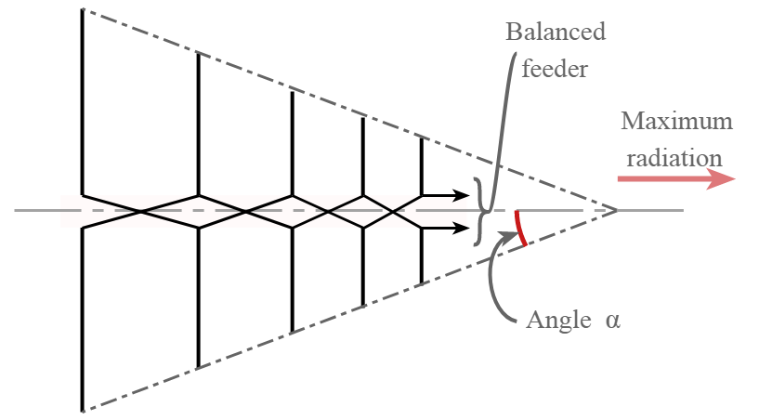
Types of Antennas (cont.)
Log-Periodic Antenna
Beam
This consists of multiple dipole antennas of varying lengths, connected together.
High bandwidth
Moderate directivity
Commonly used as a VHF TV antenna
The input impedance repeats periodically when plotted vs. the log of the frequency.

Slide 18
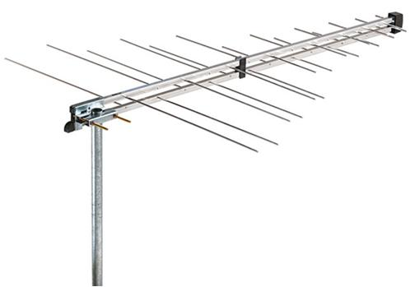
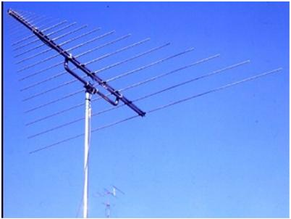
Types of Antennas (cont.)
Log Periodic Antenna (cont.)

Slide 19
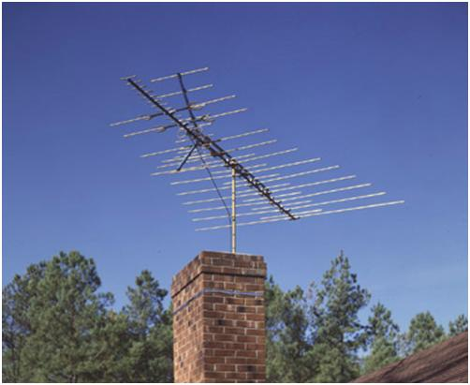
Types of Antennas (cont.)
Typical Outdoor TV Antenna
Corner Reflector
UHF Yagi
VHF Log Periodic

Slide 20
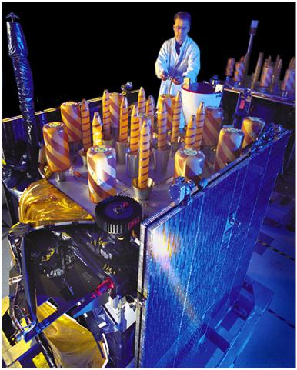
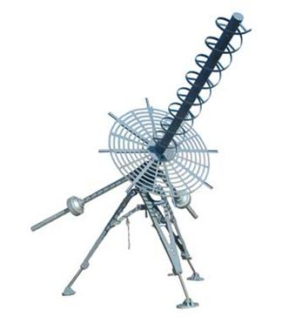
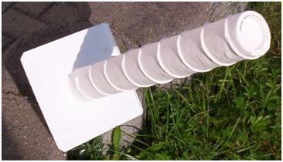
Types of Antennas (cont.)
CP Helical Antenna
GPS satellite
Helical antennas are often used for circular polarization.

Slide 21
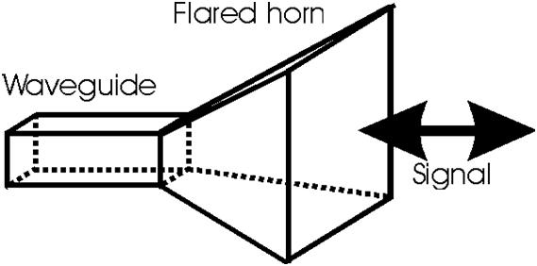
Types of Antennas (cont.)
Horn Antenna
It acts like a “loudspeaker” for electromagnetic waves.
High bandwidth
Moderate to high directivity (directivity is determined by the size / wavelength)
Commonly used at microwave frequencies and above
Often used as a feed for a reflector antenna

Slide 22
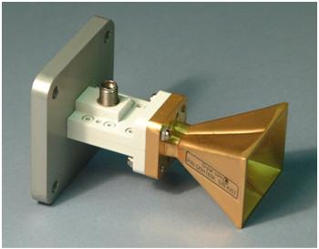
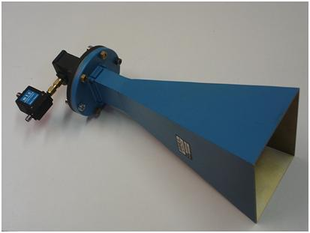
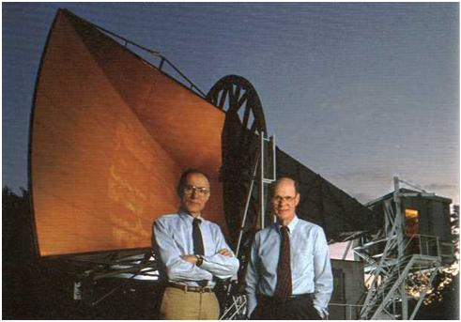
Types of Antennas (cont.)
Horn Antenna (cont.)
Arno A. Penzias and Robert W. Wilson used a large horn antenna to detect microwave signals from the “big bang” (Nobel Prize, 1978).

Slide 23
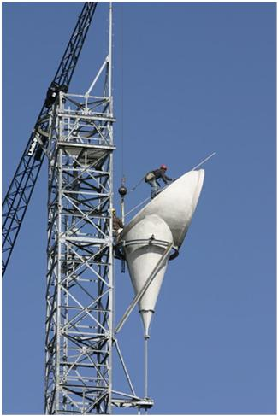
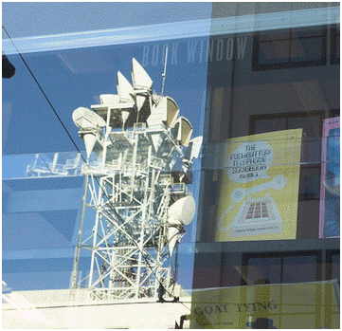
Types of Antennas (cont.)
Horn Antenna (cont.)
This is a variation called the “hoghorn” antenna (a combination of horn+reflector).

Slide 24
Types of Antennas (cont.)
Microstrip (Patch) Antenna
Current
It consists of a printed “patch” of metal on top of a grounded dielectric substrate.
Acts as a radiating resonant cavity
Easily fed by microstrip line or coaxial cable
Low to moderate bandwidth (usually a few percent)
Low directivity (unless used in an array)
Low-profile (h can be made very small, at the expense of bandwidth)
Can be easily made by etching or machining
Can be made conformable (flexible and mounted on a curved surface)
Commonly used at microwave frequencies and above

Slide 25
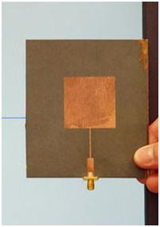
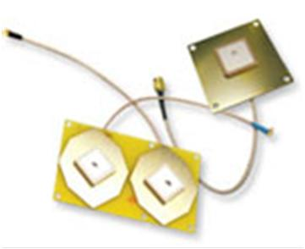
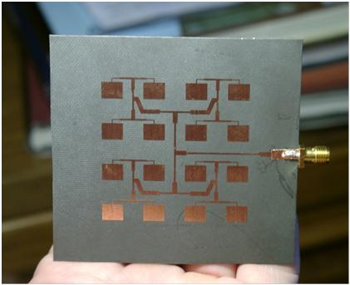
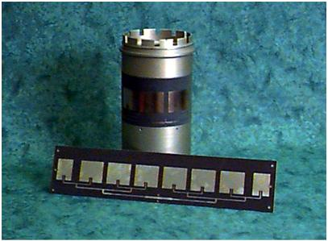
Types of Antennas (cont.)
Microstrip (Patch) Antenna (cont.)

Slide 26

Types of Antennas (cont.)
Dielectric Resonator Antenna (DRA)
The dielectric resonator antenna was invented by our very own Prof. Long in the Dept. of ECE!
Cylindrical DRA
It consists of a dielectric material (such as ceramic) on top of a grounded dielectric substrate.
Acts as a resonating dielectric object
Moderate to large bandwidth
Low directivity (unless used in an array)
Commonly used at microwave frequencies and above
Usually more difficult to fabricate than a patch antenna

Slide 27
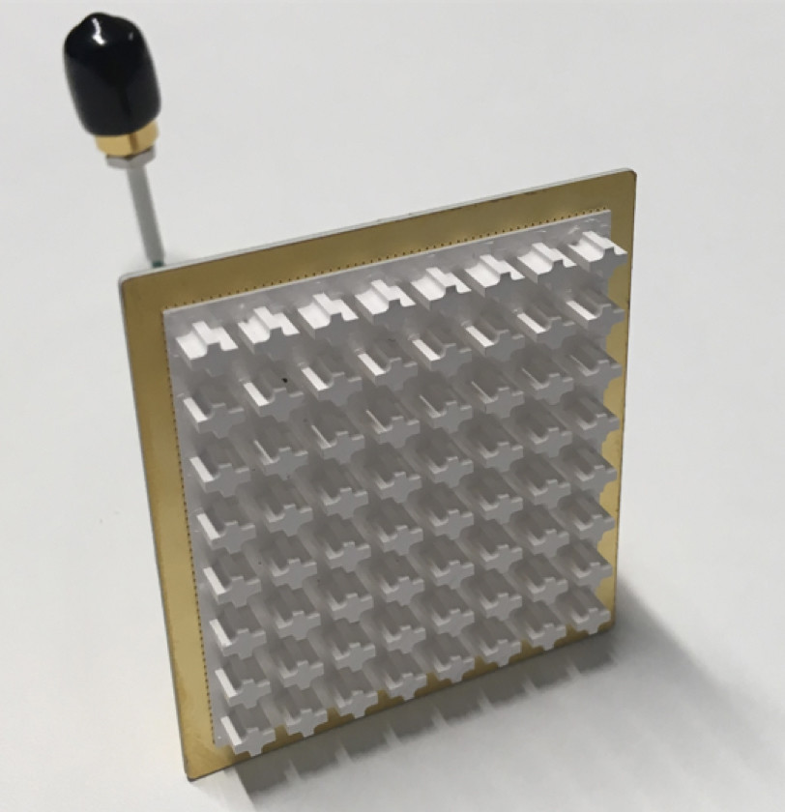
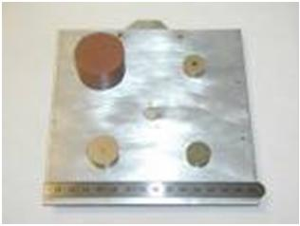
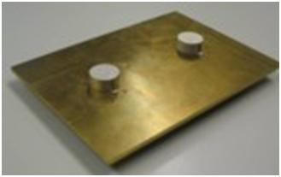
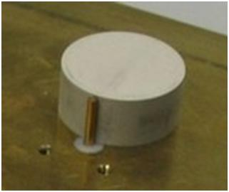
Types of Antennas (cont.)
Dielectric Resonator Antenna (cont.)

Slide 28
Antenna Radiation
We consider here the radiation from an antenna.
S = Poynting vector
r
"far field"
+
-
(phasor electric field)
The far-field radiation acts like a plane wave going in the radial direction.
The shape of the pattern in the far field is only a function of (θ, φ).

Slide 29
Antenna Radiation (cont.)
How far do we have to go to be in the far field?
Sphere of minimum diameter D that encloses the antenna.
+
-

Slide 30
Antenna Radiation (cont.)
The far-field has the following form:
Example: vertical dipole
TM_{z}
Depending on the type of antenna, either or both polarizations may be radiated
(e.g., a vertical wire antenna radiates only E_{θ} polarization).
Example: horizontal loop antenna
TE_{z}

Slide 31
Antenna Radiation (cont.)
The power density in the far field is:
or

Slide 32
Antenna Radiation (cont.)
The far field always has the following form:
In decibels (dB):

Slide 33

Antenna Radiation (cont.)
A normalized far-field pattern is usually shown vs. the angle θ (for a fixed angle φ =φ₀) in polar coordinates.
The subscript “m” denotes the beam maximum.
An “elevation cut”
30°
30°
60°
60°
0º dB
-9
-6
-3
0
120°
120°
150°
150°

Slide 34
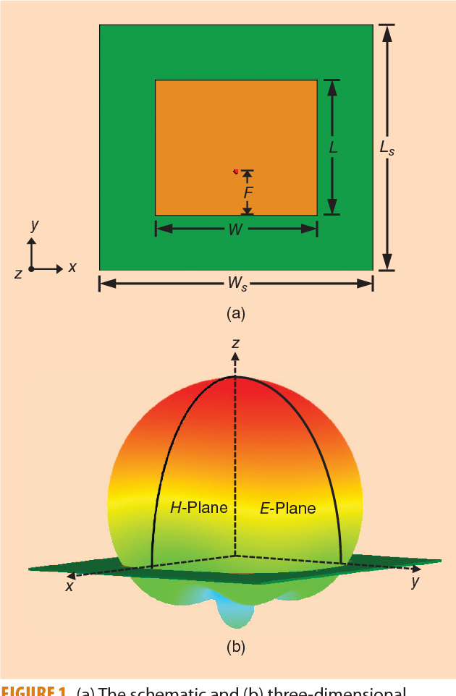
Antenna Radiation (cont.)
E-plane and H-plane
E-plane
Example: Microstrip antenna
Current flow
H-plane
Feed
E-plane:
the plane containing the E vector.
H-plane:
the plane containing the H vector.

Slide 35
Radiated Power
The Poynting vector in the far field is
The total power radiated (in Watts) is then given by
Hence, we have

Slide 36
Directivity
The directivity of the antenna in the directions (θ, φ) is defined as
The directivity (in a particular direction) is the ratio of the actual power density radiated in that direction to the power density that would be radiated in that direction if the antenna were an isotropic radiator (radiates equally in all directions).
In dB,
Note: The directivity is sometimes referred to as the “directivity with respect to an isotropic radiator.”

Slide 37
Directivity (cont.)
The directivity is then directly expressed in terms of the far field pattern:
Usually, the directions are chosen to corresponds to the main beam direction:

Slide 38
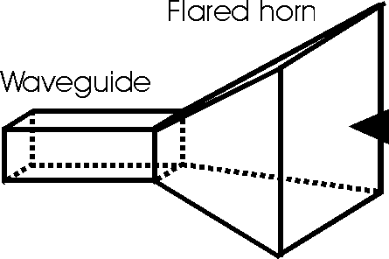
Directivity (cont.)
30°
30°
30°
30°
60°
60°
60°
60°
0 dB
0 dB
-9
-6
-3
-9
-6
-3
120°
120°
120°
120°
150°
150°
150°
150°
Antenna with moderate directivity
(e.g., dipole)
Antenna with high directivity
(e.g., horn or dish)

Slide 39
Directivity (cont.)
Two Common Cases: Dipole Antennas
Short dipole wire antenna (l << λ₀): D = 1.5
Resonant half-wavelength dipole wire antenna (l = λ₀ / 2): D = 1.643
Wire dipole antenna
Short dipole
30°
30°
60°
60°
Feed
0 dB
-9
-6
-3
120°
120°
150°
150°

Slide 40
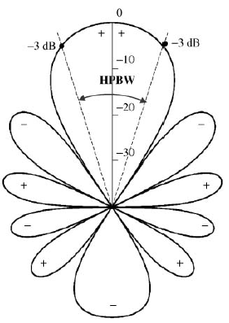
Beamwidth
The beamwidth measures how narrow the beam is
(the narrower the beamwidth, the higher the directivity).
HPBW = half-power beamwidth
At the “half-power” points:
The power density is down by a factor of 1/2.
The field is down by a factor of 1/√2 = 0.707.
In dB, we are down by 3 dB.

Slide 41
Sidelobe Level
The sidelobe level measures how large the sidelobes are.
In this example the sidelobe level is about -13 dB.
Main beam
Sidelobe level
Sidelobes

Slide 42
Gain and Efficiency
The radiation efficiency of an antenna is defined as
P_{rad} = power radiated by the antenna
P_{in} = power input to the antenna
The gain of an antenna in the directions (θ, φ) is defined as
In dB, we have

Slide 43
Gain and Efficiency (cont.)
The gain tells us how strong the radiated power density is in a certain direction, for a given amount of input power.
Recall that
Therefore, in the far field:

Slide 44
Input Impedance
The antenna acts like a load impedance during transmit.
At resonance, the input reactance X_{in} is zero (the desired situation).
Note: We usually want a match between the input impedance and the characteristic impedance Z₀ of the feeding transmission line, to avoid reflection.

Slide 45
Input Impedance (cont.)
At resonance:
Dipole:
Monopole:

Slide 46
Receive Antenna
The Thévenin equivalent circuit of an antenna being used as a receive antenna is shown below.
The Thevenin impedance is the same as the input impedance of the antenna.
+
-
+
-

Slide 47
Receive Antenna (cont.)
The power received by an optimum conjugate-matched load:
Load
+
ANT
-
P_{rec} = P_{L} = power absorbed by load
For a resonant dipole wire antenna:

Slide 48
Receive Antenna (cont.)
We can find the power received using an effective area.
Receive circuit: Assume an optimum conjugate-matched load:
P_{rec} = P_{L} = power absorbed by load
+
ANT
-

Slide 49
Receive Antenna (cont.)
We have the following general formula*:
G = G(θ,φ) = gain of antenna in direction (θ,φ)
(Usually, we assume that (θ,φ) is in the main beam direction.)
*A derivation is given in the following book:
C. A. Balanis, Antenna Engineering, 3rd Ed., 2016, Wiley.

Slide 50
Receive Antenna (cont.)
Effective area of a lossless resonant half-wave dipole antenna:
Assuming normal incidence (θ = 90º):
Assume lossless antenna:
e_{r} = 100%
(G = D)
Hence:
Note: The dipole will receive more power at a lower frequency (larger l), assuming the same incident power.

Slide 51
Example with Wire Antennas
Example
Find the received power P_{rec} in the example below, assuming that the receiver is connected to an optimum conjugate-matched load.
f = 1 [GHz] (λ₀ = 0.29979 [m])
P_{in} = 10 [W]
r = 1 [km]
Assume lossless antennas:
e_{r} = 100%
(G = D)
z
Transmit antenna (TX)
Receive antenna (RX)
r
x
Resonant dipoles

Slide 52
Example with Wire Antennas (cont.)
Gain of RX
Gain of TX
Hence:
The result is:

Slide 53
Receive Antenna (cont.)
Effective area of dish (reflector) antenna
In the maximum gain (main beam) direction:
Now it is the effective area that we know, and from this we can calculate the gain.
A_{phy} = physical area of dish
e_{ap} = “aperture efficiency”
The aperture efficiency is usually less than 1 (less than 100%).

Slide 54
Gain of Dish Antenna
Dish antenna:
Obtaining a higher gain means having a larger dish.

Slide 55
Example with Dish Antenna
Example
A microstrip antenna on a CubeSat with a gain of 8 (9.03 dB) transmits with an input power of 1 [W] at 10.0 GHz from a distance of 50,000,000 [km] (near Mars).
How much power will be received by the NASA Deep Space Network dish at Goldstone, CA, which has a diameter of 70 [m]? Assume an aperture efficiency of 0.75 (75%).
Express answer in Watts and in dBm (dB relative to a milliwatt).

Slide 56
Example with Dish Antenna (cont.)
Example (cont.)
Parameters:

