Slide 1
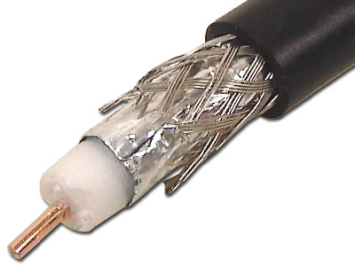
ECE 3317
Applied Electromagnetic Waves
Prof. David R. Jackson
Fall 2023
Notes 6
Transmission Lines
(Time Domain)

Slide 2
Note about Books
Note:
Chapter 10 of the Hayt & Buck book has a thorough discussion of transmission lines in the time domain.
Transmission lines is the subject of Chapter 6 in the Shen & Kong book. However, the subject of wave propagation in the time domain is not treated very thoroughly there.

Slide 3
Transmission Lines
A transmission line is a two-conductor system that is used to transmit a signal from one point to another point.
Two common examples:
Coaxial cable
Twin lead
A transmission line is normally used in the balanced (or “differential”) mode, meaning equal and opposite currents (and charges) on the two conductors.

Slide 4
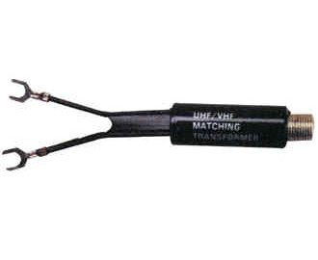
Transmission Lines (cont.)
Here’s what they look like in real-life.
Coaxial cable
Twin lead

Slide 5
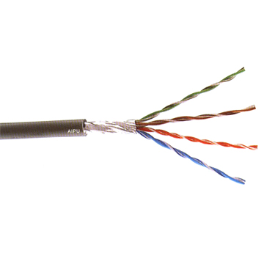
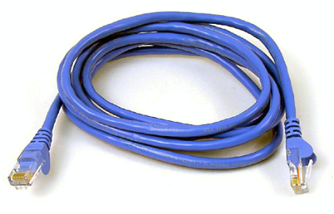
Transmission Lines (cont.)
CAT 5 cable
(twisted pair)

Slide 6
Transmission Lines (cont.)
Some practical notes:
Coaxial cable is a perfectly shielded system (no interference).
Twin line is not a shielded system – more susceptible to noise and interference.
Twin lead may be improved by using a form known as “twisted pair” (e.g., CAT 5 cable). This results in less interference.
-
-
+
-
+
+
+
+
-
+
-
+
-
-
Coax
Twin lead

Slide 7
Transmission Lines (cont.)
A common transmission line for printed circuit boards:
Microstrip line
( a “planar” transmission line)

Slide 8
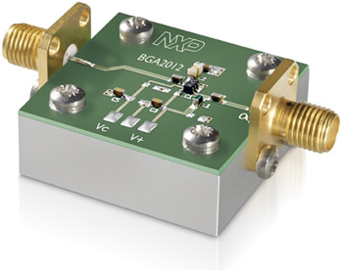
Transmission Lines (cont.)
Transmission lines are commonly met on printed-circuit boards.
Microstrip line
A microwave integrated circuit (MIC)

Slide 9
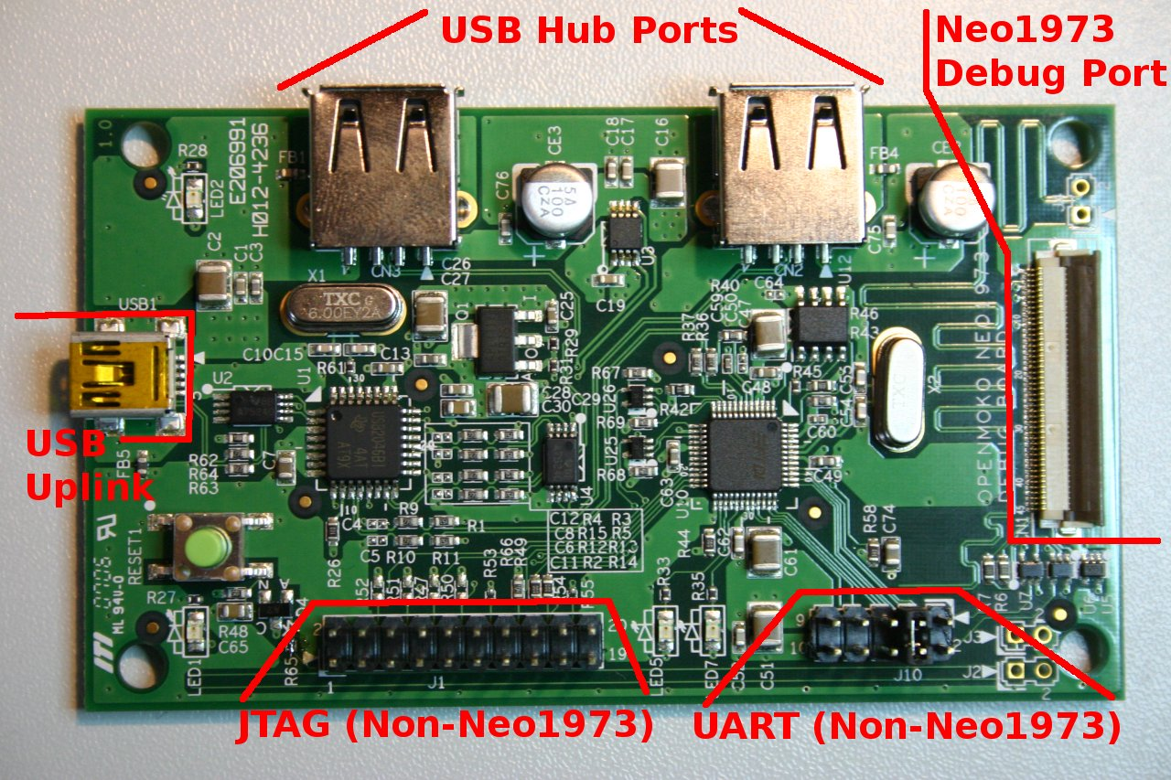
Transmission Lines (cont.)
Microstrip line

Slide 10
Transmission Lines (cont.)
Planar transmission lines commonly met on printed-circuit boards
Microstrip
Stripline
Coplanar strips
Coplanar waveguide (CPW)

Slide 11
Transmission Lines (cont.)
Symbol (schematic) for transmission line:
+
-
Note:
We use this schematic to represent a general transmission line, no matter what the actual shape of the conductors (coax, twin lead, etc.).
Note:
The current on the bottom conductor is always assumed to be equal and opposite to the current on the top conductor (but often we do not label the current on the bottom conductor, for simplicity).

Slide 12
Transmission Lines (cont.)
Four fundamental parameters that characterize any transmission line:
These are “per unit length” parameters.
4 parameters
C = capacitance/length [F/m]
L = inductance/length [H/m]
R = resistance/length [Ω/m]
G = conductance/length [S/m]
Capacitance between the two wires
Inductance due to stored magnetic energy
Resistance due to the conductors
Conductance due to the filling material between the wires

Slide 13
Circuit Model
+
-
Circuit Model:
Note: The order of the elements is not important, as long as we keep the R and L as series elements and the G and C as parallel elements.

Slide 14
Coaxial Cable
Example (coaxial cable)
(cooper or aluminum)
σ_{d} = conductivity of dielectric [S/m]
(e.g., Teflon)
σ_{m} = conductivity of metal [S/m]
μ_{m} = permeability of metal [H/m]
(skin depth of metal)

Slide 15
Coaxial Cable (cont.)
Overview of derivation: capacitance per unit length
Assume static fields
-
-
+
-
+
+
+
+
-
+
-
-
Gauss’s law
More details can be found in ECE 3318, Notes 25.

Slide 16
Coaxial Cable (cont.)
Overview of derivation: inductance per unit length
Assume static fields
×
×
Ampere’s law
×
×
a
×
×
×
b
×
(current flowing in z direction on inner conductor)
More details can be found in ECE 3318, Notes 31.

Slide 17
Coaxial Cable (cont.)
Overview of derivation: conductance per unit length
RC Analogy (ECE 3318):
More details can be found in ECE 3318, Notes 27.

Slide 18
Coaxial Cable (cont.)
Relation Between L and C:
Speed of light in dielectric medium:
This is true for ALL transmission lines.
Hence:
( A proof will be seen later.)

Slide 19
Telegrapher’s Equations
These are a fundamental set of differential equations that describe how voltage and current propagate (travel) on a transmission line.
The derivation holds for any type of transmission line.
The equations are exact, showing how any type of signal propagates on a transmission line.
We only have an exact solution for the telegrapher’s equations in the time domain for a lossless transmission line.

Slide 20
Telegrapher’s Equations (cont.)
Apply KVL and KCL laws to a small Δz slice of line:
+
+
-
-
z

Slide 21
Telegrapher’s Equations (cont.)
Hence
Now let Δz → 0:
“Telegrapher’s Equations (TEs)”

Slide 22
Telegrapher’s Equations (cont.)
Take the derivative of the first TE with respect to z.
Substitute in from the second TE.
To combine these, take the derivative of the first one with respect to z:

Slide 23
Telegrapher’s Equations (cont.)
Hence, we have:
There is no exact solution to this differential equation, except for the lossless case. Hence, we will assume lossless transmission lines in the time domain.
The same equation also holds for i.
Note: The current satisfies the same differential equation.

Slide 24
Telegrapher’s Equations (cont.)
Lossless case:

Slide 25
Solution to Telegrapher's Equations
General Solution for the lossless case:
“wave equation”
Solution:
or
where (F , G) and (f, g) are arbitrary functions.
This is called the “D’Alembert solution” to the wave equation (the solution is in the form of traveling waves).

Slide 26
Solution to Telegrapher's Equations
General Solution for the lossless case:
(1)
or
(2)
Form (1): Useful when plotting the voltage vs. distance z for different times.
Form (2): Useful when plotting the voltage vs. time t for different distances.

Slide 27
Traveling Waves
Proof of solution (Form (1)):
(A similar proof applies for form 2.)
General solution:
It is seen that the differential equation is satisfied by the general solution.

Slide 28
Traveling Waves (cont.)
Example
(rectangular pulse):
The waveform is shifted to the right by Δz = c_{d} t
“snapshots of the wave”

Slide 29
Traveling Waves (cont.)
Example
(square pulse):
The waveform is shifted to the left by |Δz| = c_{d} t
“snapshots of the wave”

Slide 30
Effects of Loss
Loss causes an attenuation in the signal level, and it also causes distortion (the pulse changes shape and usually gets broader).
z
(These effects can be studied numerically.)

Slide 31
Effects of Loss (cont.)
Example: Propagation on a lossy microstrip line
(From ECE 5317)
Input signal:

Slide 32
Effects of Loss (cont.)
Example: Propagation on a microstrip line

Slide 33
Current
Our goal is to now solve for the current on a lossless line.
(First Telegrapher’s equation)
Lossless
Assume the following forms:
The derivatives are:

Slide 34
Current (cont.)
This becomes
Equating like terms, we have:
Integrating both sides, we have:
Note:
There may be a constant of integration, but this would correspond to a DC current, which is ignored here.

Slide 35
Current (cont.)
Observation about term:
Define the characteristic impedance Z₀ of the line:
The units of Z₀ are Ohms.
Then we have:

Slide 36
Current (cont.)
Recall that
From the last slide:
Hence, we have the current as

Slide 37
Current (cont.)
Summary of the general solution for a lossless line:
For a forward wave, the current waveform is the same as the voltage, but reduced in amplitude by a factor of Z₀.
For a backward traveling wave, there is a minus sign as well.

Slide 38
Current (cont.)
Picture for a forward-traveling wave:
Forward-traveling wave
+
-

Slide 39
Current (cont.)
Physical interpretation of minus sign for the backward-traveling wave:
Backward-traveling wave
+
-
The minus sign arises from the reference direction for the current.

Slide 40
Coaxial Cable
Example: Find the characteristic impedance of a coax.
or

Slide 41
Coaxial Cable (cont.)
(intrinsic impedance of free space)

Slide 42
Twin Lead

Slide 43
Twin Line (cont.)
These are the common values used for TV.
75-300 [Ω] transformer
300 [Ω] twin lead
75 [Ω] coax
Coaxial cable
Twin lead
Note: In microwave work, the most common value is Z₀ = 50 [Ω].

Slide 44
Microstrip Line
Parallel-plate formulas:

Slide 45
Microstrip Line (cont.)
More accurate CAD formulas (from ECE 5317):
Note: The effective relative permittivity accounts for the fact that some of the fields are outside of the substrate, in the air region. The effective width w' accounts for the strip thickness.

Slide 46
Some Comments
Transmission-line theory is valid at any frequency, and for any type of waveform (assuming an ideal straight length of transmission line).
Transmission-line theory is perfectly consistent with Maxwell's equations (although we work with voltage and current, rather than electric and magnetic fields).
Circuit theory does not view two wires as a “transmission line”: it cannot predict effects such as signal propagation, reflection, distortion, etc.

Slide 47
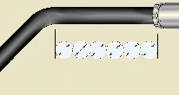
Some Comments
One thing that transmission-line theory ignores is the effects of discontinuities (e.g., bends or nearby obstacles). These may cause reflections and possibly also radiation at high frequencies, depending on the type of line.
Radiation
Transmitted
Incident
Pipe
Incident
Transmitted
Bend
Reflected
Reflected
Coax
Twin Lead
(cannot radiate)
(can radiate*)
*Twisted pair minimizes this radiation.

Slide 48
Summary Page
Lossless Line
or
F or f = wave going in +z direction.
G or g = wave going in -z direction.

