Slide 1
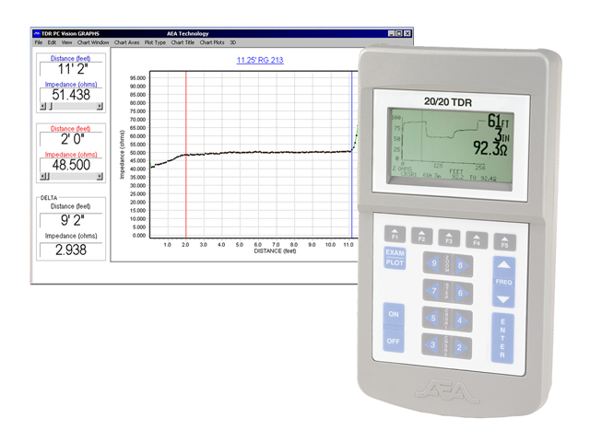
ECE 3317
Applied Electromagnetic Waves
Prof. David R. Jackson
Fall 2023
Notes 8
Transmission Lines
(Bounce Diagram)

Slide 2
Step Response
The concept of the bounce diagram is useful to find a step response on a terminated lossless line:
Lossless line
+
-
u(t) = unit step function
Note:
The bounce diagram is useful if the source is a step function or a rectangular pulse (discussed later in these notes). If the source is something else, it is better to use the general theory presented in Notes 7.
Generator voltage

Slide 3
Step Response (cont.)
The voltage wave is shown approaching the load.
+
-
(from voltage divider)

Slide 4
Bounce Diagram
Basic constants
T
The purple values give the total voltage in each triangular region.
2T
3T
4T
5T
6T

Slide 5
Steady-State Solution
Adding all infinite number of bounces (t = ∞), we have:
After some math, we have (please see the Appendix):
Note:
The steady-state solution does not depend on the transmission line length or the characteristic impedance!
This is the DC circuit-theory voltage divider equation!

Slide 6
Example
+
-
1
2
3
4
5
6

Slide 7
Example (cont.)
The bounce diagram can be used to get an “oscilloscope trace” of the voltage at any point on the line.
0.75 [ns]
1.25 [ns]
2.75 [ns]
3.25 [ns]
4.75 [ns]
Steady state voltage:

Slide 8
Example (cont.)
Final “oscilloscope trace” of the voltage at
+
-

Slide 9
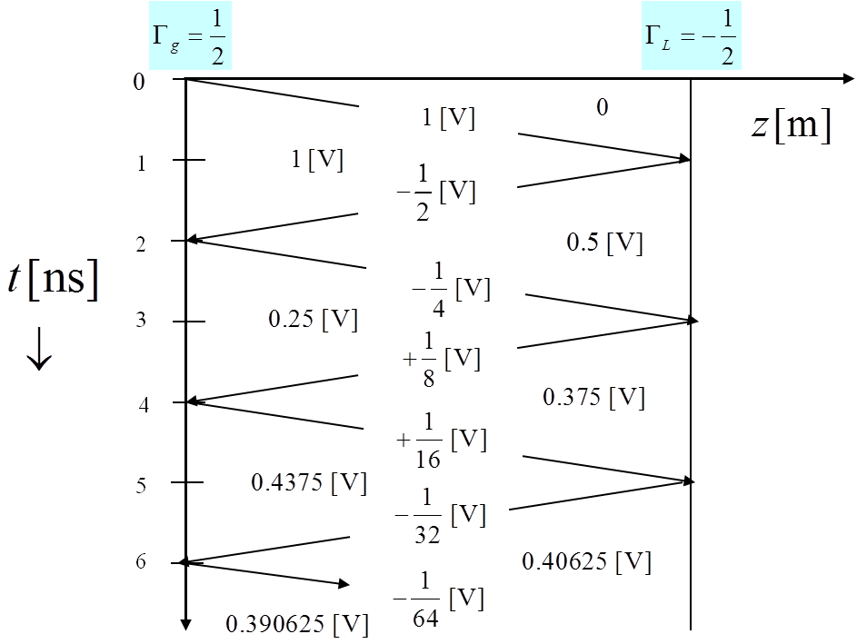
Example (cont.)
The bounce diagram can also be used to get a “snapshot” of the line voltage
at any point in time.
Wavefront is moving to the left
L/4

Slide 10
Example (cont.)
  This set of snapshots shows the waves bouncing back and forth.
Initial wave
First reflected wave

Slide 11
Bounce Diagram for Current
We just change the signs of the reflection coefficients, as shown.
Normalized Current
1
2
3
4
5
6
Note: The normalized current is defined as Z₀ i (z,t).

Slide 12
Example for Current
Oscilloscope Trace for Current
Normalized Current
1
0.75 [ns]
1.25 [ns]
2
3
2.75 [ns]
(units are volts)
4
3.25 [ns]
5
4.75 [ns]
6
Steady state current:

Slide 13
Example for Current (cont.)
Snapshot for Current
Normalized Current
Wavefront is moving to the left
1
2
3
(units are volts)
L/4
4
5
6

Slide 14
Two Transmission Lines
Here we have a reflection and transmission coefficient
at the junction between two lines.
Junction
+
-
Note:
When the wave first hits the junction, it sees the characteristic impedance of the line on the other side as a load.
KVL: T_{J} = 1 + Γ_{J}
(This follows from the fact that voltage must be continuous across the junction.)

Slide 15
Two Transmission Lines (cont.)
Bounce Diagram for Two Lines
Junction
+
-
1
2
3
0.2222 [V]
0.2222 [V]
0.4444 [V]
0.0555[V]
-0.4444 [V]
-0.3888 [V]
4

Slide 16
Pulse Response
Superposition can be used to get the response due to a rectangular pulse.
+
+
-
-
u(t) = unit step function
We thus subtract two bounce diagrams, with the second one being a shifted version of the first one.

Slide 17
Example: Pulse
Find an “oscilloscope trace” of the voltage at z = 0.75 L
Oscilloscope trace
+
-
Given pulse:

Slide 18
Example (cont.)
Subtract
Shifted trace
(shifted by 0.25 [ns])

Slide 19
Example: Pulse (cont.)
Oscilloscope trace
+
-
Oscilloscope trace of voltage

Slide 20
Example (cont.)
Final “oscilloscope trace” of the voltage at
+
-

Slide 21
Example: Pulse (cont.)
Find a “snapshot” of the voltage at t = 1.5 [ns].
+
-

Slide 22

Example: Pulse (cont.)
Shifted numbers
Original step
Delayed step
0.25
1
1.25
2
L / 2
3L / 4
2.25
3
3.25
4
4.25
5
5.25
6
6.25

Slide 23
Example: Pulse (cont.)
Snapshot from original step function
Subtract
Snapshot from shifted step function

Slide 24

Example: Pulse (cont.)
Snapshot
+
-
Snapshot of voltage
Pulse is moving to the left

Slide 25
Capacitive Load
+
-
Note: The generator is assumed to be matched to the transmission line for convenience (we wish to focus on the effects of the capacitive load).
Hence
The reflection coefficient is now a function of time.

Slide 26
Capacitive Load (cont.)
+
-
(time = t)
z
T
2T
3T

Slide 27
Capacitive Load (cont.)
+
-
At t = T : The capacitor acts as a short circuit:
At t = ∞: The capacitor acts as an open circuit:
Between t = T and t = ∞, there is an exponential time-constant behavior.
General time-constant formula:
Hence, we have:

Slide 28
Capacitive Load (cont.)
Assume z = 0
+
+
-
-
Steady-state
z
T
t
2T
3T

Slide 29
Inductive Load
+
-
At t = T: inductor acts as an open circuit:
At t = ∞: inductor acts as a short circuit:
Between t = T and t = ∞, there is an exponential time-constant behavior.
Recall:

Slide 30
Inductive Load (cont.)
Assume z = 0
+
+
-
-
z
T
t
2T
Steady-state
3T

Slide 31
Time-Domain Reflectometer (TDR)
This is a device that is used to look at reflections on a line, to look for potential problems such as breaks on the line.
“The 20/20 Step Time Domain Reflectometer (TDR) was designed to provide the clearest picture of coaxial or twisted pair cable lengths and to pin-point cable faults.”
AEA Technology, Inc.

Slide 32
Time-Domain Reflectometer (cont.)
+
-
The fault might be acting as a parallel resistor or a series resistor.
+
-

Slide 33
Time-Domain Reflectometer (cont.)
+
-
The time t_{d} indicates where the fault is.
Resistive load, R_{F} > Z₀
Resistive load, R_{F} < Z₀

Slide 34
Time-Domain Reflectometer (cont.)
The TDR can also tell us what kind of a load we have at the end of a line.
+
-
Capacitive load
Inductive load

Slide 35
Appendix: Steady-State Solution
Adding all infinite number of bounces (t = ∞) for the step response, we have:
Note: We have used

Slide 36
Appendix: Steady-State Solution (cont.)
Simplifying, we have:

Slide 37
Appendix: Steady-State Solution (cont.)
Continuing with the simplification:
Hence we finally have:

