Slide 1
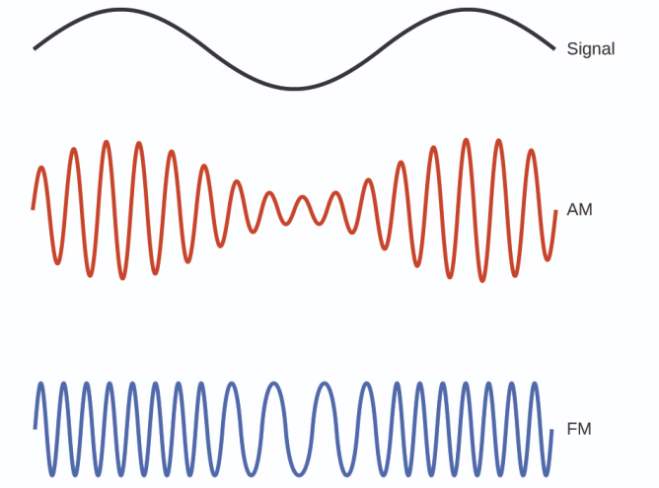
ECE 3317
Applied Electromagnetic Waves
Prof. David R. Jackson
Fall 2023
Notes 9
Transmission Lines
(Frequency Domain)

Slide 2

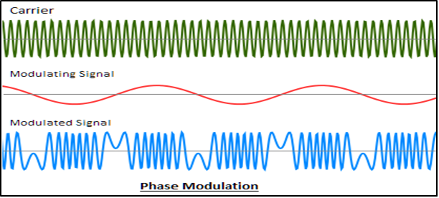
Frequency Domain
Why is the frequency domain important?
Most communication systems use a sinusoidal signal (which may be modulated).
(Some systems, like Ethernet, communicate in “baseband”, meaning that there is no carrier.)
Examples:
100BASET, 10GBASET

Slide 3
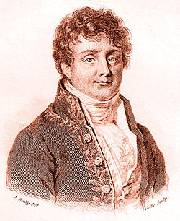
Frequency Domain (cont.)
Why is the frequency domain important?
A solution in the frequency-domain allows to solve for an arbitrary time-varying signal on a lossy line (by using the Fourier transform method).
Fourier-transform pair
For a physically-realizable (real-valued) signal, we can also write
Jean-Baptiste-Joseph Fourier

Slide 4
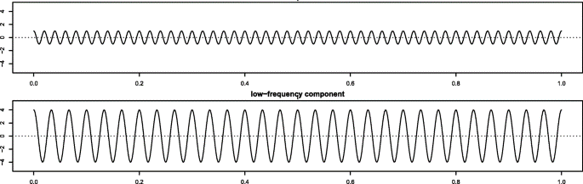
Frequency Domain (cont.)
A collection of phasor-domain signals!
Phasor
A pulse is resolved into a collection (spectrum) of infinite sinusoidal waves with different frequencies, amplitudes, and phases.
Time

Slide 5
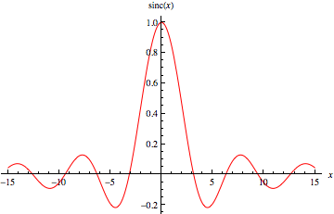
Frequency Domain (cont.)
Example: Rectangular pulse

Slide 6
Frequency Domain (cont.)
System
Phasor domain:
In the frequency domain, the system has a transfer function H(ω):
System
Time domain:
The time-domain response of the system to an input signal is:

Slide 7
Frequency Domain (cont.)
Summary
System
If we can solve the system in the phasor domain (i.e., get the transfer function H(ω)), we can get the output for any time-varying input signal.
This is one reason why the phasor domain is so important!
This applies for transmission lines also!

Slide 8
Telegrapher’s Equations
+
-

Slide 9
Frequency Domain
To convert to the phasor domain, we use:
or

Slide 10
Frequency Domain (cont.)
Note that
We can therefore write:

Slide 11

Telegrapher’s Equations
+
-

Slide 12
Frequency Domain (cont.)
Define
Then
Solution:
Note: We have an exact solution, even for a lossy line, in the phasor domain!

Slide 13
Propagation Constant
Convention: We choose the (complex) square root to be the principal branch:
(lossy case)
γ is called the propagation constant, with units of [1/m]
Review of principal branch of square root:
Note:

Slide 14
Propagation Constant (cont.)
Denote:
γ = propagation constant [1/m]
α = attenuation constant [nepers/m]
β = phase constant [radians/m]
Choosing the principle branch means that

Slide 15
Propagation Constant (cont.)
For a lossless line, we consider this as the limit of a lossy line, in the limit as the loss tends to zero:
Hence
(lossless case)
Hence, we have that
Note: α = 0 for a lossless line.

Slide 16
Propagation Constant (cont.)
Physical interpretation of waves:
Note:
The waves must decay in the direction of propagation.
(forward traveling wave)
(backward traveling wave)
Forward traveling wave:
Backward traveling wave:

Slide 17
Propagation Wavenumber
Alternative notations:
(propagation constant)
(propagation wavenumber)

Slide 18
Forward Wave
Forward traveling wave:
Denote
Then
In the time domain we have:
Hence we have

Slide 19
Forward Wave (cont.)
Snapshot of Waveform:
The distance λ_{g} is the distance it takes for the waveform to “repeat” itself in meters.
λ_{g} = guided wavelength

Slide 20
Wavelength
The wave “repeats” (except for the amplitude decay) when:
Hence:
Note: This equation can be used to find λ_{g} if we already know β :

Slide 21
Wavelength (cont.)
Lossless case:
Summary for lossless case:

Slide 22
Attenuation Constant
The attenuation constant controls how fast the wave decays.

Slide 23
Phase Velocity
The forward-traveling wave is moving in the positive z direction.
Consider a sinusoidal wave moving on a transmission line
(shown in the figure below for a lossless line (α = 0) for simplicity):
Crest of wave:

Slide 24
Phase Velocity (cont.)
The phase velocity v_{phase} is the velocity of a point on the wave, such as the crest.
Set
Take the derivative with respect to time:
Hence
We thus have
Note:
This result holds for a general lossy line.

Slide 25
Phase Velocity (cont.)
Let’s calculate the phase velocity for a lossless line:
Lossless line:
Also, we know that
Hence
(lossless line)

Slide 26
Backward Traveling Wave
Let’s now consider the backward-traveling wave
(shown in the figure below for a lossless line (α = 0) for simplicity):
This wave has the same phase velocity, but it travels backwards.

Slide 27
Group Velocity
The group velocity v_{group} is the velocity of a pulse.
We have (derivation omitted):
Note:
This result holds for a general lossy line.
Note: for a lossless line we have:

Slide 28
Attenuation in dB/m
Gain in dB:
Use the following logarithm identity:
Therefore, the “gain” is:
Hence, we have:

Slide 29
Attenuation in dB/m (cont.)
Final attenuation formulas:

Slide 30
Example: Coaxial Cable
Copper conductors (nonmagnetic: μ_{m} = μ₀ )
TV coax
Note:
The “loss tangent” of the dielectric is called tanδ_{d}.
(skin depth of the two conductors)

Slide 31
Example: Coaxial Cable (cont.)
Dielectric conductivity is often specified in terms of the loss tangent:
σ_{d} = effective conductivity of the dielectric material*
Note:
The loss tangent of practical insulating materials (e.g., Teflon) is approximately constant over a wide range of frequencies. (For example, tanδ_{d} ≈ 0.001 for Teflon.)
*The effective conductivity accounts for the actual conductivity as well as molecular friction and other effects.

Slide 32
Example: Coaxial Cable (cont.)
Relation between G and C
Hence
Recall
This relationship holds for any type of transmission line.

Slide 33
Example: Coaxial Cable (cont.)
Characteristic impedance (ignore R and G for this):
Skin depth of metal:
Effective conductivity of dielectric:

Slide 34
Example: Coaxial Cable (cont.)
a
b
z
Results for (R, L, G, C):

Slide 35
Current
Use the first Telegrapher equation:
Next, use
so

Slide 36
Current (cont.)
Hence, we have
Solving for the phasor current I, we have

Slide 37
Characteristic Impedance
Define the (complex) characteristic impedance Z₀ in the frequency domain for a lossy line:
Then we have:
Note: In the time domain, we only define Z₀ for a lossless line. In the frequency domain, we can define it for a lossy line.

Slide 38
Characteristic Impedance (cont.)
Note the reference directions!
+
-
The characteristic impedance is the ratio of the voltage to the current, for a wave traveling in the positive z direction.
Practical note: Even though Z₀ is always complex for a practical line (due to loss), we usually neglect this and take it to be real.

Slide 39
Summary of Solution
Characteristic Impedance
Lossy
Lossless:
Voltage and Current

Slide 40
Appendix: Summary of Formulas
General Lossy Case

Slide 41
Appendix: Summary of Formulas
Lossless Case

