Slide 1
ECE 3318
Applied Electricity and Magnetism
Spring 2023
Prof. David R. Jackson
Dept. of ECE
Notes 12
Conductors

Slide 2
Conductors
Ohm’s law
Material | σ [S/m]
Silver | 6.3×10⁷
Copper | 6.0×10⁷
Copper (annealed) | 5.8×10⁷
Gold | 4.1×10⁷
Aluminum | 3.5×10⁷
Zinc | 1.7×10⁷
Brass | 1.6×10⁷
Nickel | 1.4×10⁷
Iron | 1.0×10⁷
Tin | 9.2×10⁶
Steel (carbon) | 7.0×10⁶
Steel (stainless) | 1.5×10⁶
Good electric conductors: σ >> 1
Perfect electric conductor (PEC): σ → ∞
Note:
Many of the properties derived for PECs hold very accurately for
good conductors.
http://en.wikipedia.org/wiki/Electrical_resistivity_and_conductivity

Slide 3
Perfect Electric Conductors
Inside a perfect conductor, the electric field must be zero.
Ohm’s law:
PEC
or
Note:
We assume that the current density cannot go to infinity.
PEC:

Slide 4
Perfect Electric Conductors (cont.)
Inside and on a perfect conductor, the potential must be constant.
B
A
Hence
PEC
Note:
The voltage drop integral is independent of the path, so we can choose a path that stays inside the conductor (where the electric field is zero).

Slide 5
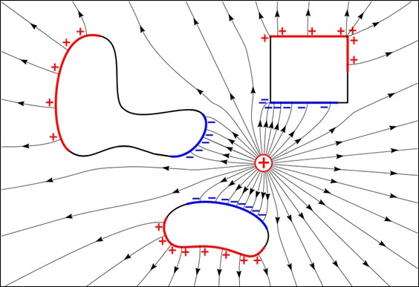
Perfect Electric Conductors (cont.)
Electric lines of flux must enter or leave a conductor perpendicular to it.
In other words: E_{t} = tangential electric field = 0
On surface of PEC:
Hence, E is perpendicular to Δr for any small Δr along the surface.
We choose a small path Δr in a
tangential direction along the surface.
PEC

Slide 6
Perfect Electric Conductors (cont.)
Inside a PEC ρ_{v} = 0
Proof: Assume a point inside where ρ_{v} > 0
ρ_{v} > 0 inside small volume
(since ρ_{v} is a continuous function).
+
+
+
+
+
+
+
PEC
Hence
Contradiction !

Slide 7
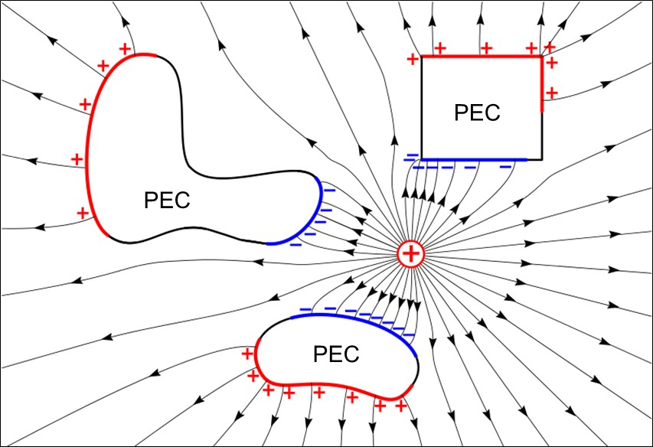
Perfect Electric Conductors (cont.)
Only ρ_{s} on the surface is allowed for a PEC.
http://en.wikipedia.org/wiki/Electrostatics

Slide 8
Properties of Conductors
Summary of Properties for PEC
+
+
+
+
+
+
PEC
+
+
+
+
+
+
+

Slide 9
Faraday Cage Effect
Inside of a hollow PEC shell in statics:
There is no electric field.
There is no ρ_{s} on the inner surface.
Static electric field source
-
q
-
-
PEC
+
-
ρ_{s}
+
-
+
Note:
The Faraday cage does not have to be grounded.
+
+
This is a shielded region (no electric field).

Slide 10
Faraday Cage Effect (cont.)
Proof of Faraday cage effect
Hollow cavity
+
+
+
+
Outline of proof:
PEC
+
+
The electric field is zero inside the conductor.
The potential on the boundary of the inner hollow cavity is constant.
The uniqueness theorem then says that the potential must be a constant throughout the hollow cavity region (see the next slide).
The electric field is then zero inside the hollow cavity as it comes from the gradient of the electric field.
+
+
+
+
+
+
+
PEC shell
Note: The uniqueness theorem is discussed on the next slide.

Slide 11
Faraday Cage Effect (cont.)
Uniqueness Theorem
If Φ = V₀ (a constant) everywhere on the boundary S,
then Φ(x,y,z) = V₀ everywhere inside the region.
Given: Φ = V₀ (a constant) on the boundary
Surface S (closed surface)

Slide 12
Faraday Cage: Practical Conductor
In static equilibrium, the Faraday cage still works, even with a practical good conductor (finite conductivity):
Static electric field source
-
q
-
-
Assumption:
It is assumed that the shell is not connected to any external wires or sources.
-
Conducting metal shell (finite conductivity)
The rest of the proof works the same way.
At equilibrium: J = 0

Slide 13
Faraday Cage: Note on Magnetic Field
A Faraday cage made of a good conductor does
not block a static magnetic field!
Copper (nonmagnetic)
N
S
Note:
A high permeability material will act as a good shield for a static magnetic field (e.g., Mu-metal, μ_{r} = 100,000).

Slide 14
Faraday Cage: Note on Magnetic Field
High permeability shield
N
S
A Faraday cage made of a high permeability material will act as a good shield for a static magnetic field.

Slide 15
High-Frequency Shielding
At high frequencies, both electric and magnetic fields are blocked by the skin effect.
Radiating antenna source
Skin depth:
Thickness >> δ
To be a good shield, the thickness of the shield should be large compared to a skin depth.
This situation is discussed in ECE 3317 (skin-depth effect).

Slide 16
Summary on Shielding
When will a closed metal shield be an effective shield?
A good conductor (σ >> 1) will block all high-frequency signals (skin effect).
In statics, a good conductor will block the electric field (Faraday Cage effect).
In statics, a good conductor will not necessarily block the magnetic field.
In statics, a high-permeability material (μ_{r} >> 1) will block the magnetic field.
Conductive shield

Slide 17
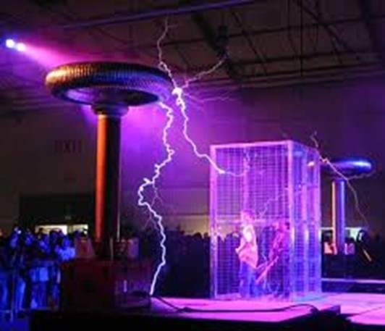
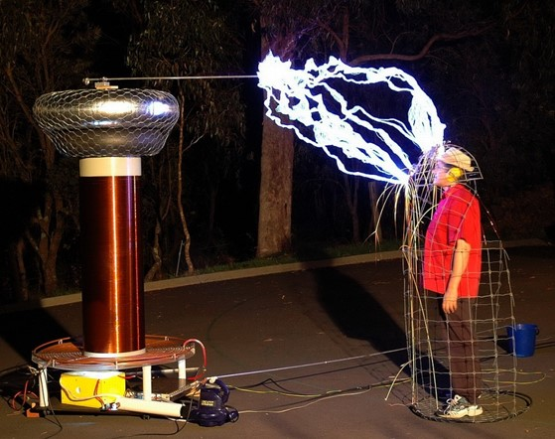
Faraday Cage Effect (cont.)
Faraday-cage effect
They are safe from the Tesla coil!

Slide 18
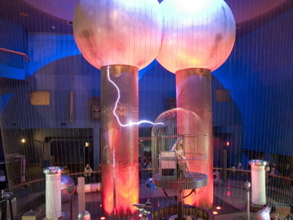
Faraday Cage Effect (cont.)
Faraday-cage effect
She is safe from the Van de Graaff generator!
(Boston Science Museum)

Slide 19
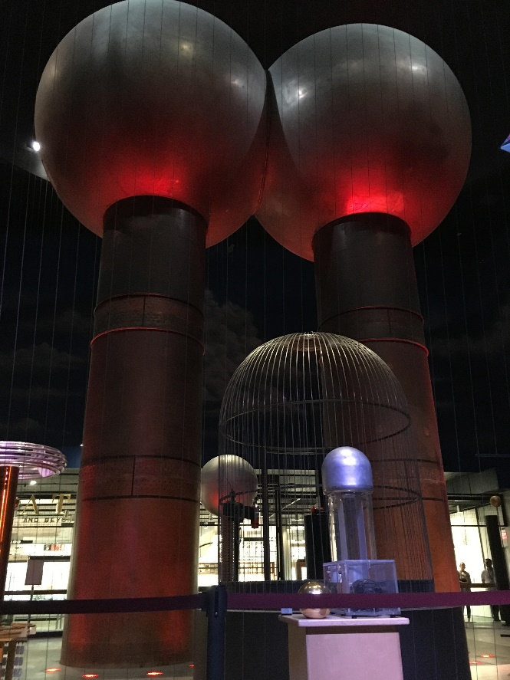
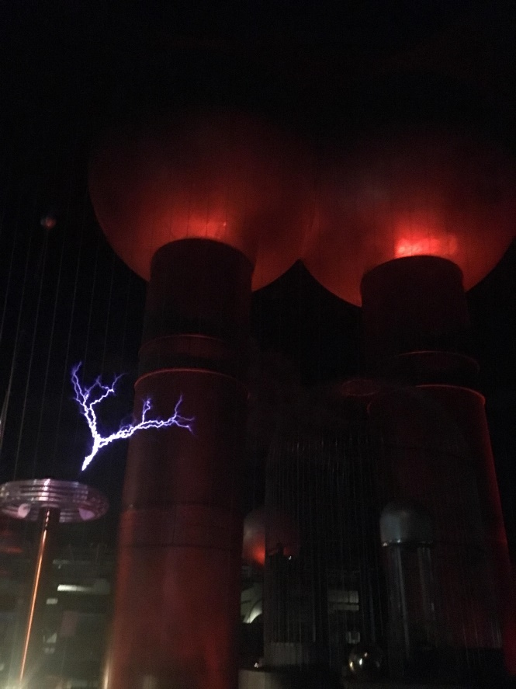
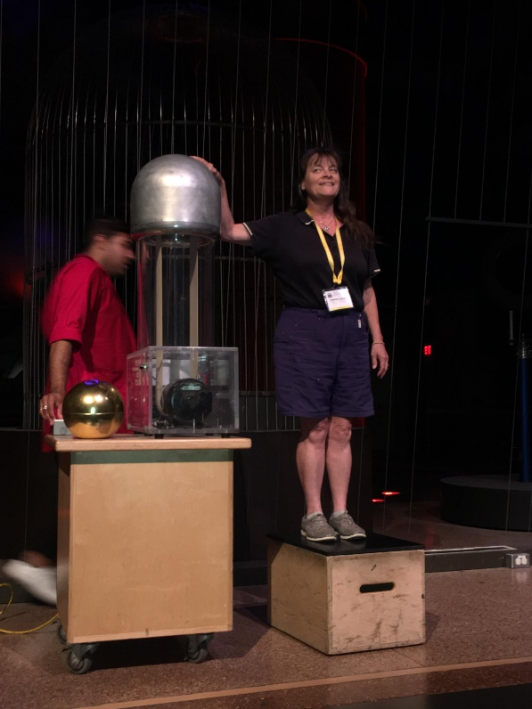
Faraday Cage Effect (cont.)
The importance of being insulated:
She is insulated from ground!
(Boston Science Museum)

Slide 20
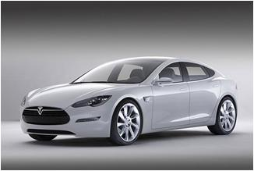
Faraday Cage Effect (cont.)
+ + +
+ + +
+ + +
+ + +
+ + +
+ + +
_ _ _
_ _ _
_ _ _
_ _ _
_ _ _
_ _ _
1) Occupants are pretty safe
(but let the charge dissipate before you get out!)
2) Occupants are not very safe
Earth
Earth

Slide 21
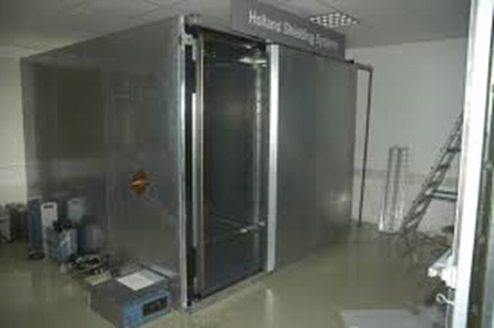
Faraday Cage Effect (cont.)
Faraday Cage Shielded Room
Self-standing modular Faraday cage Superior screening of RF/LF/HF signals, e.g. for R&D, TEMPEST and Testing purposes. The modular Faraday cage is designed to meet or even exceed the vast majority of shielding requirements. The system is constructed of shielded modular panels, available in either standard-sized or custom-designed panels to meet exact specifications in government, industry, research and development, university or hospital use. The system is completely self-standing (independent of the host building). The modular panels can be shipped and assembled by the customer or under supervision of our engineers, anywhere in the world. Applications RF/LF/HF test and measurements EMC test labs Wireless product testing EMI/RFI shielded server rooms TEMPEST / Sensitive information protection HEMP & EMP protection Neuroscience laboratories Cellular communication devices Immunity & emission test chambers Anechoic chambers MRI rooms Neurology lab etc...
http://www.directindustry.com/prod/holland-shielding-systems-bv/faraday-cages-modular-35048-1031291.html

Slide 22
Shielding and Grounding
Start with Spherical PEC shell
Neutral (no charge)
PEC
Note:
The principles illustrated here apply to any shape cavity, but for modelling purposes it is simplest to use a spherical cavity.
Drill hole and
insert point charge, then solder hole.
PEC
Find E:
Neutral shell (no charge)
PEC

Slide 23
Shielding and Grounding (cont.)
(a) r < a
a
b
q
(b) a < r < b
(PEC)
PEC
Neutral shell
(c) r > b

Slide 24
Shielding and Grounding (cont.)
Neutral shell
PEC
(outside metal)
The neutral metal shell does not block the static electric field
coming from the inside !
(The shell would be a good shield for high-frequency fields coming from the inside, however, due to the skin-depth effect.)

Slide 25
Shielding and Grounding (cont.)
Find Q_{A}, Q_{B}:
PEC
Neutral shell
+
+
+
+
+
+
-
+
-
-
+
-
-
+
-
-
-
Neutral shell:
+
+
+
PEC
+
+
+
+

Slide 26
Shielding and Grounding (cont.)
+
+
+
PEC
+
+
+
-
+
-
-
+
-
-
+
-
-
-
+
+
+
The electric field is zero inside of a PEC.
+
+
+
+
so
A Gaussian surface is chosen inside the metal shell.
or
Hence
We then also have
(neutral shell)

Slide 27
Shielding and Grounding (cont.)
+
+
+
+
PEC
+
+
-
-
-
+
+
-
-
+
-
-
-
+
+
+
+
+
+
+
Flux picture showing the charge on the surfaces
Note: Flux lines go from positive charges to negative charges.
(Also, they go from higher potential to lower potential.)

Slide 28
Shielding and Grounding (cont.)
Next, “ground” the shell:
PEC
-
-
-
-
-
-
-
-
Proof:
We can invoke the uniqueness theorem, considering the outside of the shell, the wire, the earth, and infinity to form the boundary S of our region.
PEC wire
Note: Grounding has not affected the charge on the inner surface of the shell.
Earth
The earth is modeled as a big conductor.

Slide 29
Shielding and Grounding (cont.)
Charge on outer surface:
PEC
0
-
-
-
-
-
-
-
-
PEC wire
Hence
Earth

Slide 30
Shielding and Grounding (cont.)
PEC
Charge on outer surface (cont.):
-
-
-
-
-
-
-
-
+
+
+
+
PEC
+
+
+
-
-
-
+
+
PEC wire
+
-
-
+
+
-
-
-
+
+
+
+
+
+
+
+
Earth
Neutral shell before grounding
After grounding
The charge q on the outer surface has flowed down to ground.

Slide 31
Summary of Shielding & Grounding in Statics
-
-
PEC
-
+
-
Effect # 1: Faraday cage effect
+
-
There is no static field on the inside
(does not require grounding).
+
+
+
Effect # 2: Static field penetration
+
+
+
An ungrounded shield does not block the static electric field of an inside source.
+
PEC
+
+
-
-
-
+
+
-
-
+
-
-
-
+
+
+
+
+
+
+

Slide 32
Summary of Shielding & Grounding in Statics (cont.)
PEC
-
-
-
-
-
-
-
-
Effect # 3: Grounding
A grounded shield removes the static electric field in the exterior region
and removes static charge buildup from the outer surface.
Conducting wire
(This assumes that there are no charges in the outside region.)
Earth

Slide 33
Summary of Shielding & Grounding in Statics (cont.)
PEC
Grounded Faraday cage
(effect #1 + effect #3)
A grounded hollow Faraday cage has no static field anywhere.
Conducting wire
Earth

Slide 34
Comments on Grounding*
Static Fields
Grounding removes static charge build up on objects.
Grounding removes electric fields produced from any static charge build up.
This is good for safety (e.g., when operating in explosive environments.)
This is good for reducing noise in sensitive measurements.
Power line frequency
Grounding is good for the safety of AC equipment (preventing shocks from the AC line voltage).
*This topic was also discussed in Notes 5.

