Slide 1
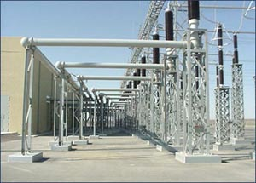
ECE 3318
Applied Electricity and Magnetism
Spring 2023
Prof. David R. Jackson
Dept. of ECE
Notes 16
Sharp Point Property

Slide 2
Sharp Point Property
A sharp point produces a strong electric field.
The system is charged with Q [C].
Determine how much charge goes to each sphere, and the
electric field at the surface of each sphere.

Slide 3
Sharp Point Property (cont.)
We ignore the effects of the wire on the charge distribution, and we ignore the interaction between the two spheres.
Also,
Solution:

Slide 4
Sharp Point Property (cont.)
so
Also, from the last slide,
A stronger electric field exists on the smaller sphere.
Hence,

Slide 5
Sharp Point Property (cont.)
Conclusion:
If there is any charge on a metallic system, the electric field well be very high at sharp points or corners.
Note:
Grounding the metallic system will remove the charge that is built up on the system (Q = 0).

Slide 6
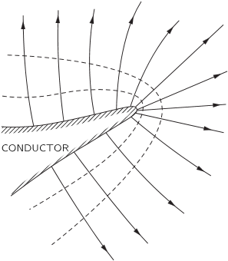
Sharp Point Property (cont.)
The field is strong as we approach a sharp bend or point
on a practical conductor that has a charge on it.
http://www.feynmanlectures.info/docroot/II_06.html

Slide 7
Sharp Point Property (cont.)
The electric field near a sharp metal point may be
much higher than the surrounding field.
Sharp point
+
-

Slide 8
Lightning Rod
- - - - - - - - - - - - - -
Strong electric field
Lightning is attracted to the rod more than the rest of the building:
Important to have
it well grounded !
Because it is taller
Because of the sharp point

Slide 9
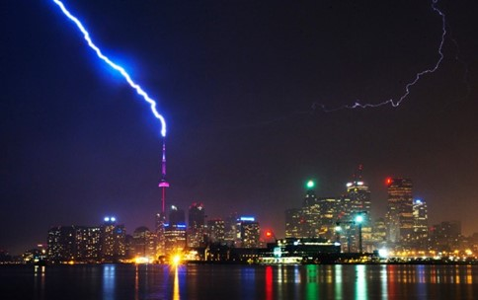
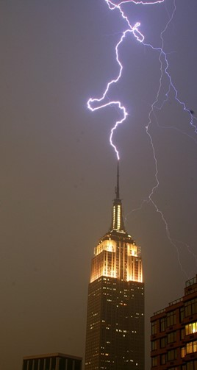
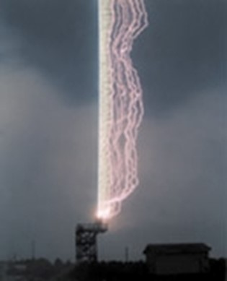
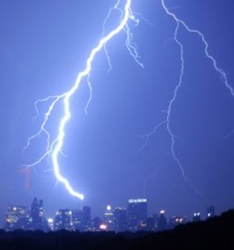
Lightning Rod (cont.)
A lighting rod in action

Slide 10
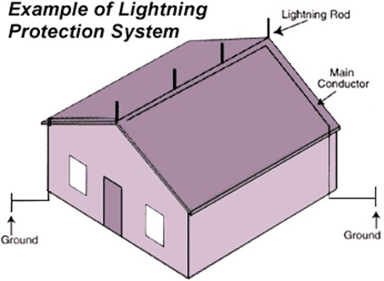
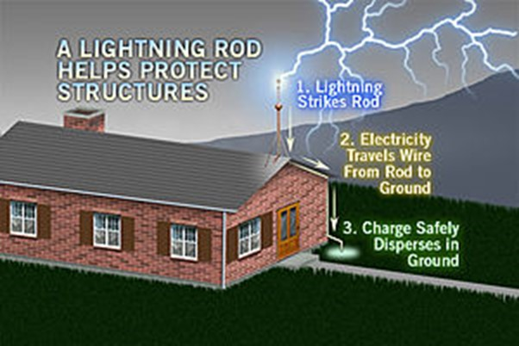
Lightning Rod (cont.)
For larger structures, it is good to have more than one rod, and/or make them as high as possible.

Slide 11
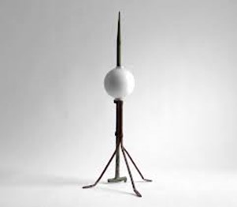
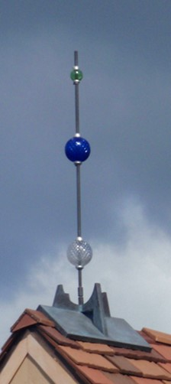
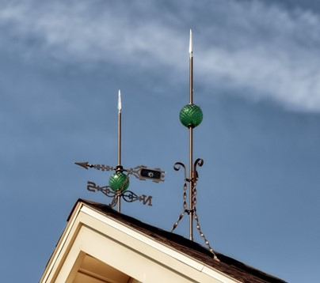
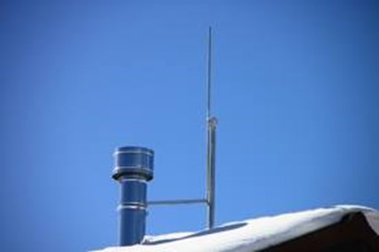
Lightning Rod (cont.)
Examples of lightning rods on homes and barns.

Slide 12
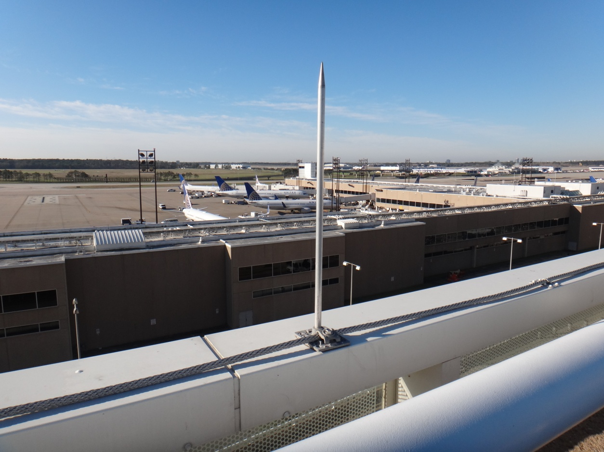
Lightning Rod (cont.)
A lightning rod on top of the “Purple Parking Garage” at IAH airport.

Slide 13
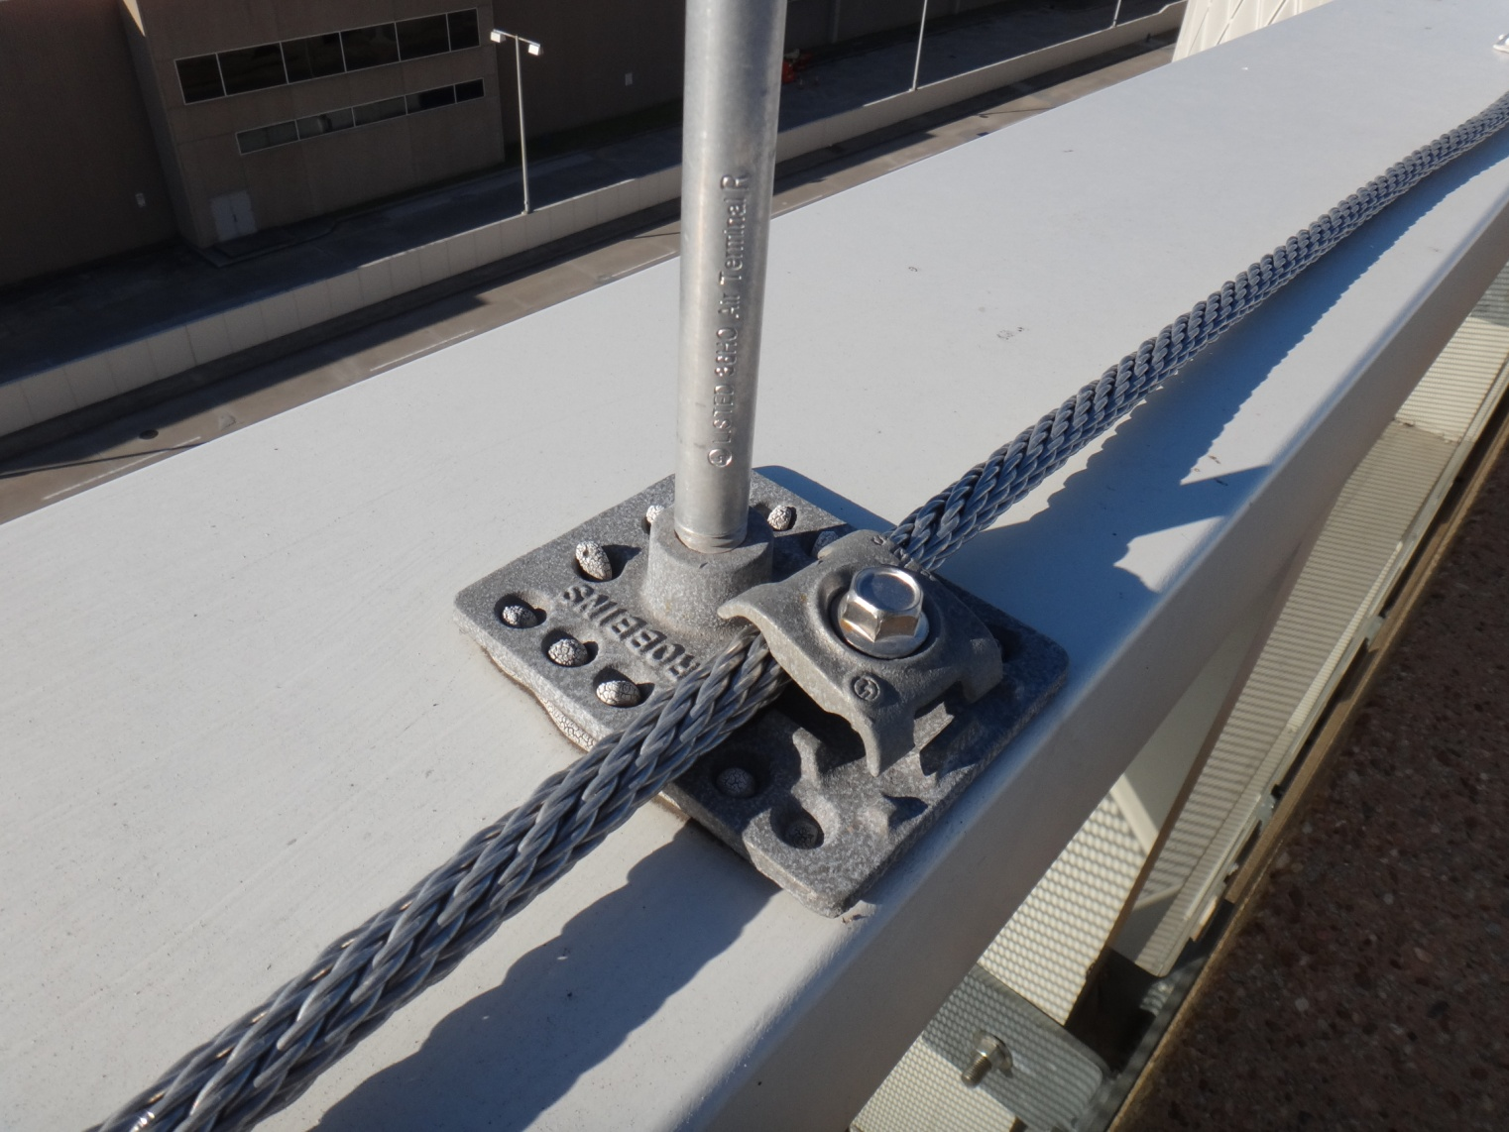
Lightning Rod (cont.)
A close-up of the grounding system at the “Purple Parking Garage” at IAH airport.

Slide 14
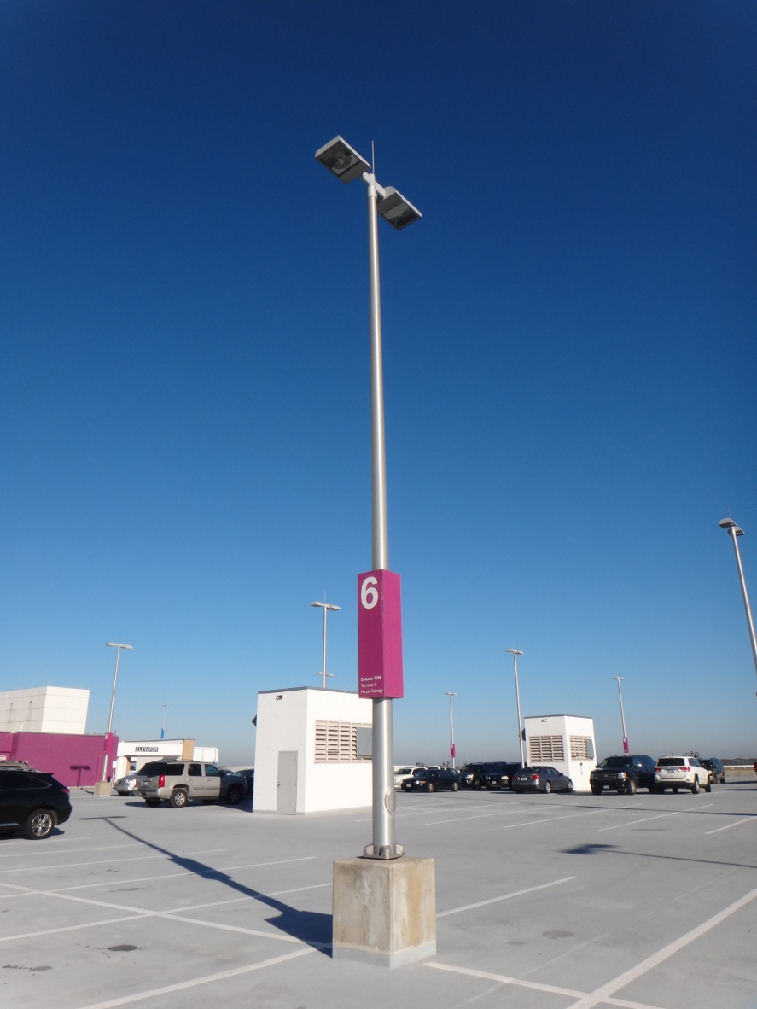
Lightning Rod (cont.)
George Bush Intercontinental Airport (IAH)
Purple Parking Garage
Lighting rods are also on top of the light posts.

Slide 15
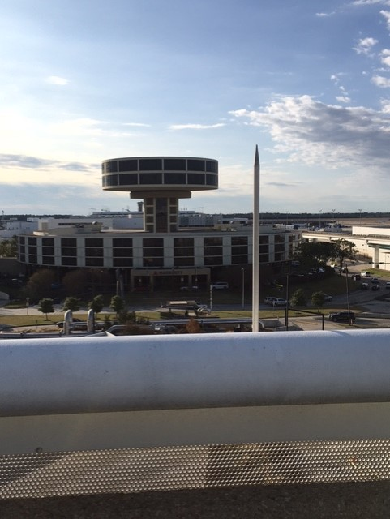
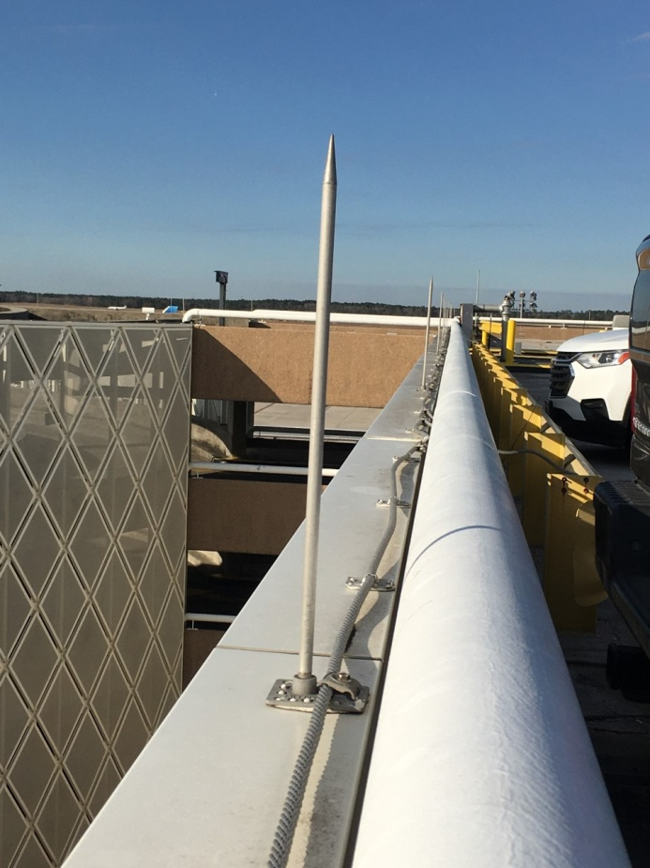
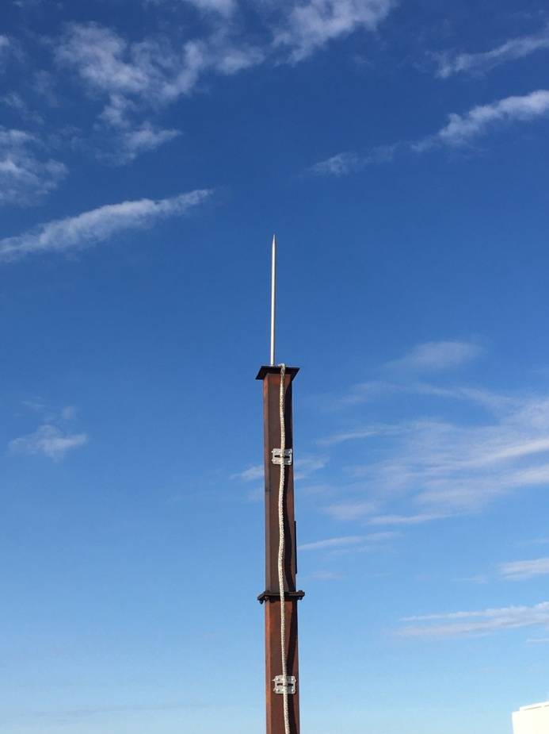
Lightning Rod (cont.)
George Bush Intercontinental Airport (IAH)
Brown Parking Garage

Slide 16
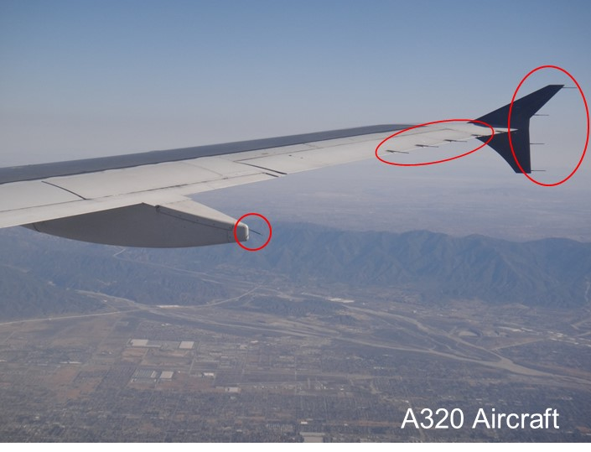
Static Discharge Wicks
“Static discharge wicks” are used on aircraft to help bleed off any charge buildup due to friction with particles (ice, dust, etc.) the atmosphere. Static charge buildup on antennas (and subsequent corona) can cause interference with radio communications.
http://en.wikipedia.org/wiki/Static_discharger

Slide 17
Edge on a Wedge
The field approaches infinity as we approach the corner of a conducting wedge.
y
x
2-D wedge
On wedge surface:
φ₀ | α
0º | 0.5
30º | 0.455
60º | 0.4
90º | 0.333

Slide 18
Knife Edge
The field approaches infinity as we approach the tip of a flat metal plate.
“Knife edge”

Slide 19
Knife Edge (cont.)
Field near the edge of a parallel-plate capacitor
Very strong field
Nearly uniform field
Weak field
Credit: Feynman Lectures on Physics

Slide 20
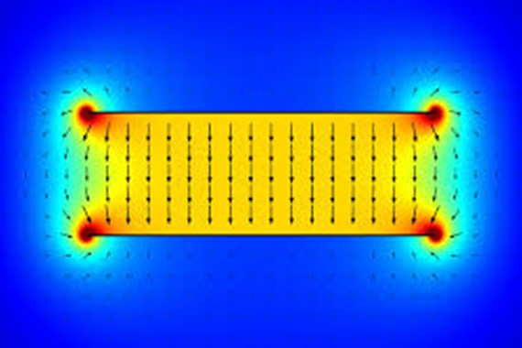
Knife Edge (cont.)
Actual physical flux plot
Simulation:
color scale shows field strength

Slide 21
Microstrip Line
The field and current approach infinity as we approach the edges of the line.
y
w
h
x
y
The edge singularity causes increased conductor loss, compared with transmissions lines such as coaxial cables. It also lowers the power handling capability due to dielectric breakdown.
or
x
w

Slide 22
Microstrip Line
Near the edges we have
(proof omitted):
y
or
x
w
Distance to right/left edge

