Slide 1
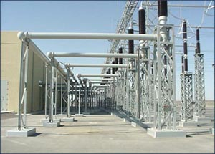
ECE 3318
Applied Electricity and Magnetism
Spring 2023
Prof. David R. Jackson
Dept. of ECE
Notes 18
Faraday’s Law

Slide 2
Example (cont.)
Find curl of E from a static point charge

Slide 3
Example (cont.)
Note:
If the curl of the electric field is zero for the field from a static point charge, then by superposition it must be zero for the field from any static charge density.
This gives us Faraday’s law:
(in statics)

Slide 4
Faraday’s Law in Statics
(Integral Form)
Stokes's theorem:
Here S is any “bowl” surface that is attached to C.
Hence

Slide 5
Faraday’s Law in Statics
(Differential Form)
We show here how the integral form also implies the differential form.
Assume
We then have (definition of curl):
Hence

Slide 6
Faraday’s Law in Statics (Summary)
Differential (point) form of Faraday’s law
Stokes’s theorem
Definition of curl
Integral form of Faraday’s law

Slide 7
Path Independence and Faraday’s Law
The integral form of Faraday’s law is equivalent to
path independence of the voltage drop calculation in statics.
Proof:
Also,
Hence,

Slide 8
Summary of Path Independence
Equivalent properties of an electrostatic field
Equivalent

Slide 9
Summary of Electrostatics
Here is a summary of the important equations
related to the electric field in statics.
Electric Gauss law
Faraday’s law
Constitutive equation (free space)

Slide 10
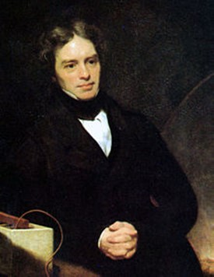
Faraday’s Law: Dynamics
Experimental Law (dynamics):
This is the general Faraday’s law in dynamics.
Michael Faraday*
(from Wikipedia)
*Ernest Rutherford stated: "When we consider the magnitude and extent of his discoveries and their influence on the progress of science and of industry, there is no honour too great to pay to the memory of Faraday, one of the greatest scientific discoverers of all time".

Slide 11
Faraday’s Law: Dynamics (cont.)
Experiment
Magnetic field B_{z} (increasing with time)
Electric field E
The changing magnetic field produces an electric field.
Assume a B_{z} field that increases with time:

Slide 12
Faraday’s Law: Dynamics (cont.)
A changing magnetic field produces a circulating electric field.
Note:
The circulation of the electric field about the z axis is opposite to the right hand, due to the minus sign in Faraday’s law.
Magnetic field B_{z} (increasing with time)
Electric field E

Slide 13
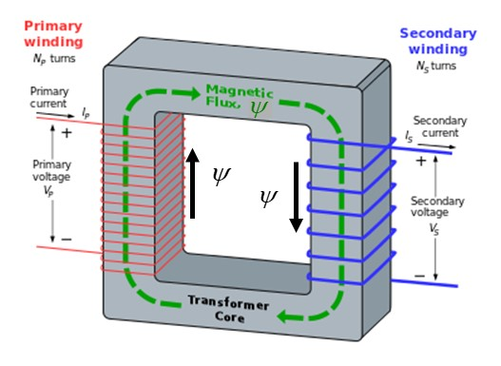
Eddy Currents
Eddy currents are currents that flow inside a transformer core (or other conducting object) due to a changing magnetic field.
Eddy current
Eddy current cause power loss.

Slide 14
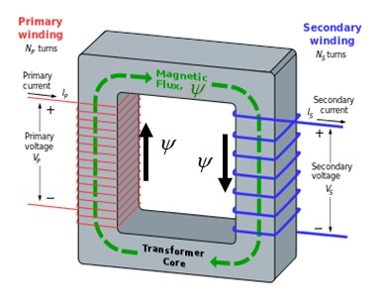
Eddy Currents (cont.)
Assume no φ variation.
Cylindrical coordinates
Assume no φ variation
Transformer core
Magnetic field B_{z} (increasing with time)
Electric field E

Slide 15
Eddy Currents (cont.)
Assume no ρ variation of B_{z}.
(phasor domain)
Assume:
Transformer core
Solution:
(no ρ variation)

Slide 16
Eddy Currents (cont.)
Also, we have Ohm’s law:
Hence we have:
Transformer core
Eddy currents*
Note that the eddy currents increase with frequency!
*The currents look like eddies or whirlpools in water.

Slide 17
Eddy Currents (cont.)
Laminated cores are used to reduce eddy currents.
Solid core
The laminated core consists of layers of iron material coated with electrical insulation.
Laminated core

Slide 18
Faraday’s Law: Integral Form
Integrate both sides over an arbitrary open surface (bowl) S:
Apply Stokes’s theorem for the LHS:
Note:
The right-hand rule determines the direction of the unit normal, from the direction along C.
Faraday's law in integral form

Slide 19
Faraday’s Law: Integral Form (cont.)
Assume that the surface and the path are not changing with time:
Define magnetic flux through the surface S:
We then have
Note:
The right-hand rule determines the direction of the unit normal in the flux calculation, from the direction along C.

Slide 20
Faraday’s Law: Summary
Summary
Stationary surface
where
The voltage drop around a closed path is equal to the rate of change of magnetic flux through the path.
Note: The closed path can be anything: in free space, inside of a metal wire, etc.

Slide 21

Eddy Currents (Revisited)
Solid core
Integral form of Faraday's law:
This is the same result we obtained before, using the differential form of Faraday's law.

Slide 22
Faraday’s Law for a Loop
We measure a voltage across a loop due to
a changing magnetic field inside the loop.
(This is the basis for how AC generators and transformers work.)
+
-
Open-circuited loop
Magnetic field B (B_{z} is changing with time)

Slide 23
Faraday’s Law for a Loop (cont.)
+
-
Note: A lower case v denotes that it is time-varying.
Also
Note:
The voltage drop along the PEC wire (from B to A inside the wire) is zero.
So we have

Slide 24
Faraday’s Law for a Loop (cont.)
Hence:
+
-

Slide 25
Faraday’s Law for a Loop (cont.)
Assume a uniform magnetic field for simplicity.
(At least it is uniform over the loop area.)
Assume
Then we have:
+
-
so
A = area of loop

Slide 26
Faraday’s Law for a Loop (cont.)
Summary
Assume
General form
+
-
Uniform field
A = area of loop
ψ_{z} = magnetic flux through loop in z direction

Slide 27
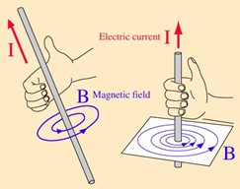
Lenz’s Law
This is a simple rule to tell us the polarity of the output voltage
(without having to do any calculation).
We visualize a high-impedance resistor R added to the circuit:
Assume
+
The output voltage polarity corresponds to a current flow that opposes the change in the flux in the loop.
-
In this example, a clockwise current is set up, since this opposes the change in flux through the loop. The clockwise current then corresponds to the output voltage polarity shown.
Note:
A right-hand rule tells us the direction of the magnetic field due to a wire carrying a current.
(A wire carrying a current in the z direction produces a magnetic field in the positive φ direction.)
A = area of loop
B_{z} is increasing with time.

Slide 28
Example: Magnetic Field Probe
A small loop can be used to measure the magnetic field (for AC).
+
-
Assume
Note: The magnetic field is assume constant over the loop area.
Assume
Then we have
A = area of loop
At a given frequency, the output voltage is proportional to the strength of the magnetic field.

Slide 29
Applications of Faraday’s Law
Faraday’s law explains:
How AC generators work
How transformers work
Output voltage of generator
Output voltage on secondary of transformer
Note: For N turns in a loop we have

Slide 30
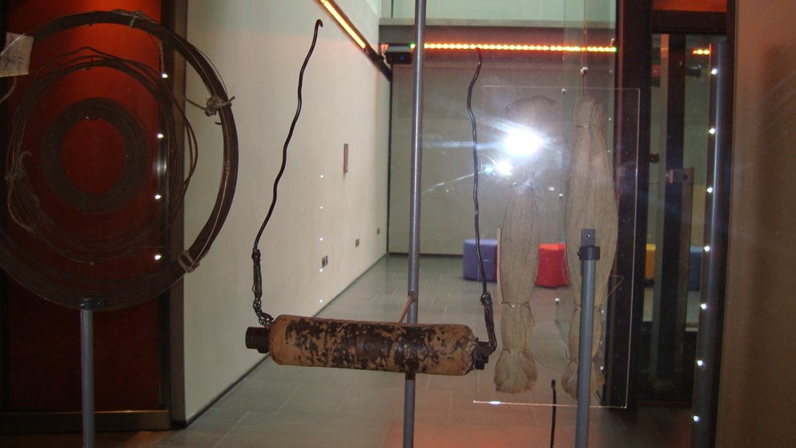
The world's first electric generator!
(invented by Michael Faraday)
A magnet is slid in and out of the coil, resulting in a voltage output.
(Faraday Museum, London)

Slide 31
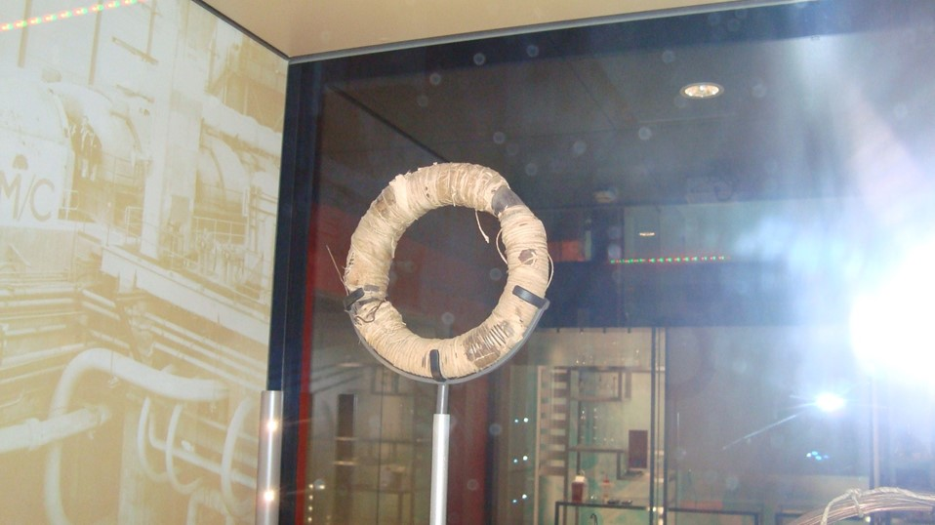
The world's first transformer!
(invented by Michael Faraday)
The primary and secondary coils are wound together on an iron core.
(Faraday Museum, London)

Slide 32
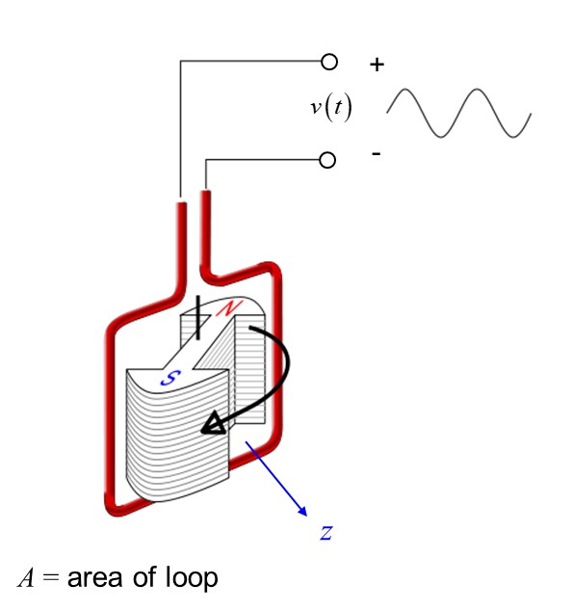
AC Generators
Diagram of a simple alternator (AC generator) with a rotating magnetic core (rotor) and stationary wire (stator), also showing the output voltage induced in the stator by the rotating magnetic field of the rotor.
Open-circuit coil
Assume that B_{z} is constant over the loop.
(Magnetic flux comes out of the north pole.)
http://en.wikipedia.org/wiki/Alternator

Slide 33

AC Generators (cont.)
Open-circuit coil
so
or
(phasor domain)

Slide 34
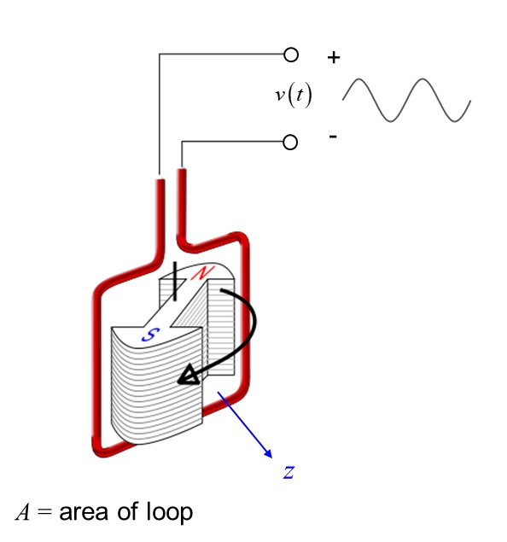
AC Generators (cont.)
Open-circuit coil
Summary
If the magnet rotates at a fixed speed,
a sinusoidal voltage output is produced.
Note:
The angular velocity of the magnet is the same as the radian frequency of the output voltage (for a simple two-pole magnet).

Slide 35

AC Generators (cont.)
Thévenin Equivalent Circuit
Open-circuit coil
+
-
N turns

Slide 36
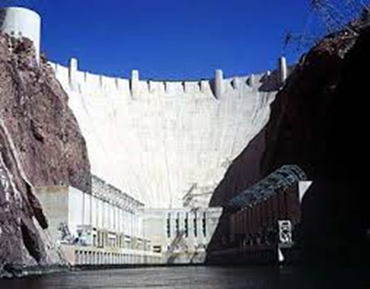
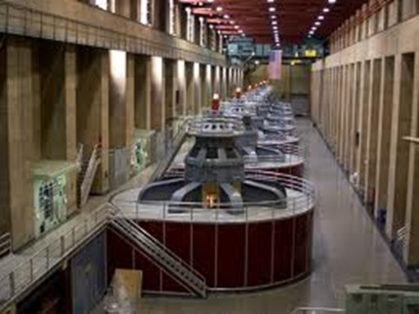
AC Generators (cont.)
Generators at Hoover Dam

Slide 37
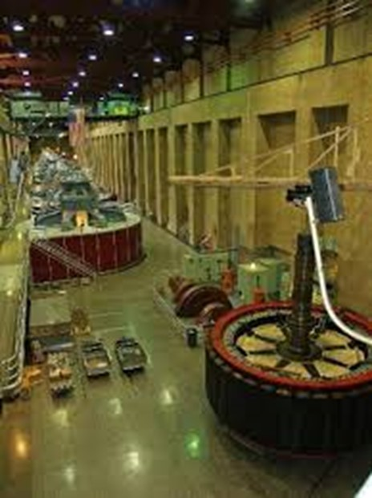
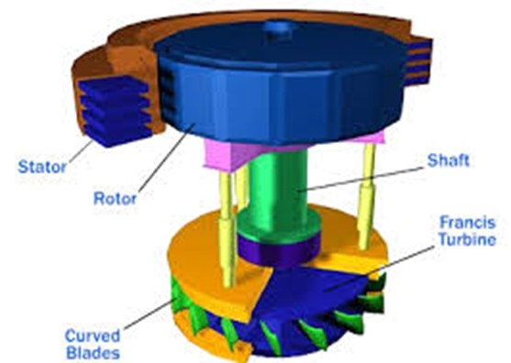
AC Generators (cont.)
Generators at Hoover Dam

Slide 38
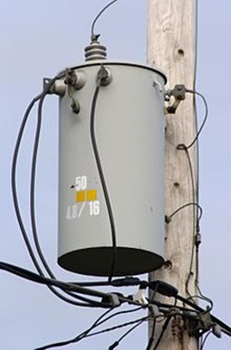
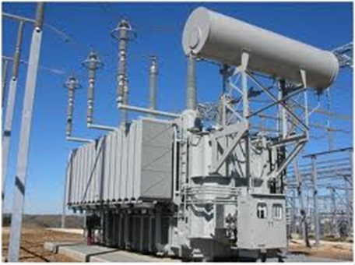
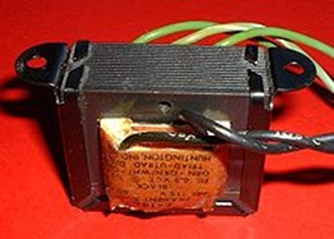
Transformers
A transformer changes an AC signal from one voltage to another.
http://en.wikipedia.org/wiki/Transformer

Slide 39
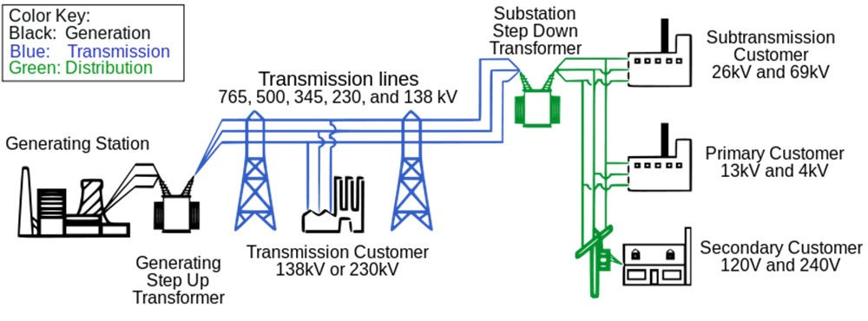
Transformers (cont.)
High voltages are used for transmitting power over long distances (less current means less conductor loss).
Low voltages are used inside homes for convenience and safety.
http://en.wikipedia.org/wiki/Electric_power_transmission

Slide 40
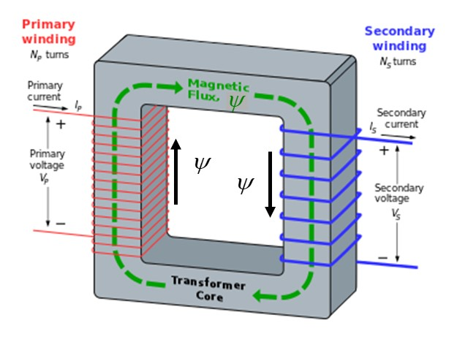
Transformers (cont.)
Note:
The sign is correct from Lens’ law.
Note:
The sign is correct from Lens’ law.
Hence
Ideal transformer (no flux leakage):
(time domain)
(phasor domain)
http://en.wikipedia.org/wiki/Transformer

Slide 41
Transformers (cont.)
Ideal transformer (no losses):
(power in = power out)
Hence
so
(time domain)
(phasor domain)

Slide 42

Transformers (cont.)
Impedance transformation (phasor domain):

Slide 43

Transformers (cont.)
Hence
so

Slide 44
Transformers (cont.)
Impedance transformation

Slide 45
Transformers (cont.)
Example: Audio matching circuit
The PA should see a matched load (50 [Ω]) for
maximum power transfer to the load (speaker).
Audio output circuit
Power amplifier (PA)
Transformer

Slide 46
Transformers (cont.)
Isolation transformer
An isolation transformer is used isolate the input and output circuits (no direct electrical connection between them). It can also be used to connect a grounded circuit to an ungrounded one.
The transformer is being used as a form of “balun”, which connects a “balanced circuit” (the two leads are at a symmetric +/- voltage with respect to ground) to an “unbalanced circuit” (where one lead is grounded).
Ungrounded input
Grounded output

Slide 47
Measurement Error from Magnetic Field
Find the voltage readout on the voltmeter.
Perfectly conducting leads
+
+
-
-
Voltmeter
Applied magnetic field:
Note:
The voltmeter is assumed to have a very high internal resistance, so that negligible current flows in the circuit. (We can neglect any magnetic field coming from the current flowing in the loop.)

Slide 48
Measurement Error from Magnetic Field (cont.)
Faraday’s law:
+
+
-
-
Voltmeter
Perfectly conducting leads

Slide 49
Measurement Error from Magnetic Field (cont.)
From the last slide,
+
+
-
-
Therefore
Voltmeter
Perfectly conducting leads
Note:
There is no voltage drop along the perfectly conducting leads.
or

Slide 50
Measurement Error from Magnetic Field (cont.)
Summary
Perfectly conducting leads
+
+
-
-
Voltmeter
Practical note:
In such a measurement, it is good to keep the leads close together (or even better, twist them.)

Slide 51
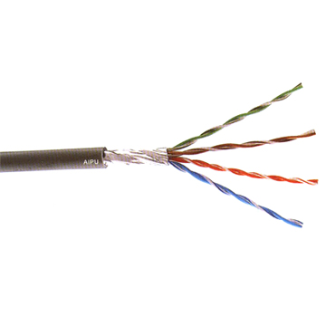
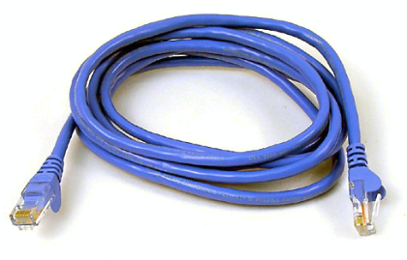
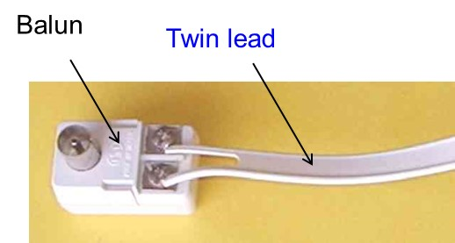
Twisted Pair Transmission Line
Twisted pair is used to reduced interference pickup in a transmission line, compared to “twin lead” transmission line.
CAT 5 cable
(twisted pair)
Note:
Coaxial cable is perfectly shielded and has no interference.
Coax

Slide 52
Maxwell’s Equations (Differential Form)
Electric Gauss law
Faraday’s law
Magnetic Gauss law
Ampere’s law
Constitutive equations

Slide 53
Maxwell’s Equations
(Integral Form)
Electric Gauss law
Faraday’s law
Magnetic Gauss law
Ampere’s law

Slide 54
Maxwell’s Equations (Statics)
In statics, Maxwell's equations decouple into two independent sets.
Electrostatics
Magnetostatics

Slide 55
Maxwell’s Equations (Dynamics)
In dynamics, the electric and magnetic fields are coupled together.
Each one, changing with time, produces the other one.
Example:
A plane wave propagating through free space
E
z
H
power flow
From ECE 3317:

