Slide 1
ECE 3318
Applied Electricity and Magnetism
Spring 2023
Prof. David R. Jackson
Dept. of ECE
Notes 19
Gradient and Laplacian

Slide 2
Gradient
We can write this as
Hence

Slide 3
Directional Derivative Property
We look at how a function changes from one point to a nearby point.
(from calculus)
Recall:
Hence

Slide 4
Directional Derivative Property (cont.)
Use
Then
This gives us the directional derivative:
“Directional derivative”

Slide 5
Physical Interpretation
Gradient
We can also write:
Direction we march in
The gradient is perpendicular to a level curve of the function (cosθ = 0 → θ = π /2 ).
We maximize the directional derivative when we march along in the direction of the gradient (θ = 0).
The magnitude of the gradient vector gives us the directional derivative when we go in the direction of the gradient.

Slide 6
Mountain Example
Topographic map: Φ(x, y) = height of the landscape at any point.
y
50
x
40
30
20
Φ = 10 [m]
Φ = 0 [m]
Φ = -1 [m]

Slide 7
Summary of Gradient Formulas
Rectangular
See Appendix A.2 of the Hayt & Buck book for a derivation that holds in any coordinate system.
Cylindrical
Spherical

Slide 8
Relation Between E and Φ
Recall:
Also, from calculus
Hence, from the above two results we have

Slide 9
Relation Between E and Φ (cont.)
This must be true for any path.
Assume a small path in the x direction:
Similarly, for the second integral:

Slide 10
Relation Between E and Φ (cont.)
Hence:
Similarly, using paths in the y and z directions, we have
Hence, we have

Slide 11
Relation Between E and Φ (cont.)
Summary:
This gives us a new way to find the electric field, by first calculating the potential and then taking the gradient (illustrated next with examples).
Note:
The choice of R (the reference point) does not affect E
(the gradient of a constant is zero).

Slide 12
Example
Find E from the point charge
z
q [C]
y
x

Slide 13
Line Charge Example
y
Find E from the line charge
x
2
1
b
0
Φ = -1 [V]
From previous calculation:
Arbitrary reference point

Slide 14
Example
z
Find: E (0, 0, z)
(0, 0, z)
On the z axis:
R
a
y
x
ρ_{l0} [C/m]
From previous calculation:

Slide 15
Example (cont.)
so
We thus have

Slide 16
Vector Identity
Proof:

Slide 17
Curl Property in Electrostatics (revisited)
(in statics)
so

Slide 18
Equivalent Statements of Path Independence
In Statics
Path Independence
for voltage drop

Slide 19
Poisson Equation
This is a differential equation that the potential satisfies.
(This is useful for solving “boundary value problems” that involve conductors or dielectrics.)
Start with the electric Gauss law:

Slide 20
Poisson Equation (cont.)
Define the “Laplacian”:
Poisson’s Eq.:

Slide 21
Poisson Equation (cont.)
Del-operator notation for Laplacian:
so
∇² = “Laplacian operator”
Hence

Slide 22
Poisson Equation (cont.)
Hence, we have
“Poisson Equation”
If
then
“Laplace Equation”
Note:

Slide 23
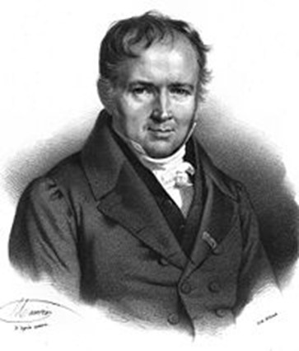
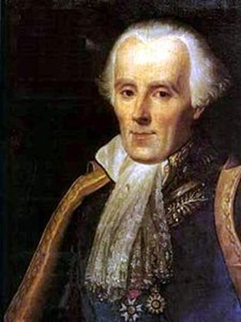
Poisson Equation (cont.)
Siméon Denis Poisson
1781 – 1840
Pierre-Simon Laplace
1749 – 1827
(from Wikipedia)
Notes:
23

Slide 24
Laplacian
See Appendix A.2 of the Hayt & Buck book for a derivation that holds in any coordinate system.
Rectangular
Cylindrical
Spherical

Slide 25
Summary of Formulas:
Electrostatic Triangle
One nice way to summarize all of the equations of electrostatics into one nice visual display is the “electrostatic triangle”
(courtesy of Prof. Donald R. Wilton).

Slide 26
Electrostatic Triangle

