Slide 1
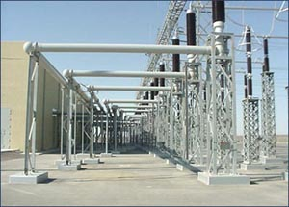
ECE 3318
Applied Electricity and Magnetism
Spring 2023
Prof. David R. Jackson
Dept. of ECE
Notes 2
Charge
Notes prepared by the EM Group University of Houston

Slide 2
Statics
Definition: No time variation. In terms of frequency, f = 0 [Hz]
The electromagnetic field splits into two independent parts:
Electrostatics: (q, E) charge produces electric field
Magnetostatics: (I, B) current produces magnetic field
The static approximation is usually accurate for d << λ₀
(d is the dimension of the circuit or device).
Example:
The electric field from a 60 [Hz] power line mainly comes from the charge on it.
The magnetic field from a 60 [Hz] power line mainly comes from the current on it.

Slide 3
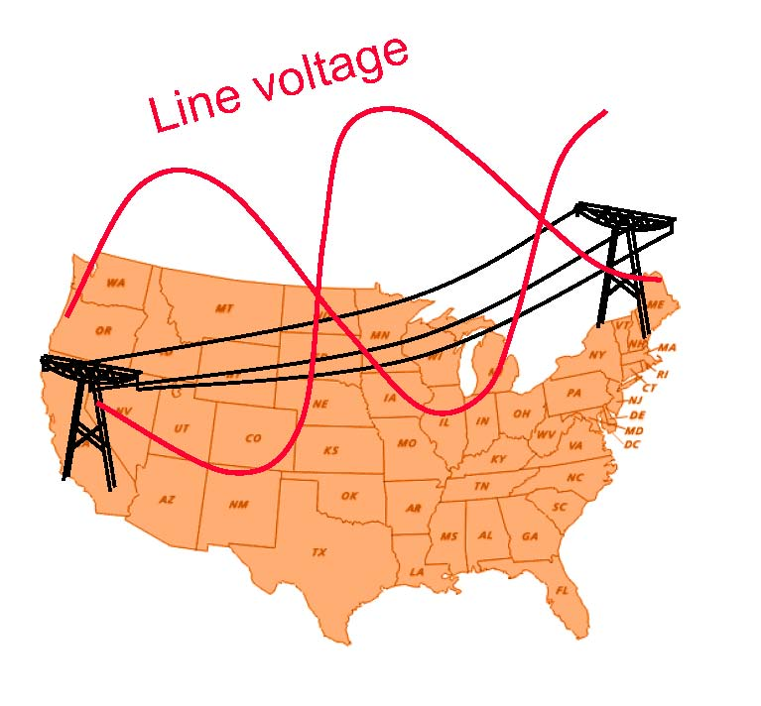
Statics (cont.)
Example: f = 60 [Hz]
Note: This is an exact (defined) value since 1983.
This gives:
Clearly, most circuits fall into the static-approximation category at 60 [Hz]!

Slide 4
Statics (cont.)
The following are special cases of electromagnetics at low frequency:
Circuit theory (e.g., ECE 2201, ECE 2202)
Electronics
Power engineering
Magnetics (design of motors, generators, transformers, etc.)
Examples of high-frequency systems that are not modeled by statics:
Antennas
Transmission lines
Microwaves
Optics
ECE 3317

Slide 5
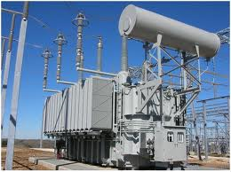
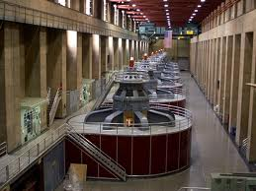
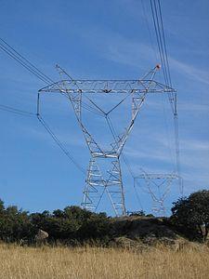
Statics (cont.)
Examples of low-frequency systems
Power buses in a substation
A transformer in a substation
Overhead high-voltage power lines
Generators at Hoover dam

Slide 6
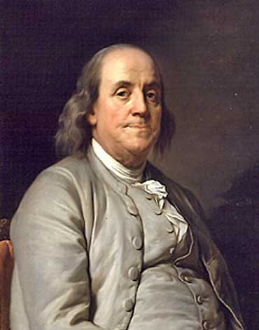
Charge
Ben Franklin chose the convention of using positive and negative charges.
e
p
Atom
Ben Franklin

Slide 7
Charge Density
1) Volume charge density ρ_{v} [C/m³]
a) Uniform (homogeneous) volume charge density
+ + + +
+ + + +
+ + + +
Example: protons floating in space.
Uniform cloud of charge density

Slide 8
Charge Density (cont.)
b) Non-uniform (inhomogeneous) volume charge density
+ + + +
+ + + +
+ + + +
Non-uniform cloud of charge density
Example: Protons are closer together as we move to the right.

Slide 9
Charge Density (cont.)
so
Hence

Slide 10
Charge Density (cont.)
2) Surface charge density ρ_{s} [C/m²]
Example: Protons are sprayed onto a sheet of paper.
Non-uniform sheet of surface charge density
+ + + +
+ + + +
+ + + +
Non-uniform
Uniform

Slide 11
Charge Density (cont.)
so
Hence

Slide 12
Charge Density (cont.)
3) Line charge density ρ_{l} [C/m]
Example: Protons are sprayed onto a thread.
+
+
+
+
+
+
+
+
+
+
+
+
+
+
Non-uniform line charge density
Non-uniform
Uniform

Slide 13
Charge Density (cont.)
+
+
+
+
+
+
+
+
+
+
+
+
+
+
so
Hence

Slide 14
Charge Summary

Slide 15
Example
Find: Q
ρ_{v} = ρ_{v0} =10 [C/m³]
Note: This is a uniform charge density.

Slide 16
Example
ρ_{v} = 2r [C/m³], r < a
This is a separable integrand with fixed limits of integration, so we can split it up into a product of 1-D integrals.
Note: This is a non-uniform (inhomogeneous) charge density.
Find: Q
(Please see the next slide for a reminder about spherical coordinates.)
Separable integrand

Slide 17
Reminder of Spherical Coordinates
.
Note: 0 ≤ θ ≤ π

Slide 18
Example:
Find the Equivalent Surface Charge Density for a Slab of Volume Charge Density
Note:
Equivalent charge density is a helpful concept for finding the fields from charges, as we will see later in Gauss’s law.

Slide 19
Example (cont.)
Equivalent surface charge density:

Slide 20
Example (cont.)
Compare:
In our case (uniform volume charge density) we have:
so

Slide 21
Example (cont.)
Analogy with mass density:
Metal plate
(mass per unit area of the plate)

