Slide 1
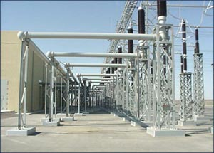
ECE 3318
Applied Electricity and Magnetism
Spring 2023
Prof. David R. Jackson
Dept. of ECE
Notes 20
Dielectrics

Slide 2
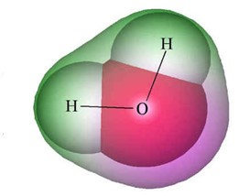
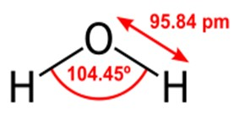
Dielectrics
Single H₂O molecule:
H⁺
H⁺
Water
+
+
-
O⁻

Slide 3
Dielectrics (cont.)
H⁺
H⁺
Water
+
+
-
O⁻
“Vector dipole moment” of molecule p:
+
“Dipole” model:
-
Notes:
3

Slide 4
Dielectrics (cont.)
-
+
-
-
+
+
+
-
-
+
-
+
The dipoles representing the water molecules are normally pointing in random directions.
Note: The molecules are not floating in water – they make up the water.

Slide 5
Dielectrics (cont.)
The dipoles partially align under an applied electric field.
+
-
+
-
+
-
+
-
+
-
+
-
+
-
+
+
-
-
+
-
+
-

Slide 6
Dielectrics (cont.)
Define: P = total dipole moment/volume
N molecules (dipoles) inside ΔV
-
+
-
+
We can also write this as
N_{v} = number of molecules per unit volume
p^{ave} = average vector dipole moment
Define the electric flux density vector D:

Slide 7
Dielectrics (cont.)
Linear material:
Note: χ_{e} > 0 for most materials
The term χ_{e} is called the “electric susceptibility.”
Note:
A negative value of χ_{e} would mean that the dipoles align against the field.
Define:
Then we have
or
where

Slide 8
Typical Linear Materials
Teflon
Water
Styrofoam
Quartz
(a very polar molecule, fairly free to rotate)
Note: ε_{r} > 1 for most materials:

Slide 9
Dielectrics: Bound Charge
Assume (hypothetically) that P_{x} increases as x increases inside the material:
-
+
-
+
-
+
-
+
Note:
For simplicity, the dipoles are shown perfectly aligned, with the number of aligned dipoles increasing with x.
-
+
-
+
-
+
-
+
-
+
A net volume charge density is created inside the material, called the “bound charge density” or “polarization charge density.”
ρ_{vb} = “bound charge density”: it is caused by the molecules rotating.
ρ_{v} = “free charge density”: this is charge that you place inside the material. You can freely place it wherever you want.

Slide 10
Dielectrics: Bound Charge (cont.)
Bound charge densities
-
+
-
+
Bound surface charge density
-
+
-
+
-
+
-
+
-
+
-
+
-
+
Note: The total charge is zero since the object is assumed to be neutral.
Total volume charge density inside the material:
This total charge density may be viewed as being in free space
(since there is no material left after the molecules are removed).

Slide 11
Dielectrics: Bound Charge (cont.)
Formulas for the two types of bound charge density
E = electric field inside the object (what the molecules see)
Here P comes from E at the surface, but inside the object.
+
+
+
+
- -
- - -
- - -
+
-
The unit normal points outward from the dielectric.
-
-
Here P comes from E inside the object.
A derivation of these formulas is given in the Appendix.

Slide 12
Dielectrics: Gauss’s Law
Inside a material:
The above equation is valid inside of a material, even though it involves the permittivity of free space. But we prefer to have only the free charge density in the equation, since this is what is known.
The goal is to calculate (and hopefully eliminate) the bound-charge density term on the right-hand side.

Slide 13
Dielectrics: Gauss’s Law (cont.)
The free-space form of Gauss’s law is
or
Hence
This is the usual Gauss’s law: This is why the definition of D is so convenient!

Slide 14
Dielectrics: Gauss’s Law (Summary)
Important conclusion:
Gauss’ law works the same way inside a dielectric as it does in vacuum, with only the free charge density (i.e., the charge that is actually placed inside the material) being used on the right-hand side.
We simply use ε instead of ε₀ !

Slide 15
Example
Point charge inside dielectric shell
Find D, E
Dielectric spherical shell with ε_{r}
Gauss’ law:
(The point charge q is the only free charge in the problem.)

Slide 16
Example (cont.)
Hence
We then have

Slide 17
Example (cont.)
Flux Plot
Note that there are less flux lines inside the dielectric region
(assuming that the flux lines represent the electric field).

Slide 18
Exotic Materials
Plasmas
Plasmas have a relative permittivity that is less than one
(and can even be negative)
Lossless plasma:
ω_{p} = plasma resonance frequency
(derived in ECE 6340)
Lossy plasma:
υ = plasma collision frequency (loss term)

Slide 19
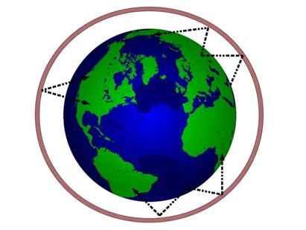
Exotic Materials (cont.)
Plasmas
Low frequencies (f < 30 MHz) will reflect off the ionosphere.
The ionosphere has a relative permittivity that is less than one, so the waves will bend (refract) “away from the normal” and travel back down to the earth, bouncing off of the earth.
Shortwave radio signals propagate around the earth by “skipping” off the ionosphere.
https://en.wikipedia.org/wiki/Skywave

Slide 20
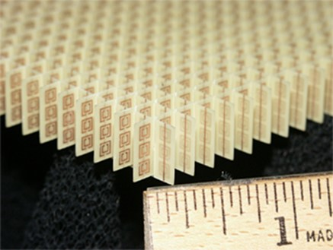
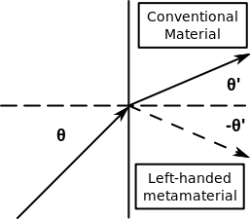
Exotic Materials (cont.)
Artificial “metamaterials” that have been designed that have
exotic permittivity and/or permeability performance.
http://en.wikipedia.org/wiki/Mhttp://en.wikipedia.org/wiki/Metamaterialetamaterial
“Negative index” metamaterial array configuration, which was constructed of copper split-ring resonators and wires mounted on interlocking sheets of fiberglass circuit board. The total array consists of 3 by 20×20 unit cells with overall dimensions of 10×100×100 mm.
(over a certain bandwidth of operation)

Slide 21
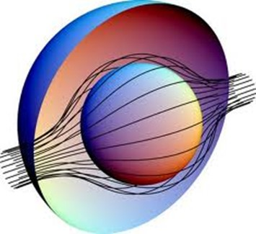
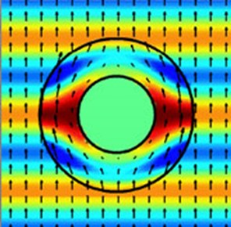
Exotic Materials (cont.)
The Duke cloaking device masks an object from one wavelength at microwaves.
Image from Dr. David R. Smith.
Cloaking of objects is one area of research in metamaterials.

Slide 22
Appendix
In this appendix we derive the formulas for the bound change densities:
where

Slide 23
Appendix (cont.)
Model:
Dipoles are aligned in the x direction end-to-end. The number of dipoles that are aligned (per unit volume) changes with x.
Observation point
-
+
-
+
-
+
-
+
N_{v} = # of aligned dipoles per unit volume
-
+

Slide 24
Appendix (cont.)
-
+
-
+
-
+
-
+
-
+
Hence
N_{v} = # of aligned dipoles per unit volume

Slide 25
Appendix (cont.)
Hence
-
+
-
+
-
+
-
+
-
+
N_{v} = # of aligned dipoles per unit volume
or

Slide 26
Appendix (cont.)
For dipole aligned in the x direction,
In general,
or

Slide 27
Appendix (cont.)
After applying the divergence theorem, we have the integral form
Applying this to a shallow pillbox surface at a dielectric boundary, we have
Denoting
we have

