Slide 1
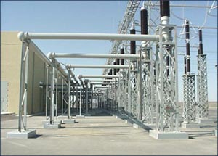
ECE 3318
Applied Electricity and Magnetism
Spring 2023
Prof. David R. Jackson
Dept. of ECE
Notes 22
Dielectric Breakdown

Slide 2
Dielectric Breakdown
1
Arcing (spark)
+
-
Spark
Parallel-plate capacitor with uniform electric field
E_{c} = “critical electric field”
The air ionizes and “runaway” (avalanche) breakdown occurs

Slide 3
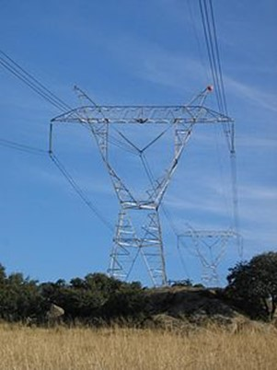
Dielectric Breakdown (cont.)
2
Corona Discharge (local breakdown)
+
-
Bundled conductors tend to act like one larger conductor in terms of the breakdown.
400 kV high-voltage transmission line near Madrid, Spain (Wikipedia)
Power lines are often grouped together (“bundled conductors”) to reduce conductor losses and the corona effect.

Slide 4
Example
Coaxial cable
Find: V_{max} (assume a safety factor SF = 2)
At breakdown:
-
-
+
-
+
+
+
Set ρ = a (breakdown occurs here first):
+
-
+
-
-

Slide 5
Example (cont.)
Thus
Hence
We then have
or

Slide 6
Example (cont.)
Larger coaxes (larger a) can handle more voltage and power.
With safety factor:

Slide 7
Example (cont.)
Power flowing down the line:
Phasor domain voltage
(from ECE 3317)
(derived later)
This gives us

Slide 8
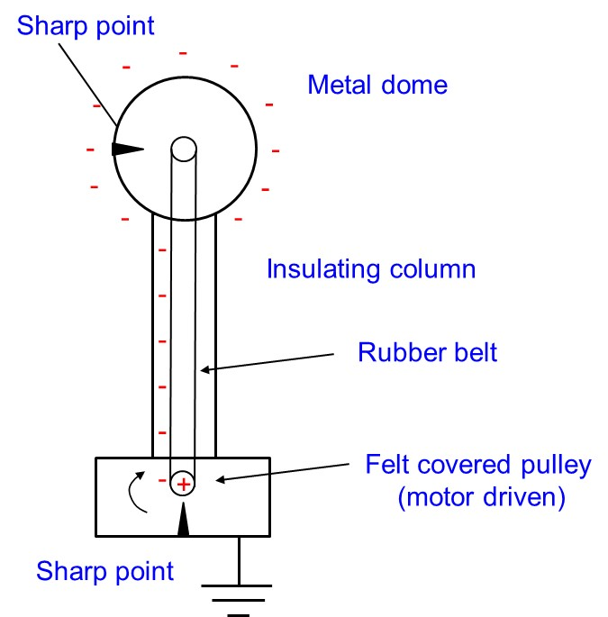
Van de Graaff Generator
Principles:
(1) Electric field is high near sharp points: air is ionized and charges are free to jump on/off.
(2) Faraday cage effect: No matter how much charge is placed on the dome, it goes to the outside and there is little field on the inside.
The felt on the bottom pulley becomes positively charged.

Slide 9
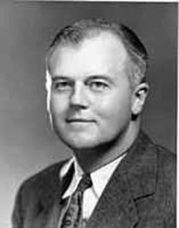
Van de Graaff Generator (cont.)
Dr. Robert J. Van de Graaff (1901-1967) was a professor at Princeton university and a Research Associate at MIT. The Van de Graaff generator was invented in 1929 and originally used as a research tool in early atom-smashing and high energy X-ray experiments.

Slide 10
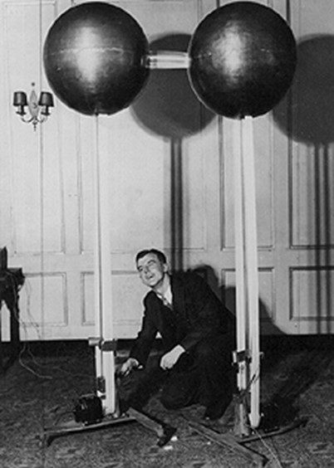
Van de Graaff Generator (cont.)
This picture shows Dr. Van de Graaff with his first generator (80 [kV]).

Slide 11
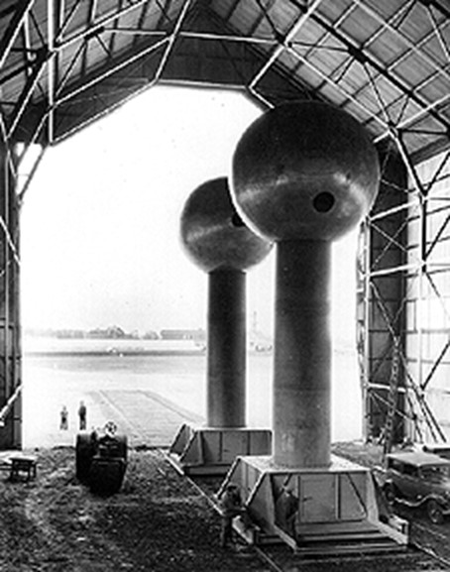
Van de Graaff Generator (cont.)
Inside each dome there was a laboratory.
The world’s largest air-insulated Van de Graaff generator, designed and built by Van de Graaff during 1931-1933. The spheres are 15 feet in diameter and 43 feet off the ground. It can produce 7 [MV].

Slide 12
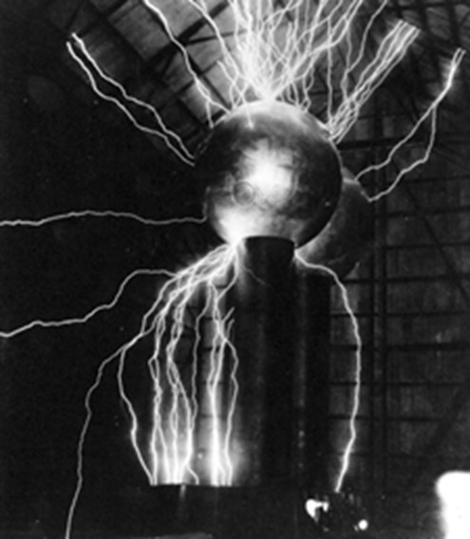
Van de Graaff Generator (cont.)
In the early 1950's, the giant Van de Graaff generator was donated to the Boston Museum of Science.
For years, it was enclosed in a small steel structure on the Museum's property, where it was occasionally demonstrated.
Finally, in 1980, the Thomson Theatre of Electricity was completed inside the museum. The generator is demonstrated at least twice daily, to teach public and school audiences about electricity and lightning.

Slide 13
Van de Graaff Generator (cont.)
Boston Museum of Science

Slide 14
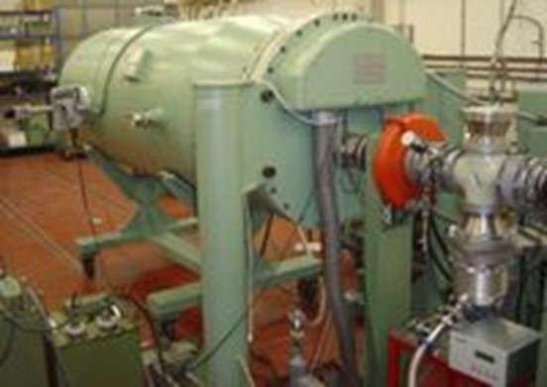
Van de Graaff Generator (cont.)
A modern Van de Graaff generator integrated with a particle accelerator. The generator produces the high voltages (in the megavolt range) that accelerates particles.
(from Wikipedia)

Slide 15
Van de Graaff Generator (cont.)
For more information:
http://en.wikipedia.org/wiki/Van_de_Graaff_generator

Slide 16
Van de Graaff Generator (cont.)
Find the maximum voltage V_{max} on a Van de Graaff Generator in air
Point charge electric field formula:
+
+
+
+
+
Point charge potential formula:
+
+
+
+
Hence
(Assume zero volts at infinity.)
A bigger dome can support a higher voltage!

Slide 17
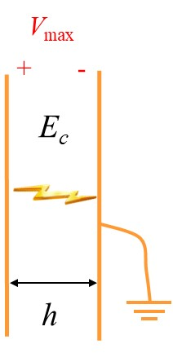

Van de Graaff Generator (cont.)
Find the maximum spark length to a grounded sphere
+
+
V_{max}
+
+
a
a
+
+
+
+
+
h
The spheres are approximated as flat conductors.

Slide 18
Van de Graaff Generator (cont.)
Example
Assume
Note:
This dimension corresponds to the small
Van de Graaff that we have in the ECE Department.
Maximum voltage
Spark length

Slide 19
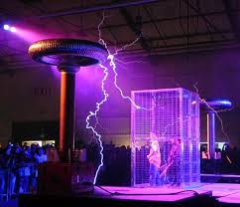
Tesla Coil
This is used to produce high voltage at AC (typically about 1 [MHz]).

Slide 20
Tesla Coil (cont.)
Equivalent circuit for a typical Tesla coil
(“resonant air-core transformer”)
RF choke
Spark gap
(resonance)
+
+
120 V
(RMS)
60 Hz
6600 V
(RMS)
60 Hz
250 kV
500 KHz
+
-
V₁
V₂
-
-
Step-up
transformer
Air-core
transformer
Output: 250 kV at 500 kHz
At resonance:
(Tesla coil in our lab)

Slide 21
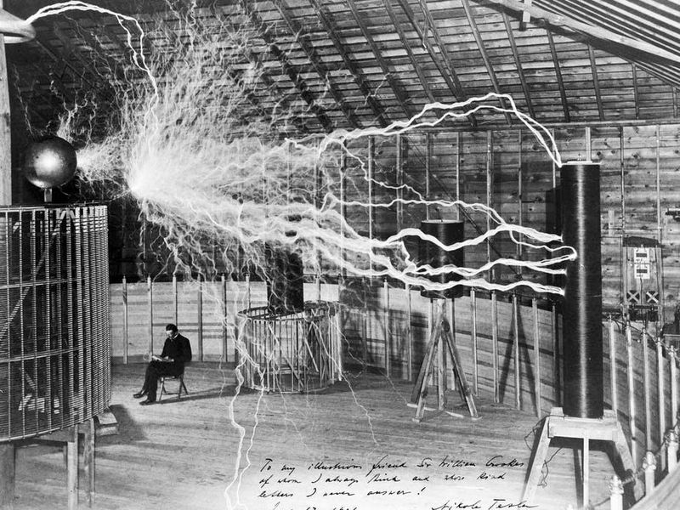
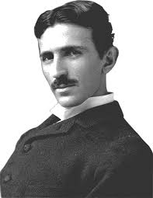
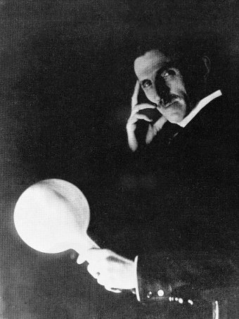
Tesla Coil (cont.)
Pictures of Tesla:
(1) by himself; (2) in his lab with a Tesla coil; (3) lighting a lightbulb wirelessly.

Slide 22
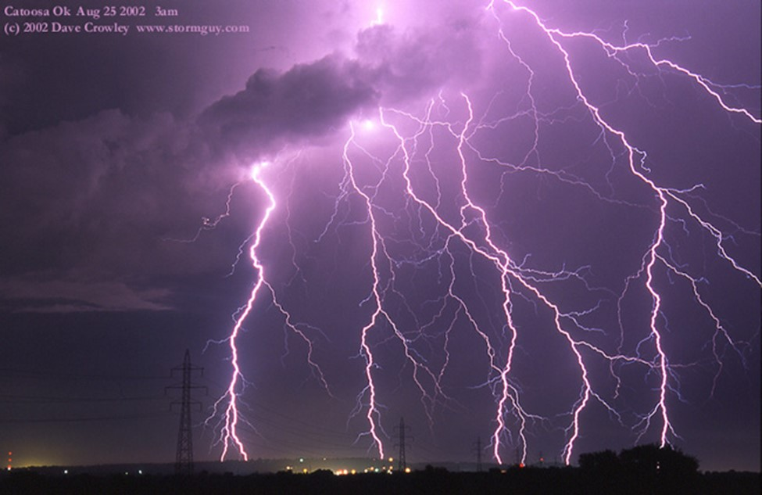
Lightning

Slide 23
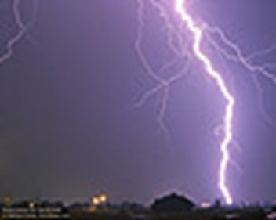
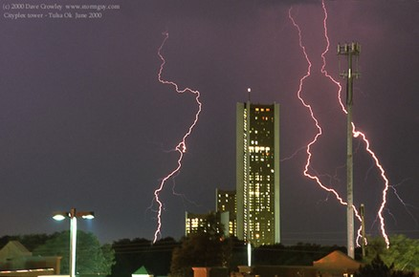
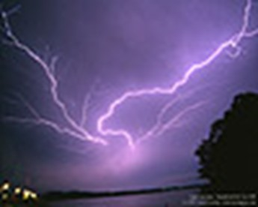
Lightning (cont.)

Slide 24
Lightning (cont.)
Lightning strikes at George Bush Intercontinental Airport, June 12, 2012.
Credit: “texansgirl34”

Slide 25
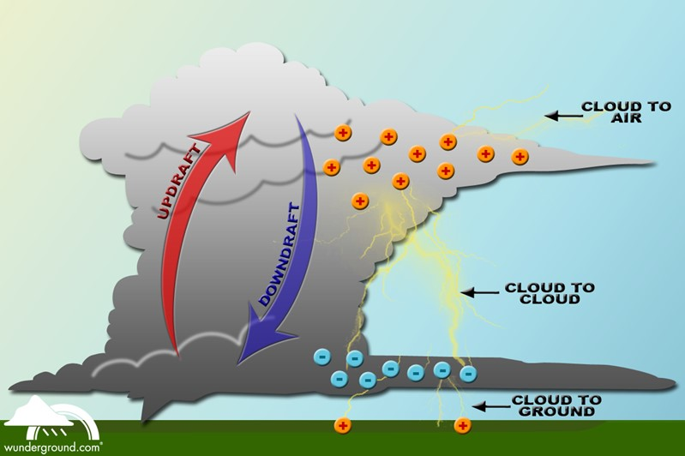
Lightning (cont.)
Powerful air currents and friction between ice and water particles are believed responsible for the charge formation.
The base of the thunder has negative charge and the top has positive charge (though there can be pockets of charge that are opposite).

Slide 26


Lightning (cont.)
+ + +
+ + +
+ + +
_ _ _
_ _ _
_ _ _
Negative lightning
+ + + + + + + + + + + + + + + + + + + + + + + + + + + + + + +
Earth
Most lightning comes from negative charges at the base of a thundercloud (negative lightning).
About 5% comes from the positive charges at the top (positive lightning).

Slide 27
Lightning (cont.)
+ + +
+ + +
Positive lightning
+ + +
_ _ _
_ _ _
_ _ _
+ + + + + + + + + + + + + +
Earth
Positive lighting can be up to 10 times as powerful as negative lightning: it can result it a “bolt from the blue,” striking miles away from the visible cloud (up to 25 miles away or more).

Slide 28
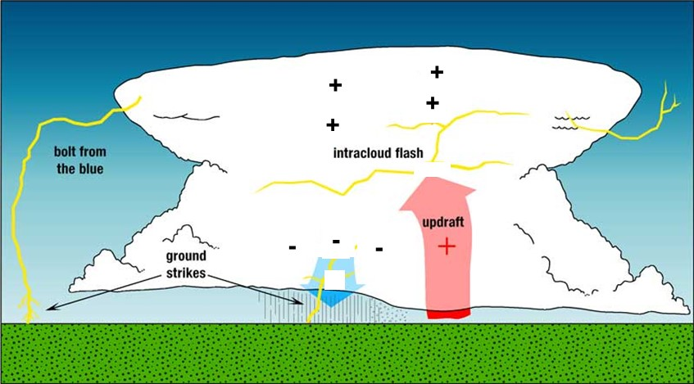
Lightning (cont.)
The different types of lightning that are usually observed are shown here.

Slide 29
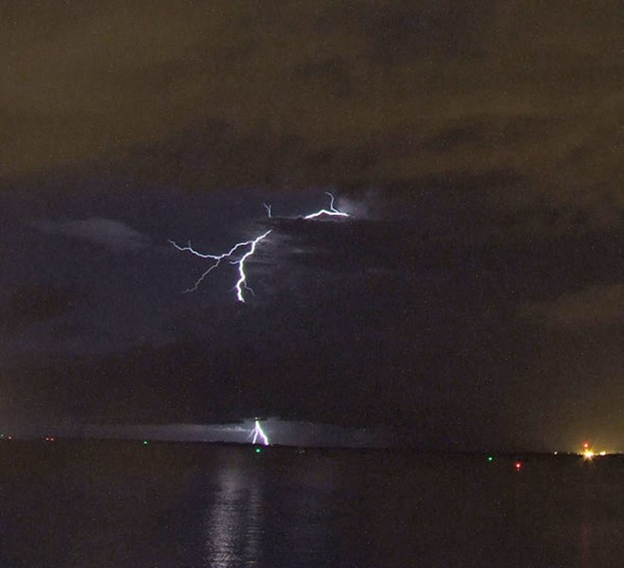
Lightning (cont.)
Positive lightning (note that it originates from the top of the cloud).

Slide 30
Lightning (cont.)
+ + +
+ + +
+ + +
_ _ _
_ _ _
_ _ _
+ + + + + + + + + + + + + + + + + + + + + + + + + + + + + + +
Earth
The base of the thundercloud is typically at an altitude of about 1,500 [m]. The top of the thundercloud may be at about 10,000 [m] or higher.
The voltage drop between the cloud base and ground is typically 150 [MV].
This is not nearly enough to arc from the cloud to ground!

Slide 31
Lightning (cont.)
A “stepped leader” begins descending from the cloud. It is a group of electrons that zigzags toward the earth. The charge is typically about -5 [C].
+ + +
+ + +
+ + +
_ _ _
_ _ _
_ _ _
One theory is that cosmic rays are responsible for the formation of the leader, which ionize atoms and release electrons that get accelerated by the high electric fields.
The stepped leader travels about 50 [m] in about 1 [μs], then pauses for about 50 [μs], and then continues, pausing every 50 [m] or so.
The width of the leader channel is about 1.0 [cm].
The stepped leader does not “know” where it will strike until it is about 40 [m] or so from the earth.

Slide 32
Lightning (cont.)
+ + +
+ + +
+ + +
_ _ _
_ _ _
_ _ _
The stepped leader may branch as it descends (this is responsible for the forked appearance of most lighting).
Branches
+ + + + + + + + + + + + + + + + + + + + + + + + + + + + + + +
Earth

Slide 33

Lightning (cont.)
Main channel
Branches

Slide 34
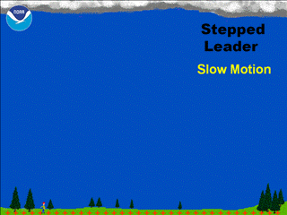
Lightning (cont.)
The pptx version has an animation (go to full-screen mode).
http://en.wikipedia.org/wiki/Lightning

Slide 35
Lightning (cont.)
As the stepped leader approaches the earth, positive “streamers" rise up from the earth to meet it.
The streamers are more likely to come from conducting objects with sharp points (e.g., a lightning rod).
Streamers may be up to about 50 [m] in length
+ + +
+ + +
+ + +
_ _ _
_ _ _
_ _ _
-
-
+
+
+
+
+
+
+ + + + + + + + + + + + + + + + + + + + + + + + + + + + + + +
Earth

Slide 36
Lightning (cont.)
+ + +
+ + +
+ + +
_ _ _
_ _ _
_ _ _
At a height of about 40 [m] (up to about 50 [m]), a streamer meets with the stepped leader, and a conducting channel is formed to earth.
-
-
Contact point
+
+
+ + + + + + + + + + + + + + + + + + + + + + + + + + + + + + +
Earth

Slide 37
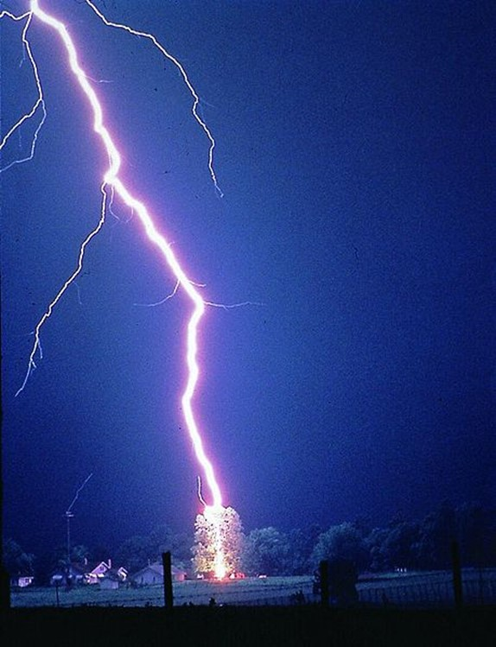
Lightning (cont.)
A lightning flash terminates on a tree.
(An un-attached streamer is visible on the earth surface projection to the left.)
http://en.wikipedia.org/wiki/Lightning

Slide 38
Lightning (cont.)
A powerful surge of current (“return stroke”) flows upward from the ground to the cloud. This is what is visible as the lightning bolt.
The current surge travels upward at about 25% the speed of light. The charge in the branches is drained as the surge passes by, lighting the branches as well.
The peak current is typically 15 [kA] (sometimes reaching 100 [kA]). The return stroke typically lasts about 100 [μs].
+ + +
+ + +
+ + +
_ _ _
_ _ _
_ _ _
-
-
-
-
-
-
-
-
-
current surge
+ + + + + + + + + + + + + + + + + + + + + + + + + + + + + + +
Earth

Slide 39
Lightning (cont.)
The current typically stops for about 50 [ms].
A new leader, called the “dart leader” usually descends from the cloud along the previous path. There is usually no branching as it goes.
The dart leader travels about 10 times faster than the stepped leader, without pausing. It carries about -1 [C].
Another return stroke occurs when the dart leader reaches the ground.
+ + +
+ + +
+ + +
_ _ _
_ _ _
_ _ _
+ + + + + + + + + + + + + + + + + + + + + + + + + + + + + + +
Earth

Slide 40
Lightning (cont.)
+ + +
+ + +
+ + +
The dart-leader / return-stroke combination typically repeats 3 or 4 times.
The entire event (lighting flash) typically lasts 0.2 [s] (sometimes as long a 1 [s] or more).
The total charge deposited on the ground (from the stepped leader, the dart leaders, and current flow between them) is about -25 [C].
_ _ _
_ _ _
_ _ _
+ + + + + + + + + + + + + + + + + + + + + + + + + + + + + + +
Earth

Slide 41
Lightning (cont.)
+ + +
+ + +
+ + +
_ _ _
_ _ _
_ _ _
Lightning may not always strike the tallest object around!
+ + + + + + + + + + + + + + + + + + + + + + + + + + + + + + +
Earth

Slide 42
Lightning (cont.)
The “rolling sphere” method is often used to visualize what objects are vulnerable to being struck by lightning.
Anything the sphere touches as it rolls is subject to being hit.
This assumes that the maximum length of a streamer is 50 [m].
Rolling sphere
Earth

Slide 43
Ground-to-Cloud Lightning
+ + +
+ + +
+ + +
_ _ _
_ _ _
_ _ _
Ground-to-cloud lightning may occur, from objects that are very tall (like radio towers).
In this case a positive leader emerges from the object on the ground, and steps upward towards the cloud.
+
+
+
+ + + + + + + + + + + + + + + + + + + + + + + + + + + + + + +
Earth

Slide 44
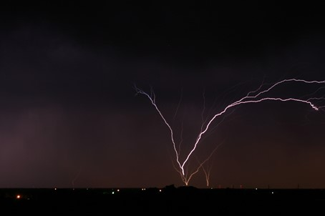
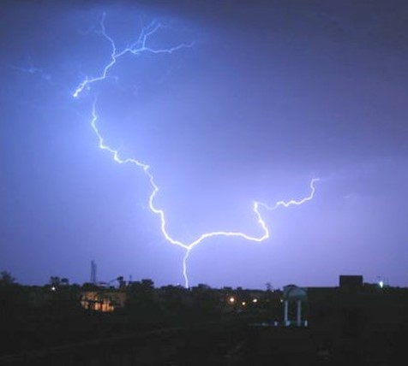

Ground-to-Cloud Lightning (cont.)
Ground-to-cloud lightning (note the upward forking)

Slide 45
Lightning and Aircraft
A commercial airplane is typically struck by lightning about once a year.
The passengers are usually safe due to the “Faraday cage effect.”
In about 10% of the cases, the airplane intercepts a leader that is traveling from the cloud (the plane “gets in the way” of the lightning).
In about 90% of the cases, the airplane initiates the lightning strike: The leader emerges from the plane. This is often in the form of a “bi-directional leader.”
In the bi-directional leader, a positive leader emerges from the top of the plane, and shortly after a negative leader emerges from the bottom of the plane (which is now negatively charged).

Slide 46
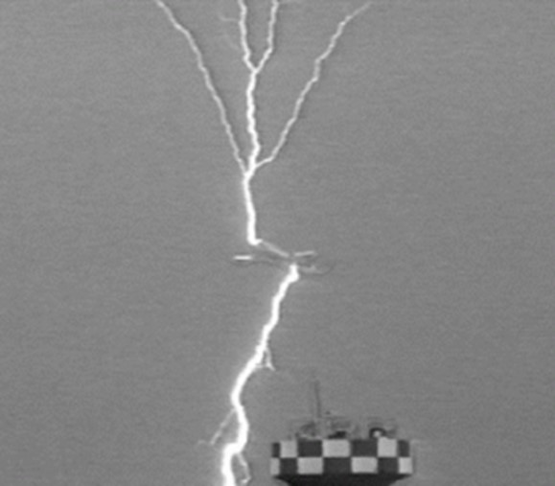
Lightning and Aircraft (cont.)
+ + +
+ + +
Plane “stuck” by lightning while on takeoff from the Komatsu Air Force Base off the coast in the Sea of Japan.
+ + +
_ _ _
_ _ _
_ _ _
Upward-going positive leader (note upward branching)
Downward-going negative leader (note downward branching)

Slide 47
Lightning Rod
A lighting rod is a rod of metal that is well grounded, and ideally fairly sharp at the end.
The taller the better.
It launches a good streamer (better than the surrounding points on the building) because of the high electric field near the tip.
It should be well grounded to discharge safely a lighting strike.
+ + +
+ + +
+ + +
_ _ _
_ _ _
_ _ _
High electric field
Positive streamer
+ + + + + + + + + + + + + + + + + + + + + + + + + + + + + + +
Earth

Slide 48
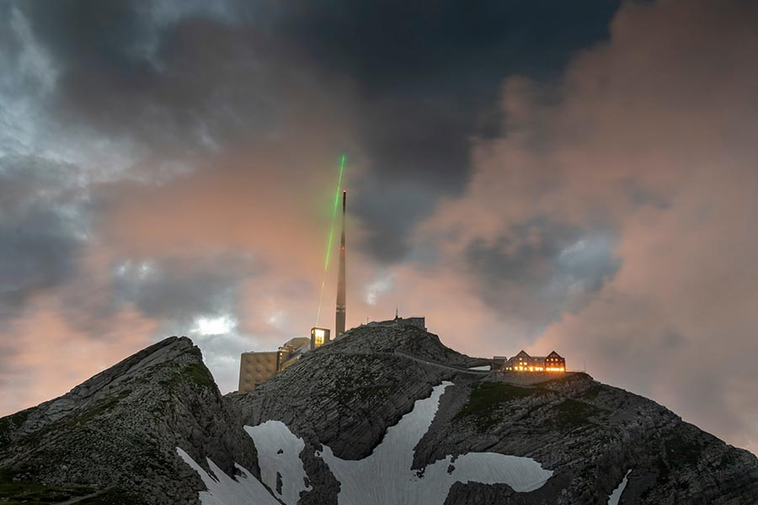
Laser Lightning Rod
Experimental study in the Swiss Alps to see if a high-power laser beam can act as a lightning rod (by ionizing the air).
Heather M. Hill, “Lightning strikes a laser rod,” Physics Today, Jan. 25, 2023, DOI:10.1063/PT.6.1.20230125a

Slide 49
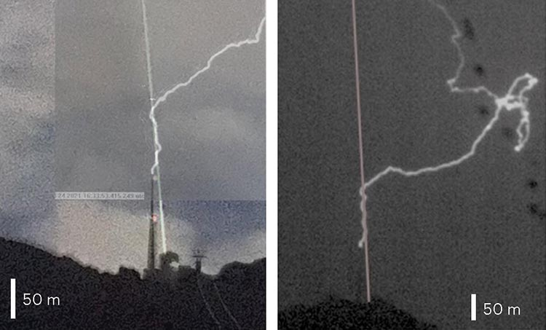
Laser Lightning Rod (cont.)
Results appear to be promising!

Slide 50
Lightning Safety
Danger exists due to:
Direct strike from lightning
Secondary flashover (after lightning has hit another nearby object)*
Ground currents induced by lighting strike
*Do not assume you are safe under a tree, just because the tree is taller than you!

Slide 51
Lightning Safety (cont.)
+ + +
+ + +
The ground current near the strike may be very large.
This causes an large electric field along the surface of the earth.
It is possible to be electrocuted without being hit by the lightning.
It is best to keep your feet together!
+ + +
_ _ _
_ _ _
_ _ _
-
+
Earth
conductivity = σ

Slide 52
Lightning Safety (cont.)
Sample calculation
+ + +
+ + +
+ + +
I = 20 [kA]
r = 10 [m]
σ = 0.1 [S/m]
_ _ _
_ _ _
_ _ _
E_{r} = 318 [V/m]
-
+
Earth
conductivity = σ

Slide 53
Lightning Safety (cont.)
Summary of Lightning Safety Rules
1) The best protection is to be inside of a closed metal structure such as a building or an automobile (Faraday cage effect).
2) If outside:
Make sure you are not the tallest object around.
Do not stand near the tallest object around (secondary flashover effect).
Do not carry metal poles or metal objects like golf clubs, etc. (lightning rod effect).
3) If you feel that a strike is imminent nearby:
Put your feet together, crouch down, and face away from the tallest object.

Slide 54
Other Lightning-like Atmospheric Discharges
Sprites are large-scale electrical discharges that occur high above thunderstorm clouds, or cumulonimbus, giving rise to a quite varied range of visual shapes flickering in the night sky. They are triggered by the discharges of positive lightning between an underlying thundercloud and the ground. They often occur in clusters, lying 50 kilometres (31 mi) to 90 kilometres (56 mi) above the Earth's surface.
Blue jets differ from sprites in that they project from the top of the cumulonimbus above a thunderstorm, typically in a narrow cone, to the lowest levels of the ionosphere 40 to 50 km (25 to 30 miles) above the earth. In addition, whereas red sprites tend to be associated with significant lightning strikes, blue jets do not appear to be directly triggered by lightning (they do, however, appear to relate to strong hail activity in thunderstorms).They are also brighter than sprites and, as implied by their name, are blue in color.
ELVES often appear as a dim, flattened, expanding glow around 400 km (250 mi) in diameter that lasts for, typically, just one millisecond. They occur in the ionosphere 100 km (62 mi) above the ground over thunderstorms. ELVES is a whimsical acronym for Emissions of Light and Very Low Frequency Perturbations due to Electromagnetic Pulse Sources. This refers to the process by which the light is generated; the excitation of nitrogen molecules due to electron collisions (the electrons possibly having been energized by the electromagnetic pulse caused by a discharge from an underlying thunderstorm).
http://en.wikipedia.org/wiki/Upper-atmospheric_lightning

Slide 55
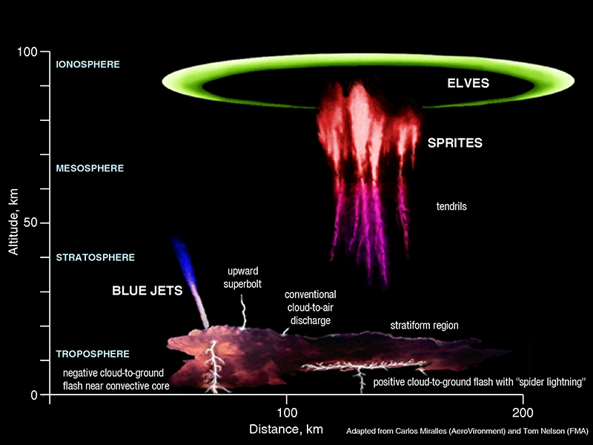
Other Atmospheric Discharges
http://en.wikipedia.org/wiki/Upper-atmospheric_lightning

Slide 56
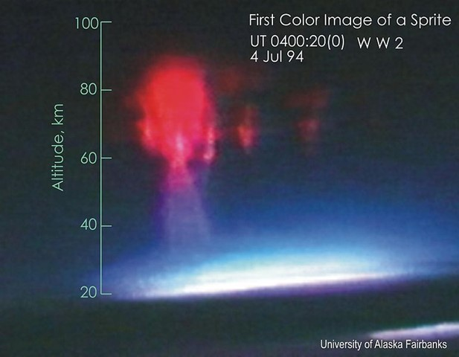
Atmospheric Discharges (cont.)
First color image of a sprite. It was obtained during a 1994 NASA/University of Alaska aircraft campaign to study sprites. The event was captured using an intensified color TV camera. The red color was subsequently determined to be from nitrogen fluorescent emissions excited by a lightning stroke in the underlying thunderstorm.
http://en.wikipedia.org/wiki/Upper-atmospheric_lightning

Slide 57
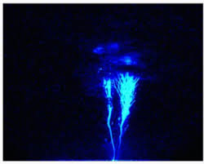
Atmospheric Discharges (cont.)
Blues Jets were observed for the first time in 1994. Conical jets of blue light propagate electrically from the core and are ejected from the top of the thunderstorms clouds towards the upper atmosphere at a speed of approximately 120 km/s. They usually propagate in narrow cones of 15° and do not exceed 40-50 kilometers in altitude. They are not directly related to cloud-to-ground lightnings and are not aligned with the local magnetic field.
http://en.wikipedia.org/wiki/Upper-atmospheric_lightning

Slide 58
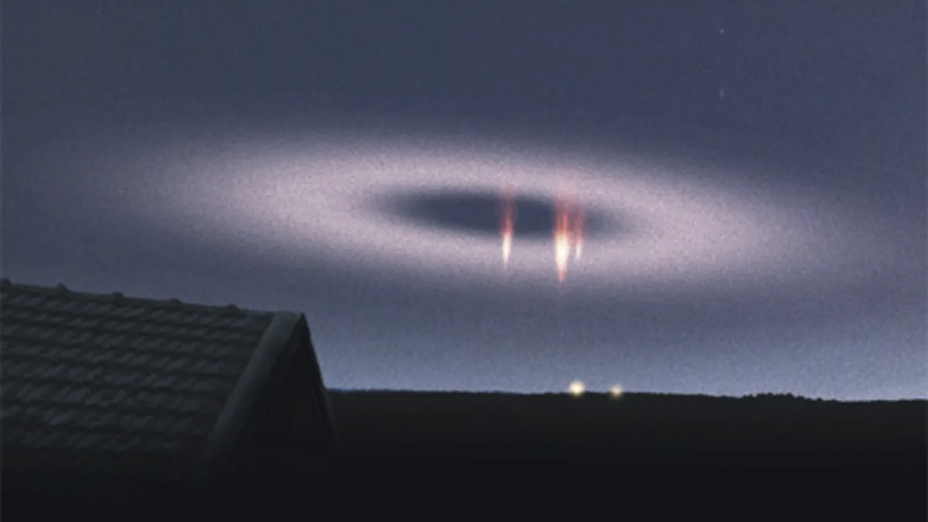
Atmospheric Discharges (cont.)
An elf, as photographed in 2009 by Tim Kantola in Finland. The elf is seen together with red sprites.
https://yle.fi/news/3-5972450

