Slide 1
ECE 3318
Applied Electricity and Magnetism
Spring 2023
Prof. David R. Jackson
Dept. of ECE
Notes 25
Capacitance

Slide 2
Capacitance
Note:
The “A” conductor has the positive charge (connected to anode).
+
++++++++++++++++++
Capacitor
C [F]
-
- - - - - - - - - - - - - - - - -
Notation:
A capacitor is two metal objects with equal and opposite charge. (It does not always have to look like this!)
Q = Q_{A}
V = V_{AB}
(both positive)
Note: The value of C is always positive!

Slide 3
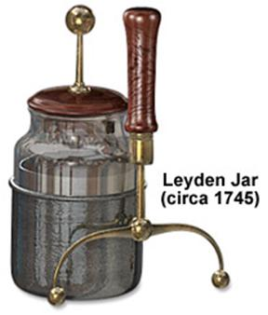
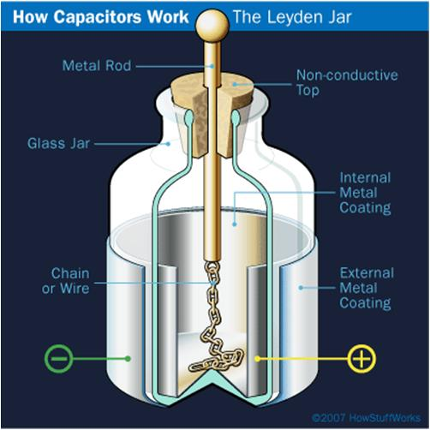
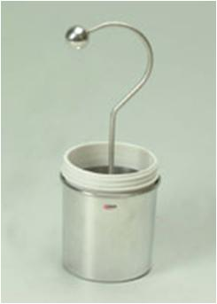
Leyden Jar
The Leyden Jar was one of the earliest capacitors. It was invented in 1745 by Pieter van Musschenbroek at the University of Leiden in the Netherlands (1746).
Notes:
3

Slide 4
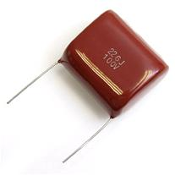
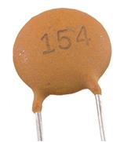
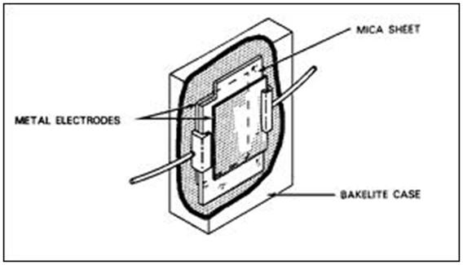
Typical Capacitors
Ceramic capacitors
The ceramic capacitor is often manufactured in the shape of a disk. After leads are attached to each side of the capacitor, the capacitor is completely covered with an insulating moisture-proof coating. Ceramic capacitors usually range in value from 1 picofarad to 0.01 microfarad and may be used with voltages as high as 30,000 volts.
Notes:
4

Slide 5
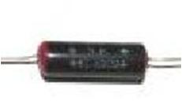
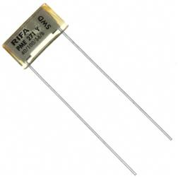
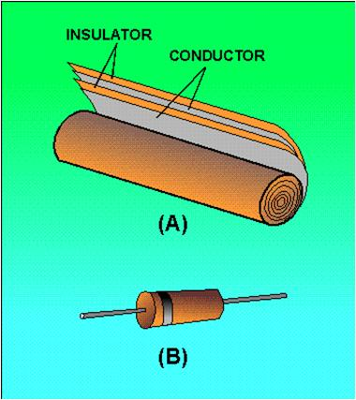
Typical Capacitors (cont.)
Paper capacitors
A paper capacitor is made of flat thin strips of metal foil conductors that are separated by waxed paper (the dielectric material). Paper capacitors usually range in value from about 300 picofarads to about 4 microfarads. The working voltage of a paper capacitor rarely exceeds 600 volts.
Notes:
5

Slide 6
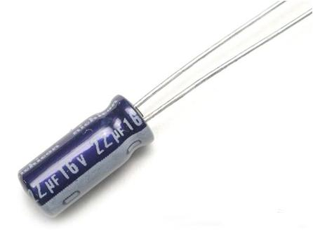
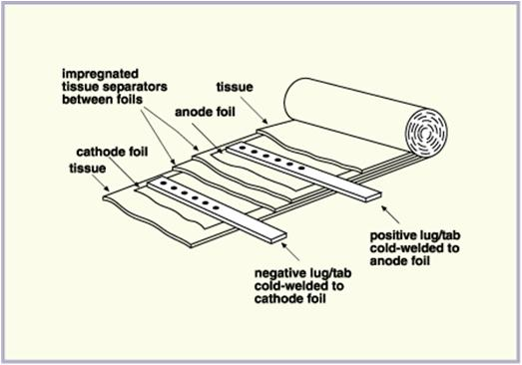
Typical Capacitors (cont.)
Electrolytic capacitors
-
+
Note: One lead (anode) is often longer than the other to indicate polarization.
This type of capacitor uses an electrolyte (sometimes wet but often dry) and requires a biasing voltage (there is an anode and a cathode). A thin oxide layer forms on the anode due to an electrochemical process, creating the dielectric. Dry electrolytic capacitors vary in size from about 4 microfarads to several thousand microfarads and have a working voltage of approximately 500 volts.
Notes:
6

Slide 7
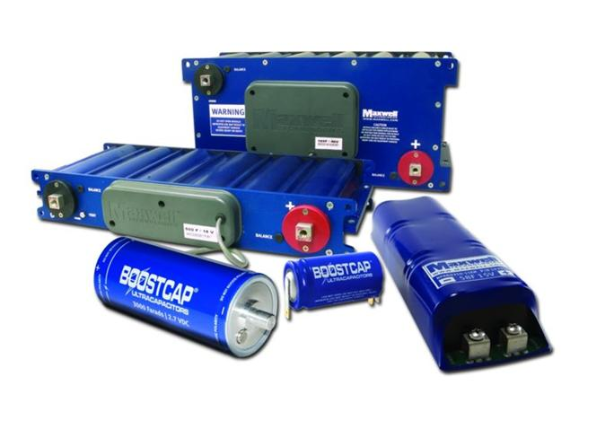
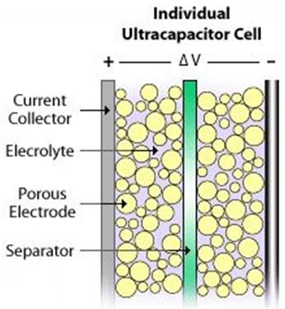
Typical Capacitors (cont.)
Supercapacitors (Ultracapacitors)
Compared to conventional electrolytic capacitors, the energy density is typically on the order of thousands of times greater.
Maxwell Technologies "MC" and "BC" series supercapacitors (up to 3000 farad capacitance)
Notes:
7

Slide 8
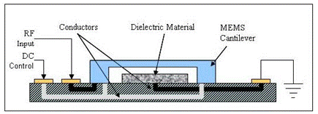
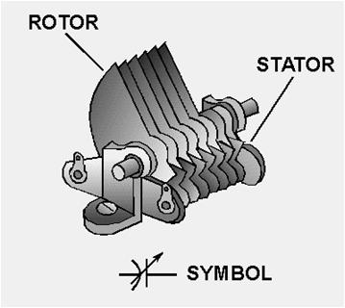
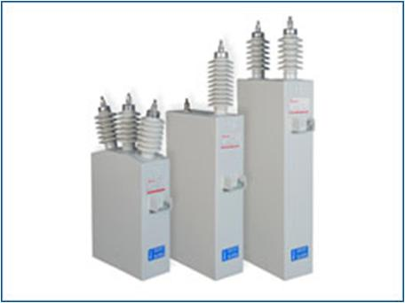
Typical Capacitors (cont.)
MEMS capacitor
Variable capacitor
Capacitors for substations
Notes:
8

Slide 9
Current - Voltage Equation
-
-
-
+
+
+
+
-
-
-
-
+
-
The reference directions for voltage and current correspond to “passive sign convention” in circuit theory.
Note:
Q is the charge that flows from left to right, into plate A.

Slide 10
Current - Voltage Equation (cont.)
Hence we have
+
-
“Passive sign convention”

Slide 11
Example
Find C
++++++++++++++++++
- - - - - - - - - - - - - - - - -
Ideal parallel plate capacitor
Method #1 (start with E)
Note that the top plate has charge on the lower surface, and the bottom plate has charge on the top surface.
Assume:

Slide 12
Example (cont.)
Hence
Remember:
The unit normal vector in the boundary condition formula always points outward from the conductor. On the bottom surface of the top plate, this means pointing down.
Note:
C is only a function of the geometry and the permittivity!

Slide 13
Example (cont.)
Method #2 (start with ρ_{s})
++++++++++++++++++
- - - - - - - - - - - - - - - - -
Hence

Slide 14
Example (cont.)
Hence
Therefore,
or

Slide 15
Example
ε_{r} = 6.0 (mica)
A = 1 [cm²]
h = 0.01 [mm]

Slide 16
Example
Find C
+ + + + + + + + + + + + + + + +
2
1
- - - - - - - - - - - - - - - -
Starting assumption:
(D_{x} is the same in both regions, from boundary conditions.)
Goal:
Put Q and V in terms of D_{x0}.
B. C. on plate A:

Slide 17
Example (cont.)

Slide 18
Example (cont.)
or
Hence:
where
Hence,

Slide 19
Example
Find C
+ + + + + + + + + +
+ + + + + +
- - - - - - - - - -
- - - - - -
Starting assumption:
(E_{x} is the same in both regions, from boundary conditions.)
Goal:
Put Q and V in terms of E_{x0}.

Slide 20
Example (cont.)
where
or

Slide 21
Example
Find C_{l}
(capacitance / length)
Coaxial cable

Slide 22
Example (cont.)
Hence we have
Therefore
We then have

Slide 23
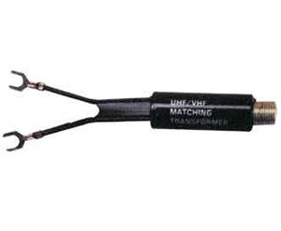
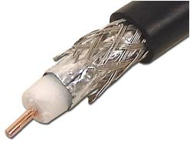
Example (cont.)
Formula from ECE 3317:
(characteristic impedance)
The characteristic impedance is one of the most important numbers that characterizes a transmission line.
Coax for cable TV: Z₀ = 75 [Ω]
Twin lead for TV: Z₀ = 300 [Ω]
Coaxial cable
Twin lead

Slide 24
Example (cont.)
Formula from ECE 3317:
Assume
Hence
Using our expression for C_{l} for the coax gives:

Slide 25
Example (cont.)
Hence, the characteristic impedance of the
coaxial cable transmission line is:
where
(intrinsic impedance of free space)

