Slide 1
ECE 3318
Applied Electricity and Magnetism
Spring 2023
Prof. David R. Jackson
Dept. of ECE
Notes 28
Magnetic field and Ampere’s Law

Slide 2
Magnetic Field
S
N
ε_{r}
N
S
N
N
Note: Flux lines come out of north poles!
Lorentz force Law:
This experimental law defines B.
B is the magnetic flux density vector.
In general, (with both E and B present):
The units of B are Webers/m² or Tesla [T].

Slide 3
Magnetic Field (cont.)
A magnetic field can never give energy to a particle that is moving on a path.

Slide 4
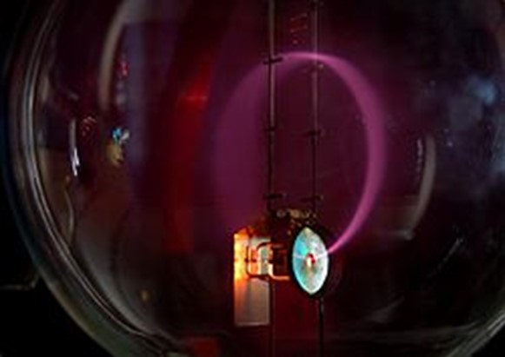
Magnetic Field (cont.)
×
×
×
×
×
×
×
×
×
×
×
×
×
×
×
×
Beam of electrons moving in a circle, due to the presence of a magnetic field. Purple light is emitted along the electron path, due to the electrons colliding with gas molecules in the bulb.
(From Wikipedia)
A stable orbit is a circular path:

Slide 5
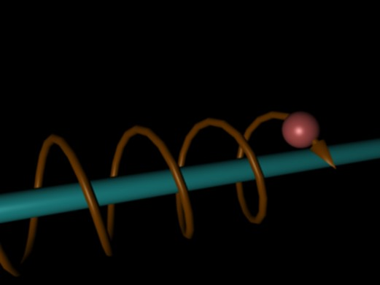
Magnetic Field (cont.)
The most general stable path is a helix,
with the helix axis aligned with the magnetic field.
There is no force in the axis direction (hence a constant velocity in this direction).
Magnetic field lines thus “guide” charged particles.

Slide 6
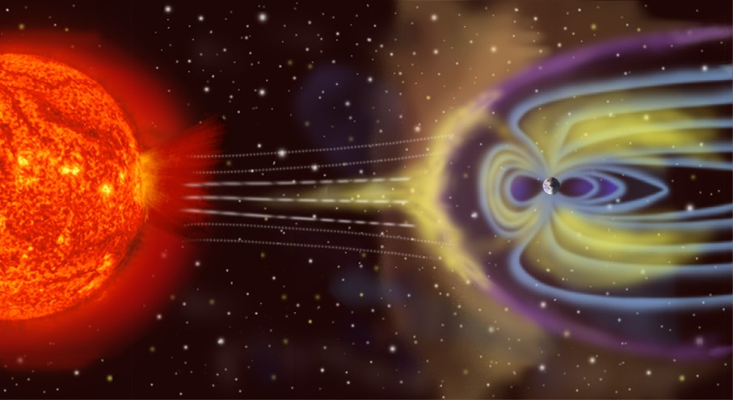
Magnetic Field (cont.)
The earth's magnetic field protects us from charged particles from the sun (called the solar wind).
The particles spiral along the directions of the magnetic field,
and are thus directed towards the poles.

Slide 7
Magnetic Field (cont.)
This also explains the auroras seen near the north pole (aurora borealis) and the south pole (aurora australis).
The particles from the sun that reach the earth are directed towards the poles.

Slide 8
Magnetic Gauss Law
S (closed surface)
N
N
S
Magnetic pole (not possible) !
Note: Magnetic flux lines come out of a north pole and go into a south pole.
No net magnetic flux out !

Slide 9
Magnetic Gauss Law: Differential Form
From the definition of divergence we then have
Hence

Slide 10
Ampere’s Law
I
Infinite wire with a DC current
Iron filings
Experimental law:
(This is an exact value:
please see next slide.)

Slide 11
Ampere’s Law (cont.)
Note: The definition of the Amp* is as follows:
1 [A] current produces:
* This is actually the definition before May 20, 2019. Please see Notes 3 for more discussion of this.
Hence
so

Slide 12
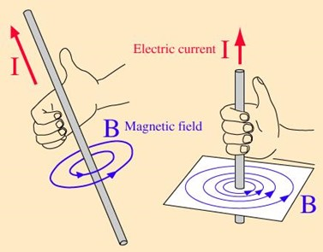
Ampere’s Law (cont.)
I
Infinite wire with a DC current
Iron filings
Note:
There is a “right-hand rule” for predicting the direction of the magnetic field from a wire.
(The thumb is in the direction of the current, and the fingers are in the direction of the field.)

Slide 13
Ampere’s Law (cont.)
Define:
(This is the definition of H in free space.)
Hence
H is called the “magnetic field”.
The units of H are [A/m].
(for single infinite wire)

Slide 14
Ampere’s Law (cont.)
Next, consider an infinite wire inside of an arbitrary closed path.
Wire inside path
A current (wire) is inside a closed path.
Observation:
The answer does not depend on the shape of the path!
We integrate counterclockwise.

Slide 15
Ampere’s Law (cont.)
Next, consider an infinite wire outside of an arbitrary closed path.
Wire outside path
Note:
The angle φ smoothly goes from zero back to zero as we go around the path, starting on the x axis.
Observation:
The answer does not depend on the shape of the path!
A current (wire) is outside a closed path.

Slide 16
Ampere’s Law (cont.)
Hence
Ampere’s Law (DC currents)
Although the law was derived for an infinite vertical wire of current, the assumption is made that it holds for any current.
This is now an experimental law.
Note:
The same DC current I_{encl} goes through any surface that is attached to C
(This follows from the KCL law.)

Slide 17
Ampere’s Law (cont.)
Right-hand rule for Ampere’s law:
The fingers of the right hand are in the direction of the path C, and the thumb gives the reference direction for the current that is enclosed by the path.
(If the contour C goes counterclockwise, then the reference direction for current is pointing up.)
“Right-Hand Rule”

Slide 18
Ampere’s Law Summary
Summary of Ampere’s law:
The direction of the current enclosed is chosen by the right-hand rule.
Right-hand rule for Ampere’s law:
The fingers of the right hand are in the direction of the path C, and the thumb gives the reference direction for the current that is enclosed by the path.
(If the contour C goes counterclockwise, then the reference direction for current is pointing up.)

Slide 19
Amperes’ Law: Differential Form
(from Stokes’s theorem)
ΔS is a small planar surface.
Since the unit normal is arbitrary (it could be any of the three unit vectors), we have

Slide 20
Maxwell’s Equations (Statics)
Electric Gauss law
Magnetic Gauss law
Faraday’s law
Ampere’s law

Slide 21
Maxwell’s Equations (Dynamics)
Electric Gauss law
Magnetic Gauss law
Faraday’s law
Ampere’s law
This term is called “displacement current”.

Slide 22
Ampere’s Law: Finding H
Rules:
1) The “Amperian path” C must be a closed path.
2) The sign of I_{encl} is from the right-hand rule.
3) Pick C in the direction of H (to the extent possible).
Note:
Ampere’s law is only useful when the problem is very symmetric
(there is only one unknown component of magnetic field).

Slide 23
Example
Calculate H
I
1) First solve for H_{φ} .
“Amperian path”
An infinite line current along the z axis

Slide 24
Example (cont.)
I
“Amperian path”
Note:
Whenever we integrate counterclockwise on a circular path, the LHS of Ampere’s law will always be the same:

Slide 25
Example (cont.)
2) H_{z} = 0
H_{ρ} dρ cancels
H_{z} = 0 at ∞
3) H_{ρ} = 0
Magnetic Gauss law:

Slide 26
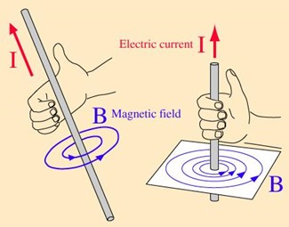
Example (cont.)
Summary
I

Slide 27
Example
Coaxial cable
DC current
This inner wire is solid.
The outer shield (jacket) of the coax has a thickness of t = c – b.
ρ < a
Note: The permittivity of the material inside the coax does not matter here.
b < ρ < c
Note:
At DC, the current density inside the conductor is uniform, since the electric field is uniform
(due to the fact that the voltage drop in the z direction is path independent).

Slide 28
Example (cont.)
The other components are zero, as in the wire example.
This formula holds for any radius, as long as we get I_{encl} correct.

Slide 29
Example (cont.)
ρ < a
a <ρ < b

Slide 30
Example (cont.)
b <ρ < c
ρ > c

Slide 31
Example (cont.)
Summary
ρ < a
a <ρ < b
b <ρ < c
Note:
There is no magnetic field outside of the coax
(a perfect “shielding property”).
ρ > c

Slide 32
Example
Ideal solenoid:
Solenoid
n→ ∞
n = # turns/meter
Length → ∞
Calculate H
Note:
We will say more about relative permeability later.
First, find H_{z}
ρ < a
H_{ρ} dρ cancels
H_{z} is zero at ∞

Slide 33
Example (cont.)
ρ > a
H_{ρ} dρ cancels
H_{z} = 0 at ∞
so
Hence

Slide 34
Example (cont.)
The other components of the magnetic field are zero:
1) H_{φ} = 0 since
2) H_{ρ} = 0 from

Slide 35
Example (cont.)
Summary
n = # turns/meter
Note:
A right-hand rule can be used to determine the direction of the magnetic field (the same rule as for a straight wire).
Note:
A larger relative permeability will give a larger magnetic flux density. This results is a stronger magnet, or a larger inductance.

Slide 36
Example
Calculate H
- side
Infinite sheet of current
+ side
Top view

Slide 37
Example (cont.)
(superposition with line currents)
(magnetic Gauss Law)
Also, by symmetry:

Slide 38
Example (cont.)
- side
+ side
Note:
There is no contribution from the left and right edges (the edges are perpendicular to the field).

Slide 39
Example (cont.)
Note:
We can use a right hand-rule to quickly determine the direction of the magnetic field:
Put your thumb is in the direction of the current, and your fingers will give the overall direction of the magnetic field.
Note: The magnetic field does not depend on y.

Slide 40
Example
Parallel-plate transmission line
Find H everywhere
Assume
w >> h
(We neglect fringing here.)

Slide 41
Example (cont.)
Two parallel sheets (plates) of opposite surface current

Slide 42
Example (cont.)
“bot”
“top”
Magnetic field due to bottom plate
Magnetic field due to top plate

Slide 43
Example (cont.)
We then have
Recall that
Hence

Slide 44
Example (cont.)
We could also apply Ampere’s law directly (without using superposition):
Note:
It is convenient to put one side (top) of the Amperian path in the region where the magnetic field is zero.
y
Δx
C
h
x
Hence

Slide 45
Low Frequency Calculations
At low frequency, the DC formulas should be accurate,
as long as we account for the time variation in the results.
Example (line current in time domain)
z
i(t)
ρ
y
r
x

Slide 46
Low Frequency Calculations (cont.)
We can also used the DC formulas in the phasor domain.
Example (line current in the phasor domain)
z
i(t)
ρ
y
r
x
(phasor H field)

Slide 47
Low Frequency Calculations (cont.)
Example (cont.)
Converting from phasor domain to the time domain:
(phasor H field)
Hence

