Slide 1
ECE 3318
Applied Electricity and Magnetism
Spring 2023
Prof. David R. Jackson
Dept. of ECE
Notes 31
Inductance

Slide 2
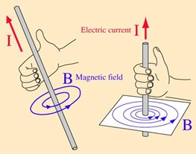
Inductance
Consider a single loop carrying a current:
Right-hand rule for determining the direction of the magnetic field from a current.
Note that the current shown here (flowing counterclockwise) produces a magnetic flux that goes up through the loop.
Single turn coil
The current I produces a flux ψ though the loop.

Slide 3
Inductance
Magnetic flux through loop:
The unit normal is chosen from a
“right hand rule for the inductor flux”:
The fingers are in the direction of the current reference direction, and the thumb then gives the direction of the unit normal for the flux calculation.
Single turn coil
(In this picture, ψ is the flux going up.)
Definition of inductance:
Note: L is always positive

Slide 4
Right-Hand Rules
Note:
Please see the Appendix for a summary of right-hand rules.
1) RH rule for Stokes’s theorem
2) RH rule for Faraday’s law
3) RH rule for Ampere’s law
4) RH rule for the direction of the magnetic field
5) RH rule for the inductor flux

Slide 5
N-Turn Solenoid
We assume here that the same flux cuts though each of the N turns.
The definition of inductance is now

Slide 6
Example
Find L
Note:
We neglect “fringing” here and assume that we have the same magnetic field in the core as if the solenoid were infinite.
From previous notes:
so

Slide 7
Example (cont.)
Final result:
Note: L is increased by using a high-permeability core!

Slide 8
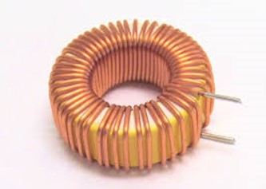
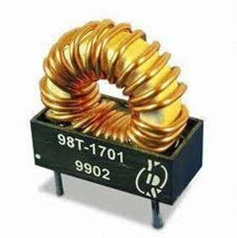
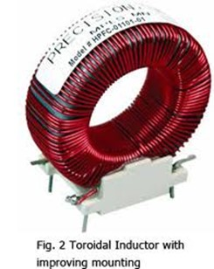
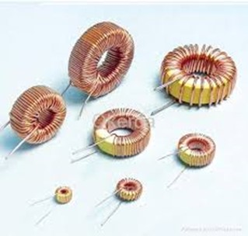
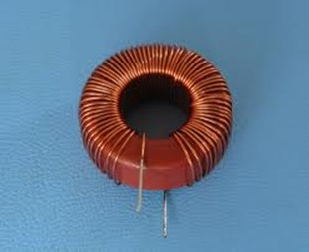
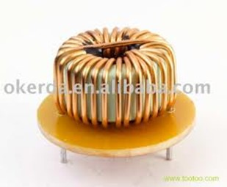
Toroidal Inductor

Slide 9
Example
Toroidal Inductor
Find H inside toroid
Find L
Note:
This is a practical structure, in which we do not have to neglect fringing and assume that the core length is very large in order for the answer to be accurate.

Slide 10
Example (cont.)
The radius R is the average radius (measured to the center of the toroid).
Assume
A is the cross-sectional area:

Slide 11
Example (cont.)
so
Hence
We then have

Slide 12
Example (cont.)
Hence

Slide 13
Example
Coaxial cable
Ignore flux inside wire and shield
(PEC conductors)
Find L_{l}
(inductance per unit length)
A short is added at the end to form a closed loop.
-
I
Center conductor
+
Note: We calculate the flux through the surface S shaded in green.

Slide 14
Example (cont.)
-
Center conductor
+

Slide 15
Example (cont.)
-
Center conductor
+

Slide 16
Example (cont.)
Hence
Per-unit-length:

Slide 17
Example (cont.)
Recall:
Note: μ_{r} = 1 for most practical coaxial cables.
From previous notes:
Hence:
(intrinsic impedance of free space)

Slide 18
Voltage Law for Inductor
Apply Faraday’s law:
-
+
Reminder:
The unit normal is chosen from the right-hand rule in Faraday’s law, according to the direction of the path C. Here, ψ = -ψ_{z}.
PEC wire:
Hence
Note: There is no electric field inside the wire.
Here ψ is the flux coming out of the page.

Slide 19
Voltage Law for Inductor (cont.)
From the inductor definition we have:
so
-
+
or
Note:
The direction of the current is chosen from the right-hand rule for the inductor flux.
Note: We are using the “passive” sign convention here.

Slide 20
Voltage Law for Inductor (cont.)
Summary of Inductor Law
-
+
Note: We are using the “passive” sign convention here.

Slide 21
Energy Stored in Inductor
+
-
-
+
Hence we have:
For DC we have:

Slide 22
Energy Formula for Inductor
We can write the inductance in terms of stored energy as:
Next, we use
We then have
This gives us an alternative way to calculate inductance.

Slide 23
Example
Find L using the energy formula
Solenoid
From a previous example, we have
Energy formula:
Hence, we have

Slide 24
Example
Find L_{l} using the energy formula
Coaxial cable
Note:
We ignore the magnetic stored energy from fields inside the good conductors.
(We would have fields inside the conductors at DC, but not at high frequency.)

Slide 25
Example (cont.)
Per-unit-length:
Note:
We could include the stored energy inside inner wire region and the shield region if we were at DC. These contributions would give us the “internal inductance” of the coax.
This would only be important at low frequency, not high frequency, for good conductors.

Slide 26
Internal Inductance
Internal inductance per unit length of straight infinite wire
This comes from the energy stored inside the conductor.
Take one-meter length in z direction:
DC current
Ampere’s law:
(Use counterclockwise Amperian path.)
Final result:

Slide 27
Example
External inductance:
(from previous calculation)
Internal inductance:
(from wire formula)

Slide 28
Appendix
In this appendix we summarize the various right-hand rules that we have seen so far in electromagnetics.

Slide 29
Summary of Right-Hand Rules
Stokes’s theorem:
Fingers are in the direction of the path C, the thumb gives the direction of the unit normal.
Faraday’s law:
Fingers are in the direction of the path C, the thumb gives the direction of the unit normal for calculating the flux.
(stationary path)
Fingers are in the direction of the path C, the thumb gives the reference direction for the current enclosed.
Ampere’s law:

Slide 30
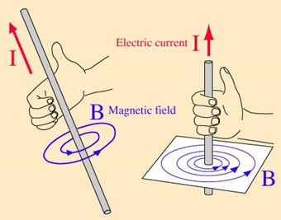
Summary of Right-Hand Rules (cont.)
Magnetic field law:
For a wire or a current sheet or a solenoid, the thumb is in the direction of the current and the fingers give the direction of the magnetic field. (For a current sheet or solenoid the fingers are simply giving the overall sense of the magnetic field direction.)
Inductor flux rule:
Fingers are in the direction of the current I and the thumb gives the direction of the unit normal for calculating the flux.
Notes:
30

