Slide 1
ECE 3318
Applied Electricity and Magnetism
Spring 2023
Prof. David R. Jackson
Dept. of ECE
Notes 8
Coulomb’s Law II
Notes prepared by the EM Group University of Houston

Slide 2
Example
Annulus of uniform surface charge density

Slide 3
Example (cont.)
Top view

Slide 4
Example (cont.)
Note:
The upper limits are larger than the lower limits, in order to keep the differential lengths (defining the differential area dS′) positive.

Slide 5
Example (cont.)
Switch integration order and do φ' integral first:
function of φ ′
Note:
By doing the φ ′ integral first and realizing that it is zero for the first term, we save a lot of work.
Note that

Slide 6
Example (cont.)
Hence:
Note:
We have a separable integrand with fixed limits.
(We can split this double integral into the product of two one-dimensional integrals.)

Slide 7
Example (cont.)

Slide 8
Example (cont.)
Summary

Slide 9
Example (cont.)
Limiting case: a → 0, b → ∞ (infinite sheet of surface charge)
or
ρ_{s0}
+ for z > 0
- for z < 0

Slide 10
Example (cont.)
Summary: Infinite sheet of uniform surface charge density
+ for z > 0
- for z < 0
ρ_{s0}
Note:
The magnitude of the electric field does not depend on distance from the sheet!
Note:
The electric field vector is discontinuous across a sheet of surface charge density.

Slide 11
Example
Finite-length uniform line charge
φ

Slide 12
Example (cont.)
φ

Slide 13
Example (cont.)
Geometric way:
φ

Slide 14
Example (cont.)
φ
Note:
The upper limit is larger than the lower limit, in order to keep the differential length positive.

Slide 15
Example (cont.)
For the second term, note that by symmetry,
φ
(The integrand is an odd function of z′.)
Hence, we have

Slide 16
Example (cont.)
Because the integrand is even,
φ

Slide 17
Example (cont.)
Summary
φ

Slide 18
Example (cont.)
Limiting case: let h → ∞
Infinite uniform line charge

Slide 19
Example (cont.)
Summary: Infinite uniform line charge density

Slide 20
Example
Two infinite uniform line charges

Slide 21
Example (cont.)
For a single line charge ρ_{l0} on the z axis:
Let
From superposition:

Slide 22
Example (cont.)
or
Hence, we have:

Slide 23
Example (cont.)
Summary
Answer in vector form:

Slide 24
Example (cont.)
Summary
Answer in component form:

Slide 25
Example
Two point charges (dipole)
Note:
Two equal and opposite point charges form an “electrostatic dipole”.

Slide 26
Example (cont.)
Single charge at origin:
From superposition:

Slide 27
Example (cont.)
Summary

Slide 28
Example (cont.)
Dipole Approximation
The term p is the “dipole moment”.
(The derivation is omitted.)

Slide 29
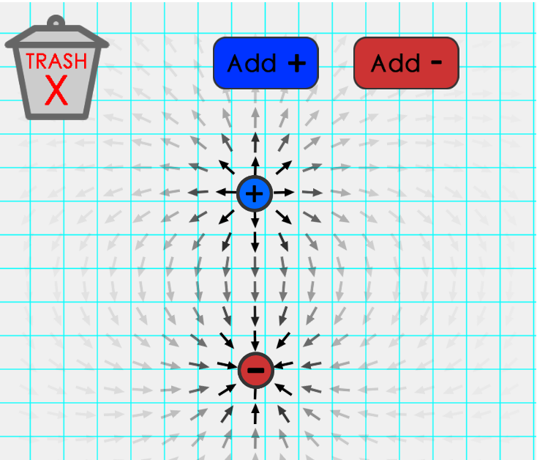
Electric Field Applet
https://www.physicsclassroom.com/Physics-Interactives/Static-Electricity/Electric-Field-Lines/Electric-Field-Lines-Interactive

