Slide 1
ECE 3318
Applied Electricity and Magnetism
Spring 2023
Prof. David R. Jackson
Dept. of ECE
Notes 9
Flux
Notes prepared by the EM Group University of Houston

Slide 2
Flux Density
From Coulomb’s law:
Flux lines
(Flux lines show us the direction of the electric field vector.)
Define:
“flux density vector”
Charge in free space
(This definition holds in free space.)
We then have

Slide 3
Flux Through Surface
Define flux through a surface:
Note:
In this picture, flux is the flux crossing the surface in the outward sense.
Cross-sectional view

Slide 4
Example
Find the flux from a point charge going out through a spherical surface.
S
(We want the flux going out.)

Slide 5
Example (cont.)

Slide 6
Current Analogy
Conducting medium
Analogy with electric current
A small electrode in a conducting medium spews out current equally in all directions.
Cross-sectional view

Slide 7
Current Analogy (cont.)
Electric Flux
Current
Free-space
Conducting medium

Slide 8
Water Analogy
N streamlines
Each electric flux line is like a stream of water.
Water streams
Each stream of water carries
F_{n} / N [m³/s].
Water nozzle (omnidirectional)
F_{n} = flow rate of water out of nozzle [m³/s]
F_{s} = flow rate of water out of surface [m³/s]
Note that the flow rate through a closed surface is F_{s} = F_{n}.

Slide 9
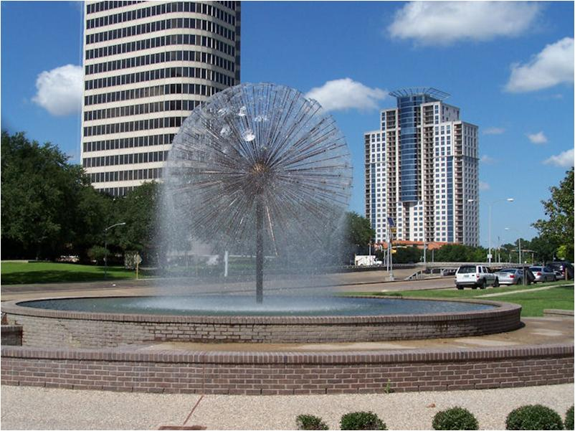
Water Analogy (cont.)
Here is a real “flux fountain”
(Wortham fountain, a.k.a. the “Dandelion” on Allen Parkway).

Slide 10
Water Analogy (cont.)
Analogy example:
Find F_{s} (flow rate through surface S)

Slide 11
Flux through a Surface using Flux Lines
(Point Charge)
Example:
Find ψ (flux through surface S)

Slide 12
Flux in 2-D Problems
2-D problems: Everything is infinite and not changing in the z direction.
We now define the flux per meter in the z direction.
We can think of ψ_{l} as being the flux through a surface S that is the contour C extruded one meter in the z direction.

Slide 13
Flux Plot (2-D)
Rules for a 2-D flux plot:
Flux lines are in the direction of the electric field*.
The magnitude of the electric field is inversely proportional to the spacing between flux lines**.
Flux lines come out of positive charges and end on negative charges (they cannot stop or begin in free space)***.
* A convention we adopt.
** A convention we adopt.
*** A consequence of Gauss’s law.
Flux plot for a line charge

Slide 14
Example
Line charge
Notice how the flux lines get closer as we approach the line charge: there is a stronger electric field there.
According to rule #2:
If W is the distance between flux lines:
This happens automatically in this example by choosing a fixed number of equally-spaced flux lines.

Slide 15
Flux Property in 2-D Flux Plots
The flux (per meter) ψ_{l} through a contour is proportional to the number of flux lines that cross the contour.
N_{C} is defined as the number of flux lines through C.
Note:
The constant of proportionality depends on how many flux lines you decide to draw.
General E field
Please see the Appendix for a proof of this flux property.

Slide 16
Example
Goal:
Graphically evaluate
C
Note:
The answer will be more accurate if we use a plot with more flux lines!

Slide 17
Equipotential Contours
An equipotential contour C_{V} is a contour on which the potential is constant.
Line charge example
Flux lines
Equipotential contours C_{V}

Slide 18
Equipotential Contours (cont.)
Property:
The flux line are always perpendicular to the equipotential contours.
(proof on next slide)
(Φ = constant )

Slide 19
Equipotential Contours (cont.)
Proof of perpendicular property:
Two nearby points on an equipotential contour are considered.
Proof:
On C_{V} :
Conclusion: The Δr vector is perpendicular to the flux lines.

Slide 20
Method of Curvilinear Squares
2-D Flux Plot
Assumption:
Assume a constant voltage difference ΔV between adjacent equipotential lines in a 2-D flux plot.
Note:
Along a flux line, the voltage always decreases as we go in the direction of the flux line.
“Curvilinear square”
Note:
It is called a curvilinear “square” even though the shape may be rectangular.

Slide 21
Method of Curvilinear Squares (cont.)
Theorem: The shape (aspect ratio L/W) of the “curvilinear squares” is preserved throughout the flux plot.
Assumption: ΔV is constant throughout plot.

Slide 22
Method of Curvilinear Squares (cont.)
Proof of constant aspect ratio property
If we integrate along the flux line, E is in the same direction as dr .
Hence,
so
Therefore

Slide 23
Method of Curvilinear Squares (cont.)
Hence,
Also,
Reminder:
In a flux plot the magnitude of the electric field is inversely proportional to the spacing between the flux lines.
so
The constant C₁ is some constant of proportionality.
Hence,
(proof complete)

Slide 24
Example
Line charge
Notice how the flux lines get closer as we approach the line charge: there is a stronger electric field there.
The aspect ratio L/W has been chosen to be unity in this plot.
In this example L and W are both proportional to the radius ρ.

Slide 25
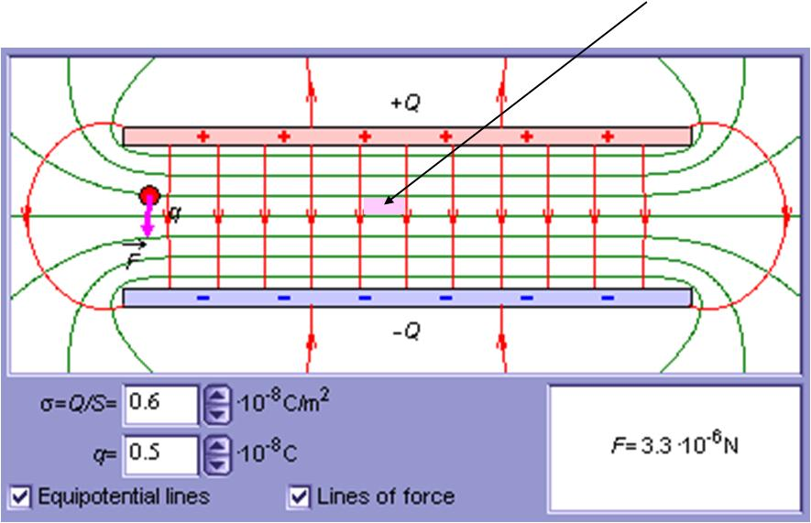
Example
A parallel-plate capacitor
Note: L / W ≈ 0.5

Slide 26
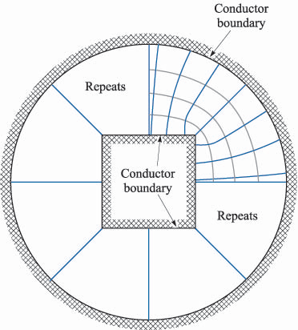
Example
Coaxial cable with a square inner conductor
Figure 6-8 in the Hayt and Buck book (9th Ed.).

Slide 27
Making a Flux Plot
Here are the rules for making a 2-D flux plot, assuming that we start with equipotential contours separated by a fixed value of ΔV *:
Rule 1: We start with equipotential contours having a fixed ΔV between.
Rule 2: Flux lines are drawn perpendicular to the equipotential contours.
Rule 3: L / W is kept constant throughout the plot.
If all of these rules are followed, then we have the following properties:
Flux lines are in direction of E.
The magnitude of the electric field is inversely proportional to
the spacing between the flux lines.
* This is what you will be doing in the class project.

Slide 28
Example
In the class project, you will be drawing in flux lines.
(The equipotential contours come from Excel.)
Parallel-plate capacitor region

Slide 29
Example (cont.)
In the class project, you will be drawing in flux lines.
Parallel-plate capacitor region

Slide 30
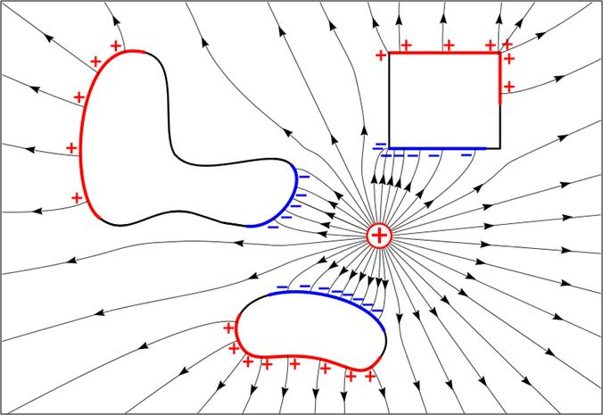
Flux Plot with Conductors
Conductor
Some observations:
Flux lines are closer together where the field is stronger.
The field is strong near a sharp conducting corner.
Flux lines begin on positive charges and end on negative charges.
Flux lines enter a conductor perpendicular to it.
http://en.wikipedia.org/wiki/Electrostatics

Slide 31
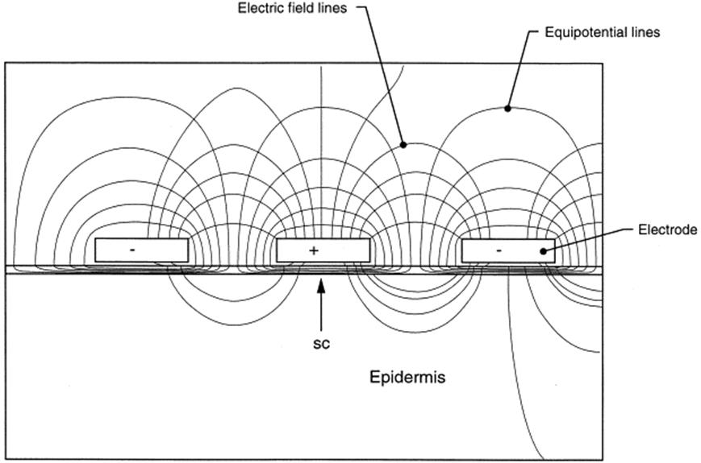
Example of Electric Flux Plot
Note:
In this example, the aspect ratio L/W is not held constant !
Electroporation-mediated topical delivery of vitamin C for cosmetic applications
Lei Zhang^{a,} , Sheldon Lerner^{b}, William V Rustrumª, Günter A Hofmannª
ª Genetronics Inc., 11199 Sorrento Valley Rd., San Diego, CA 92121, USA
^{b} Research Institute for Plastic, Cosmetic and Reconstructive Surgery Inc., 3399 First Ave., San Diego, CA 92103, USA.

Slide 32
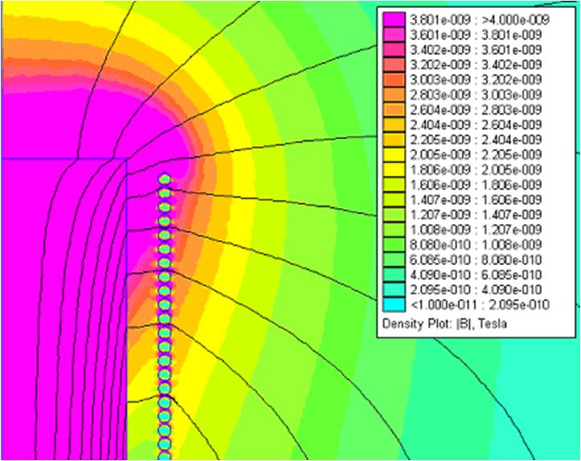
Example of Magnetic Flux Plot
Solenoid wrapped around a ferrite core (cross sectional view)
Flux plots are often used to display the results of a numerical simulation, for either the electric field or the magnetic field.
Magnetic flux lines
Ferrite core
Solenoid windings

Slide 33
Appendix:
Proof of Flux Property

Slide 34
Proof of Flux Property
N_{C} : flux lines
Through C
One small piece of the contour
(the length is ΔL)
so
or

Slide 35
Flux Property Proof (cont.)
Also,
(from the property of a flux plot)
Hence, substituting into the above equation, we have
Therefore,
(proof complete)

