Slide 1
ECE 3355 Electronics
Lecture Notes
Set 5 – Version 36
Diodes
Dr. Dave Shattuck
Dept. of ECE, Univ. of Houston

Slide 2
Diodes
We will cover material from Sections 3.1 through 3.5 and 4.1 through 4.7 from the 7th Edition of the Sedra and Smith text. We will not cover all of the detail that is in the textbook.

Slide 3
Overview of this Part
Diodes
In this part, we will cover the following topics:
Semiconductor Physics Overview
Diode Plots, Load Lines, Diode Models
The Guess-and-Test Method
Useful Diode Circuits
Notes:
You can click on the blue text to jump to the subject that you want to learn about now.

Slide 4
Diodes
Diodes are like one-way valves for current. They only conduct in one direction. This makes them very useful for some kinds of applications, but also make them inherently nonlinear devices, which makes solving diode circuits harder.
It is actually possible to make a one-way valve for water flow, although it is not shown here. Your heart has one way valves. A diode is an electronic analog for the valves in your heart.

Slide 5
One Way Valves
Diodes are like one-way valves for current. They only conduct in one direction. This is analogous to the valves in your heart, through which blood passes in only one direction.
Heart Valves allow blood to flow in only one direction.

Slide 6
SEMICONDUCTORS AND THE PN JUNCTION
There are conductors, and insulators. Semiconductors are somewhere in between in terms of their conductivity.
(An aside: Semiinsulators is too hard to pronounce, and has consecutive i's.)
(Another aside: Semiconductors are not the people who collect tickets on large trucks.)

Slide 7
SEMICONDUCTORS AND THE PN JUNCTION
Semiconductors have a valence of 4 - they form covalent bonds with each other. With sufficient energy, an electron can break a bond, and we produce
  1) a free electron
  and
  2) a hole.

Slide 8
SEMICONDUCTORS AND THE PN JUNCTION
Free electrons can move. Thus, a material with free electrons will conduct electricity. A free electron is called a mobile charge carrier. (This is sort of redundant.)
Holes can also move; this motion is virtual, but conceptually and effectively works the same way as with free electrons. Thus, a material with holes will conduct electricity. A hole is also called a mobile charge carrier.

Slide 9
SEMICONDUCTORS AND THE PN JUNCTION
A string of silicon atoms are shown below.

Slide 10
SEMICONDUCTORS AND THE PN JUNCTION
A string of silicon atoms are shown below. A hole has been added, by removing an electron (typically, this is done by doping, that is by adding impurities.).

Slide 11
SEMICONDUCTORS AND THE PN JUNCTION
A string of silicon atoms are shown below. Now, we put a voltage across the string of silicon atoms.

Slide 12
SEMICONDUCTORS AND THE PN JUNCTION
A string of silicon atoms are shown below. As the electrons move, due to the voltage, the hole moves in the opposite direction.

Slide 13
SEMICONDUCTORS AND THE PN JUNCTION
A string of silicon atoms are shown below. As the electrons move, due to the voltage, the hole moves in the opposite direction.

Slide 14
SEMICONDUCTORS AND THE PN JUNCTION
A string of silicon atoms are shown below. As the electrons move, due to the voltage, the hole moves in the opposite direction.

Slide 15
SEMICONDUCTORS AND THE PN JUNCTION
A string of silicon atoms are shown below.
A hole propagates in direction of more negative voltage. It acts like a positively charged mobile charge carrier. That is how we treat it.

Slide 16
SEMICONDUCTORS AND THE PN JUNCTION
In a pure semiconductor, there are equal numbers of holes and free electrons, since every time a free electron gets away, a hole is created. We call a pure semiconductor an intrinsic semiconductor. People who make semiconductors go to great trouble to make pure silicon crystals, called wafers.

Slide 17
SEMICONDUCTORS AND THE PN JUNCTION
In pure silicon wafers, the concentration of free electrons, called n, must be the same as the concentration of holes, called p, so
n_{i} = p_{i}
where n_{i} is called the intrinsic density of free electrons, and p_{i} is called the intrinsic density of holes.
The values of n and p are functions of temperature, which makes sense, since it will determine the number of free electron/hole pairs. It follows that temperature will dramatically affect the conductivity.

Slide 18
SEMICONDUCTORS AND THE PN JUNCTION
There are two ways that charges move:
1) due to electric fields, called drift
2) due to concentration gradients, called diffusion
Well, all this is fine, but pretty useless. The market for temperature dependent conductors is pretty limited. The key step comes next. We add impurities.
No. Really, what do we do? Ans: No, really, this is what we do. We add special kinds of impurities to increase the number of free electrons, or the number or holes.

Slide 19
SEMICONDUCTORS AND THE PN JUNCTION
By introducing a whole bunch of atoms with a valence of 3, we obtain an excess of holes. (More holes than free electrons.) These atoms are called acceptors, and result in a change in the semiconductor to what we call a
p material. In p materials, holes are the majority carriers, and free electrons are the minority carriers.

Slide 20
SEMICONDUCTORS AND THE PN JUNCTION
By introducing a whole bunch of atoms with a valence of 5, we obtain an excess of free electrons. (More free electrons than holes.) These atoms are called donors, and result in a change in the semiconductor to what we call a
n material. In n materials, free electrons are the majority carriers, and holes are the minority carriers.

Slide 21
SEMICONDUCTORS AND THE PN JUNCTION
We can put the n material next to the p material.
Right after we put these areas together, there is a concentration gradient. The only things able to move, though, are the mobile charge carriers. There is diffusion. When a hole meets a free electron, they annihilate each other. This is called recombination.
We build up a depletion region, at the junction, which is depleted of mobile charge carriers.

Slide 22
SEMICONDUCTORS AND THE PN JUNCTION
When the carriers move, they leave behind a net charge density. This charge density produces an electric field which opposes the diffusion current. Therefore, the diffusion does not go on forever, but reaches an equilibrium condition.
This, in turn, produces a potential distribution in the junction. Take care. This is a local voltage drop, not a battery. It is a potential barrier to more flow of charge carriers.

Slide 23
SEMICONDUCTORS AND THE PN JUNCTION
The diffusion produces a potential distribution in the junction, which is a potential barrier to more flow of charge carriers.
The voltage at the junction acts as a barrier, a hindrance to majority carrier flow. Since there are a few, but not many, minority carriers, the current will be pretty small unless this barrier is lowered. This barrier can be lowered by biasing, or the external application of voltage across the junction.

Slide 24
SEMICONDUCTORS AND THE PN JUNCTION
When the voltage is applied to reduce the barrier, this is called forward biasing. With sufficient voltage, current will flow. When it is applied to increase the barrier, this is called reverse biasing. Very little current will flow.
Current only flows in one direction. This is pretty neat. This is called rectification. Remember, that this is a passive device. We call this device a diode.

Slide 25

Are these diodes really useful?
This is a good question.
The answer is, YES! You bet they are. They are definitely worth the trouble.
We will look at what kinds of things we can do with diodes, once we learn how to model them, and solve circuits that have them included.
Go back to Overview slide.

Slide 26
Diode Models
Thus far, we have mostly had linear components. We had nonlinear circuits when we talked about amplifiers and saturation, but we tried to avoid saturation. Now, here we have a fundamental, nonlinear device. It is not only nonlinear, it is also fundamentally polar, in that it is not symmetrical.
We begin by looking at ways to model the diode.

Slide 27
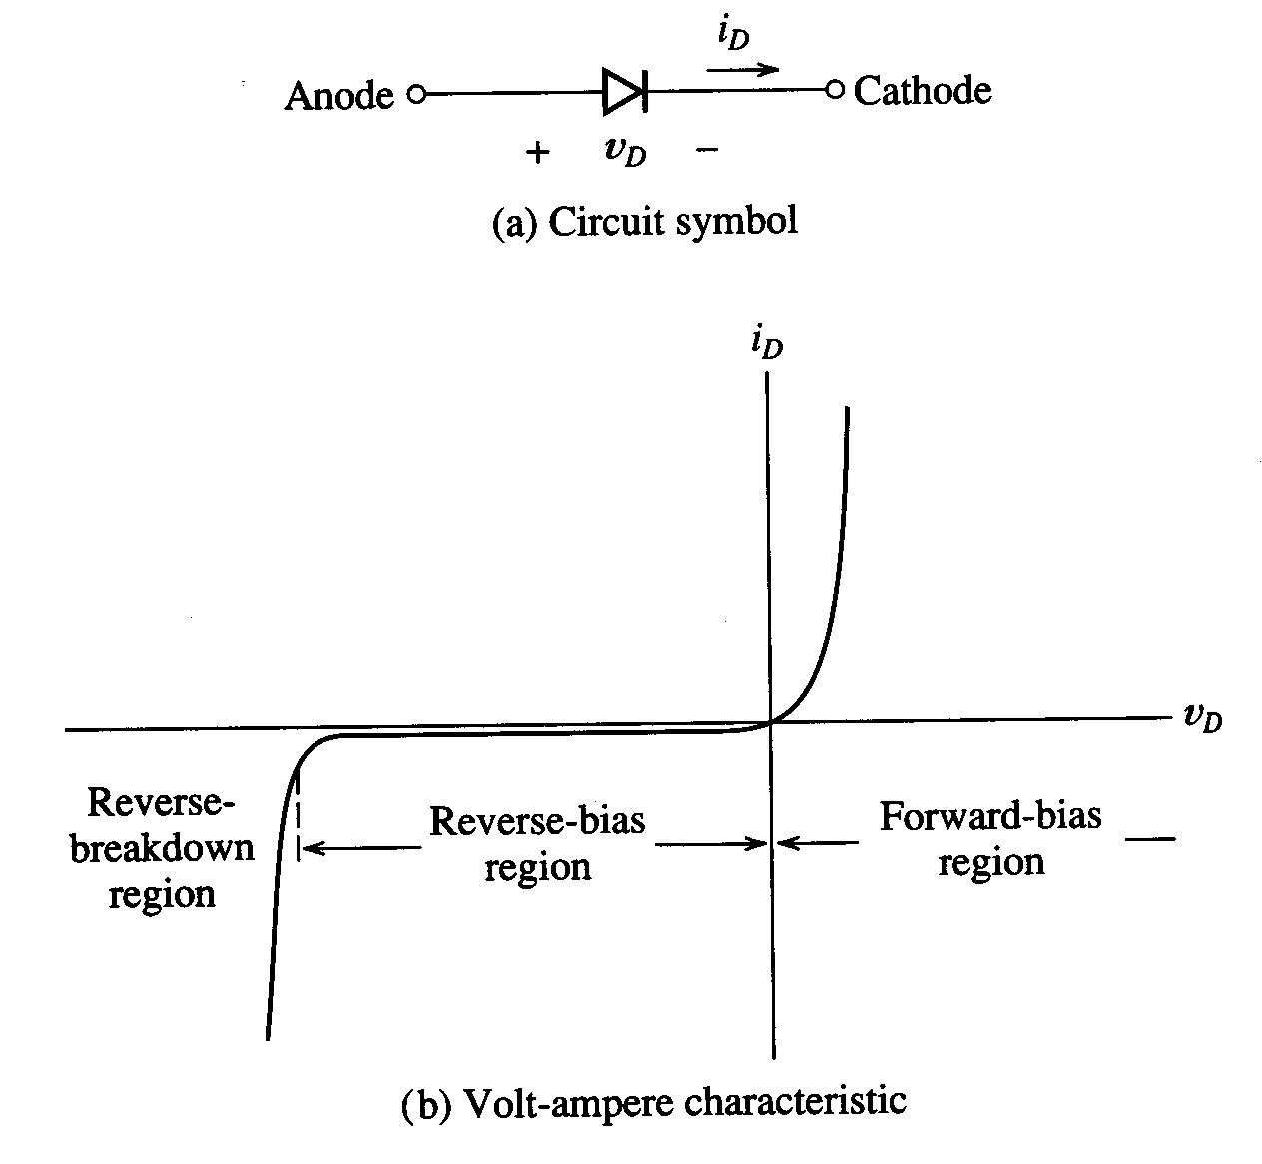
Diode Models
We begin by looking at ways to model the diode. We need a schematic symbol for the diode, which follows. We call the p region side the anode and the n region side the cathode.

Slide 28
Diode Models
We show here a plot of i_{D} as function of v_{D} for a diode. Note the reference polarities are shown in the diagram.

Slide 29
Diode Problem Solutions
There will be 4 different ways that we could solve diode problems.
  Use actual data for the diode, typically in the form of a plot.
  Use the diode equation, typically in the form of a plot, or using iterative methods.
  Use the ideal diode approximation.
  Use the piecewise linear diode model.
Actually, the ideal diode is simply a special case of the piecewise linear diode model, as we shall see.

Slide 30
Diode Plots
There will be 4 different ways that we could solve diode problems. The first one is:
  Use actual data for the diode, typically in the form of a plot.
The actual data for the diode is plotted, and then the characteristics for the circuit are plotted on the same axes. The plot of the characteristics of the circuit is called a “load line”.

Slide 31
Load Lines
A load line is a plot of the characteristics of the circuit.
The assumption is that the circuit, connected to the diode, is linear, and can be modeled using Thévenin's Theorem. Thévenin's Theorem leads to a relationship that can be plotted, which turns out to be a straight line. This straight line is called a “load line”.

Slide 32
Diode Models
There will be 4 different ways that we could solve diode problems. The last three are:
  Use the diode equation, typically in the form of a plot, or using iterative methods.
  Use the ideal diode approximation.
  Use the piecewise linear diode model.
The last three approaches involve the idealization of the diode in a variety of ways. Which one will be useful? This depends on the need for accuracy. These idealizations are called diode models.

Slide 33
Diode Equation
The first, and most accurate model for the diode is called the diode equation.
Where i_{D} and v_{D} are defined in the diagram shown.

Slide 34
Diode Equation
In the diode equation,
The quantities
I_{S} = the saturation current,
n = the material constant, typically in the range from 1 to 2, and
V_{T} = the thermal voltage.

Slide 35
Diode Equation
In the diode equation,
V_{T} = the thermal voltage, and
k = Boltzmann's constant
= 1.38 x 10⁻²³ [Joules/Kelvin]
T = the absolute temperature in [Kelvins]
q = the magnitude of the electronic charge
= 1.602 x 10⁻¹⁹ [Coulombs].

Slide 36
Diode Equation
In the diode equation,
V_{T} = the thermal voltage, and
k = Boltzmann's constant
= 1.38 x 10⁻²³ [Joules/Kelvin]
T = the absolute temperature in [Kelvins]
q = the magnitude of the electronic charge
= 1.602 x 10⁻¹⁹ [Coulombs].
Note that the thermal voltage has units of voltage, but only varies with temperature. Thus, the name, thermal voltage.

Slide 37
Diode Equation
We can see that the diode equation qualitatively models the behavior of the diode, outside the reverse breakdown region.

Slide 38
Diode Equation
Look at the plot for negative voltages. The term in the brackets is dominated by the
-1 for voltages with significant magnitude, thus,
i_{D} = -I_{S}.
The current goes to a value, then stays mostly flat. It seems to saturate. Thus, the name, saturation current.

Slide 39
Diode Equation
Look at the plot for positive voltages. The term in the brackets is dominated by the exponential for voltages with significant magnitude. Thus, we have the exponential shaped curve, in the forward bias
region.

Slide 40
Ideal Diode Model
The ideal diode model is presented graphically in the diagram that follows.

Slide 41
Ideal Diode Model
In this model, the diode can be in one of two states: it is either off, or it is on.
· In the off state, the current is zero, independent of voltage. This is the same as an open circuit.
· In the on state,
the voltage is
zero,
independent of
current. This
is the same as
a short circuit.

Slide 42
Ideal Diode Model
In this model, the diode can be in one of two states: it is either off, or it is on. In general, when we solve a circuit using this model, we do not know which state the diode is in. We might have a good idea, but we do not know.

Slide 43
Ideal Diode Model
In this model, the diode can be in one of two states: it is either off, or it is on. In general, when we solve a circuit using this model, we do not know which state the diode is in. Therefore, we use the following approach. We guess, and then we test that guess.

Slide 44
Ideal Diode Model
We guess, and then we test that guess. How do we test? We use what we know.
In the off state, the current is zero, independent of voltage. This is the same as an open circuit. This only happens when the voltage v_{D} is negative.
In the on state, the voltage is zero, independent of current. This is the same as a short circuit. This only happens when the current i_{D} is positive.
The underlined phrases become the tests that we use to decide if our guess are good ones.

Slide 45
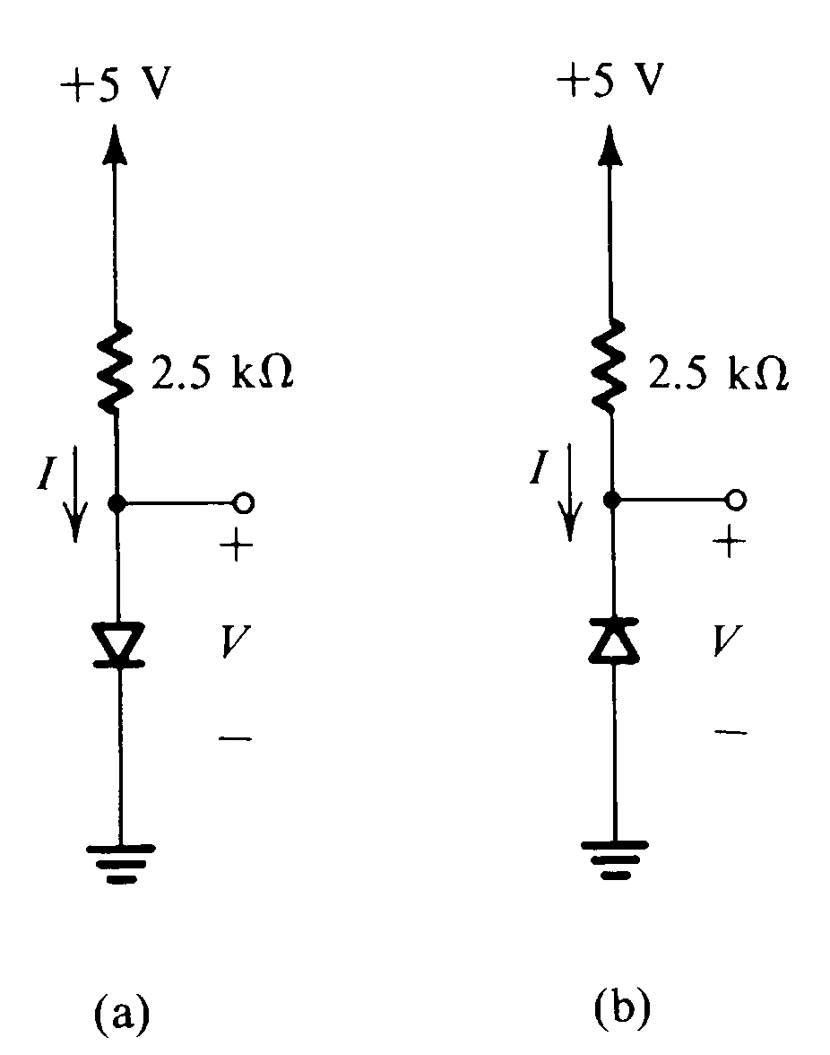
Ideal Diode Model
Let’s try out this on some simple circuits.

Slide 46
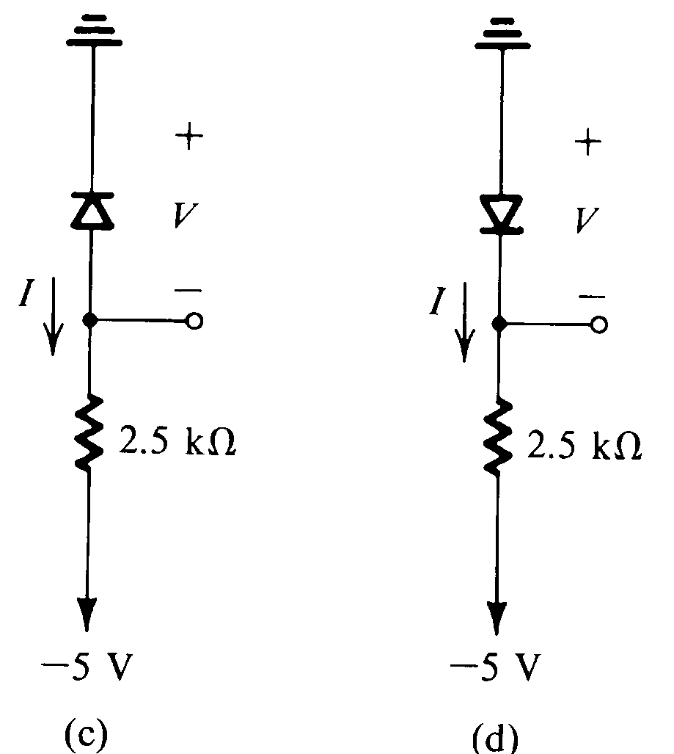
Ideal Diode Model
Here are some more to try.

Slide 47
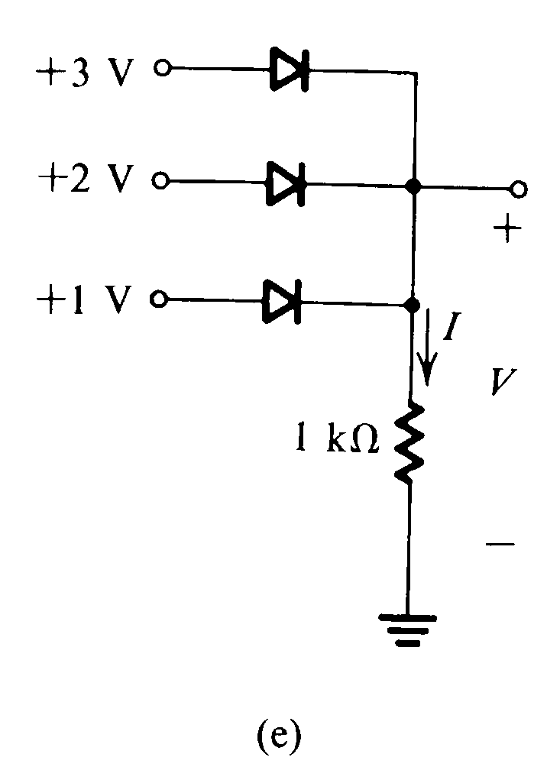
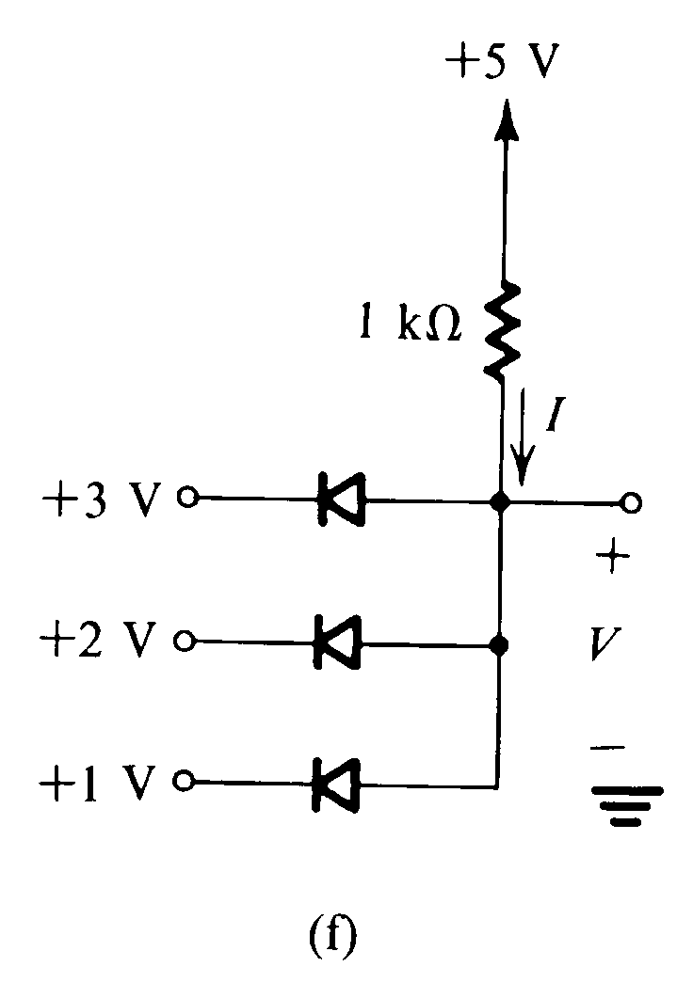
Ideal Diode Model
These are a little bit harder, but involve the same approach.

Slide 48
Analysis with the Piecewise-Linear Diode Model
The next diode model is the 3355 Piecewise Linear Diode Model.
This model with its characteristic curve, is given
here.

Slide 49
3355 Piecewise-Linear Diode Model
This diode model is more accurate than the ideal diode model.
It is not a widely used model, but we will use it to practice using special models.

Slide 50
3355 Piecewise-Linear Diode Model Labels
The -I_{s} and V_{f} are labels for axis values.
The r_{d} is the inverse of the slope of the line indicated.

Slide 51
3355 Piecewise-Linear Diode Model Parameters
I_{S} = reverse saturation current.
V_{f} = Thevenin Voltage for diode in the forward biased region.
r_{d} = resistance of diode in the conducting region.

Slide 52
3355 Piecewise-Linear Diode Model Parameters
V_{f} = Thevenin Voltage for diode in the forward biased region. (In previous years, we called this the threshold voltage V_{thres}, which is too long, or V_{th}, which looked like a Thevenin voltage, or V_{T}, which looked like the thermal voltage. If you look at old exams, you may notice any of these different versions.)

Slide 53
3355 Piecewise-Linear Diode Model Regions
There are four regions of the plot for nonzero values of I_{S}, V_{f} and r_{d}. There is an equivalent circuit that can be used to represent the diode in each region, and a test for that region.

Slide 54
3355 Piecewise-Linear Diode Model Region 1
Behavior: Constant current, independent of voltage
Model: Current source
Test: Is v_{D} ≤ 0?
Region 1

Slide 55
3355 Piecewise-Linear Diode Model Region 2
Behavior: Zero voltage, independent of current
Model: Wire (zero valued voltage source)
Test: Is -I_{S} ≤ i_{D} ≤ 0?
Region 2

Slide 56
3355 Piecewise-Linear Diode Model Region 3
Behavior: Zero current, independent of voltage
Model: Open circuit (zero valued current source)
Test: Is 0 ≤ v_{D} ≤ V_{f}?
Region 3

Slide 57
3355 Piecewise-Linear Diode Model Region 4
Behavior: Linear relationship between voltage and current
Model: Thevenin equivalent
Test: Is V_{f} ≤ v_{D}? -- or -- Is i_{D} ≥ 0?
Region 4

Slide 58
3355 Piecewise-Linear Diode Model Compared to Ideal Diode
Note that the ideal diode is just the piecewise linear model, but with zero values of I_{S}, V_{f}, and r_{d}.

Slide 59
Using the Piecewise Linear Diode Model - 1
Let’s try out this on some simple circuits.
Solve using values of
I_{S} = 1[mA],
V_{f} = 1[V], and
r_{d} = 1[kΩ].

Slide 60
Using the Piecewise Linear Diode Model - 2
Here are some more to try.
Solve using values of
I_{S} = 1[mA],
V_{f} = 1[V], and
r_{d} = 1[kΩ].

Slide 61


Using the Piecewise Linear Diode Model - 3
These are a little bit harder, but involve the same approach. Solve using values of
I_{S} = 1[mA], V_{f} = 1[V], and r_{d} = 1[kΩ].

Slide 62
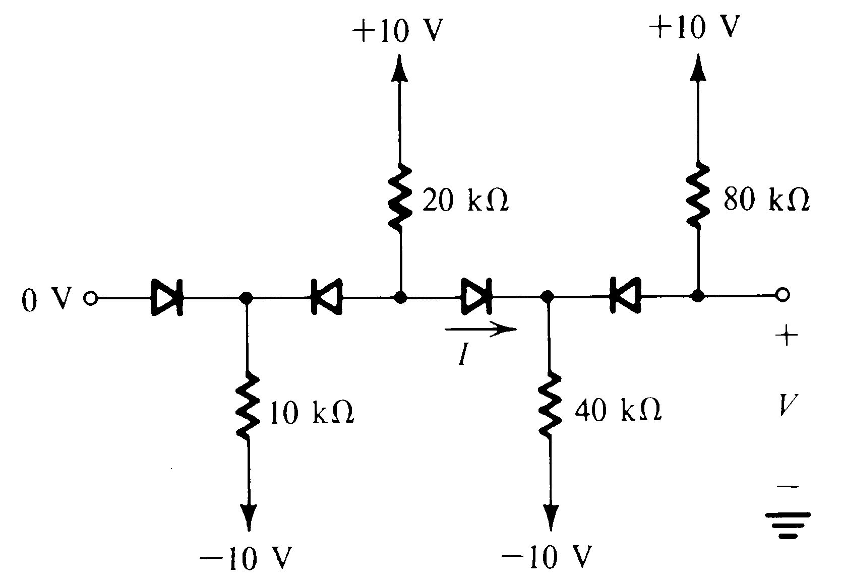
Some Other Practice Circuits - 1
Here is another circuit to practice on.

Slide 63
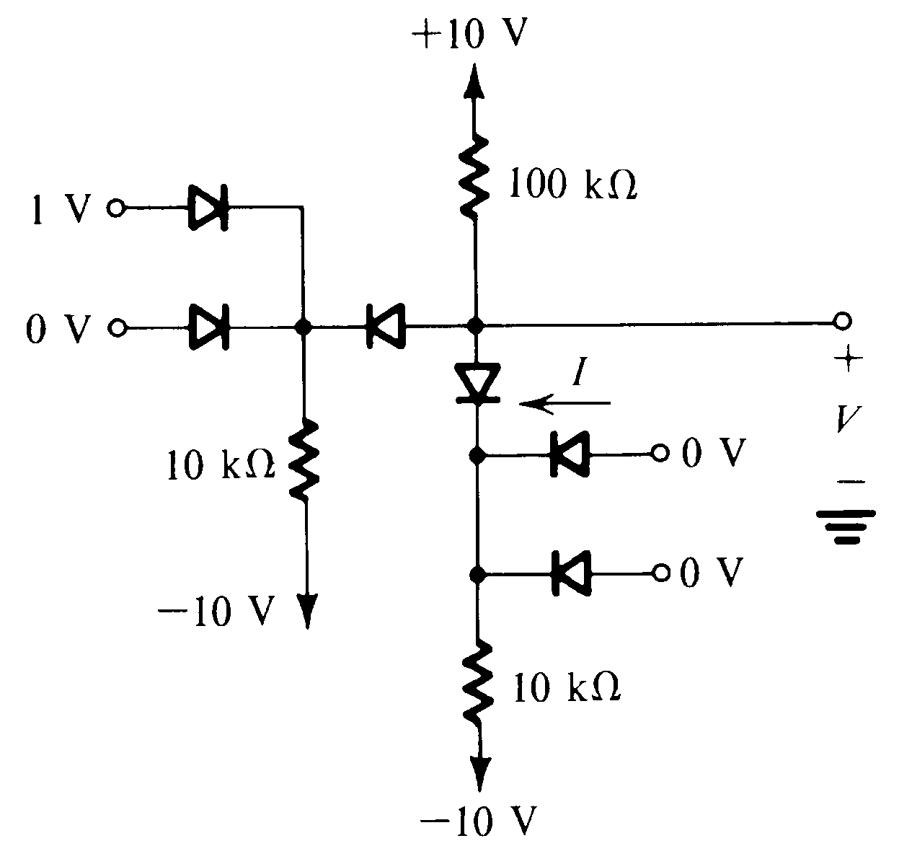
Some Other Practice Circuits - 2
Here is another circuit to practice on.

Slide 64

Nonlinear Circuits
Thus far, we have considered only analysis for constant voltages. What if the input for a circuit is not a constant?

Slide 65
Nonlinear Circuits
Thus far, we have considered only analysis for constant voltages. What if the input for a circuit is not a constant?
Answer: Conceptually, we need to apply the same analysis, an infinite number of times.
Practically, of course,
this would take a long time.

Slide 66
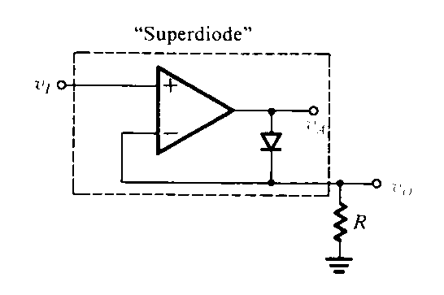
Super Diode
A diode with improved characteristics can be obtained by putting a diode in the feedback loop of an op amp.
This diagram is taken from Sedra and Smith

Slide 67
Super Diode Limits
This will appear to work as an ideal diode. However, as the frequency components of v_{I} go up, its behavior degrades due to the time it takes for the op amp to leave saturation.
This diagram is taken from Sedra and Smith

Slide 68
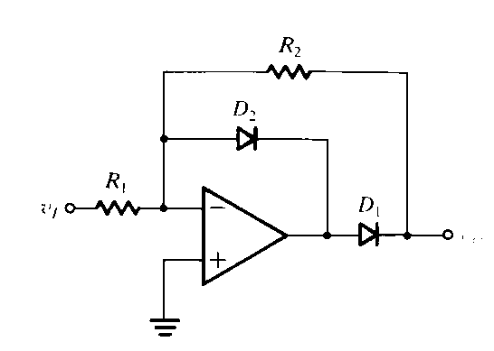
Super-Duper Diode
This is an improved version. The diode D2 prevents the op amp from saturating when diode D1 is off. This allows the circuit to respond to higher frequency inputs.
This diagram is taken from Sedra and Smith

Slide 69
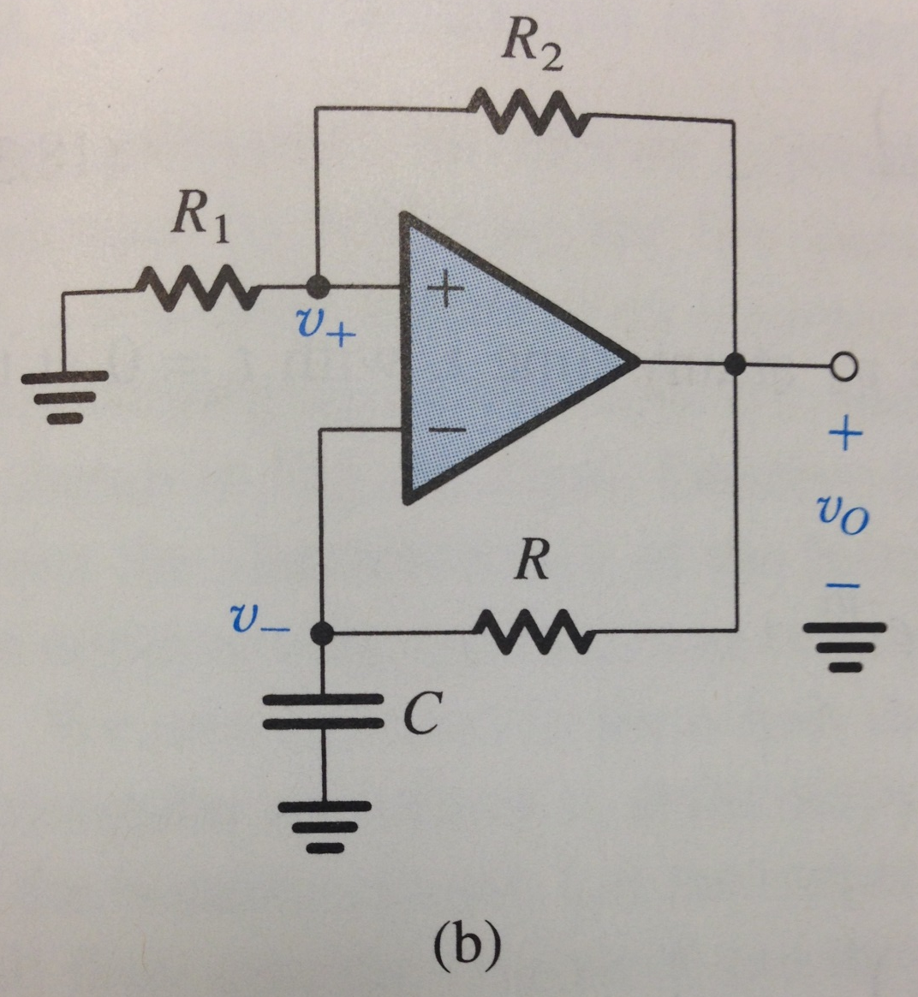
Astable Multivibrator
Here is a circuit that can produce a square wave output with no input. Let’s analyze it.
First question: Does this op amp have negative feedback?
This diagram is taken from Sedra and Smith, 7th Edition, Figure 18.26, page 1413

Slide 70
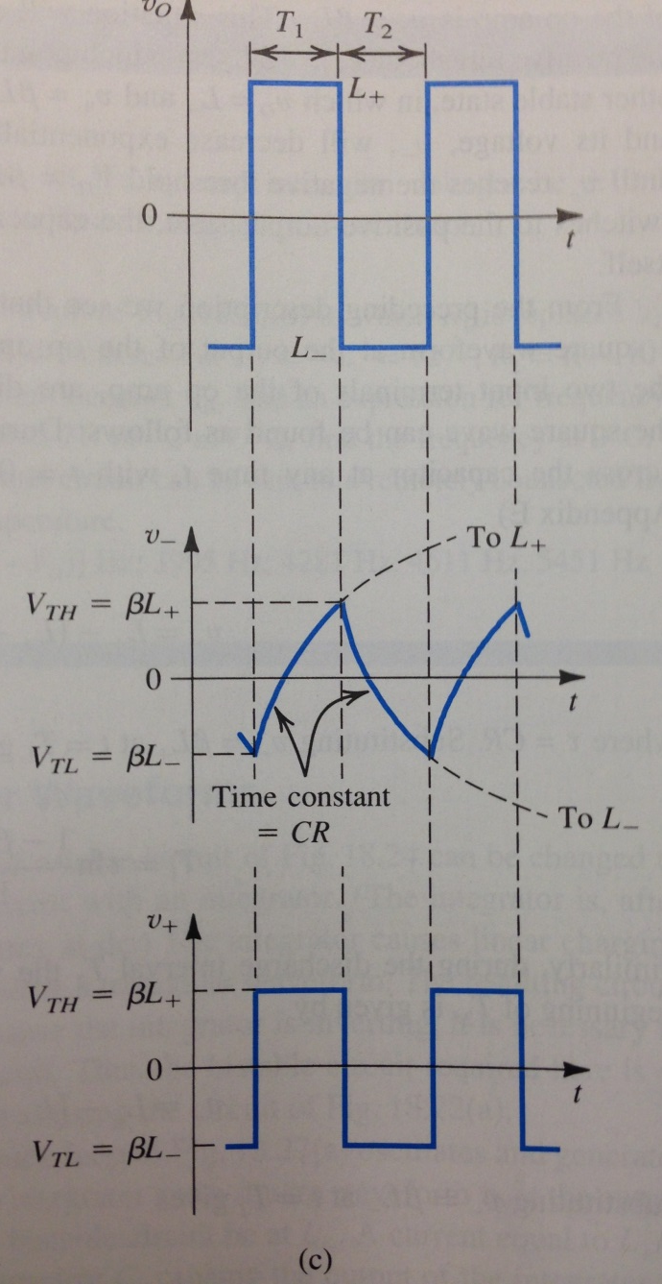
Astable Multivibrator
The output voltage v_{O} is a square wave.
The non-inverting input is a voltage divider away from that output voltage.
The inverting input is always chasing the output, but can only change exponentially because of the capacitor. It is a first-order step response, with a periodically changing source voltage, which is the output.
This diagram is taken from Sedra and Smith, 7th Edition, Figure 18.26, page 1413

Slide 71
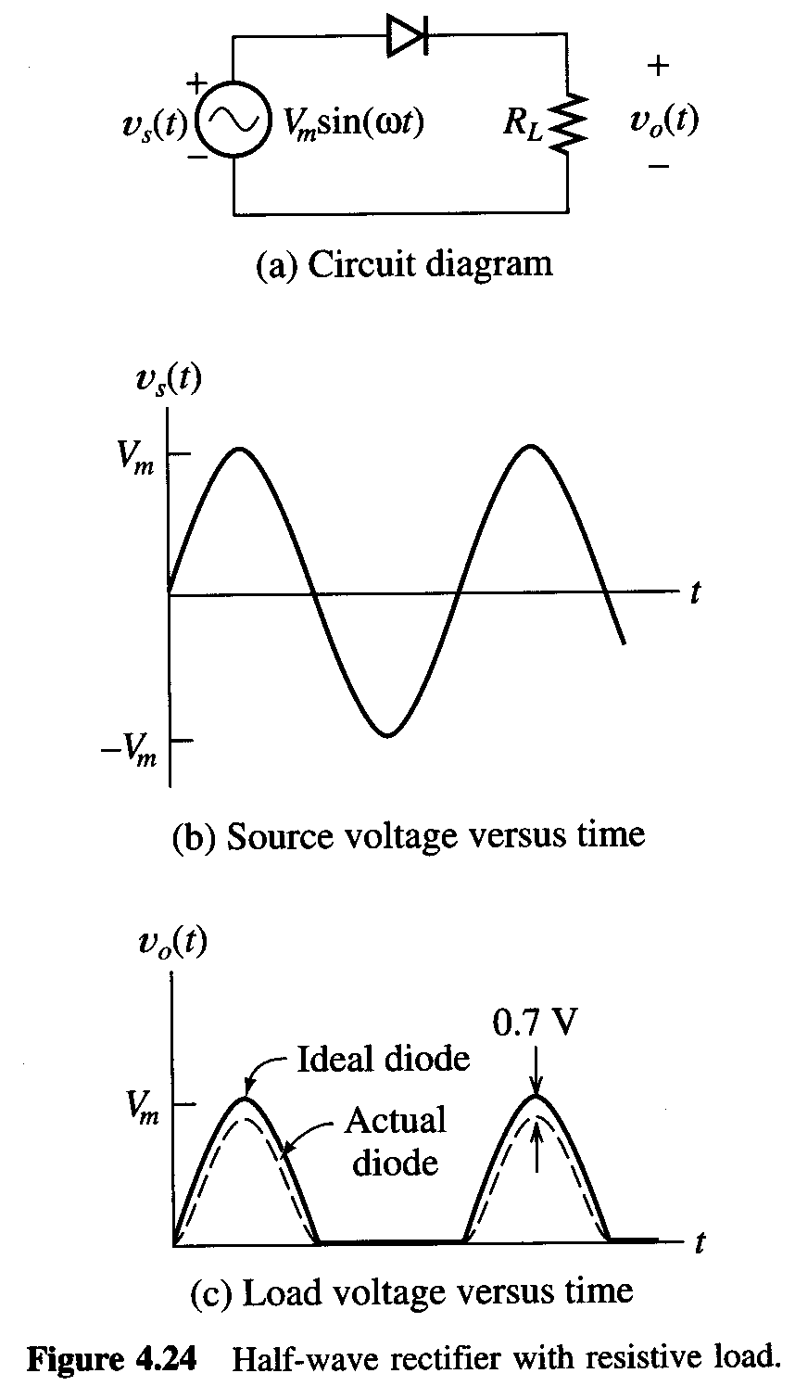
Rectifier Circuits
Thus far, we have considered only analysis for constant voltages. What if the input for a circuit is not a constant?
Conceptually, we need to apply the same analysis, an infinite number of times. Practically, of course, this would take a long time.
Instead, we need to use some insight. Take the case of the circuit called the half-wave rectifier.

Slide 72
Half-Wave Rectifier
Let’s analyze this circuit, using our ECE3455 Piecewise Linear Diode Model, with I_{S} = 0, V_{f} = 0.7[V] and r_{d} = 0.
For v_{s} > V_{f}, the diode will turn on, and the output v_{o}(t) will be just V_{f} less than the input.
For v_{s} < V_{f}, the diode will turn off, and the output v_{o}(t) will be zero.

Slide 73
Half-Wave Rectifier Analysis
For v_{s} > V_{f}, the diode will turn on, and the output v_{o}(t) will be just V_{f} less than the input. This diagram assumes
V_{f} = 0.7[V].
For v_{s} < V_{f}, the diode will turn off, and the output v_{o}(t) will be zero.

Slide 74
Half-Wave Rectifier Analysis
The output waveform looks very much like the input, but only the positive part goes through. If we think of positive voltage as what we want, the part that is “right”, then we say that the voltage has been “rectified”. This circuit is called a rectifier. Notice that only half of the circuit gets to the output. We call this circuit a half-wave rectifier.

Slide 75
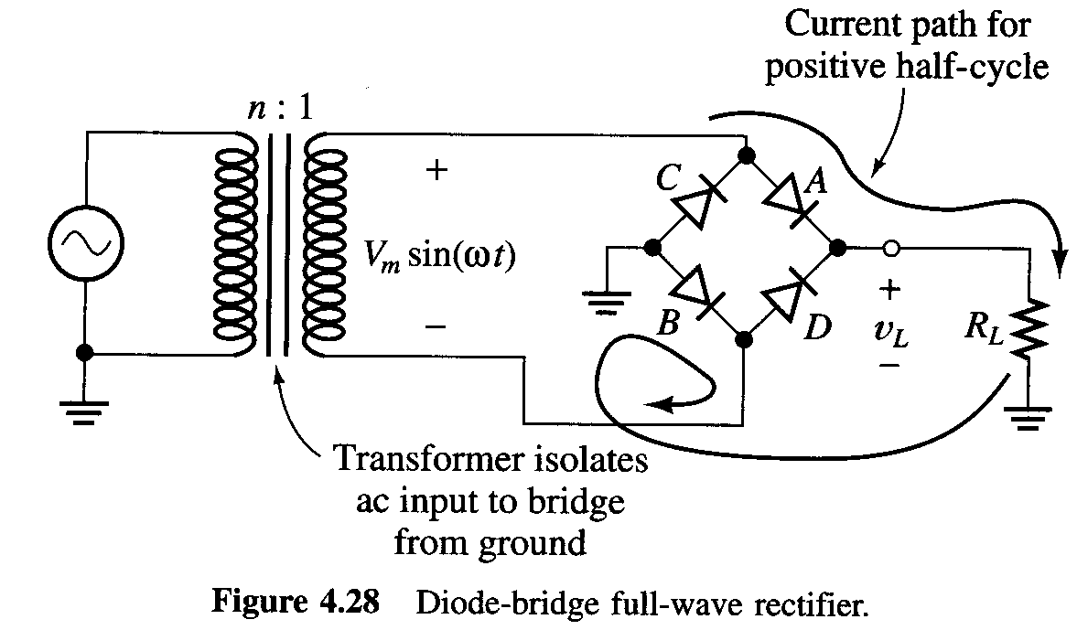
Full-Wave Rectifier
The bridge rectifier is a circuit which is also called a full-wave rectifier. Essentially, this means that both halves of the input go through the output, but with the same polarity.

Slide 76
Full-Wave Rectifier, Analysis 1
In this circuit, the load voltage v_{L} is positive for all values of the input. The output is driven for both half-cycles of the input. Thus, it is called a full-wave rectifier.

Slide 77
Full-Wave Rectifier, Analysis 2
Note that the output of this circuit has a significant dc component, even though there is no dc component at the input. Therefore, it is a non-linear circuit, since superposition does not hold.

Slide 78
DC Power Supply Requirement
Since this circuit has a significant dc component, with no dc component at the input, it can be used to produce a dc power supply. A dc power supply must be a nonlinear circuit.

Slide 79
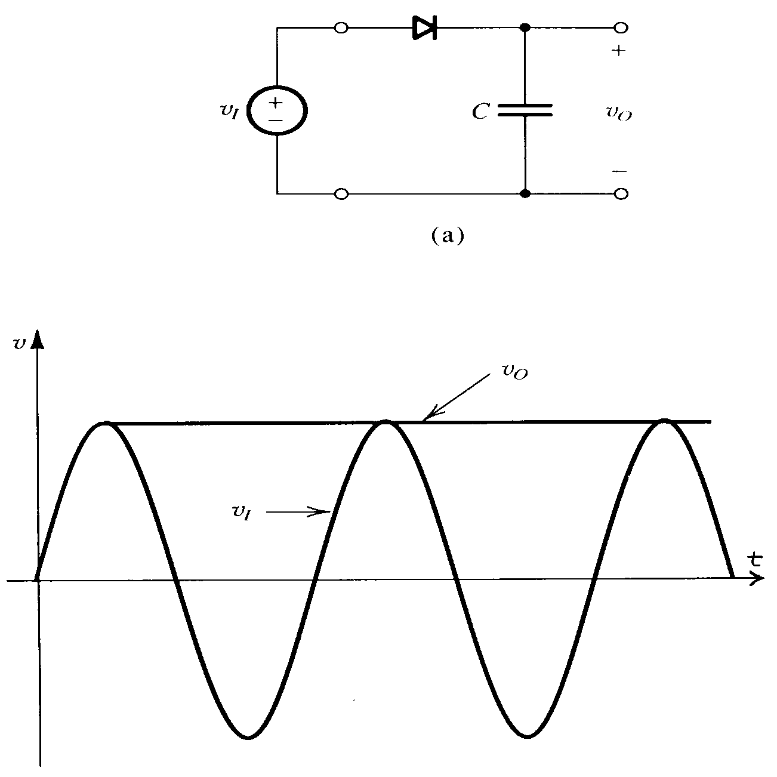
DC Power Supplies, Peak Detector
Power Supplies use a rectifier with a capacitor at the output. We start with a half-wave rectifier, since it is simpler. Show Fig. 3.32 from Sedra and Smith. This is a half-wave rectifier with a capacitor, which holds the peak value of the input source, v_{I}(t).

Slide 80
DC Power Supplies, Peak Detector
This circuit will hold the peak value only because there is nothing connected at the output. When we connect a load, something different happens.

Slide 81
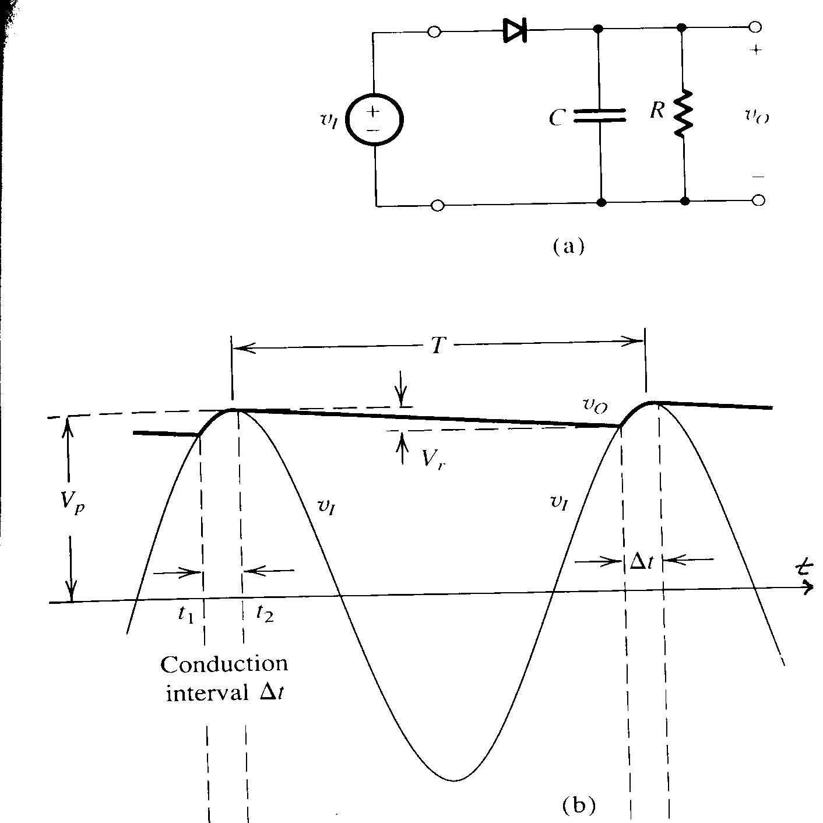
DC Power Supplies
Here we have connected a load, R, at the output. Look carefully at the diagram for the output voltage, v_{O}(t). Note that it no longer holds the peak value, but decreases exponentially.

Slide 82
DC Power Supplies
There is a short time period, which is referred to here as the Conduction interval Δt, where the diode is on, and conducts. During this time, v_{O}(t) = v_{I}(t).

Slide 83
DC Power Supplies
There is a longer time period, which is about as long as the period of the input wave, where the diode is off. During this time, the resistor and capacitor make a natural response circuit, and

Slide 84
DC Power Supplies
The total waveform, v_{O}(t), is a complicated combination of a sinusoid, and a decaying exponential, even for a simple diode model. A more accurate diode model makes for a very complicated solution.

Slide 85
DC Power Supplies, Approximations
The waveform, v_{O}(t), is often approximated as a simpler case, that is a dc component equal to V_{p}, and an ac component whose peak-to-peak value is called V_{r}, the ripple voltage.

Slide 86
DC Power Supplies, Approximations
The dc component of v_{O}(t) is often approximated by the zero-to-peak input sinusoid, perhaps decreased by the threshold voltage of the diode, and/or by half the ripple voltage.

Slide 87
DC Power Supplies, Approximations
The ac component of v_{O}(t) which we called the ripple voltage, or V_{r}, can also be approximated. The following is a derivation of a simple estimate of the ripple voltage, Vr, which is defined as the peak to peak voltage on the output of the power supply.

Slide 88
Ripple Voltage Approximation
The ac component of v_{O}(t) which we called the ripple voltage, or V_{r}, can also be approximated.
Assume an ideal diode. (If the input amplitude is much larger than V_{f}, we make little error in ignoring V_{f}. If the input amplitude is not much larger than V_{f}, we can make a more accurate estimate by using a better diode model.)
Assume that RC >> T, which we make possible by picking C large.
Since RC >> T, we can treat the exponential decay as a straight line.

Slide 89
Ripple Voltage Approximation
The ripple voltage, or V_{r}, can be approximated.
The charge gained by capacitor during charging, Q_{acq}, is
Q_{acq} = C V_{r} .
The charge lost during discharge, Q_{lost}, is
Q_{lost} = i_{L} (T-Δt) ≈ i_{L} T .
Here, we have assumed that
(T-Δt) ≈ T,
since it discharges for almost the entire period.

Slide 90
Ripple Voltage Approximation
The ripple voltage, or V_{r}, can be approximated.
The voltage is a straight line, with a slope we will call m, and a peak equal to V_{p}. So, the current is just that voltage divided by R,

Slide 91
Ripple Voltage Approximation
The ripple voltage, or V_{r}, can be approximated.
Now, since RC >> T, we assume that m = 0. Then, with Q_{acq} = Q_{lost}, and plugging in we get
where I_{L} is the load current, which is almost constant with time, and so is expressed as a dc quantity.

Slide 92
Ripple Voltage Approximation
The ripple voltage, or V_{r}, can be approximated.
With a full wave rectifier, the frequency is effectively doubled, so
which is a very handy little equation. It is surprisingly accurate, considering the number of approximations used to get it.

Slide 93
Testing the Ripple Voltage Approximation
But, if we are making this many assumptions, shouldn’t we test them?
Yes.
How?
By performing The DC Power Supply laboratory exercise. This is called Experiment V. There are lots of ways to go wrong when performing this lab. Here are 4 of them.

Slide 94

DC Power Supply Lab Error 1
Careless use of resistance substitution box.
Do not turn large scale down to zero before turning the smaller scale up to nine. If you do this, you will effectively short out the output, resulting in a very large current, and you will let the “magic smoke” out of the fuse.

Slide 95

DC Power Supply Lab Error 2
Careless setting of ac/dc setting on ammeter.
If you look for 0.5A of current through the load, with the ammeter set to measure the ac component, you will let the “magic smoke” out of the fuse.

Slide 96

DC Power Supply Lab Error 3
Grounding both sides of the transformer.
The oscilloscope reference clips are connected to ground. If you connect these clips on both sides of the transformer, you will have shorted diode B using the reference clips of the oscilloscope probes. Significant current will flow through them, and they will get very hot. Be careful how you connect the scope clips.

Slide 97

DC Power Supply Lab Error 4
The voltage regulator will have several Volts across it, and half an Amp through it. This can be about 5[W].
Will it get hot?
Not if it is big.
Is it big?
No. So, will it get hot?
Yes.
Several students have walked around with small burn marks in the shape of voltage regulators on their fingers. This is not required. Use heat sinks, and be careful.

Slide 98
Linear Small-Signal Model of the Diode
Remember amplifiers, biasing, and small signals?
We shall look at a similar thing for diodes. Clearly, diode characteristics are nonlinear. However, in some regions, the characteristics can be replaced by a straight line.

Slide 99
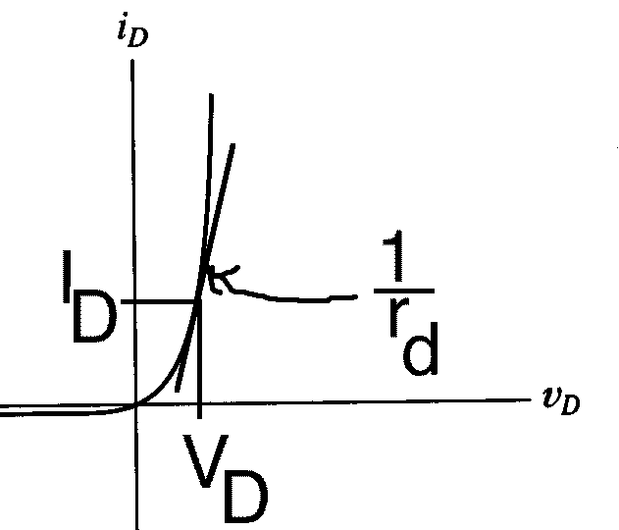
Linear Small-Signal Model of the Diode
If the characteristic is viewed as a straight line, for signal purposes the device is just a resistor. The value of the resistance is the inverse slope of the i_{D} vs v_{D} characteristic, at the Q point. This will apply for small signals, around the Q point.
Q Point
slope =

Slide 100
Linear Small-Signal Model of the Diode
In other words, if we apply a dc voltage or current to the diode, we place the diode at a Q point. Then, we can treat the diode as if it were a resistor, equal to the inverse of the slope of the diode characteristic, as long as we stay close to that point.
Q Point
slope =

Slide 101
Linear Small-Signal Model of the Diode
In other words, if we apply a dc voltage or current to the diode, we place the diode at a Q point. Then, we can treat the diode as if it were a resistor, equal to the inverse of the slope of the diode characteristic, as long as we stay close to that point.
We stay close by using only small signals, which are called small signals.
slope =

Slide 102
Linear Small-Signal Model of the Diode
In other words, if we apply a dc voltage or current to the diode, we place the diode at a Q point. Then, we can treat the diode as if it were a resistor, equal to the inverse of the slope of the diode characteristic, as long as we stay close to that point.
We call this resistance the dynamic resistance of the diode, and label it r_{d}. It can be expressed as:
slope =

