Slide 1
ECE 3455: Electronics
Chapter 6: Bipolar Junction Transistors
Figures from Sedra and Smith, Microelectronic Circuits 5ed. and 6 ed., Oxford Press

Slide 2
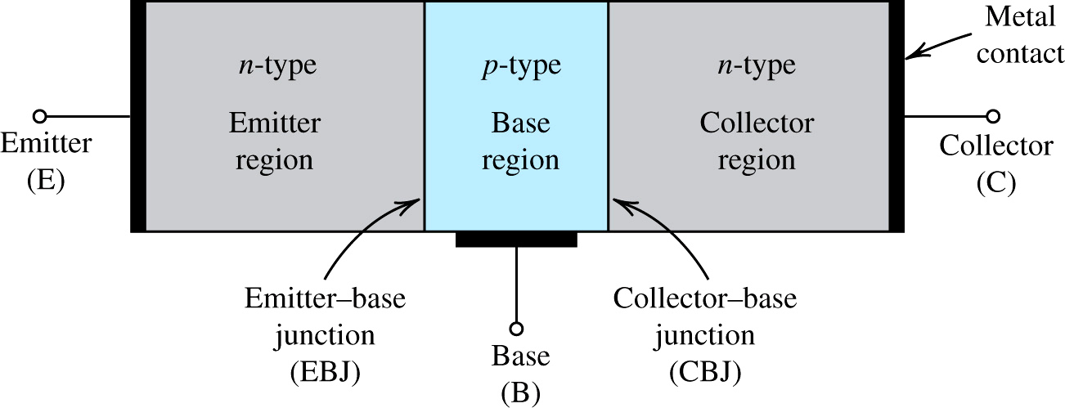
Figure 6.1 A simplified structure of the npn transistor.
Notes:
sedr42021_0501.jpg

Slide 3
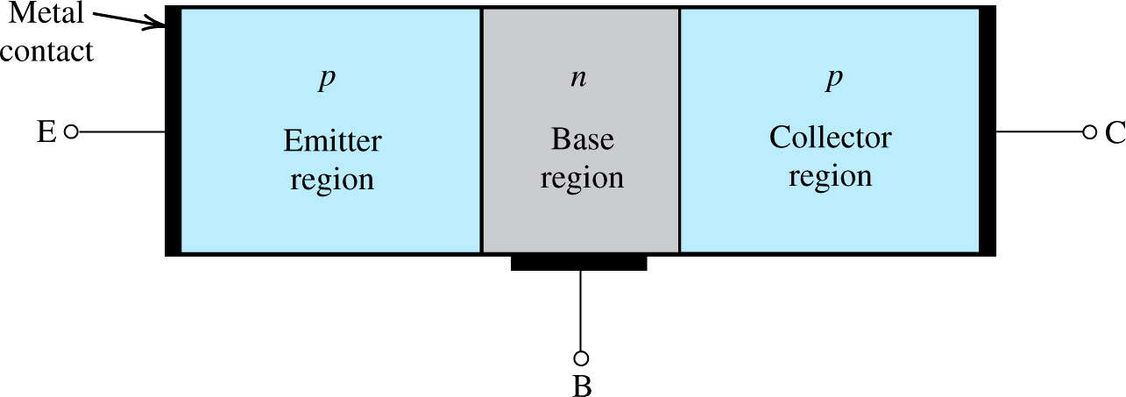
Figure 6.2 A simplified structure of the pnp transistor.

Slide 4
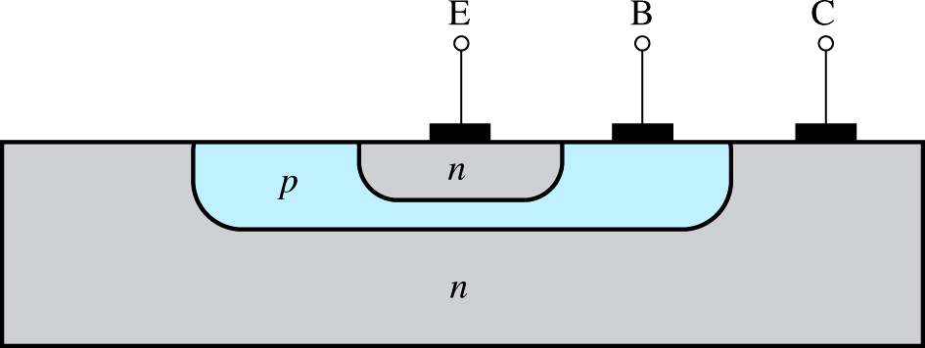
Figure 6.7 Cross-section of an npn BJT.

Slide 5
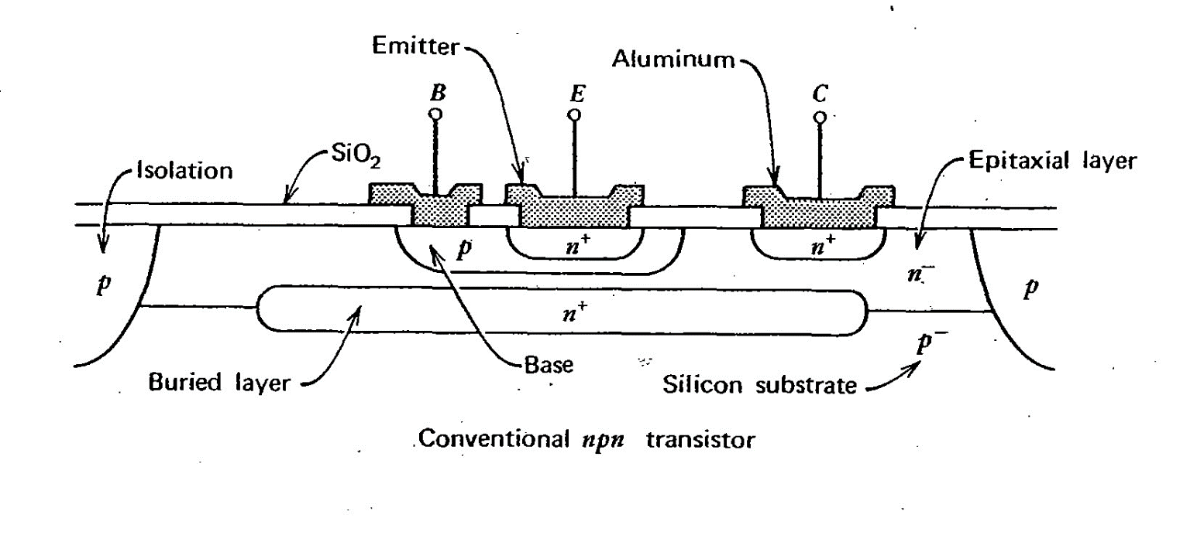
Direction of electron flow during forward-active biasing

Slide 6
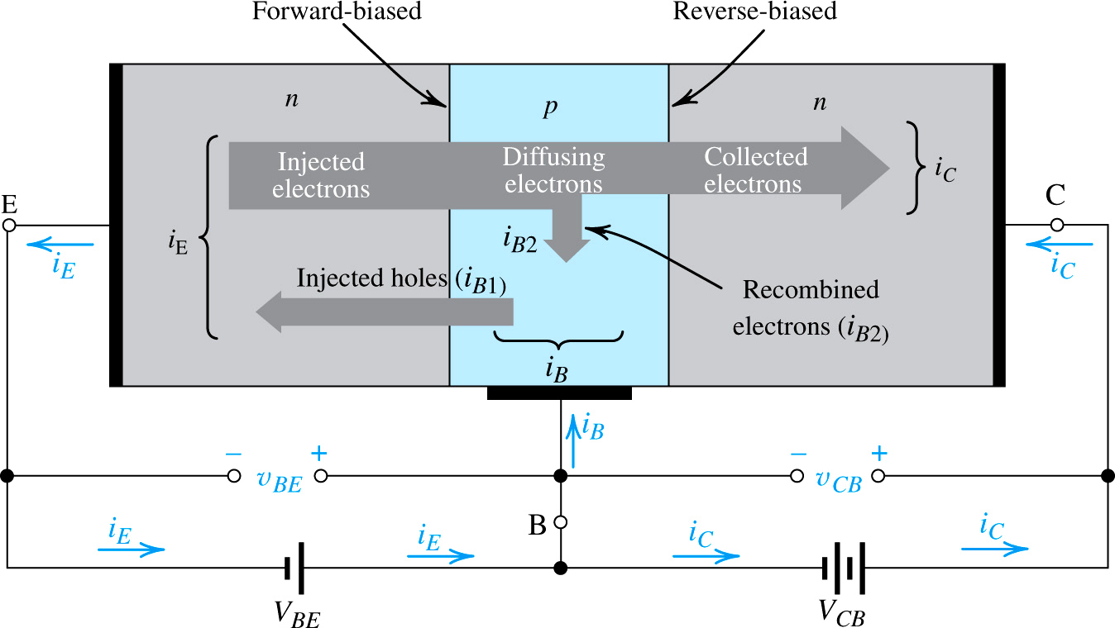
Figure 6.3 Current flow in an npn transistor biased to operate in the active mode. (Reverse current components due to drift of thermally generated minority carriers are not shown.)

Slide 7
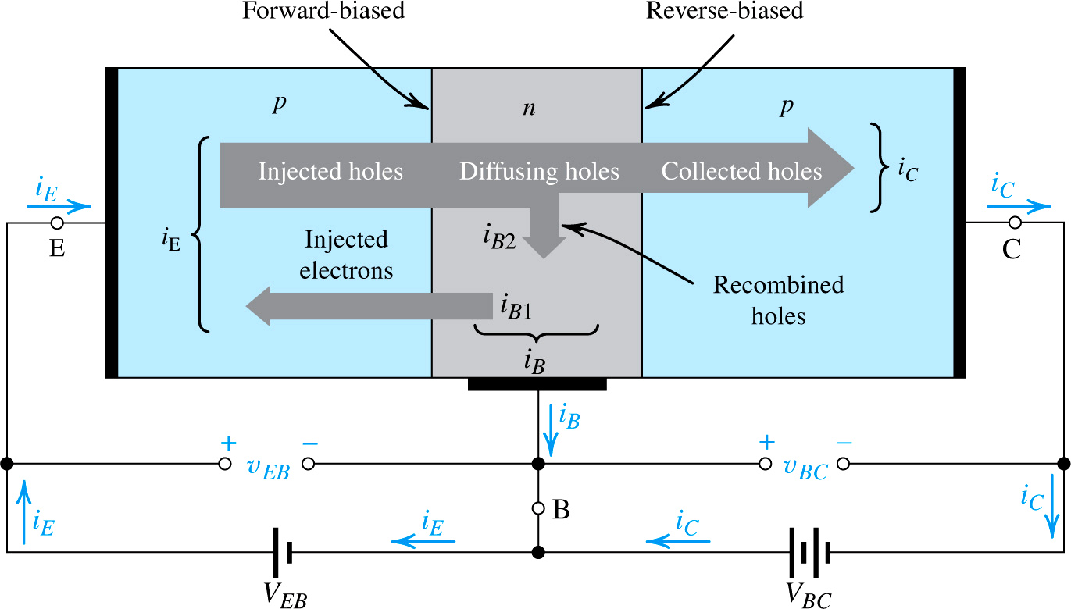
Figure 6.10 Current flow in a pnp transistor biased to operate in the active mode.

Slide 8
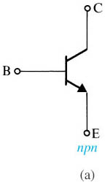
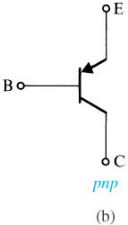
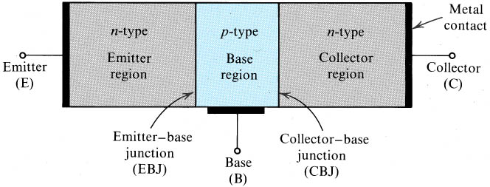
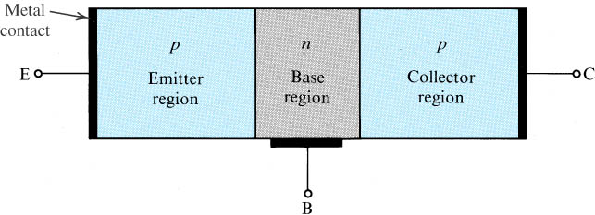
Circuit Symbols
The arrow is at the emitter, and it points to the n-type region. In the npn, the emitter is n type; in the pnp, the base is n-type.
+
+
n
v_{CB}
-
p
v_{CE}
+
v_{BE}
n
-
-
Notes:
sedr42021_0513a.jpg

Slide 9
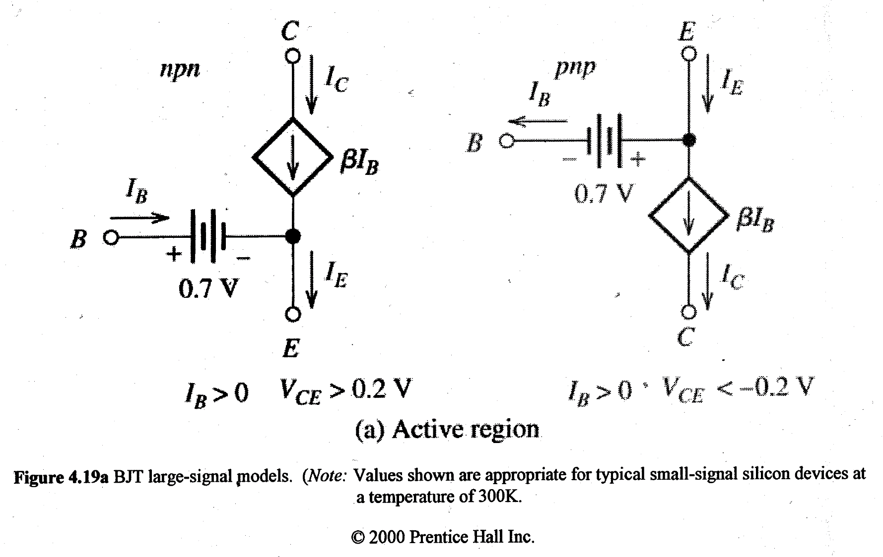
DC (large signal) model for active region…
Hambley 2ed., Prentice Hall 2000

Slide 10
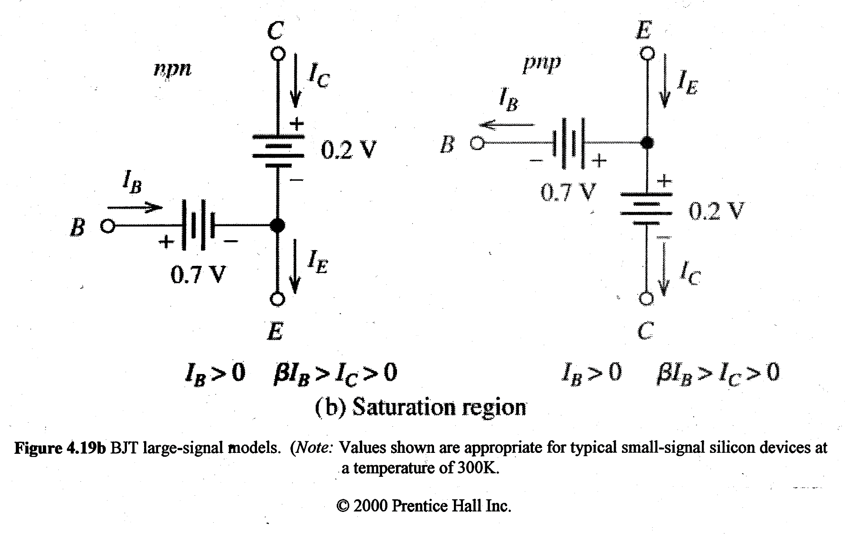
DC (large signal) model for saturation region…
Hambley 2ed., Prentice Hall 2000

Slide 11
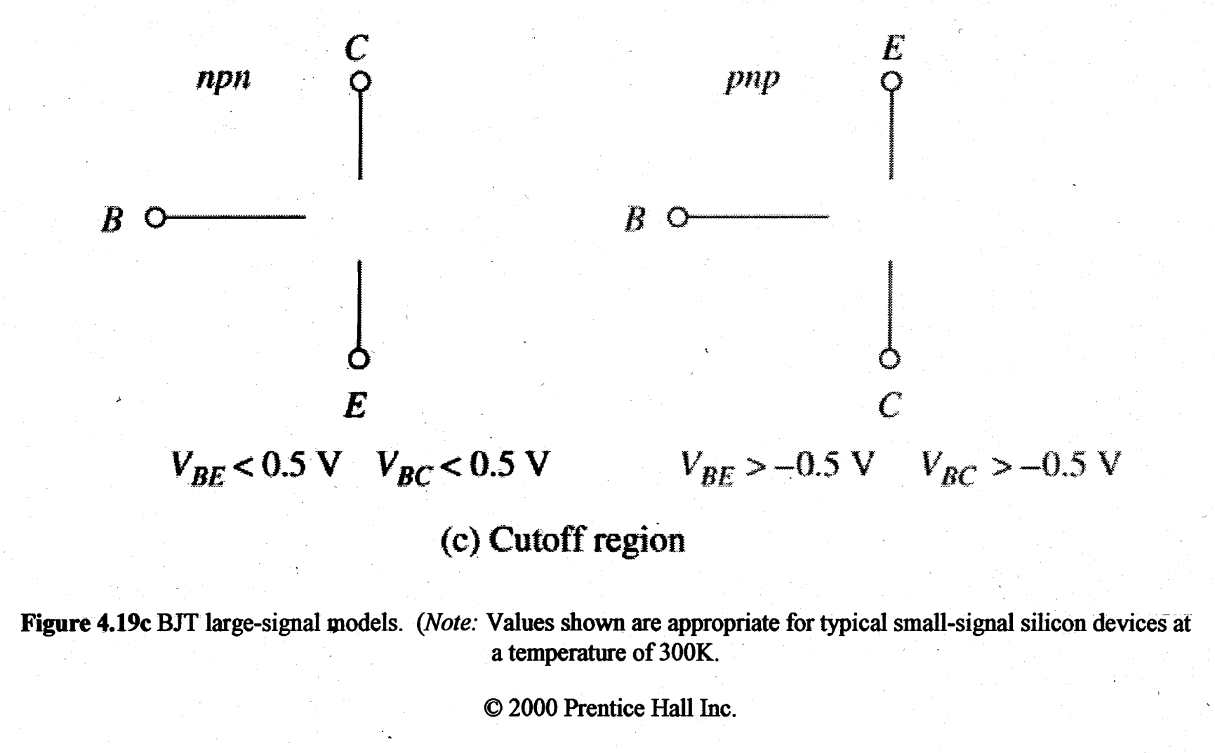
DC (large signal) model for cutoff region…
Hambley 2ed., Prentice Hall 2000

Slide 12
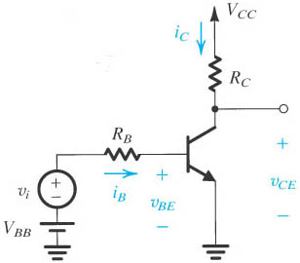
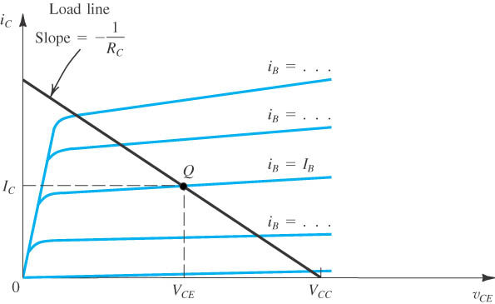
BJT Characteristic Curves: along the v_{CE} axis
Assume that v_{BE} = 0.7 V, so BE junction is ON. Then…
v_{CE} = v_{CB} + v_{BE}
a) For any i_{B}: v_{CE} = 0 means CB junction is in forward bias because v_{CB} = -0.7 V. There is no net current flow, so i_{C} ~ 0.
b) An increase in v_{CE} causes the CB junction to be less and less forward biased, and finally reverse-biased. When fully reverse-biased, we are in active mode and i_{C} is approx. constant.
+
+
n
v_{CB}
-
p
v_{CE}
+
v_{BE}
n
-
-
active mode
Figure 5.27 Circuit whose operation is to be analyzed graphically.
b)
v_{CE} = v_{CB} + v_{BE} = v_{CB} + 0.7 V if BE junction is “on”.
a)
cut-off
saturation
Figure 5.29 Graphical construction for determining the dc collector current I_{C} and the collector-to-emitter voltage V_{CE} in the circuit of Fig. 5.27.
Notes:
sedr42021_0529.jpg

Slide 13
We are looking here at i_{C} vs. v_{CE}, because we can think of these as the output current and output voltage.
active mode
KVL around output loop:
saturation
cut-off
Figure 5.29 Graphical construction for determining the dc collector current I_{C} and the collector-to-emitter voltage V_{CE} in the circuit of Fig. 5.27.
Notes:
sedr42021_0529.jpg

Slide 14
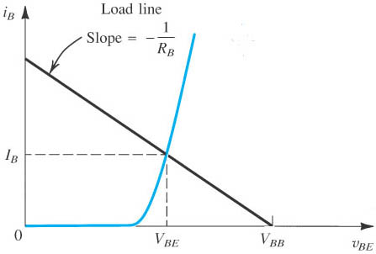
A KVL around the base-emitter loop determines I_{B}.
KVL around input loop:
Figure 5.27 Circuit whose operation is to be analyzed graphically.
We can think of either i_{B} or v_{BE} as an input, so the graph shows the input characteristics for this device.
Figure 5.28 Graphical construction for the determination of the dc base current in the circuit of Fig. 5.27.
Notes:
sedr42021_0527.jpg

Slide 15
BJT Characteristic Curves: along the load line
c)
+
active mode
v_{CB}
-
b)
a)
v_{CE} = v_{CB} + v_{BE}
cut-off
saturation
Follow the load line, beginning at a)...
a) V_{CC} is positive, reverse-biasing the BC junction if i_{C} is small. If i_{B} = i_{C} = 0, v_{CE} = V_{CC} →cutoff
b) Now increased forward bias until v_{BE} ~ 0.6 V. As i_{B} increases, i_{C} increases, lowering v_{CE}; we are in active mode: BE junction forward biased and CB junction reverse biased.
c) As i_{B} increases further, i_{C} increases and v_{CE} decreases to the point that the BC junction becomes forward biased. Now we are in saturation: BE junction forward bias and CB junction forward bias. In saturation, v_{CE} is typically ~ 0.2 V, which means v_{CB} = - 0.4 V (so CB is reverse-biased, but only slightly) if v_{BE} is 0.6 V.

Slide 16
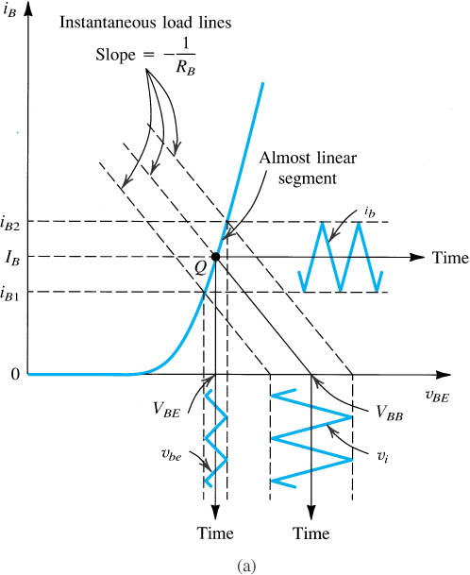
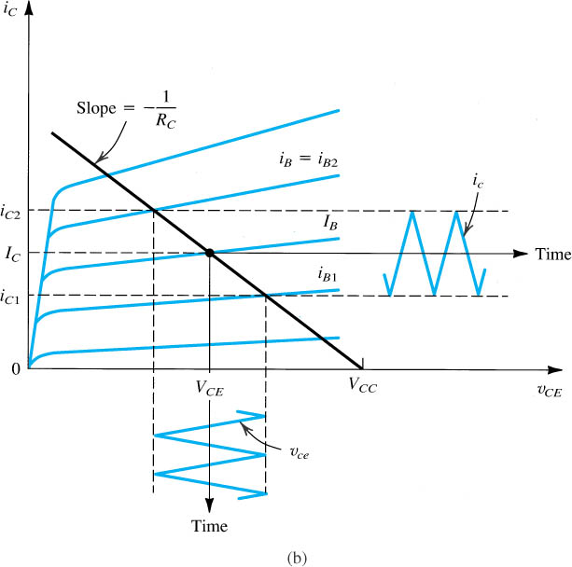
BJT Amplification
7. Bottom Line: Current Gain: Δi_{C} >> Δi_{B}
4. The base current change shows up here…
3. …which changes the base current i_{b}.
6. …and a change in collector current i_{c}.
2. …changes the BE voltage v_{be}…
1. Applying a signal v_{i}…
5. …with a corresponding change in CE voltage v_{ce}…
Figure 5.30 Graphical determination of the signal components v_{be}, i_{b}, i_{c}, and v_{ce} when a signal component v_{i} is superimposed on the dc voltage V_{BB} (see Fig. 5.27).
Notes:
sedr42021_0530a.jpg

Slide 17
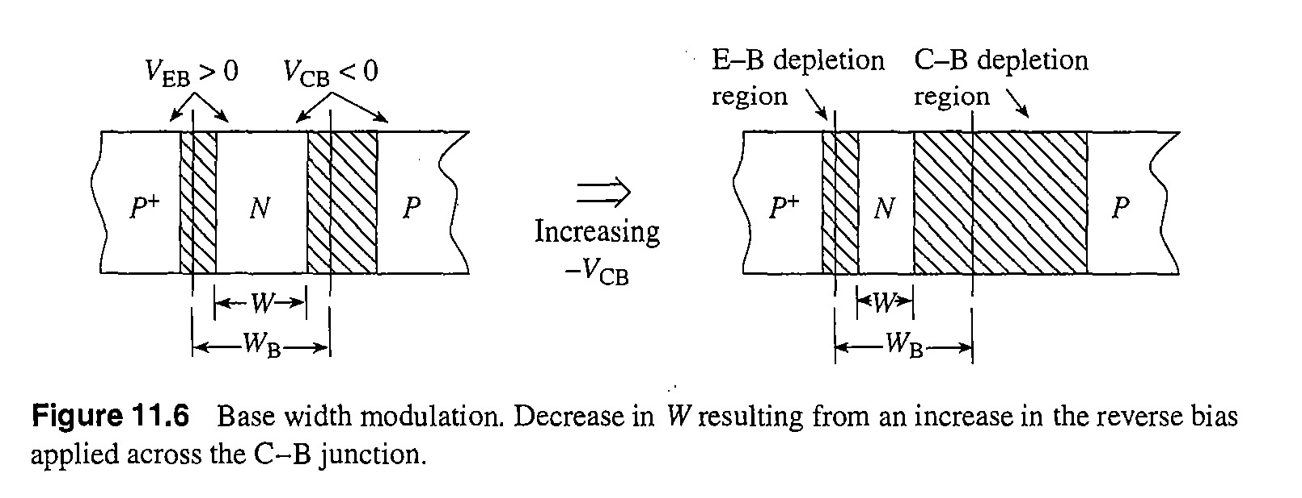
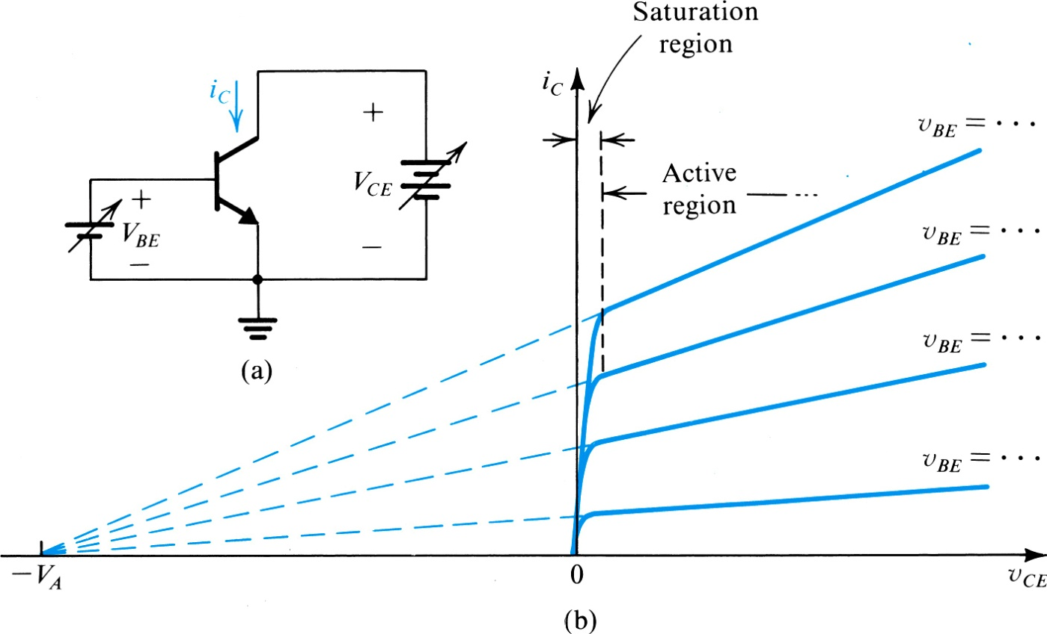
Base-Width Narrowing: the Early Effect
Robert F. Pierret, Semiconductor Device Fundamentals, Prentice Hall, 1996
The intersection of the i_{C}-v_{CE} curves is known as the “Early Voltage” after James Early.

Slide 18
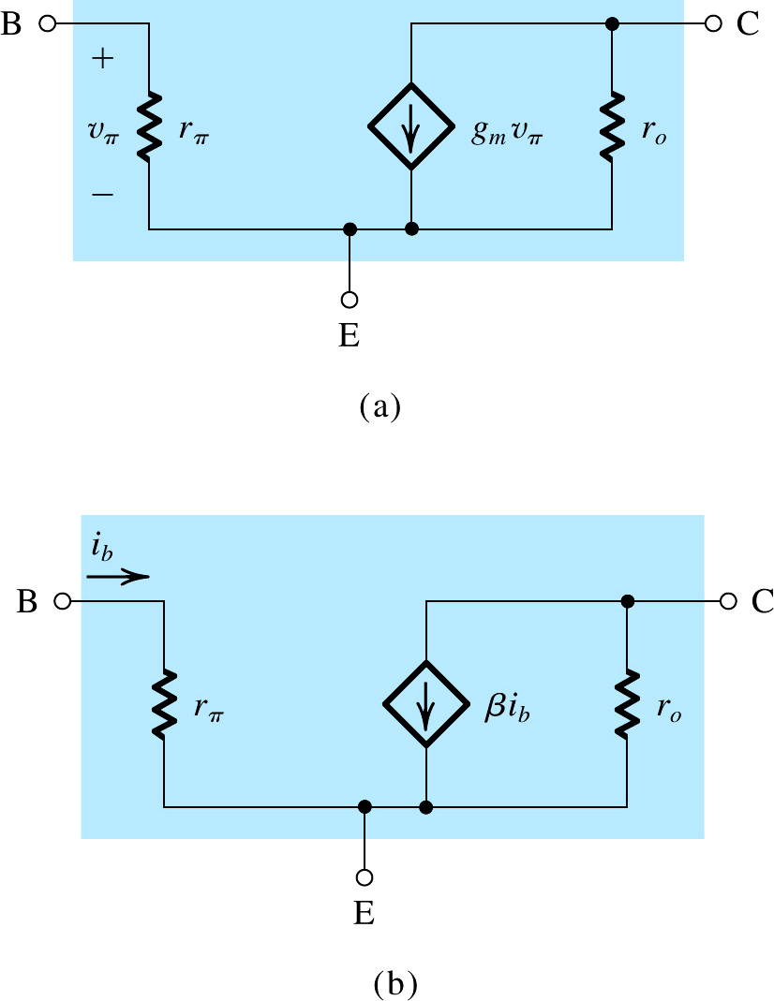
i_{c}
Modeling the Early Effect
+
v_{ce}
-
With a resistance in parallel with the current source, i_{c} is the sum of g_{m}v_{be} and v_{ce}/r_{o}, which more accurately predicts the i_{c} - v_{ce} behavior.
i_{c}
+
v_{ce}
-
Figure 6.47 The hybrid-π small-signal model, in its two versions, with the resistance r_{o} included.
Microelectronic Circuits, Sixth Edition
Sedra/Smith Copyright © 2010 by Oxford University Press, Inc.

Slide 19
Finding ac model parameters from the characteristic curves
Output Resistance r_{o}
We have already seen that the slope of the i_{C} – v_{CE} curve gives r_{o}.
slope = 1/r_{ο}

Slide 20
Current Gain β
We defined current gain as β = I_{B}/I_{C} when we looked at the dc BJT. For ac, gain is β = Δi_{C}/Δi_{B}.

Slide 21
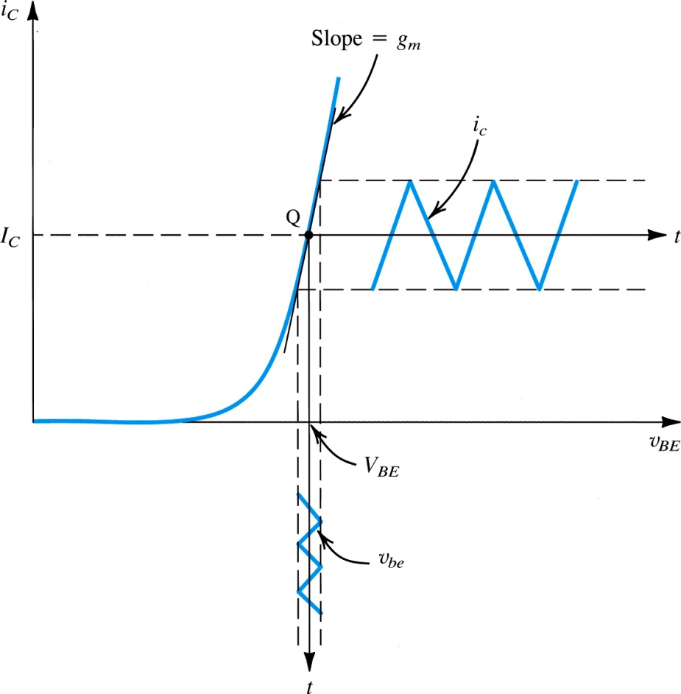
i_{B}
slope = 1/r_{π}
Base Resistance r_{π}
i_{b}
If we look at the change in i_{b} with v_{be} (ac component of the graph to the left) we will find the inverse of r_{π}.
I_{B}
Relationship to dc parameters

Slide 22
slope = g_{m}
Transconductance g_{m}
If we look at the change in i_{c} with v_{be} (ac component of the graph to the left) we will find g_{m}.
Relationship to dc parameters

Slide 23
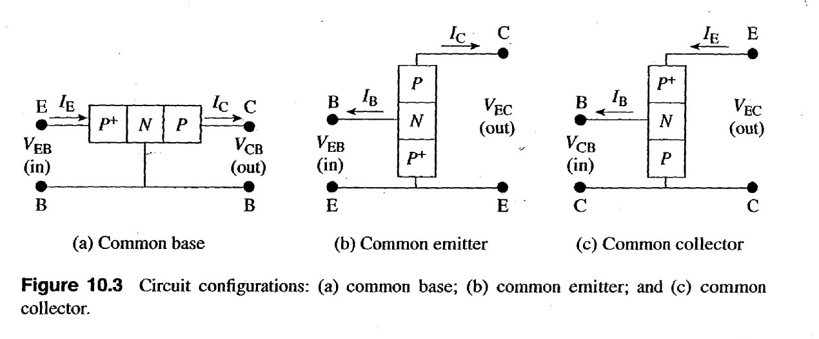
There are three terminals; since we need two for input and two for output, there are three possible combinations, with one “common” terminal in each case.
Pierret, “Semiconductor Device Fundamentals”, Prentice Hall, 1996

Slide 24
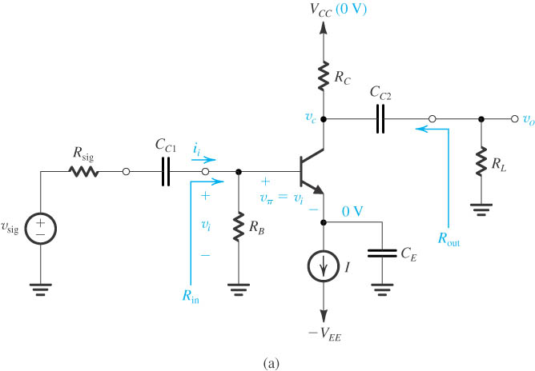
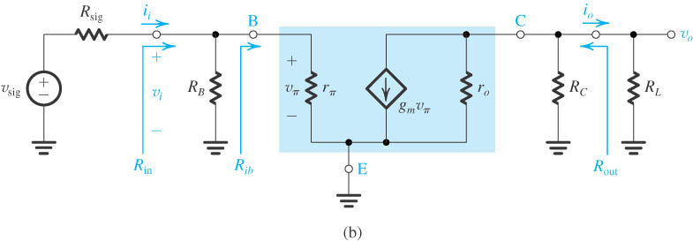
Common Emitter
Input resistance
moderate/small
Output resistance
large
Open Circuit Voltage gain
large
Short Circuit Current gain
large
Large voltage and current gain but R_{in} and R_{o} not good for voltage amplifier.
Figure 5.60 (a) A common-emitter amplifier using the structure of Fig. 5.59. (b) Equivalent circuit obtained by replacing the transistor with its hybrid-π model.

Slide 25
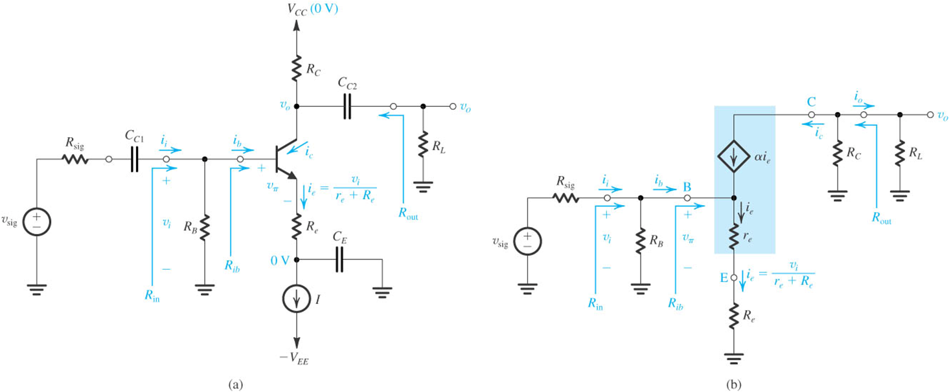
Common Emitter with R_{E}
R_{e} increases R_{in} but reduces open circuit voltage gain. Current gain and output resistance are unchanged.
Input resistance
Open Circuit Voltage gain
increased
reduced
R_{ib} greatly increased by resistance reflection rule (Miller)
Voltage gain reduced by ~ (1+g_{m}R_{e}); R_{ib} increased by this factor.
Figure 5.61 (a) A common-emitter amplifier with an emitter resistance R_{e}. (b) Equivalent circuit obtained by replacing the transistor with its T model.

Slide 26
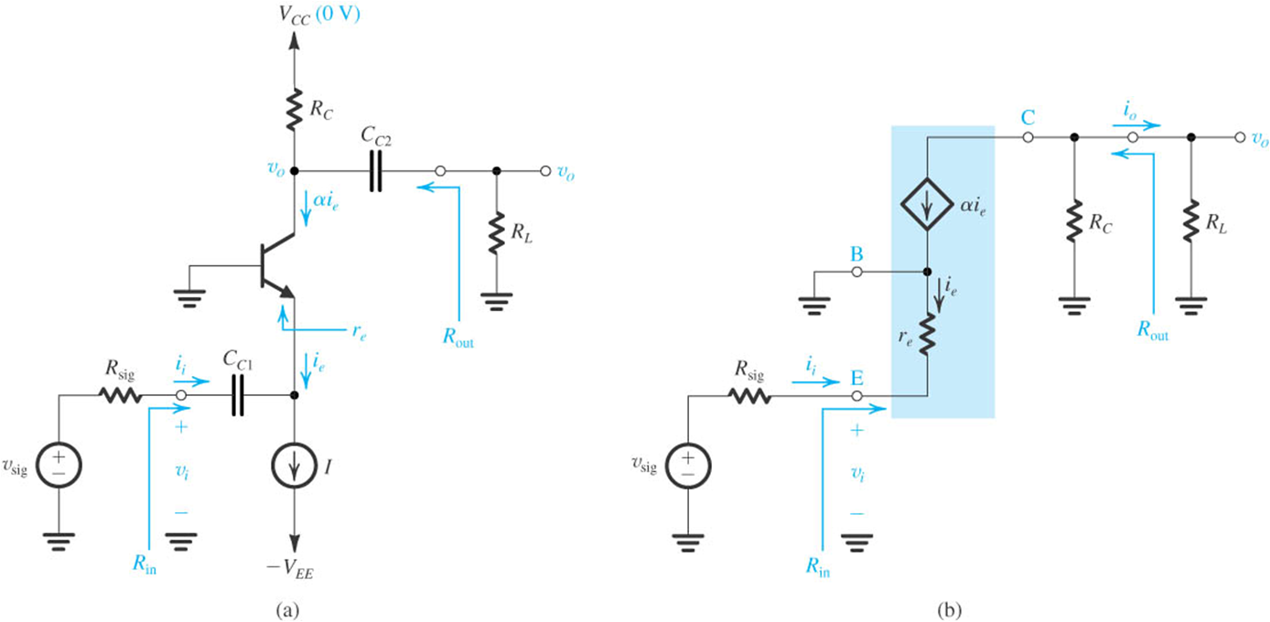
Common Base
Input resistance
Open Circuit Voltage gain
Short Circuit Current gain
small
large
unity
Output resistance
Non-inverting version of common emitter.
large
Figure 5.62 (a) A common-base amplifier using the structure of Fig. 5.59. (b) Equivalent circuit obtained by replacing the transistor with its T model.
Good for unity gain current buffer.

Slide 27
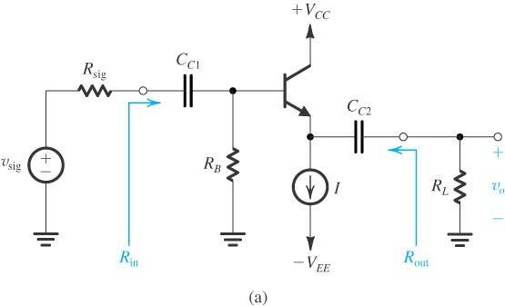
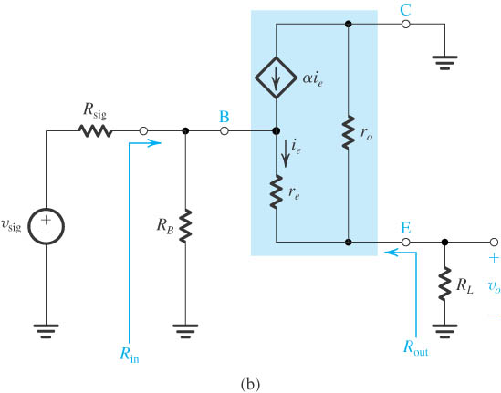
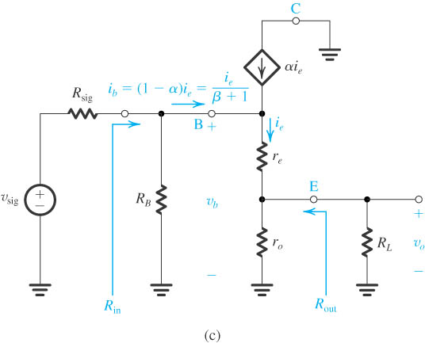
Common Collector
Figure 5.63 (a) An emitter-follower circuit based on the structure of Fig. 5.59. (b) Small-signal equivalent circuit of the emitter follower with the transistor replaced by its T model augmented with r_{o}. (c) The circuit in (b) redrawn to emphasize that r_{o} is in parallel with R_{L}. This simplifies the analysis considerably.

Slide 28
Input resistance
$$R_{in}=R_{B}||R_{ib}$$
large
$$R_{ib}=(β+1)(r_{e}+r_{o}||R_{L})$$
Output resistance
$$R_{out}=r_{o}||\left(r_{e}+\frac{R_{sig}}{β+1}\right)$$
small
Open Circuit Voltage gain
Current gain
$$\frac{v_{o}}{v_{sig}}=\frac{r_{o}||R_{L}}{\frac{R_{sig}}{(β+1)}+r_{e}+(r_{o}||R_{L})}$$
~unity
large
Voltage gain ~1 so emitter follows base input voltage (emitter follower)
Good for amplifier output stage: large R_{in}, small R_{out}.

