Slide 1

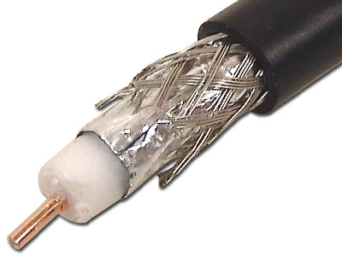
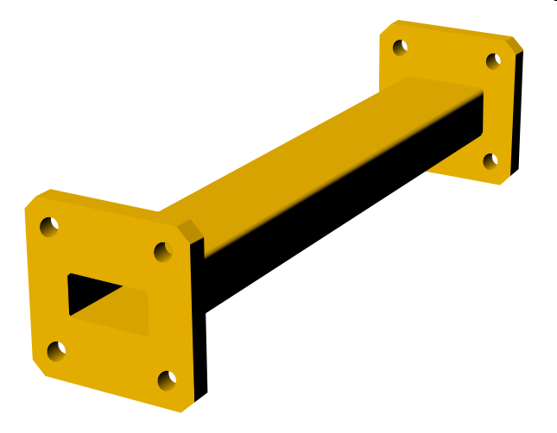
Adapted from notes by Prof. Jeffery T. Williams
ECE 5317-6351
Microwave Engineering
Fall 2019
Prof. David R. Jackson
Dept. of ECE
Notes 1
Waveguiding Systems

Slide 2
Waveguiding Structures
A waveguiding structure is one that carries a signal (or power) from one point to another.
There are three common types:
Transmission lines
Fiber-optic guides
Waveguides
Note:
An alternative to using waveguiding structures is wireless transmission using antennas.
(Wireless systems are discussed later. Antennas are discussed in ECE 5318.)

Slide 3
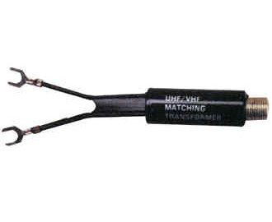
Transmission Line
Properties
Has two conductors running parallel (one can be inside the other)
Can propagate a signal at any frequency (in theory)
Becomes lossy at high frequency
Can handle low or moderate amounts of power
Does not have signal distortion, unless there is loss (but there always is)
May or may not be immune to interference (shielding property)
Does not have E_{z} or H_{z} components of the fields (TEM_{z})
Twin lead
(shown connected to a 4:1 impedance-transforming balun)
Coaxial cable (coax)

Slide 4
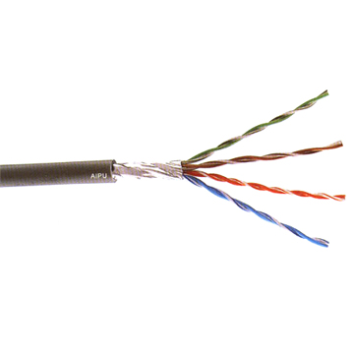
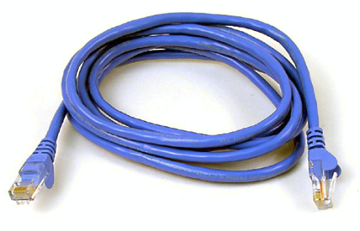
Transmission Line (cont.)
CAT 5 cable
(twisted pair)
The two wires of the transmission line are twisted to reduce interference and radiation from discontinuities.

Slide 5
Transmission Line (cont.)
Transmission lines commonly met on printed-circuit boards
Microstrip
Stripline
Coplanar strips
Coplanar waveguide (CPW)

Slide 6
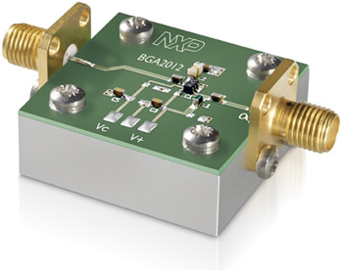
Transmission Line (cont.)
Transmission lines are commonly met on printed-circuit boards.
Microstrip line
A microwave integrated circuit.

Slide 7

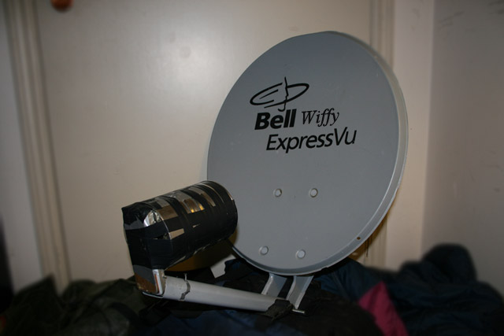
Waveguides
Properties
Consists of a single hollow metal pipe
Can propagate a signal only at high frequency: f > f_{c}
The width must be at least one-half of a wavelength
Has signal distortion, even in the lossless case
Immune to interference
Can handle large amounts of power
Has low loss (compared with a transmission line)
Has either E_{z} or H_{z} component of the fields (TM_{z} or TE_{z})
http://en.wikipedia.org/wiki/Waveguide_(electromagnetism)

Slide 8
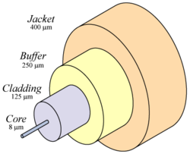
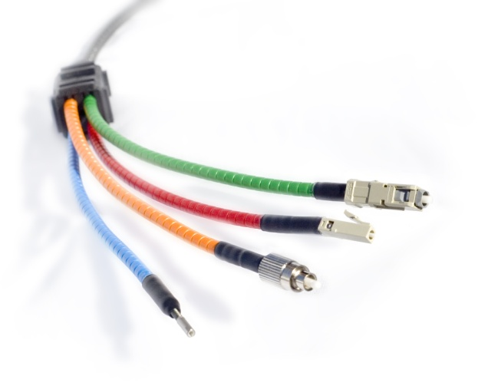
Fiber-Optic Guide
Properties
Uses a dielectric rod
Operates at optical (infrared) frequencies
Can be made to have very low loss
Has minimal signal distortion
Has a very high bandwidth
Very immune to interference
Not suitable for high power
Has both E_{z} and H_{z} components of the fields (“hybrid mode”)

Slide 9
Fiber-Optic Guide (cont.)
Two types of fiber-optic guides:
1) Single-mode fiber
Carries a single mode, as with the mode on a transmission line or waveguide. Requires the fiber diameter to be small relative to a wavelength.
2) Multi-mode fiber
Has a fiber diameter that is large relative to a wavelength. It operates on the principle of total internal reflection (critical angle effect).
Note: The carrier is at optical frequency, but the modulating (baseband) signal is often at microwave frequencies (e.g., TV, internet signal).

Slide 10
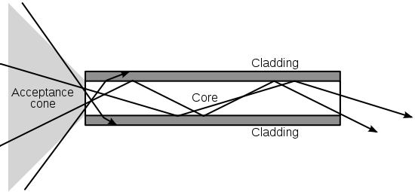
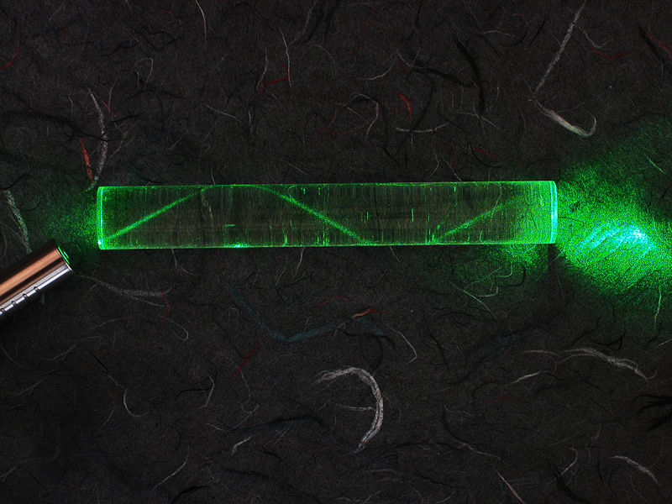
Fiber-Optic Guide (cont.)
Multi-mode Fiber
Higher index core region
http://en.wikipedia.org/wiki/Optical_fiber

