Slide 1
Adapted from notes by Prof. Jeffery T. Williams
ECE 5317-6351
Microwave Engineering
Fall 2019
Prof. David R. Jackson
Dept. of ECE
Notes 11
Waveguiding Structures Part 6:
Planar Transmission Lines

Slide 2
Planar Transmission Lines
ε_{r}
ε_{r}
Microstrip
Stripline
w
w
ε_{r}
ε_{r}
Coplanar Waveguide (CPW)
Conductor-backed CPW
ε_{r}
ε_{r}
Slotline
Conductor-backed Slotline

Slide 3
Planar Transmission Lines (cont.)
ε_{r}
ε_{r}
Coplanar Strips (CPS)
Conductor-backed CPS
Stripline is a planar version of coax.
Coplanar strips (CPS) is a planar version of twin lead.

Slide 4
Stripline
Common on circuit boards
Fabricated with two circuit boards
Homogenous dielectric
(perfect TEM mode*)
TEM mode
* The mode is a perfect TEM mode if there is no conductor loss.
(also TE & TM Modes at high frequency)
Field structure for TEM mode:
Electric Field
Magnetic Field

Slide 5
Stripline (cont.)
Analysis of stripline is not simple.
TEM mode fields can be obtained from an electrostatic analysis (e.g., conformal mapping).
A closed stripline structure is analyzed in the Pozar book by using an approximate numerical method:
(to simulate stripline)

Slide 6
Stripline (cont.)
Conformal Mapping Solution (R. H. T. Bates)
Exact solution (for t = 0):
K = complete elliptic integral of the first kind
R. H. T. Bates, “The characteristic impedance of the shielded slab line,” IEEE Trans. Microwave Theory and Techniques, vol. 4, pp. 28-33, Jan. 1956.

Slide 7
Stripline (cont.)
Curve fitting this exact solution:
Effective width
Fringing term
Note:
The factor of 1/2 in front is from the parallel combination of two ideal PPWs.

Slide 8
Stripline (cont.)
Inverting this solution to find w for given Z₀:

Slide 9
Stripline (cont.)
Attenuation
Dielectric Loss:
(TEM formula)

Slide 10
Stripline (cont.)
Conductor Loss:
Note: We cannot let t → 0 when we calculate the conductor loss.

Slide 11
Stripline (cont.)
Note about conductor attenuation:
It is necessary to assume a nonzero conductor thickness in order to accurately calculate the conductor attenuation.
The perturbational method predicts an infinite attenuation if a zero thickness is assumed.
Practical note:
A standard metal thickness for PCBs is 0.7 [mils] (17.5 [μm]), called “half-ounce copper”.
1 mil = 0.001 inch

Slide 12
Microstrip
Inhomogeneous dielectric
⇒ No TEM mode
Note: Pozar uses (W, d)
TEM mode would require k_{z} = k in each region, but k_{z} must be unique!
Requires advanced analysis techniques
Exact fields are hybrid modes (E_{z} and H_{z})
For h /λ₀ << 1, the dominant mode is quasi-TEM.

Slide 13
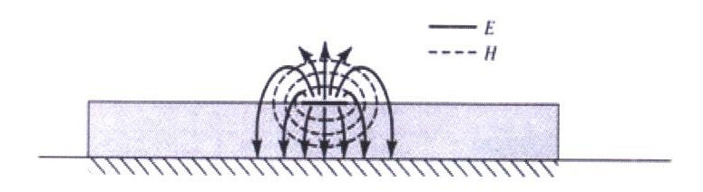
Microstrip (cont.)
Part of the field lines are in air,
and part of the field lines are inside the substrate.
Figure from Pozar book
Note:
The flux lines get more concentrated in the substrate region as the frequency increases.

Slide 14

Microstrip (cont.)
Equivalent TEM problem:
Actual problem
The effective permittivity gives the correct phase constant.
The effective strip width gives the correct Z₀.
Equivalent TEM problem

Slide 15
Microstrip (cont.)
Effective permittivity:
Note:
This formula ignores “dispersion”, i.e., the fact that the effective permittivity is actually a function of frequency.
Limiting cases:
(narrow strip)
(wide strip)

Slide 16
Microstrip (cont.)
Characteristic Impedance:
Note:
This formula ignores the fact that the characteristic impedance is actually a function of frequency.

Slide 17
Microstrip (cont.)
Inverting this solution to find w for a given Z₀:
where

Slide 18
Microstrip (cont.)
More accurate formulas for characteristic impedance that account for dispersion (frequency variation) and conductor thickness:

Slide 19
Microstrip (cont.)
where
Note:

Slide 20
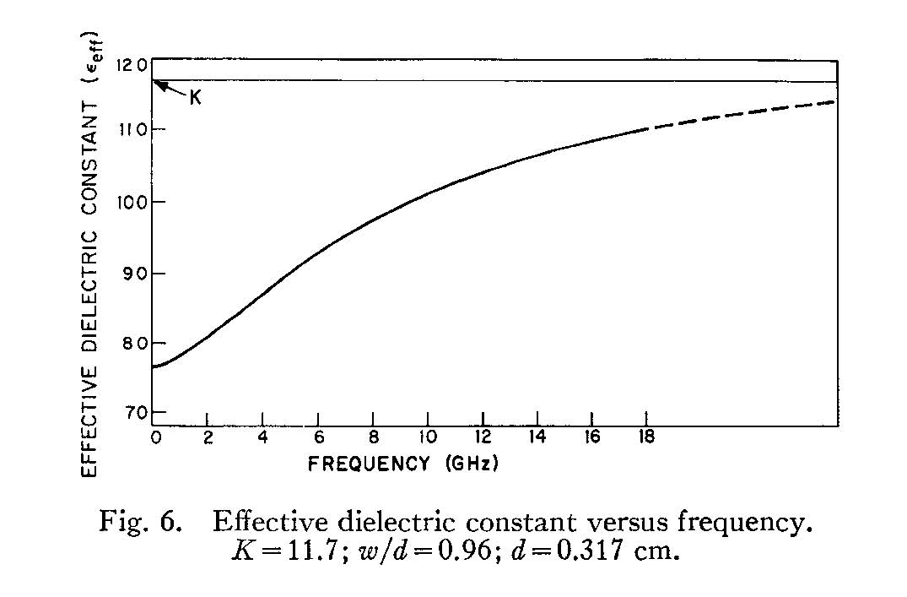
Microstrip (cont.)
12.0
11.0
10.0
Effective dielectric constant
9.0
Frequency variation
(dispersion)
8.0
“A frequency-dependent solution for microstrip transmission lines," E. J. Denlinger, IEEE Trans. Microwave Theory and Techniques, Vol. 19, pp. 30-39, Jan. 1971.
7.0
Frequency (GHz)
Parameters: ε_{r} = 11.7, w/h = 0.96, h = 0.317 cm
Note:
The flux lines get more concentrated in the substrate region as the frequency increases.
Note:
The phase velocity is a function of frequency, which causes pulse distortion.
Quasi-TEM region

Slide 21
Microstrip (cont.)
Attenuation
Dielectric loss:
“filling factor”
Conductor loss:
very crude (“parallel-plate”) approximation
(More accurate formulas are given on next slide.)

Slide 22
Microstrip (cont.)
More accurate formulas for conductor attenuation:
This is the number e = 2.71828 multiplying the term in parenthesis.

Slide 23
Microstrip (cont.)
REFERENCES
L. G. Maloratsky, Passive RF and Microwave Integrated Circuits, Elsevier, 2004.
I. Bahl and P. Bhartia, Microwave Solid State Circuit Design, Wiley, 2003.
R. A. Pucel, D. J. Masse, and C. P. Hartwig, “Losses in Microstrip,” IEEE Trans. Microwave Theory and Techniques, pp. 342-350, June 1968.
R. A. Pucel, D. J. Masse, and C. P. Hartwig, “Corrections to ‘Losses in Microstrip’,” IEEE Trans. Microwave Theory and Techniques, Dec. 1968, p. 1064.

Slide 24

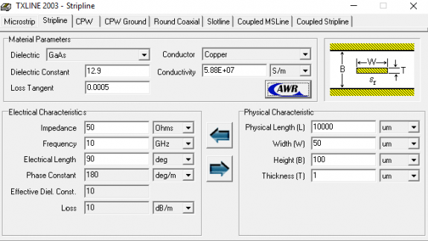
TXLINE
This is a public-domain software for calculating the properties of some common planar transmission lines.
https://www.awr.com/software/options/tx-line

