Slide 1
Adapted from notes by Prof. Jeffery T. Williams
ECE 5317-6351
Microwave Engineering
Fall 2019
Prof. David R. Jackson
Dept. of ECE
Notes 12
Waveguiding Structures Part 7:
Transverse Equivalent Network (TEN)

Slide 2
Waveguide Transmission Line Model
Our goal is to come up with a transmission line model for a waveguide mode.
The waveguide mode is not a TEM mode, but it can be modeled as a wave on a transmission line.
+
-
“Transverse Equivalent Network” model of TE₁₀ waveguide mode

Slide 3
Waveguide Transmission Line Model (cont.)
For a waveguide mode, voltage and current are not uniquely defined.
TE₁₀ Mode
-
+
The voltage depends on x!

Slide 4
Waveguide Transmission Line Model (cont.)
Examine the transverse (x, y) fields of a waveguide mode:
Modal amplitudes
Note:
The shape function e_{t} (x,y) has an arbitrary amplitude normalization.
Note: The minus sign above arises from:
Wave impedance

Slide 5
Waveguide Transmission Line Model (cont.)
Introduce a defined voltage into the field equations:
We may use whatever definition of voltage we wish here.
(In other words, C₁ is arbitrary.)
We then have:

Slide 6
Waveguide Transmission Line Model (cont.)
Next, introduce a characteristic impedance (having an arbitrary value) into the equations:
where

Slide 7
Waveguide Transmission Line Model (cont.)
Summary of Fields
The z dependence of the transverse fields behaves like
voltage and current on a transmission line.

Slide 8
Waveguide Transmission Line Model (cont.)
The transmission-line model is called the
Transverse Equivalent Network (TEN)
model of the waveguide.
+
-
same k_{z}
Waveguide

Slide 9
Waveguide Transmission Line Model (cont.)
Power flow down the waveguide (complex power):
Complex power flowing down the TEN transmission line.

Slide 10
Waveguide Transmission Line Model (cont.)
Assume we choose to have:
Then we have the following constraint:
It is not necessary to make this assumption of equal powers,
but it is a useful choice that can be made (we will adopt this choice).

Slide 11
Waveguide Transmission Line Model (cont.)
Summary of Constants
(assuming equal powers)
Once we pick Z₀, the constants are determined.
The most common choice:

Slide 12
Waveguide Transmission Line Model (cont.)
Summary

Slide 13
TE₁₀ Mode of Rectangular Waveguide
We make the following choices:
Choose Z₀ = Z_{TE}
Assume power equality

Slide 14
TE₁₀ Mode (cont.)
Calculate this term:
so
Note:
The transverse shape function e_{t} has been chosen (arbitrarily) to have a unit amplitude at the center of the waveguide.

Slide 15
TE₁₀ Mode (cont.)
We have:
Take the conjugate of the second one and then multiply the two equations together.
Solution:
Note:
The solution is unique to within a phase term (we choose the phase to be zero here).

Slide 16
TE₁₀ Mode (cont.)
Recall:
Hence:

Slide 17
TE₁₀ Mode (cont.)
Summary for TE₁₀ mode

Slide 18
Example: Waveguide Discontinuity
For a 1 [V/m] (field at the center of the guide) incident TE₁₀ mode in guide A, find the TE₁₀ mode fields in both guides, and the reflected and transmitted powers.
a

Slide 19
Example (cont.)
TEN
Convention:
Choose Z₀ = Z_{TE}
Assume power equality
Note:
C₁ is the same for both guides, but C₂ is different.

Slide 20
Example (cont.)
TEN
Equivalent reflection problem:
Note:
The above TEN enforces the continuity of voltage and current at the junction, and hence the tangential electric and magnetic fields are automatically continuous in the WG problem.

Slide 21
Example (cont.)
Hence we have:
TEN
Recall that for the TE₁₀ mode:

Slide 22
Example (cont.)
Hence, for the waveguide problem we have the fields as:

Slide 23
Example (cont.)
Substituting in for C₁ and e_{t}, we have (guide A):

Slide 24
Example (cont.)
Substituting in for C₂ and h_{t}, we have (guide A):

Slide 25
Example (cont.)
Substituting in for C₁ and e_{t}, we have (guide B):

Slide 26
Example (cont.)
Substituting in for C₂ and h_{t}, we have (guide B):

Slide 27
Example (cont.)
Summary of Fields

Slide 28
Example (cont.)
Power Calculations:
Note: In this example, Z₀ and Γ are real.
Recall:

Slide 29
Example (cont.)
Final Results:
a
Note: 90.1% of the incident power is transmitted.

Slide 30
Quarter-Wave Transformer in Waveguide
A quarter-wave transformer is shown here.
Goal:
Top view
Now 100% of the incident power is now transmitted.

Slide 31
Quarter-Wave Transformer in Waveguide (cont.)
Waveguide problem
Top view
TEN

Slide 32
Quarter-Wave Transformer in Waveguide (cont.)
Design recipe:

Slide 33
Quarter-Wave Transformer in Waveguide (cont.)
Example:
Results:
Top view

Slide 34
Matching Elements in Waveguide
Rectangular Waveguide
(end view)
Note:
Planar discontinuities are modeled as purely shunt elements.
⇒
Inductive iris
⇒
Capacitive iris
⇒
Resonant iris
The equivalent circuit gives us the correct reflection and transmission of the TE₁₀ mode.

Slide 35
Matching Elements in Waveguide (cont.)
Inductive iris in air-filled waveguide
Top view
Note:
The shunt inductor models the effects of the iris and gives the amplitudes of the TE₁₀ mode correctly everywhere, but the TEN model does not tell us how strong the higher-order modes are.
Higher-order mode region
Because the element is a shunt discontinuity, we have
TEN Model

Slide 36
Matching Elements in Waveguide (cont.)
Much more information can be found in the following reference:
N. Marcuvitz, Waveguide Handbook, Peter Perigrinus, Ltd. (on behalf of the Institute of Electrical Engineers), 1986.
Equivalent circuits for many types of discontinuities
Accurate CAD formulas for many of the discontinuities
Graphical results for many of the cases
Sometimes, measured results

Slide 37
Using Irises for Matching
An iris is shown here being used for matching to a load
(illustrated for a horn antenna load).
Top view
An inductive iris is shown being used for matching.

Slide 38
Using Irises for Matching (cont.)
The TEN is shown
Physical Problem
TEN Model

Slide 39
Using Irises for Matching (cont.)
A field probing can be used to determine the unknown load impedance Z_{L}.

Slide 40
Using Irises for Matching (cont.)
A field probing can be used to determine the unknown load impedance Z_{L}.
TEN Model

Slide 41
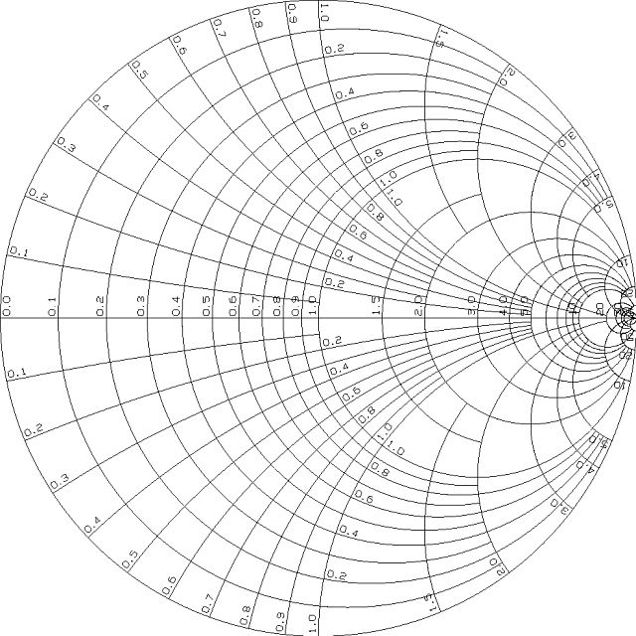
Using Irises for Matching (cont.)
A Smith chart can be used to find the unknown load impedance.

Slide 42
Using Irises for Matching (cont.)
A Smith chart can also be used to find the location of the shunt susceptance and its value.

Slide 43
Using Irises for Matching (cont.)
Note:
We must use this upper point for an inductive iris.
Choose:

Slide 44
Using Irises for Matching (cont.)
A quarter-wave transformer matching scheme is shown here.
(The arbitrary distance d gives us a “safety buffer” from the horn discontinuity,
to allow the higher-order modes to decay. The extra λ_{g}/2 is also a safety buffer.)
Top view
Quarter-wave transformer
Safety buffers
The iris is used to cancel the input susceptance at z = -d.

Slide 45
Using Irises for Matching (cont.)
Choose:

Slide 46
Using Irises for Matching (cont.)
Now we don’t need an iris!

