Slide 1
Adapted from notes by Prof. Jeffery T. Williams
ECE 5317-6351
Microwave Engineering
Fall 2019
Prof. David R. Jackson
Dept. of ECE
Notes 19
Multistage Transformers

Slide 2
Single-stage Transformer
A single-stage transformer length is shown below.
Note: Normally θ₁ = π /2 at the center frequency.

Slide 3
Single-stage Transformer (cont.)
Assume small reflections:
(This neglects terms that are quadratic and higher.)

Slide 4
Multistage Transformer
Assuming small reflections:
where
Note that this is a polynomial in powers of z = exp(-j2θ).

Slide 5
Multistage Transformer (cont.)
(N+1 terms)
If we assume symmetric reflections of the sections about the center of the structure (not a symmetric layout of line impedances), we have:
or
Last term

Slide 6
Multistage Transformer (cont.)
Hence, for symmetric reflections we can also write:
Note: This is a finite Fourier cosine series.

Slide 7
Multistage Transformer (cont.)
Design philosophy:
If we choose a response for Γ(θ ) that is in the form of either a polynomial (in powers of z = exp (-j2θ )) or a Fourier cosine series, we can obtain the needed values of Γ_{n} and hence complete the design.
Design #1
or
(does not assume symmetric reflections)
Design #2
(assumes symmetric reflections)

Slide 8
Multistage Transformer (cont.)
Two common designs:
Binomial (Butterworth):
  This design has the “flattest” response about the center frequency.
  This is an example of Design 1.
Chebyshev:
  This design has a constant ripple over the bandwidth.
  This design has the largest bandwidth for a given acceptable level of reflection coefficient.
  This is an example of Design 2.

Slide 9
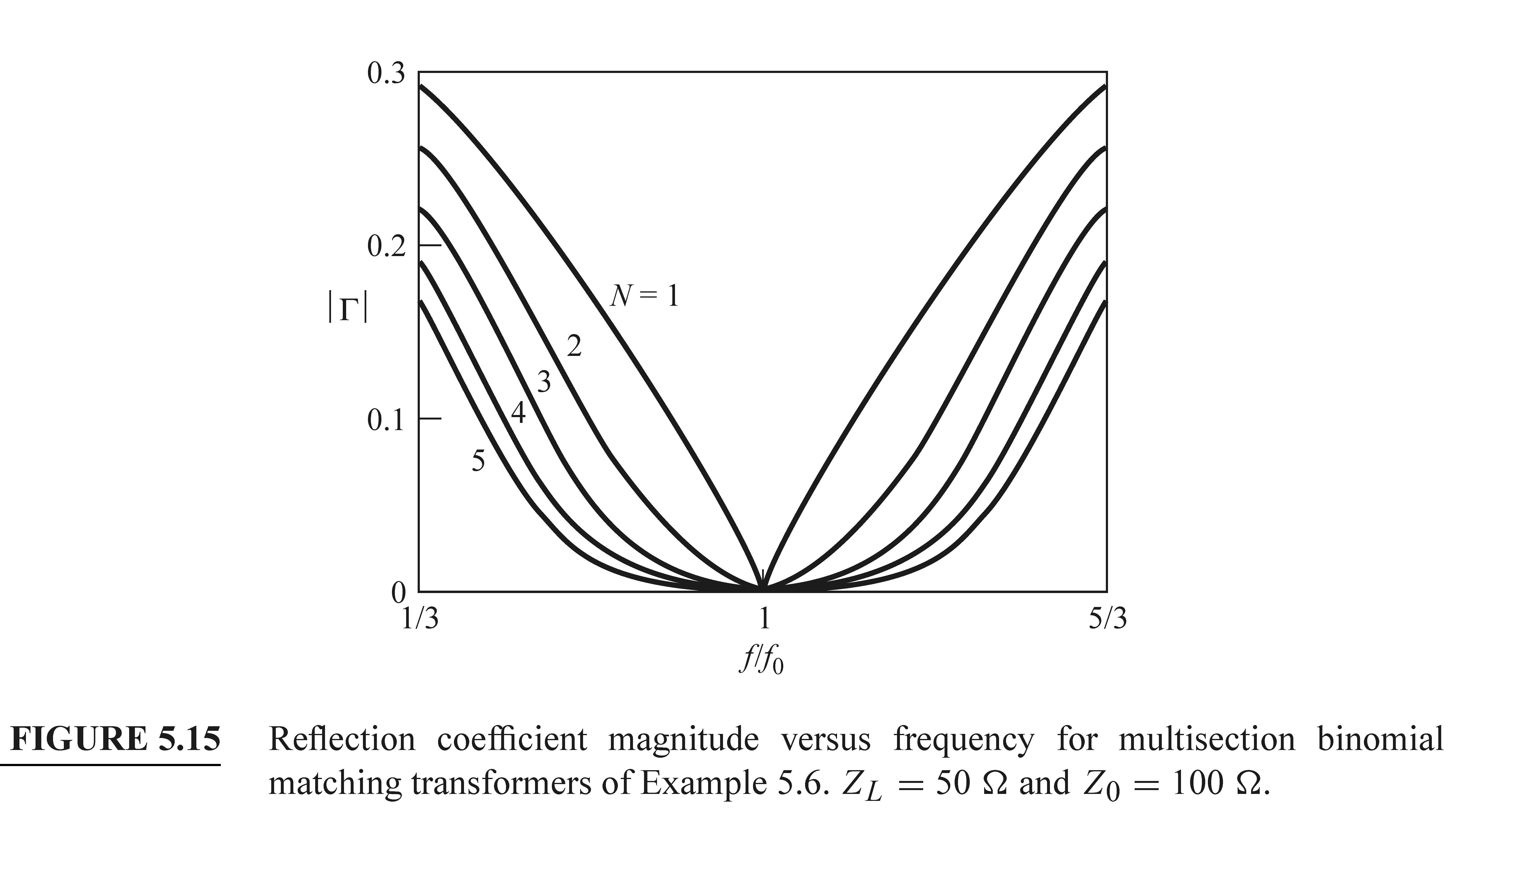
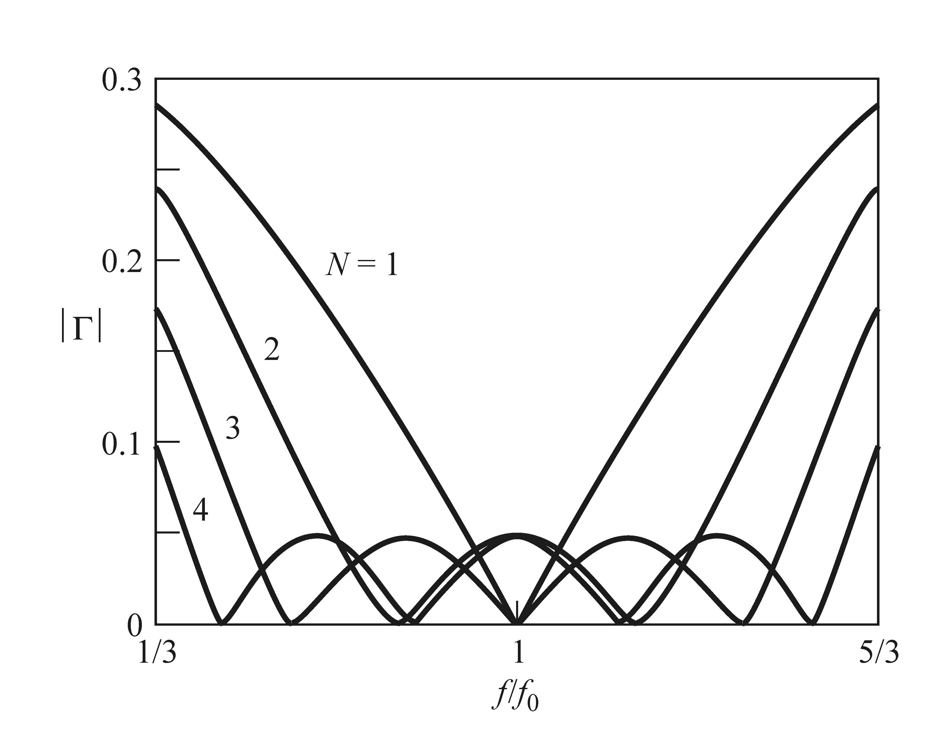
Multistage Transformer (cont.)
Examples of Reflection Coefficient Responses
Binomial
Chebyshev

Slide 10
Binomial (Butterworth*) Multistage Transformer
This is an example of Design #1.
Choose:
(A is real, could be positive or negative)
(alternative useful form)
*The name comes from the British physicist/engineer Stephen Butterworth, who described the design of filters using the binomial principle in 1930.

Slide 11
Binomial Multistage Transformer (cont.)
Maximally flat property:
Use:
Choose all lines to be a quarter wavelength at the center frequency so that
(We have a perfect match at the center frequency.)
The reflection coefficient stay small for as wide a frequency as possible.

Slide 12
Binomial Multistage Transformer (cont.)
Using the binomial expansion, we can express the Butterworth response in terms of a polynomial series:
A binomial type of response is obtained if we thus choose
We want to use a multistage transformer to realize this type of response.
Set equal
(Both are now in the form of polynomials.)
First, we need to solve for A.

Slide 13
Binomial Multistage Transformer (cont.)
Solving for A:
Use:
Hence
Also
(A zero-length set of lines has no effect.)
Equating these two limiting results, we have

Slide 14
Binomial Multistage Transformer (cont.)
Then solving for Γ_{n}:
Set equal
Equating responses for each term in the polynomial series gives us:
Hence
or

Slide 15
Binomial Multistage Transformer (cont.)
Solving for Z_{n+1}, we have:
where
Note:
The Pozar book also introduces an approximate form of this equation involving ln(Z_{L} / Z₀). It is recommend to use this exact form.
This gives us a solution for the line impedances
(a recursive formula).

Slide 16
Binomial Multistage Transformer (cont.)
Note on reflection coefficients
Note that:
Hence
Although we did not assume that the reflection coefficients were symmetric in the design process (Design #1), they actually come out that way for the binominal design.

Slide 17
Binomial Multistage Transformer (cont.)
Note:
The table only shows data for Z_{L} > Z₀ since the design can be reversed (Ioad and source switched) for Z_{L} < Z₀.
(All of the Γ_{n} values become their negative, but this does not change the |Γ| response.)

Slide 18
Binomial Multistage Transformer (cont.)
Example showing a microstrip line
A three-stage transformer is shown.

Slide 19
Binomial Multistage Transformer (cont.)
Note:
Increasing the number of lines increases the bandwidth.

Slide 20
Binomial Multistage Transformer (cont.)
Bandwidth
First choose Γ_{m}
Maximum acceptable reflection
The relative bandwidth is then:
Hence

Slide 21
Binomial Multistage Transformer (cont.)
Summary of Design Formulas
Reflection coefficient response
A coefficient
Design of line impedances
Bandwidth

Slide 22
Example
Example: Three-stage binomial transformer
Given:

Slide 23
Example (cont.)
We then have:

Slide 24
Example (cont.)
The results for the line impedances are:

Slide 25
Example (cont.)
Using the table in Pozar we have:
(The above normalized load impedance is the reciprocal of what we actually have.)
Hence, switching the load and the source ends, we have
Therefore, we have

Slide 26
Example
Bandwidth:
Note:
A single quarter-wave transformer has a bandwidth of about 6% (for Γ_{m} = 0.05).

Slide 27
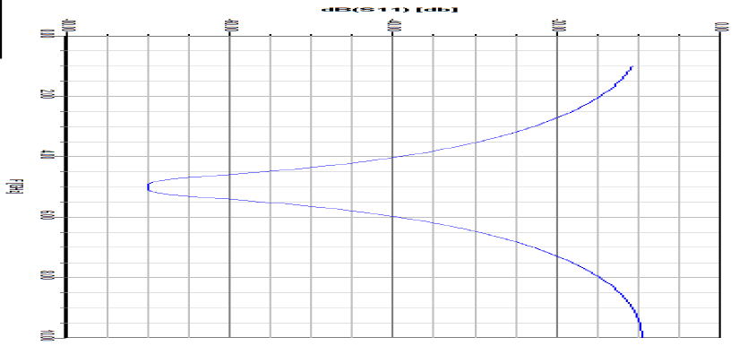
Example (cont.)
Microstrip
Response from Ansys Designer (5 GHz Design)

Slide 28
Load Check for Consistency
Consider an N stage transformer:
We have N line impedances:
We have N+1 reflection coefficients:
If we start at the input end and work our way up, our Z_{n} values we will ensure that the first N reflection coefficients are correct. We then have no control over the final one, Γ_{N}. We can calculate Z_{N} to check the consistency (see how close it is to the specified load value).

Slide 29
Load Check for Consistency (cont.)
Example: Previous N = 3 Butterworth design
For the load we have:
(Not exact, but fairly consistent)

Slide 30
Chebyshev Multistage Matching Transformer
This is an example of Design #2.
Chebyshev polynomials of the first kind:
We choose the response to be in the form of a Chebyshev polynomial.
(This will lead to a finite Fourier cosine series in θ.)

Slide 31
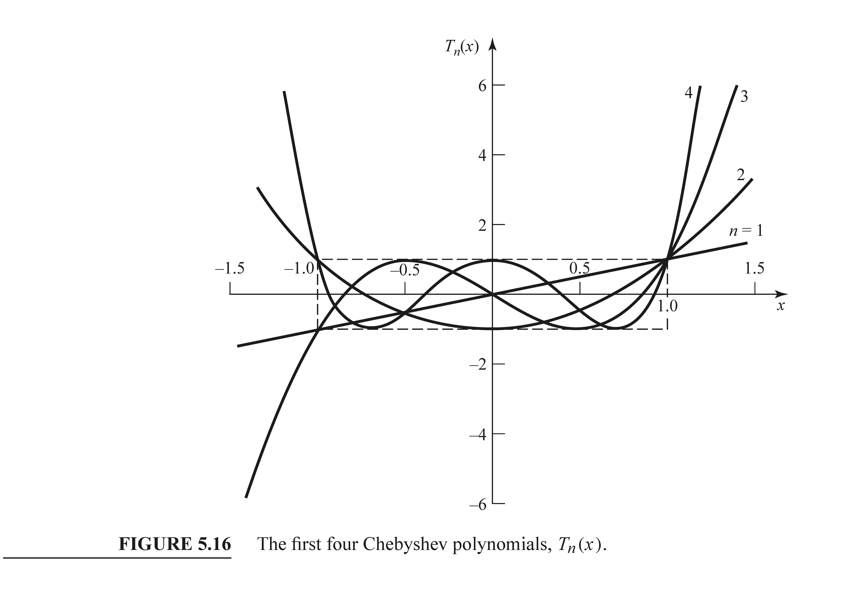
Chebyshev Transformer (cont.)

Slide 32
Chebyshev Transformer (cont.)
A Chebyshev response will have equal ripple within the bandwidth.
Choose:
This can be put into a form involving the terms cos (nθ )
(i.e., a finite Fourier cosine series).
Note: As frequency decreases, x increases.

Slide 33
Chebyshev Transformer (cont.)
We have that, after some algebra,
Hence, the term T_{N} (secθ_{m} cosθ ) can be cast into a finite cosine Fourier series expansion.
There is no general formula though!

Slide 34
Chebyshev Transformer (cont.)
Transformer design
Choice of response:
General form of response (Design #2):
From the above formulas we can extract the coefficients Γ_{n}
(no general formula is available).

Slide 35
Chebyshev Transformer (cont.)
Solve for A:

Slide 36
Chebyshev Transformer (cont.)
Alternative formula for A:
Which sign is correct?
Hence

Slide 37
Chebyshev Transformer (cont.)
Calculation of θ_{m}
Also, we have from the definition of the Chebyshev polynomial:
Hence, we have

Slide 38
Chebyshev Transformer (cont.)
From the last slide we have
We then have

Slide 39
Chebyshev Transformer (cont.)
Summary of Design Formulas
Reflection coefficient response
θ_{m} term
A coefficient
No formula is given for the line impedances. Use the Table from Pozar or generate (“by hand”) the solution by expanding Γ(θ ) into a polynomial with terms cos (nθ ).
Design of line impedances
Bandwidth

Slide 40
Chebyshev Transformer (cont.)
Note: The table only shows data for Z_{L} > Z₀ since the design can be reversed
(Ioad and source switched) for Z_{L} < Z₀ .

Slide 41
Example
Example: Three-stage Chebyshev transformer
Given:

Slide 42
Example
Example: Three-stage Chebyshev transformer
Given:
Hence,
Also,
(finite Fourier cosine series form)
Equate

Slide 43
Example
Equating coefficients from the previous equations on the last slide, we have:

Slide 44
Example (cont.)
We now evaluate the reflection coefficients:
Recall:
We then have:

Slide 45
Example (cont.)
Recall:
Results:
(The load is 100 [Ω]; this is pretty close.)

Slide 46
Example (cont.)

Slide 47
Example (cont.)
Bandwidth:

Slide 48
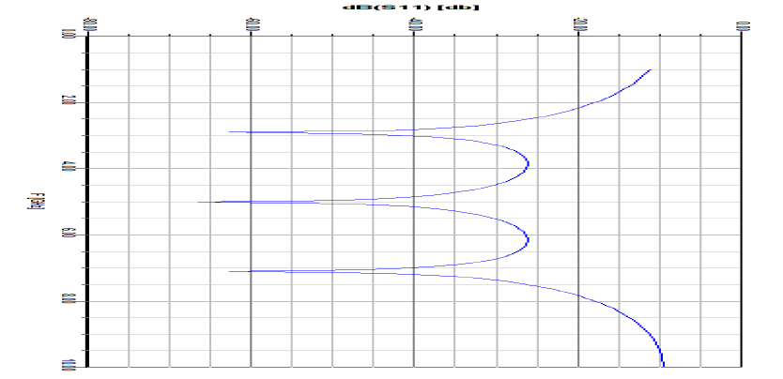
Example (cont.)
Response from Ansys Designer (5 GHz Design)

Slide 49
Comparison of Designs
Comparison of Binomial (Butterworth) and Chebyshev
The Chebyshev design has a higher bandwidth (100% vs. 69%).
The increased bandwidth comes with a price: ripple in the passband.
As the ripple level goes to zero, the Chebyshev response approaches that of the Butterworth.
Note:
It can be shown that the Chebyshev design gives the
highest possible bandwidth for a given N and Γ_{m}.

Slide 50
Comparison of Designs (cont.)
Comparison of Butterworth and Chebyshev Designs (N = 3)
Butterworth
Chebyshev

Slide 51
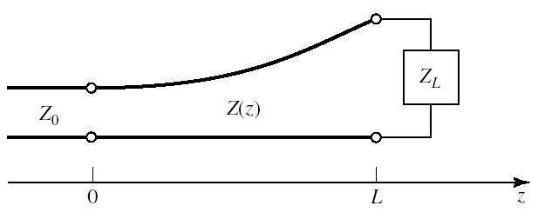
Tapered Transformer
The Pozar book also talks about using continuously tapered lines to match between an input line Z₀ and an output load Z_{L}. (pp. 255-261). Please read this.
The “Klopfenstein taper” gives the Z(z) that is best
(lowest reflection coefficient)
for a given length L.

