Slide 1
Adapted from notes by Prof. Jeffery T. Williams
ECE 5317-6351
Microwave Engineering
Fall 2019
Prof. David R. Jackson
Dept. of ECE
Notes 21
Quadrature Coupler and
Rat-Race Coupler

Slide 2
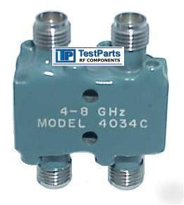
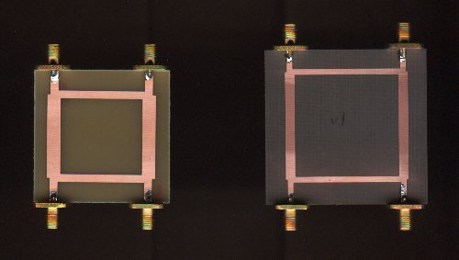
Quadrature (90º) Coupler
“A quadrature coupler is one in which the input is split into two signals (usually with a goal of equal magnitudes) that are 90 degrees apart in phase. Types of quadrature couplers include branchline couplers (also known as quadrature hybrid* couplers), Lange couplers and overlay couplers.”
Taken from “Microwaves 101”
http://www.microwaves101.com/encyclopedia/Quadrature_couplers.cfm
This coupler is very useful for obtaining circular polarization:
There is a 90º phase difference between ports 2 and 3.
Note:
The term “hybrid” denotes the fact that there is an equal (3 dB) power split to the output ports.

Slide 3
Quadrature Coupler (cont.)
1
2
90º Coupler
4
3
The quadrature hybrid is a lossless 4-port (the S matrix is unitary ).
All four ports are matched.
The device is reciprocal (the S matrix is symmetric.)
Port 4 is isolated from port 1, and ports 2 and 3 are isolated from each other.

Slide 4
Quadrature Coupler (cont.)
The quadrature coupler is usually used as a splitter:
1
2
90º Coupler
+90º out of phase
φ₂- φ₃ = 90º
-90º out of phase
φ₂- φ₃ = -90º
4
3
Note: A matched load is usually placed on port 4.
The signal from port 1 splits evenly between ports 2 and 3, with a 90º phase difference.
The signal from port 4 splits evenly between ports 2 and 3, with a -90º phase difference.
Can be used to produce right-handed circular polarization.
Can be used to produce left-handed circular polarization.

Slide 5
Quadrature Coupler (cont.)
Branch-Line Coupler
A microstrip realization of a quadrature hybrid (branch-line coupler) is shown here.
Notes:
We only need to study what happens when we excite port 1, since the structure is physically symmetric.
We use even/odd mode analysis (exciting ports 1 and 4) to figure out what happens when we excite port 1.
An analysis of the branch-line coupler is given in the Appendix.

Slide 6
Quadrature Coupler (cont.)
Summary
The input power to port 1 divides evenly between ports 2 and 3, with ports 2 and 3 being 90º out of phase.
Note: A matched load is usually placed on port 4.

Slide 7
Quadrature Coupler (cont.)
A coupled-line coupler is one that uses coupled lines (microstrip, stripline) with no direct connection between all of the ports.
Please see the Pozar book for more details.
Port 1
Port 2
Port 3
Port 4
This coupler has a 90º phase difference between the output ports (ports 2 and 3), and can be used to obtain an equal (-3 dB) power split or another split ratio.

Slide 8
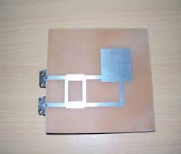
Quadrature Coupler (cont.)
Circularly-polarized microstrip antennas can be fed with a 90º coupler.
One feed port produces RHCP, the other feed port produced LHCP.
Note: This is a better way (higher bandwidth) to get CP than with a simple 90º delay line.

Slide 9
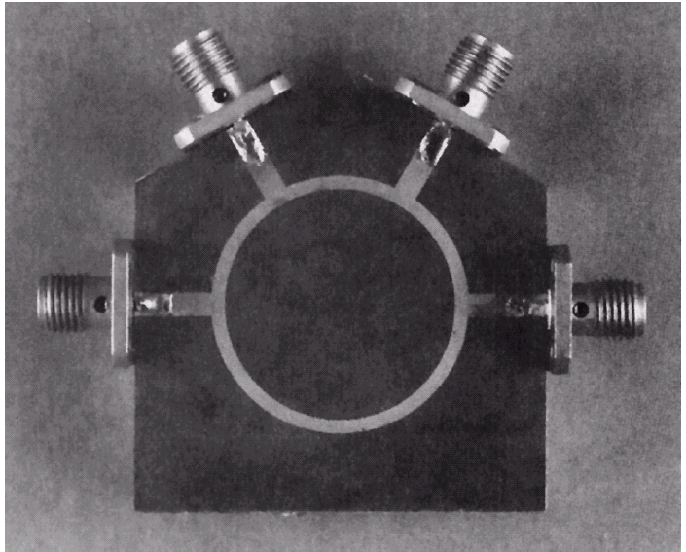
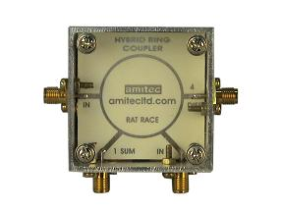
Photograph of a microstrip ring coupler
Courtesy of M. D. Abouzahra, MIT Lincoln Laboratory
Rat-Race Ring Coupler (180º Coupler)
“Applications of rat-race couplers are numerous, and include mixers and phase shifters. The rat-race gets its name from its circular shape, shown below.”
Taken from “Microwaves 101”
http://www.microwaves101.com/encyclopedia/ratrace_couplers.cfm

Slide 10
Rat-Race Coupler (cont.)
1
2
180º Coupler
4
3
The rat race is a lossless 4-port (the S matrix is unitary).
All four ports are matched.
The device is reciprocal (the S matrix is symmetric).
Port 4 is isolated from port 1, and ports 2 and 3 are isolated from each other.

Slide 11
Rat-Race Coupler (cont.)
The rat race can be used as a splitter:
Σ
1
2
180º Coupler
In phase
180º out of phase
Δ
4
3
Note: A matched load is usually placed on port 4.
The signal from the “sum port” Σ (port 1) splits evenly between ports 2 and 3, in phase. This could be used as a power splitter (alternative to Wilkinson).
The signal from the “difference port” Δ (port 4) splits evenly between ports 1 and 2, 180º out of phase. This could be used as a balun.

Slide 12
Rat-Race Coupler (cont.)
The rat race can be used as a combiner:
Signal 1 (V₁)
Σ
1
2
Δ
180º Coupler
4
3
Signal 2 (V₂)
The signal from the sum port Σ (port 1) is the sum of the input signals 1 and 2.
The signal from the difference port Δ (port 4) is the difference of the input signals 1 and 2.

Slide 13
Rat-Race Coupler (cont.)
A microstrip realization is shown here.
An analysis of the rat-race coupler is given in the Appendix.

Slide 14
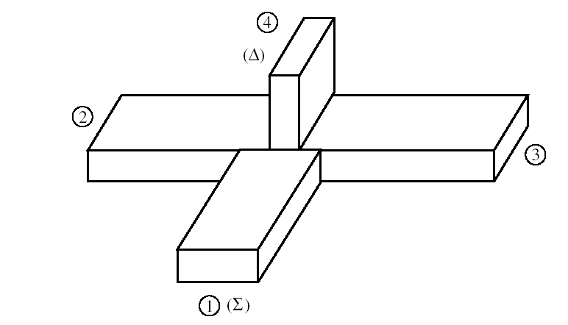

Magic T
A waveguide realization of a 180º coupler is shown here, called a “Magic T.”
“Magic T”
Note: Irises are usually used to obtain matching at the ports.
IEEE Microwave Theory and Techniques Society
Note the logo!

Slide 15
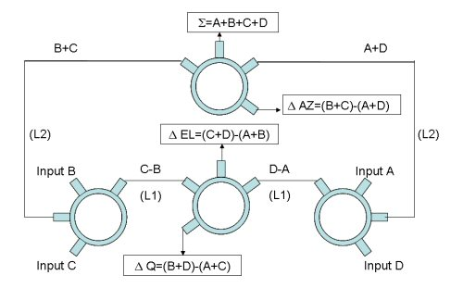
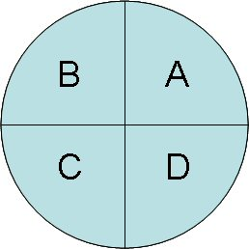
Monopulse Radar
Rat-Race couplers are often used in monpulse radar.
Input from B
Input from A
Four antennas
Input from C
Input from D
Rat-Race:
https://www.microwaves101.com/encyclopedias/monopulse-comparator-networks

Slide 16
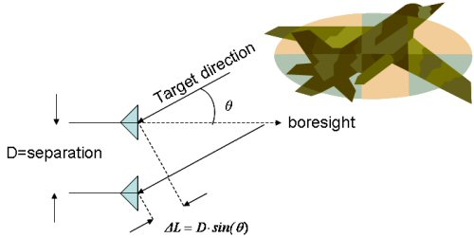
Monopulse Radar (cont.)
The difference signals are used to determine the azimuth and elevation of the target.
The difference between the two antenna signals maps into the phase difference Δφ, which maps into the angle θ.
https://www.microwaves101.com/encyclopedias/monopulse-comparator-networks

Slide 17
Appendix A
Here we analyze the quadrature coupler.
Port 1 Excitation
“even” analysis
⇒
Input admittance of open-circuited stub:

Slide 18
Appendix A (cont.)
Port 1 Excitation
“odd” problem
⇒
Input admittance of short-circuited stub:

Slide 19
Appendix A (cont.)
Consider the general case:
.
In general:
Shunt load on line
Quarter-wave line

Slide 20
Appendix A (cont.)
Hence we have:

Slide 21
Appendix A (cont.)
Continuing with the algebra, we have:

Slide 22
Appendix A (cont.)
Hence we have:
Convert this to S parameters (use Table 4.2 in Pozar):
Note:
We are describing a two-port device here, in the even and odd mode cases.
This is a 2×2 matrix, not a 4×4 matrix.

Slide 23
Appendix A (cont.)
Adding even and odd mode cases together:
Hence
By symmetry:

Slide 24
Appendix A (cont.)
By symmetry and reciprocity:

Slide 25
Appendix A (cont.)
By symmetry and reciprocity:

Slide 26
Appendix A (cont.)
By symmetry and reciprocity:

Slide 27
Appendix B
Here we analyze the Rat-Race Ring coupler.
Layout
Schematic

Slide 28
Appendix B (cont.)
Port 1 Excitation
“even” problem
⇒

Slide 29
Appendix B (cont.)
Port 1 Excitation
“odd” problem
⇒

Slide 30
Appendix B (cont.)
Proceeding as for the 90º coupler, we have:

Slide 31
Appendix B (cont.)
Converting from the ABCD matrix to the S matrix, we have:
Note:
We are describing a two-port device here, in the even and odd mode cases.
This is a 2×2 matrix, not a 4×4 matrix.
Use Table 4.2 in Pozar

Slide 32
Appendix B (cont.)
For the S parameters coming from port 1 excitation, we then have:

Slide 33
Appendix B (cont.)
Similarly, exciting port 2, and using symmetry and reciprocity, we have the following results (derivation omitted):

