Slide 1
Adapted from notes by Prof. Jeffery T. Williams
ECE 5317-6351
Microwave Engineering
Fall 2019
Prof. David R. Jackson
Dept. of ECE
Notes 22
Filter Design Part 1:
Insertion Loss Method

Slide 2
Filters
Consider the following circuit:
+
Filter
-
This is the basic filter circuit that we will study.
The filter is assumed to be lossless (consists of L and C elements).

Slide 3
Filters (cont.)
We can think of transmission lines connected at the input and output of the filter.
+
Filter
-
Lossless filter:
Power loss ratio:

Slide 4
Filters (cont.)
Also
Insertion Loss (dB):
From conversation of energy:

Slide 5
Filters (cont.)
The “insertion loss method” aims at designing a filter to achieve a particular type of response for the function P_{LR}(ω).

Slide 6
Low-Pass Filter
Ideal low-pass filter response
Passband
Stopband
Passband
Stopband

Slide 7
Filters (cont.)
Types of filters:
Low-pass
High-pass
Bandpass
Bandstop
Approach:
Design the low-pass filter first. The other types of filters come from this by using a frequency transformation.
(This is discussed in the next set of notes.)

Slide 8
Filters (cont.)
Common types of filters:
Butterworth (binomial)*
Chebyshev (type I)*
Chebyshev (type II)
Linear phase**
Elliptic
*Discussed in this set of notes and the next set of notes.
** Discussed in the next set of notes.

Slide 9
Note on Reflection Coefficient
Property of the Power Loss Function
(This property holds for the Fourier transform of any real-valued signal. A reflected time-domain signal must be real valued.)
(When we design a filter, we have to keep this in mind!)

Slide 10
Low-Pass Filter
Low-pass filter response:
Passband
Stopband
Cutoff frequency
The constant k is somewhat arbitrary, and defines the cutoff frequency.

Slide 11
Low-Pass Filter
Normalized low-pass filter response:
Passband
Stopband
Cutoff frequency
We design the normalized low-pass filter first (ω_{c} = 1), and then use scaling and frequency transformation to obtain the final filter (low-pass, high-pass, bandpass, bandstop).
(This is done in the next set of notes.)

Slide 12
Low-Pass Filter
Low-pass filter responses:
Butterworth
Chebyshev
Elliptic
Note:
The Chebyshev response shown is called “type 1”, with ripple in the passband. The “type 2” Chebyshev response has ripple in the stopband.

Slide 13
Low-Pass Filter
Comments:
The Butterworth design has the flattest response.
The Chebyshev (type 1) design has a constant ripple in the passband.
The Chebyshev (type 2) has a constant ripple in the stopband.
The elliptic filter has ripple in both the passband and the stopband.
The elliptic filter has the sharpest transition from the passband to the stopband, for given levels of ripple in the passband and stopband.

Slide 14
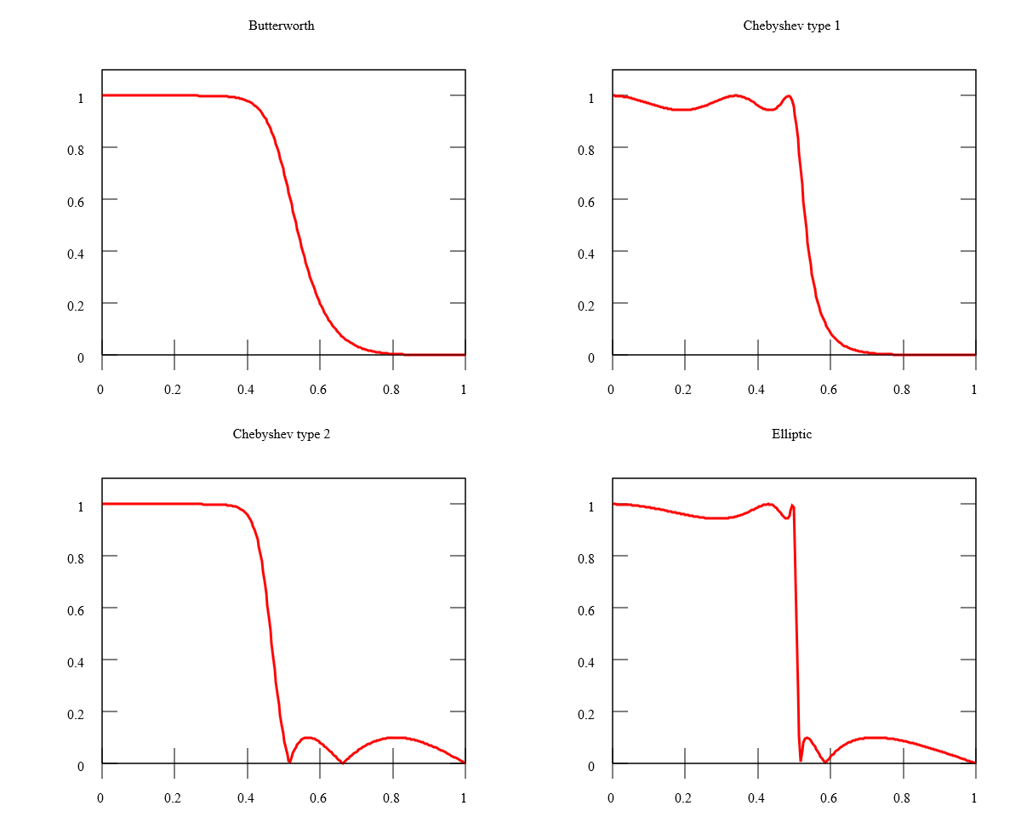
Low-Pass Filter
Comparison of Filter Responses
Butterworth
Chebyshev (type 1)
Chebyshev (type 2)
Elliptic
https://en.wikipedia.org/wiki/Electronic_filter

Slide 15
Butterworth Low-Pass Filter
Choose:
N = order of the filter*
The first N-1 derivatives of P_{LR} with respect to ω are zero.
At the band edge:
Common choice:
* As seen later, this will also be the number of (L,C) elements in the filter.

Slide 16
Butterworth Low-Pass Filter (cont.)
High-frequency limit:
Hence
so
Conclusion: IL increases at 20N dB/decade in the stopband.

Slide 17
Chebyshev Low-Pass Filter
Choose:
N = order of the filter*
There is equal ripple in the passband.
At the band edge:
Ripple level:
* As seen later, this will also be the number of (L,C) elements in the filter.

Slide 18
Chebyshev Low-Pass Filter (cont.)
High-frequency limit:
Hence
so

Slide 19
Chebyshev Low-Pass Filter (cont.)
Comparison:
Butterworth:
Chebyshev:
Conclusion:
In the stopband, the IL is larger than for the Chebyshev filter, but it increases at the same rate for both filters.

Slide 20
Two Element Low-Pass Filter
Original circuit:
+
-
Normalize impedances by R₀:
This normalization does not change the reflection coefficient.
+
-

Slide 21
Two Element Low-Pass Filter (cont.)
Normalized circuit:
+
-

Slide 22
Two Element Low-Pass Filter (cont.)
After some algebra:
or

Slide 23
Two Element Low-Pass Filter (cont.)
Hence we have:
where

Slide 24
Two Element Low-Pass Butterworth
Choose Butterworth response (k = 1):
Hence
Note:
The order N of the filter is the same as the number of (L,C) elements.

Slide 25
Two Element Low-Pass Butterworth (cont.)
Three equations:
Solution:
A₀ equation:
A₂ equation:
A₄ equation:

Slide 26
Two Element Low-Pass Butterworth (cont.)
Unnormalizing:
where
Hence:
+
-

Slide 27
Two Element Low-Pass Butterworth (cont.)
Example
Design a low-pass
Butterworth filter
+
-

Slide 28
Two Element Low-Pass Butterworth (cont.)
Results from Ansys Designer

Slide 29
Two Element Low-Pass Butterworth (cont.)
Results from Ansys Designer

Slide 30
Two Element Low-Pass Chebyshev
Choose Chebyshev response (arbitrary k value):
so
Hence:

Slide 31
Two Element Low-Pass Chebyshev (cont.)
Hence:
Solution (please see the Appendix):

Slide 32
Appendix
Chebyshev solution:
A₀ equation:

Slide 33
Appendix (cont.)
A₄ equation:

Slide 34
Appendix (cont.)
A₂ equation:
(The RHS is known.)

Slide 35
Appendix (cont.)
A₂ equation (cont.):

