Slide 1
Adapted from notes by Prof. Jeffery T. Williams
ECE 5317-6351
Microwave Engineering
Fall 2019
Prof. David R. Jackson
Dept. of ECE
Notes 24
Filter Design Part 3:
Transmission Line Filters

Slide 2
Filter Design Using Transmission Lines
In this set of notes we examine filter design using transmission Lines
Recipe:
We start with a lumped-element design.
We can use low and high impedance lines to approximate lumped elements: works for series L and shunt C elements (what you need in a low-pass design).
We can also apply Richard’s transformation to change any lumped element design into one with transmission lines.
We can also use the Kuroda identities to change series TL elements into parallel ones (more convenient for microstrip implementation).

Slide 3
Approximate Realization of Lumped Elements
Approximate method:
Narrow and wide sections of microstrip line can be used to approximately realize series lumped L and shunt C elements.
Although approximate, this is a simple technique.
This works well for low-pass filters (where we need series L and shunt C elements).

Slide 4
Approximate Realization of Lumped Elements (cont.)
Consider a section of transmission line (e.g., microstrip line):
Model:

Slide 5
Approximate Realization of Lumped Elements (cont.)
Element values in the model:
Details of calculation:

Slide 6
Approximate Realization of Lumped Elements (cont.)
Assume:
(narrow and short microstrip line)
Series inductor

Slide 7
Approximate Realization of Lumped Elements (cont.)
Assume:
(wide and short microstrip line)
Shunt capacitor

Slide 8
Approximate Realization of Lumped Elements (cont.)
From the previous derivation:
Solve for the lengths of the lines that are needed

Slide 9
Example
Design an N = 6 Butterworth stepped-impedance low-pass filter for a matched 50 Ω load with a cutoff frequency of 2.5 GHz. Choose Z_{low} = 20 Ω, Z_{high} = 120 Ω.
+
-
Choose type “a”
From table:

Slide 10
Example (cont.)
De-normalized filter:
+
-

Slide 11
Example (cont.)
+
-
Choice:

Slide 12

Example (cont.)
Microstrip Realization
#1
#3
#5
#2
#4
#6
(not drawn to scale)
Figure 8.40 from Pozar
Note:
TX line can first be used to find the line widths (from the chosen Z₀ values), and then used to find the line lengths (from the calculated electrical lengths).

Slide 13
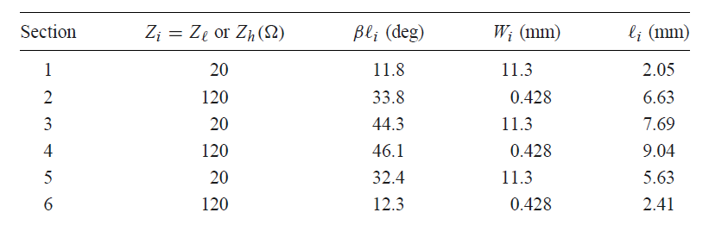
Example (cont.)
Microstrip Realization
From p. 425 of Pozar

Slide 14
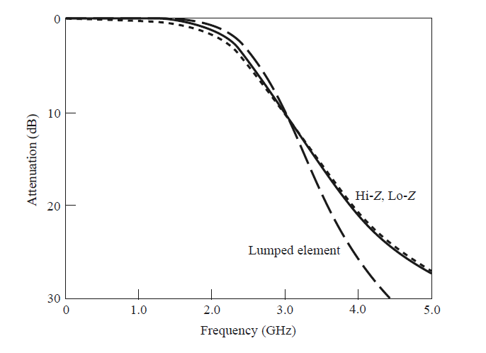
Example (cont.)
Results
The dotted line shows the result with substrate loss.
Full wave
Figure 8.41 from Pozar

Slide 15
Example (cont.)
Figure of an Actual Low-Pass Filter

Slide 16
Richard’s Transformation
Richard’s transformation
Main idea:
Short-circuited and open-circuited transmission lines are chosen to mimic the performance of the lumped L and C elements, respectively.
Richard’s transformation:
= radian frequency in lumped-element design
ω = radian frequency in transmission line design
Require:
(The lumped-element and transmission-line circuits will have the same cutoff frequency.)

Slide 17
Richard’s Transformation (cont.)
At any frequency ω, TLs can behave the same as lumped elements at frequency Ω.
Equivalent TL model for a lumped inductor:
Short
Require:
(same impedance property)
The inductor then has the same impedance at any frequency Ω as does the short-circuited transmission line at corresponding frequency ω.

Slide 18
Richard’s Transformation (cont.)
Equivalent TL model for a lumped capacitor:
Open
Require:
(same admittance property)
The capacitor then has the same admittance at any frequency Ω as does the open-circuited transmission line at corresponding frequency ω.

Slide 19
Richard’s Transformation (cont.)
Illustration of Mapping
Transmission line
Lumped element

Slide 20
Kuroda’s Identities
Kuroda’s Identity #2 is useful for transforming a series shorted TL
into a parallel open-circuited TL.
Note: The TLs all have the same electrical length.
Please see the Pozar book for a derivation.

Slide 21
Example
Design an N = 3 Chebyshev low-pass filter for a matched 50 Ω load with 3.0 dB of ripple in the passband and a cutoff frequency of 4.0 GHz.
Choose type “b” low-pass prototype:
+
-
From table:

Slide 22
Example (cont.)
Final lumped-element design:
+
-
From table:
Denormalization:
Lumped elements:

Slide 23
Example (cont.)
Convert to TLs (Richard's transformation):
+
-
Recall:

Slide 24
Example (cont.)
Add extra 50 Ω transmission lines.
+
-
These extra lines do not affect the filter performance.

Slide 25
Example (cont.)
Apply the Kuroda identity #2:
+
-

Slide 26
Example (cont.)
Final Design
+
-

Slide 27
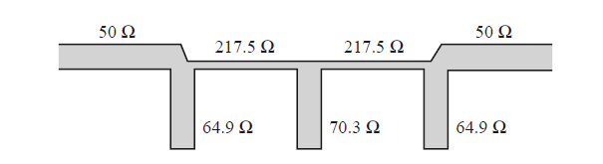
Example (cont.)
Microstrip Realization
Figure 8.36 from Pozar

Slide 28
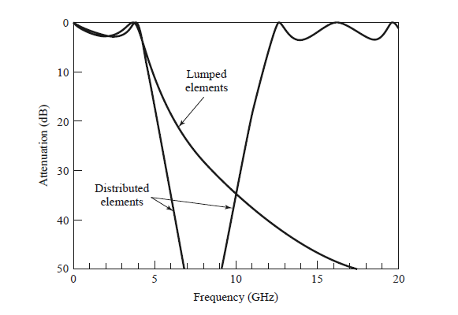

Example (cont.)
Results
The passband repeats with the TL filter!
Figure 8.37 from Pozar

