Slide 1
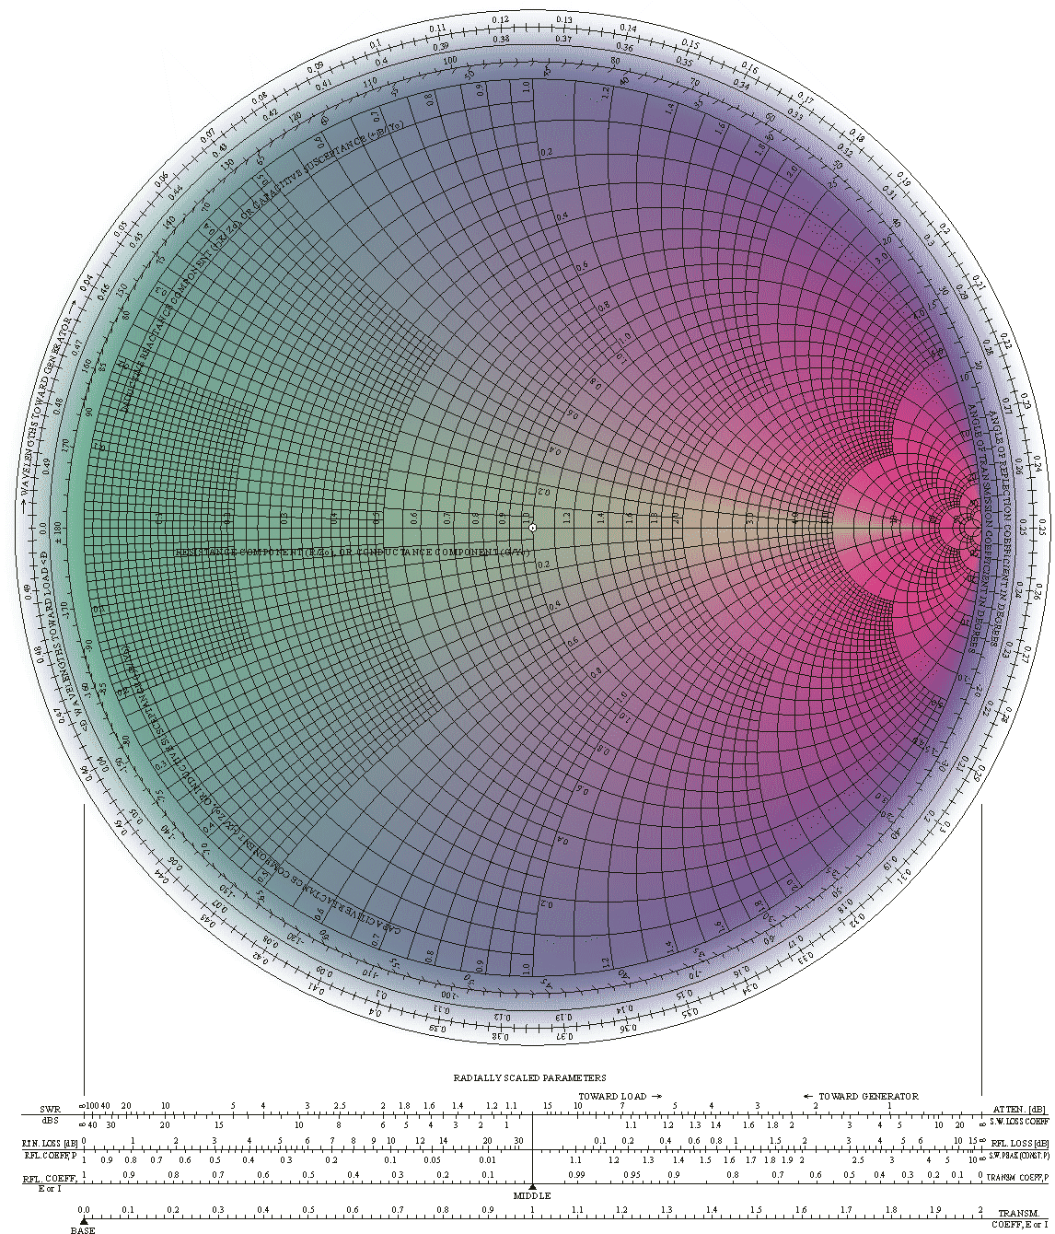
Adapted from notes by Prof. Jeffery T. Williams
ECE 5317-6351
Microwave Engineering
Fall 2019
Prof. David R. Jackson
Dept. of ECE
Notes 5
Smith Charts

Slide 2
Generalized Reflection Coefficient
Recall:
Generalized reflection Coefficient:

Slide 3
Generalized Reflection Coefficient (cont.)
Different forms for Γ(z)
Magnitude property of Γ(z)
Proof:
Lossless transmission line (α = 0)

Slide 4
Complex Γ Plane
Increasing d
(moving towards generator)
Clockwise movement!
Lossless line
Note:
Going λ/2 on the line corresponds to going all the way around the Smith chart.
d = distance from load

Slide 5
Z Chart
Start with
The Z chart is the “usual” Smith chart.
Define
Note:
The z dependence is being suppressed here.
Hence we have:
Next, multiply both sides by the RHS denominator term and equate real and imaginary parts. Then solve the resulting equations for Γ_{R} and Γ_{I} in terms of R_{n} or X_{n}. This gives two equations.

Slide 6
Z Chart (cont.)
1) Equation #1:
Equation for a circle in the Γ plane

Slide 7
Z Chart (cont.)
2) Equation #2:
Equation for a circle in the Γ plane

Slide 8
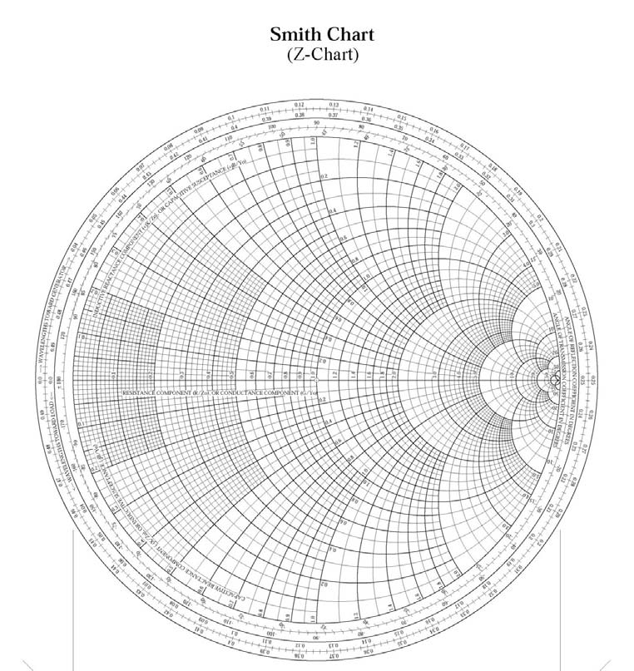
Z Chart (cont.)
Short-hand version
Γ plane
Γ plane

Slide 9
Z Chart (cont.)
Γ plane

Slide 10
Admittance Calculations with the Z Chart
Note:
Define:
Conclusion:
The same Smith chart can be used as an admittance calculator.
Same mathematical form as for Z_{n}:

Slide 11
Admittance Calculations with the Z Chart (cont.)
Γ′ plane

Slide 12
Impedance or Admittance
Calculations with the Z Chart
Normalized impedance or admittance coordinates
The Smith chart can be used for either impedance or admittance calculations, as long as we are consistent.
The complex plane is either the Γ plane or the Γ′ plane.

Slide 13
Y Chart
As an alternative way to do admittance calculations, we can continue to use the original Γ plane, and add admittance curves to the chart.
Compare with previous Smith chart derivation, which started with this equation:
(rotation of 180º)
Examples:
R_{n} = 1 circle, rotated 180º, becomes G_{n} = 1 circle.
X_{n} = 1 circle, rotated 180º, becomes B_{n} = 1 circle.
Side note: A 180º rotation on a Smith chart makes a normalized impedance become its reciprocal.

Slide 14
Y Chart (cont.)
Γ plane
The Y chart is the “mirror image” of the usual Smith chart.

Slide 15
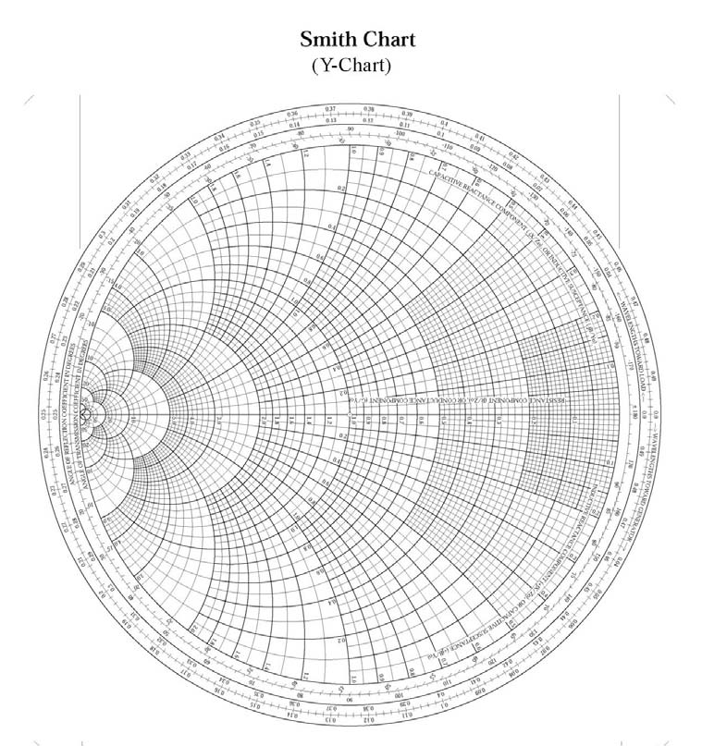
Y Chart (cont.)
Short-hand version
Γ plane

Slide 16
All Four Possibilities for Smith Charts
Z chart, used for impedance
Z chart, used for admittance
1
2
The first two are the most common.
The third is sometimes convenient.
The fourth is almost never used.
Γ plane
Γ′ plane
Y chart, used for admittance
Y chart, used for impedance
3
4
Γ plane
Γ′ plane

Slide 17
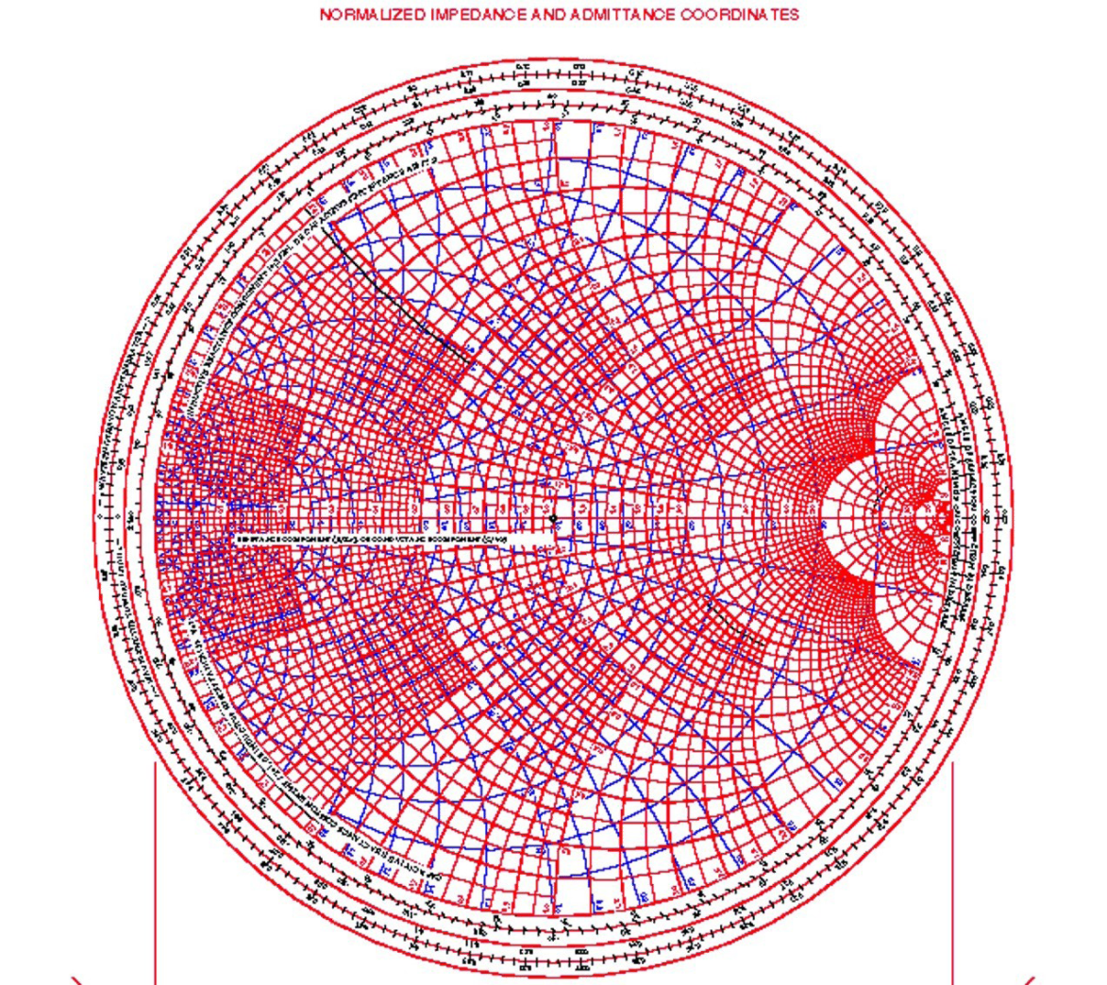
ZY Chart
Short-hand version
Inductive
Capacitive
Γ plane
This is convenient for doing matching problems that involve both series and shunt elements (done later).

Slide 18
Standing Wave Ratio
The SWR is given by the value of R_{n} on the positive real axis of the Smith chart (R_{n}^{max}).
Proof:
Γ plane

Slide 19
Electronic Smith Chart
At this link:
http://www.sss-mag.com/topten5.html
Download the following zip file:
smith_v191.zip
Extract the following files:
smith.exe mith.hlp smith.pdf
This is the application file

Slide 20
Example 1
Use the Z chart.
Z chart
a
Γ plane

Slide 21




Example 1 (cont.)
b
Z chart
c
Γ plane

Slide 22
Example 2
Use the Y chart.
Y chart
a
Γ plane

Slide 23
Example 2 (cont.)
b
c
Y chart
Γ plane

Slide 24



Example 3
Use a short-circuited section of air-filled TEM, 50 Ω transmission line
(β = k₀, λ_{g} = λ_{d} =λ₀) to create an impedance of Z_{in} = -j25 Ω at f = 10 GHz.
Use the Z chart.
Z chart
Γ plane

Slide 25

Example 4
Use an open-circuited section of 75 Ω (Y₀ = 1/75 S) air-filled transmission line at f = 10 GHz to create an admittance of Y_{in} = j1/75 S:
Use the Y chart.
Y chart
Γ plane

Slide 26
Example 5
Single-stub matching
In this example we will use the “usual” Smith chart (Z chart), but as an admittance calculator.
We want G_{in} = Y₀ (G_{in,n} = 1)

Slide 27
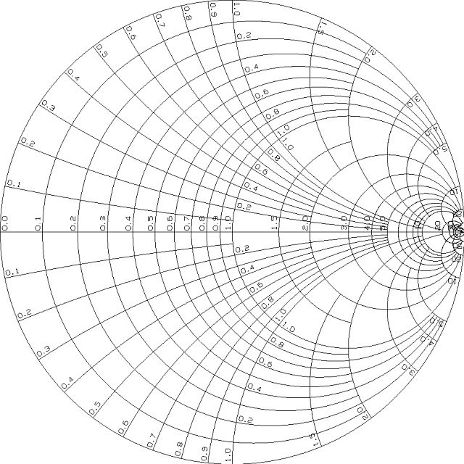
Example 5 (cont.)
Z chart
(We’ll use the first choice.)
X
X
X
Γ′ plane
Smith chart scale:
wavelengths toward load
wavelengths toward generator

Slide 28
Example 5 (cont.)
From the Smith chart:
Z chart
Analytically:
X
Γ′ plane
wavelengths toward generator

Slide 29
Example 5 (cont.)
Single-stub matching
Summary:

