Slide 1
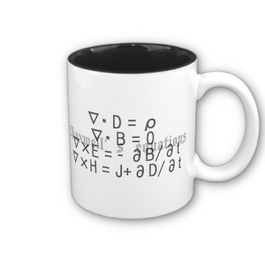
ECE 6340
Intermediate EM Waves
Fall 2016
Prof. David R. Jackson
Dept. of ECE
Notes 4

Slide 2
Debye Model
y
This model explains molecular effects.
q
Molecule at rest
Molecule:
x
We consider an electric field applied in the x direction.
The dipole moment p_{x} of this single molecule represents the average dipole moment in the x direction for all of the dipoles in a little volume.
A zero dipole moment p_{x} corresponds to a random dipole alignment in the actual material.
-q
θ
Molecule with
applied field E_{x}

Slide 3
Debye Model (cont.)
Torque on dipole due to electric field:
y
θ
x

Slide 4
Debye Model (cont.)
y
Note: T = -T_{z}
θ
x
s = spring constant
c = friction constant

Slide 5
Debye Model (cont.)
Hence
Assume
(small fields)

Slide 6
Debye Model (cont.)
θ
Note that
Hence:
Insert this into the top equation.

Slide 7
Debye Model (cont.)
Then we have:
or
Assume sinusoidal steady state:

Slide 8
Debye Model (cont.)
Hence, we have
The term P denotes the total dipole moment per unit volume.
The M superscript reminds us that we are talking about molecules.
Denote
Then we have

Slide 9
Debye Model (cont.)
Also, for a linear material,
Hence
Therefore
(The frequency is fairly low relative to molecular resonance frequencies. That is, the frequency is at millimeter wave frequency and below.)
Assume

Slide 10
Debye Model (cont.)
Denote the time constant as:
Denote the zero-frequency value as:
(real constant)
Then we have

Slide 11
Debye Model (cont.)
This would imply that
At high frequency the molecules cannot respond to the field, so the relative permittivity due to the molecules tends to unity.
This equation gives the wrong result at high frequency, where atomic effects become important.

Slide 12
Debye Model (cont.)
Include BOTH molecule and atomic effects:
Molecule effects:
Note:
Atoms can respond much faster to the field than molecules, so the atomic susceptibility is almost constant (unless the frequency is very high, e.g., at THz frequencies and above).
Atomic effects:

Slide 13
Debye Model (cont.)
We then have that
Hence:

Slide 14
Debye Model (cont.)
Permittivity formula:
Hence, we have
where
(a₁ and a₂ are real constants.)

Slide 15
Debye Model (cont.)
Note that:
so
Hence:

Slide 16
Debye Model (cont.)

Slide 17
Debye Model (cont.)
Frequency for maximum loss:
Let
A maximum occurs at
or

Slide 18
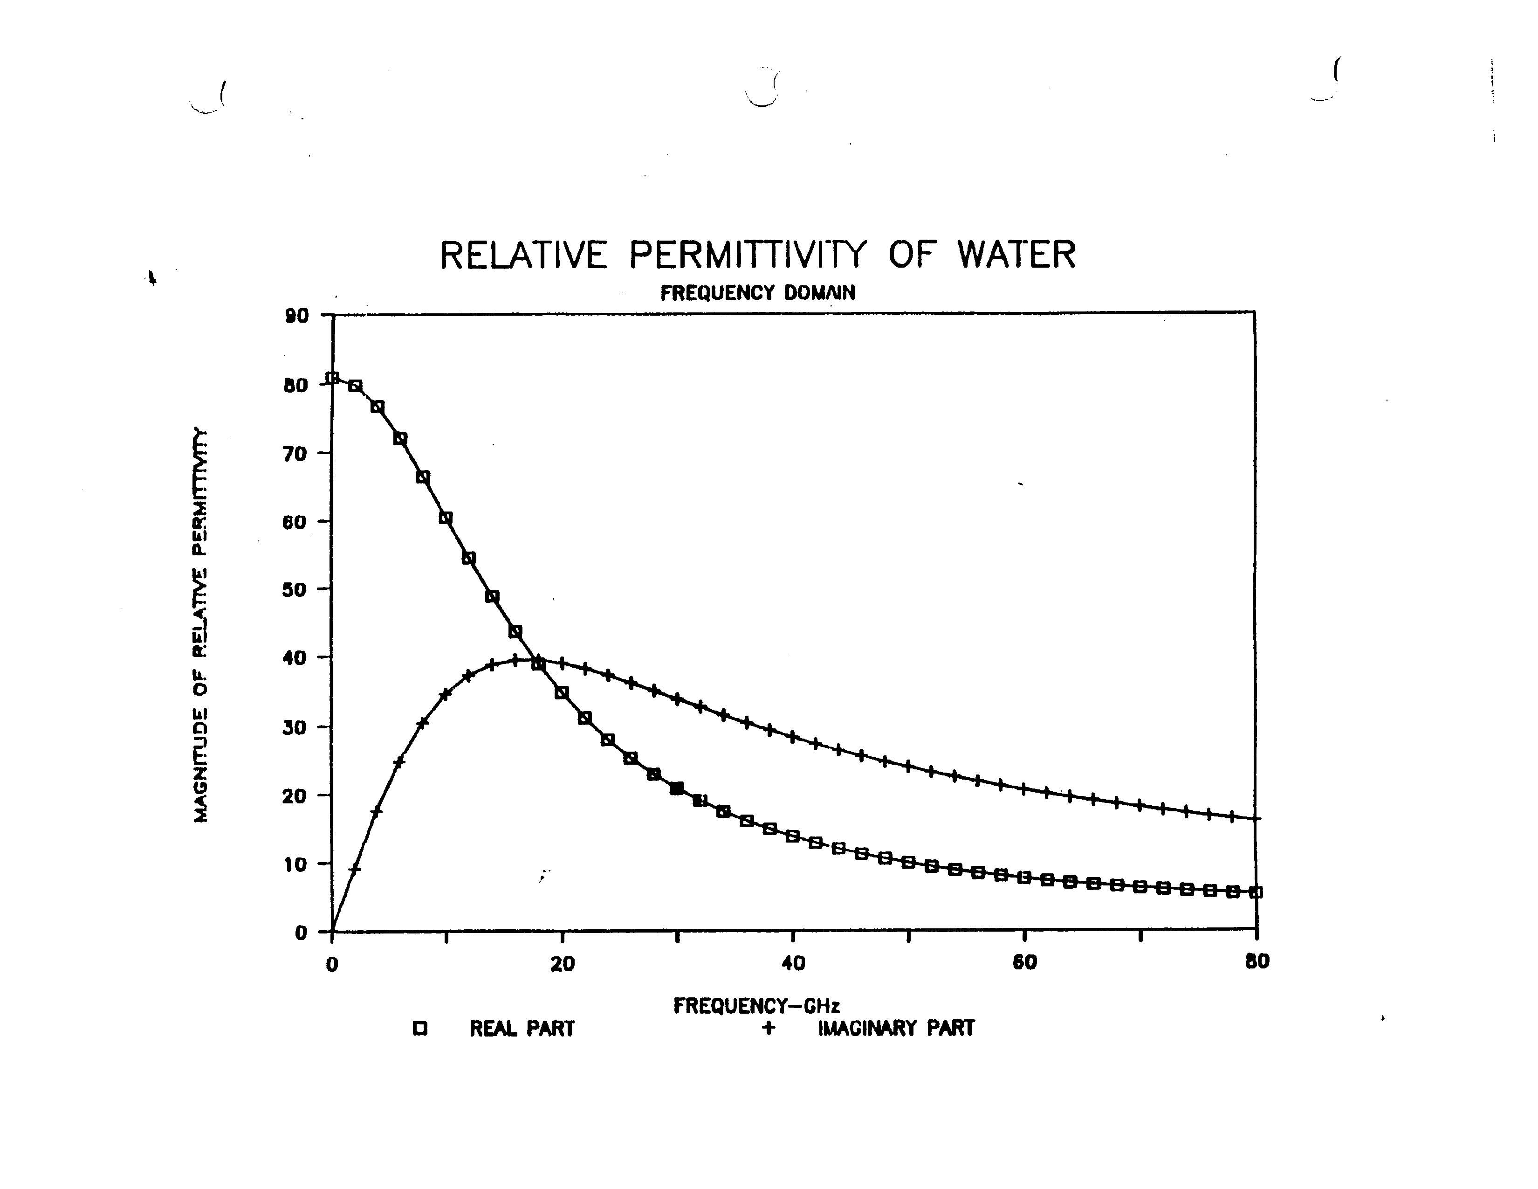
Debye Model (cont.)
Complex relative permittivity for pure (distilled) water
Water obeys the Debye model quite well.
Water obeys the Debye model quite well.

Slide 19
Example
Calculate the complex relative permittivity ε_{rc} for ocean water at 10.0 GHz.
Water obeys the Debye model quite well.
Ocean water: σ = 4 [S/m]
from previous plot for distilled water
Hence
or

Slide 20
Cole-Cole Model
This is a modification of the Debye model.
When α = 0, the model reduces to the Debye model.
This model has often been used to describe the permittivity of some polymers, as well as biological tissues.

Slide 21
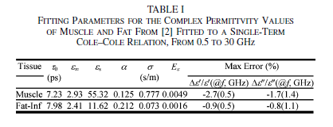
Cole-Cole Model (Cont.)
Parameters for Some Biological Tissues

Slide 22
Havriliak–Negami Model
This is another modification of the Debye model.
When α = 1 and β = 1, the model reduces to the Debye model.
This has been used to describe the permittivity of some polymers.

Slide 23
Lorentz Model
Explains atom and electron resonance effects (usually observed at high frequencies, such as THz frequencies and optical frequencies, respectively).
Electrons
Atom:
q_{e}
q_{n}
Dipole effect:
q_{n}= - q_{e}

Slide 24
Lorentz Model (cont.)
q_{e}
q_{n}
Model:
x
m
The heavy positive nucleus is fixed.
Equation of motion for electrons in atom:

Slide 25
Lorentz Model (cont.)
so
For a single atom,
or
Hence
Sinusoidal Steady State:

Slide 26
Lorentz Model (cont.)
Denote
The term P denotes the total dipole moment per unit volume.
The A superscript reminds us that we are talking about atoms.
Therefore,

Slide 27
Lorentz Model (cont.)
Hence
Denote:
(real constants)

Slide 28
Lorentz Model (cont.)
We then have
Permittivity formula:
Hence
Real and imaginary parts:

Slide 29
Lorentz Model (cont.)
Low frequency value for
(This is still "high" frequency in the Debye model.)
A sharp resonance occurs at

Slide 30
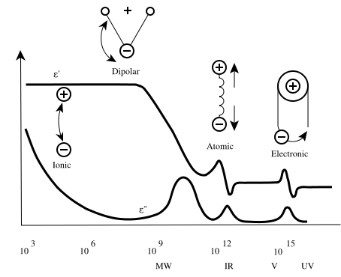
Total Response
Low frequency:
Response of a hypothetical material
10³
10⁶
10⁹
10¹²
10¹⁵
Frequency (Hz)
MW
THz
Vis
UV
From the dielectric spectroscopy page of the research group of Dr. Kenneth A. Mauritz.

Slide 31
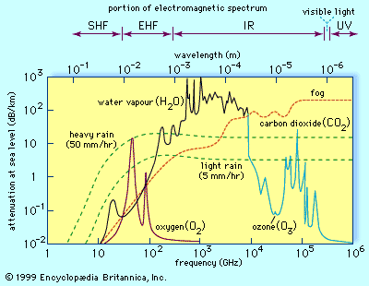
Atmospheric Attenuation
60 GHz
90 GHz

Slide 32
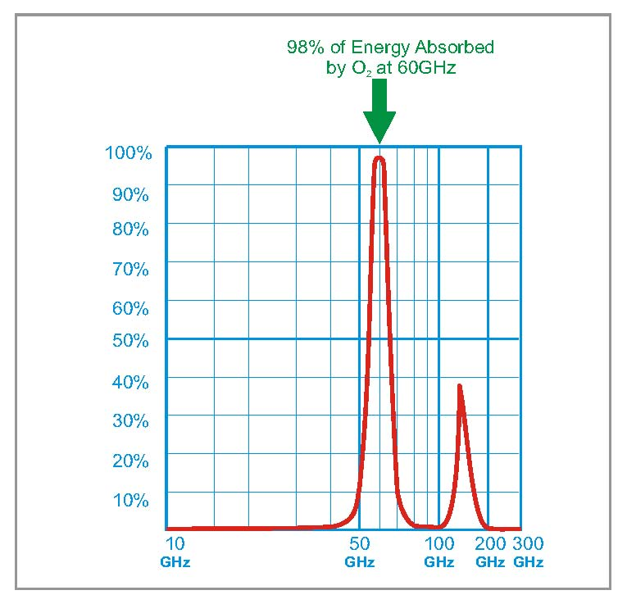
Atmospheric Attenuation (cont.)
Atmospheric
absorption (% power absorbed) for
millimeter-wave
frequencies
over a 1-km path
90 GHz
% power absorbed:
Attenuation in dB/km:
Terabeam Document Number: 045-1038-0000
Revision: A / Release Date: 09-03-2002
Copyright © 2002 Terabeam Corporation. All Rights Reserved.

Slide 33
Plasma
Electrically neutral plasma medium (positive ions and electrons):
Electron (-)
Ion (+)
We assume that only the electrons are free to move when an electric field is applied. This causes a current to flow.

Slide 34
Plasma (cont.)
Equation of motion for average electron:
There is no “spring” force now.
Force due to electric field
Force due to collisions with ions (loss of momentum)
υ = collision frequency (rate of collisions per second of average electron)
Notes: (1) The last term assumes perfect inelastic collisions (loss mechanism).
(2) We neglect the force due to the magnetic field.

Slide 35
Plasma (cont.)
Sinusoidal steady state:
Current:

Slide 36
Plasma (cont.)
Amperes’ law:
We assume that there is no polarization current – only conduction current. Hence we use ε₀.

Slide 37
Plasma (cont.)
Hence:
so
or

Slide 38
Plasma (cont.)
Define:
(ω_{p} ≡ plasma frequency)
We then have

Slide 39
Plasma (cont.)
Lossless plasma:
(Drude equation)
Plane wave in lossless plasma:

Slide 40
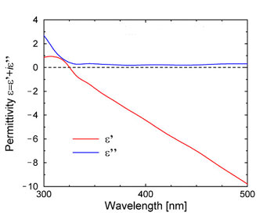
Plasma (cont.)
The Drude model is an approximate model for how
metals behave at optical frequencies.
“Plasmonic behavior”
Relative permittivity
Visible
Measured complex relative permittivity of silver at optical frequencies

Slide 41
Plasma (cont.)
At microwave frequencies, a plasma-like medium can be
simulated by using a wire medium.

Slide 42
Plasma (cont.)
An example of a directive antenna using a wire medium:
Geometrical optics (GO):
Refraction towards broadside

