Slide 1
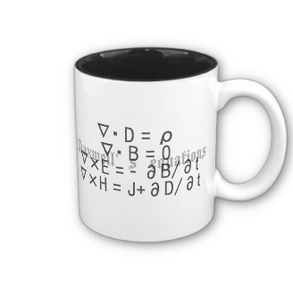
ECE 6340
Intermediate EM Waves
Fall 2016
Prof. David R. Jackson
Dept. of ECE
Notes 5

Slide 2
Magnetic Current
Maxwell’s Equations:
Missing terms correspond to ,
(North magnetic pole)
q
q^{m}
+
+

Slide 3
Magnetic Current (cont.)
Define magnetic charge so that
(A positive magnetic charge corresponds to a north magnetic pole.)
Assume that a continuity equation holds:
From this, we can show that belongs in Faraday’s Law as:

Slide 4
Magnetic Current (cont.)
Proof:
Take the divergence of both sides:
so

Slide 5
Magnetic Current
Maxwell’s Equations:
Note: Maxwell's equations are now symmetric. If we know how an electric current radiates, it will be easy to figure out how a magnetic current radiates (this is called duality).

Slide 6
Magnetic Current (cont.)
Example: Radiation from a waveguide-fed aperture
z
b
PEC
a
y
x

Slide 7
Magnetic Current (cont.)
Usefulness of magnetic current concept: radiation from a waveguide
E_{y}
b
Magnetic current
TE₁₀ mode
Waveguide with infinite baffle
Equivalence Principle
(discussed later in the semester)

Slide 8
Magnetic Current (cont.)
We can now remove the ground plane:
Magnetic current
Magnetic current
Image Theory
(discussed later in the semester)

Slide 9
Magnetic Current (cont.)
The radiation from the magnetic current is related to radiation from a corresponding electric current:
Magnetic current
Electric current
Duality
(discussed later in the semester)

Slide 10
Magnetic Current (cont.)
Summary of final radiation picture
Electric current
Radiation from electric current in free space
(discussed later in the semester)

Slide 11
Magnetic Current (cont.)
3D view of original problem
z
b
PEC
a
y
x

Slide 12
Magnetic Current (cont.)
3D view of final radiation model
z
Electric current sheet
y
a
b
x

