Slide 1
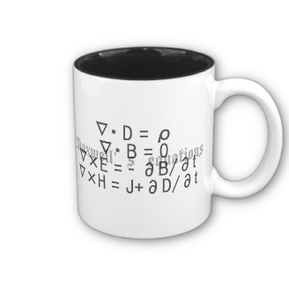
ECE 6340
Intermediate EM Waves
Fall 2016
Prof. David R. Jackson
Dept. of ECE
Notes 10

Slide 2
Wave Equation
Assume
The region is source free and homogeneous.
so
Then we have
Use
Vector Wave Equation
Hence

Slide 3
Wave Equation (cont.)
Similarly,
Taking the divergence,
Hence,
Hence ρ_{v} = 0 in the time-harmonic steady state for a homogeneous material, provided ω ≠ 0.
The zero-divergence condition is built in to the vector wave equation.

Slide 4
Vector Laplacian
Recall
In rectangular coordinates,
The vector wave equation can thus be written as
or
“Vector Helmholtz Equation”

Slide 5
Vector Laplacian (cont.)
Take the rectangular components:
Note: is not implied from the
vector Helmholtz Equation.
(see the example later)

Slide 6
Waveguide Fields
From the “guided-wave theorem,” the fields of a guided wave varying as exp(-jk_{z}z) may be written in terms of the longitudinal (z) components as

Slide 7
Waveguide Fields (cont.)
These may be written more compactly as

Slide 8
Waveguide Equations (cont.)
For the special case of TE_{z} and TM_{z} fields, we can combine these as follows:
TE_{z}
Combine

Slide 9
Waveguide Equations (cont.)
Define the wave impedance:
Then we have

Slide 10
Waveguide Equations (cont.)
Summary for TE_{z} and TM_{z} cases:
Note: For a wave going in the –z direction, we replace the minus sign with a plus sign.

Slide 11
Waveguide Equations (cont.)
Taking the cross product of both sides with gives us
Note: For any transverse vector we have
Note: For a wave going in the –z direction, we replace the plus sign with a minus sign.

Slide 12
Waveguide Equations (cont.)
For the special case of a TEM wave:
(TEM wave)

Slide 13
Example: Spurious TE₀₀ Mode
y
Rectangular Waveguide
b
x
a
In this example we show that the TE₀₀ mode of the rectangular waveguide is non-physical, since it violates the divergence condition.

Slide 14
Example (cont.)
Solution from separation of variables (given later):
y
b
x
a
TM_{mn}:
TE_{mn}:

Slide 15
Example (cont.)
Question: What is the lowest-order mode (smallest m and n) for a non-trivial field?
TM_{mn}:
TE_{mn}:
TM_{mn}: m = 1, n = 1
TE_{mn}: m = 0, n = 0 ?

Slide 16
Example (cont.)
TE_{mn} mode:
TE₀₀ mode:
The last equation holds since the normal component of the magnetic field is zero on the PEC, and there is no (x, y) variation inside the waveguide.

Slide 17
Example (cont.)
Check the divergence:
The TE₀₀ mode is a non-physical mode.
Hence
(invalid mode)
The TE₁₀ mode is actually the mode with the lowest cut-off frequency.
Whenever we solve the vector Helmholtz equation, we should check to make sure that the divergence condition is satisfied!
It turns out that all of the other modes of the rectangular waveguide are physical.

