Slide 1
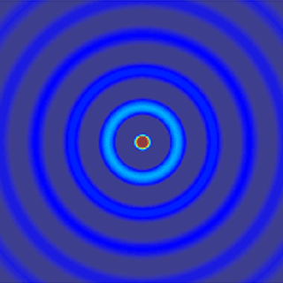
ECE 6341
Spring 2016
Prof. David R. Jackson
ECE Dept.
Notes 6

Slide 2
Leaky Modes
v
TM₁ Mode
R
SW
u
Splitting point
ISW
f = f_{s}
f > f_{s}
We will examine the solutions as
the frequency is lowered.

Slide 3
Leaky Modes (cont.)
v
a) f > f_{c} SW+ISW
TM₁ Mode
SW
u
ISW
The TM₁ surface wave is above cutoff. There is also an improper TM₁ SW mode.
Note: There is also a TM₀ mode, but this is not shown

Slide 4
Leaky Modes (cont.)
a) f > f_{c} SW+ISW
The red arrows indicate the direction of movement as the frequency is lowered.
Im k_{z}
SW
ISW
k₀
k₁
Re k_{z}
TM₁ Mode

Slide 5
Leaky Modes (cont.)
v
b) f = f_{c}
TM₁ Mode
u
The TM₁ surface wave is now at cutoff. There is also an improper SW mode.

Slide 6
Leaky Modes (cont.)
b) f = f_{c}
Im k_{z}
k₀
k₁
Re k_{z}
TM₁ Mode

Slide 7
Leaky Modes (cont.)
c) f < f_{c} 2 ISWs
v
TM₁ Mode
u
The TM₁ surface wave is now an improper SW, so there are two improper SW modes.

Slide 8
Leaky Modes (cont.)
c) f < f_{c} 2 ISWs
Im k_{z}
k₀
#1
#2
k₁
Re k_{z}
TM₁ Mode
#1
The two improper SW modes approach each other.
#2

Slide 9
Leaky Modes (cont.)
d) f = f_{s}
v
TM₁ Mode
u
The two improper SW modes now coalesce.

Slide 10
Leaky Modes (cont.)
d) f = f_{s}
Im k_{z}
Splitting point
k₀
k₁
Re k_{z}
TM₁ Mode

Slide 11
Leaky Modes (cont.)
v
e) f < f_{s}
u
The wavenumber k_{z} becomes complex (and hence so do u and v).
The graphical solution fails! (It cannot show us complex leaky-wave modal solutions.)

Slide 12
Leaky Modes (cont.)
e) f < f_{s} 2 LWs
This solution is rejected as completely non-physical since it grows with distance z (α_{z} < 0).
Im k_{z}
k₀
LW
k₁
Re k_{z}
LW
The growing solution is the complex conjugate of the decaying one (for a lossless slab).

Slide 13
Leaky Modes (cont.)
Proof of conjugate property (lossless slab)
TRE:
TM_{x} Mode
Take conjugate of both sides:
Hence, the conjugate is a valid solution.

Slide 14
Leaky Modes (cont.)
a) f > f_{c}
Here we see a summary of the frequency behavior for a typical surface-wave mode (e.g., TM₁).
b) f = f_{c}
c) f < f_{c}
Exceptions:
TM₀: Always remains a proper physical SW mode.
TE₁: Goes from proper physical SW to nonphysical ISW; remains nonphysical ISW down to zero frequency.
d) f = f_{s}
e) f < f_{s}

Slide 15
Leaky Modes (cont.)
A leaky mode is a mode that has a complex wavenumber (even for a lossless structure). It loses energy as it propagates due to radiation.
x
Power flow
θ₀
z

Slide 16
Leaky Modes (cont.)
One interesting aspect: The fields of the leaky mode must be improper (exponentially increasing).
Proof:
Notes:
β_{z} > 0 (propagation in +z direction)
α_{z} > 0 (propagation in +z direction)
β_{x} > 0 (outward radiation)
Taking the imaginary part of both sides:

Slide 17
Leaky Modes (cont.)
For a leaky wave excited by a source, the exponential growth will only persist out to a “shadow boundary” once a source is considered.
This is justified later in the course by an asymptotic analysis:
In the source problem, the LW pole is only captured when the observation point lies within the leakage region (region of exponential growth).
x
Region of weak fields
Power flow
θ₀
Region of exponential growth
z
Source
Leaky mode
A hypothetical source launches a leaky wave going in one direction.

Slide 18
Leaky Modes (cont.)
A leaky-mode is considered to be “physical” if we can measure a significant contribution from it along the interface (θ₀ = 90º) .
A requirement for a leaky mode to be strongly physical is that the wavenumber must lie within the “physical region” where is wave is a fast wave* (β_{z} = Re k_{z} < k₀).
Basic reason: The LW pole is not captured in the complex plane in the source problem if the LW is a slow wave.
* This is justified by asymptotic analysis, given later.

Slide 19
Leaky Modes (cont.)
f) f < f_{p} Physical LW
Im k_{z}
k₀
k₁
LW
Re k_{z}
Non-physical
Physical
f = f_{p}
Note: The physical region is also the fast-wave region.
Physical leaky wave region (Re k_{z} < k₀)

Slide 20
Leaky Modes (cont.)
If the leaky mode is within the physical (fast-wave) region, a
wedge-shaped radiation region will exist.
This is illustrated on the next two slides.

Slide 21
Leaky Modes (cont.)
x
Power flow
θ₀
z
Source
Leaky mode
(assuming small attenuation)
Hence
Significant radiation requires β_{z} < k₀.

Slide 22
Leaky Modes (cont.)
x
Power flow
θ₀
z
Source
Leaky mode
As the mode approaches a slow wave (β_{z} → k₀), the leakage region shrinks to zero (θ₀ → 90º).

Slide 23
Leaky Modes (cont.)
Phased-array analogy
x
θ₀
d
z
I₀
I₁
I_{n}
I_{N}
Equivalent phase constant:
Note:
A beam pointing at an angle in “visible space” requires that k_{z} < k₀.

Slide 24
Leaky Modes (cont.)
The angle θ₀ also forms the boundary between regions where the leaky-wave field increases and decreases with radial distance ρ in cylindrical coordinates (proof omitted*).
Recall: For a plane wave in a lossless region, the α vector is perpendicular to the β vector.
x
Fields are increasing radially
Power flow
θ₀
Fields are decreasing radially
ρ
z
Source
Leaky mode
*Please see one of the homework problems.

Slide 25
Leaky Modes (cont.)
Excitation problem:
Bi-directional Leaky wave: k_{z} = β_{z}-jα_{z}
Line source
The aperture field may strongly resemble the field of the leaky wave (creating a good leaky-wave antenna).
Requirements:
The LW should be in the physical region (i.e., a fast wave).
The amplitude of the LW should be strong.
The attenuation constant of the LW should be small.
A non-physical LW usually does not contribute significantly to the aperture field (this is seen from asymptotic theory, discussed later).

Slide 26
Leaky Modes (cont.)
Summary of frequency regions:
a) f > f_{c} physical SW (non-radiating, proper)
b) f_{s} < f < f_{c} non-physical ISW (non-radiating, improper)
c) f_{p} < f < f_{s} non-physical LW (radiating somewhat, improper)
d) f < f_{p} physical LW (strong focused radiation, improper)
The frequency region f_{p} < f < f_{c} is called the “spectral-gap” region
(a term coined by Prof. A. A. Oliner).
The LW mode is usually considered to be nonphysical in the spectral-gap region.

Slide 27

Leaky Modes (cont.)
f = f_{c}
Spectral-gap region
f_{p} < f < f_{c}
Im k_{z}
ISW
k₀
f = f_{s}
k₁
Re k_{z}
LW
Physical
Non-physical
f = f_{p}
Prof. A. A. Oliner

Slide 28
Field Radiated by Leaky Wave
x
TE_{x} leaky wave
Aperture
z
Line source
For x > 0:
Assume:
Note: The wavenumber k_{x} is chosen to be either positive real or negative imaginary.
Then

Slide 29
Radiation occurs at 60º.
x / λ₀
x / λ₀
10
10
5
5
0
z / λ₀
0
-10
0
10
-10
0
10

Slide 30
Radiation occurs at 60º.
x / λ₀
x / λ₀
10
10
5
5
0
z / λ₀
0
-10
0
10
-10
0
10

Slide 31
The LW is nonphysical.
x / λ₀
x / λ₀
10
10
5
5
0
z / λ₀
0
-10
0
10
-10
0
10

Slide 32
Leaky-Wave Antennas
x / λ₀
x
Aperture
z
Line source
Near field
Far field

Slide 33
Leaky-Wave Antennas (cont.)
x
x / λ₀
ρ
z
line source
Far-Field Array Factor (AF)

Slide 34
Leaky-Wave Antennas (cont.)
A sharp beam occurs at

Slide 35
Leaky-Wave Antennas (cont.)
The two beams merge to becomes a broadside beam when β_{z}< α_{z}
z

Slide 36
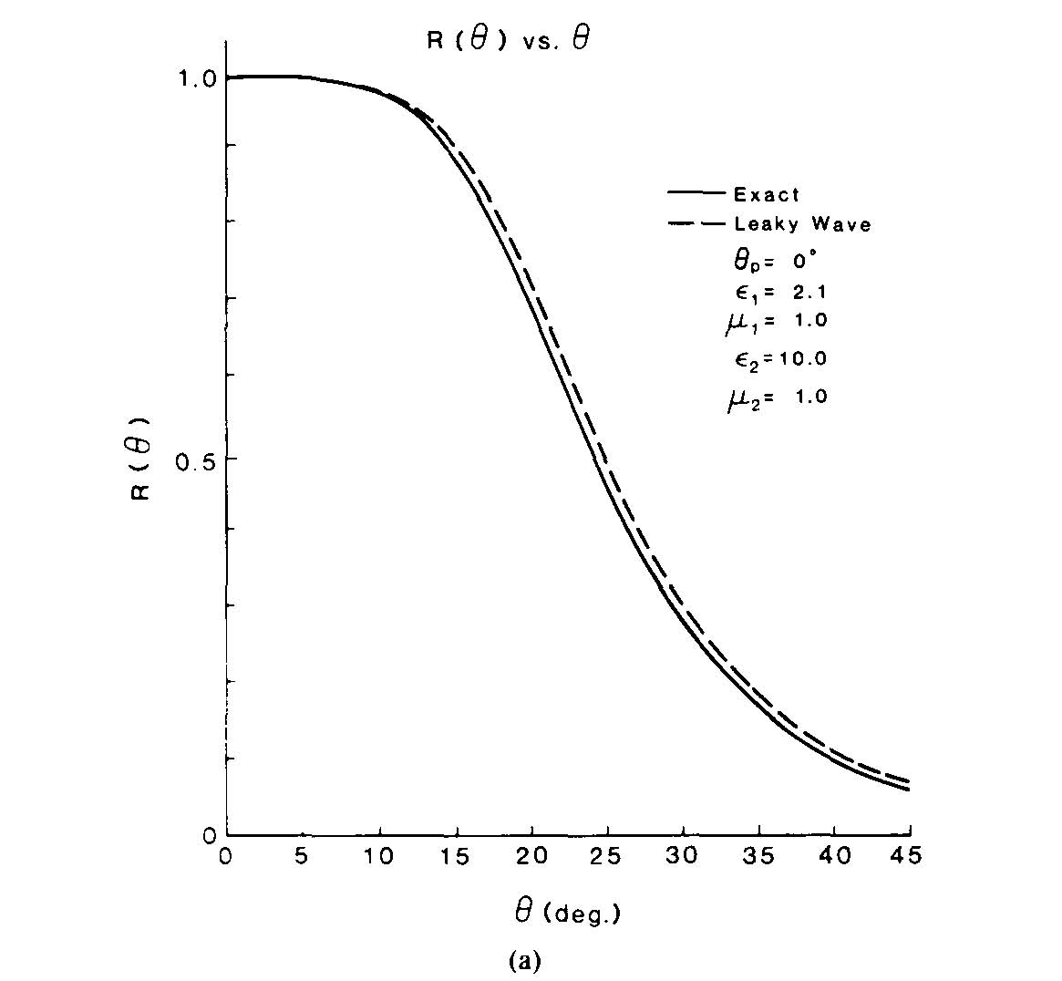
Leaky-Wave Antennas (cont.)
Two-layer (substrate/superstrate) structure excited by a line source.
x / λ₀
x
t
z
b
Far Field
D. R. Jackson and A. A. Oliner, “A Leaky-Wave Analysis of the High-Gain Printed Antenna Configuration,” IEEE Trans. Antennas and Propagation, vol. 36, pp. 905-910, July 1988.

Slide 37
Leaky-Wave Antennas (cont.)
W. W. Hansen, “Radiating electromagnetic waveguide,” Patent, 1940, U.S. Patent No. 2.402.622.
W. W. Hansen, “Radiating electromagnetic waveguide,” Patent, 1940, U.S. Patent No. 2.402.622.
y
This is the first leaky-wave antenna invented.
Slotted waveguide
Note:

Slide 38
Leaky-Wave Antennas (cont.)
x / λ₀
The slotted waveguide illustrates in a simple way why the field is weak outside of the “leakage region.”
Region of strong fields (leakage region)
Slot
a
TE₁₀ mode
Waveguide
Source
Top view

Slide 39
Leaky-Wave Antennas (cont.)
Another variation: Holey waveguide
y

Slide 40
Leaky-Wave Antennas (cont.)
x / λ₀
Another type of leaky-wave antenna, based on
substrate-integrated waveguide
Substrate-integrated waveguide (SIW)

Slide 41
Leaky-Wave Antennas (cont.)
x / λ₀
The transverse slots allow for magnetic currents that are transverse, which can radiate at endfire.
J. Liu, D. R. Jackson, and Y. Long, “Substrate Integrated Waveguide (SIW) Leaky-Wave Antenna With Transverse Slots,” IEEE Trans. Antennas and Propagation, vol. 60, pp. 20-29, Jan. 2012.

Slide 42

Leaky-Wave Antennas (cont.)
2-D Leaky-Wave Antenna
Conical Beam
Broadside Beam
Source
Source
In the air region:

Slide 43
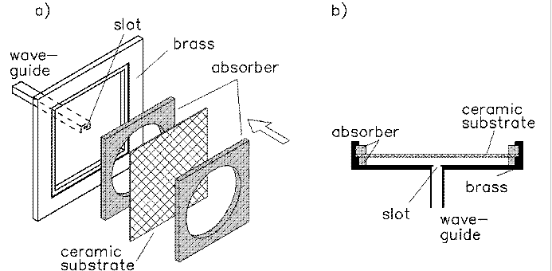
Leaky-Wave Antennas (cont.)
x / λ₀
2-D Leaky-Wave Antenna
Implementation at millimeter-wave frequencies (62.2 GHz)
ε_{r1} = 1.0, ε_{r2} = 55, h = 2.41 mm, t = 0.484 mm, a = 3.73 λ₀ (radius)

Slide 44
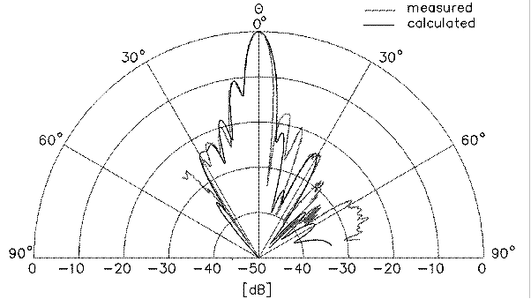
Leaky-Wave Antennas (cont.)
2-D Leaky-Wave Antenna
x / λ₀
(E-plane shown on one side, H-plane on the other side)

Slide 45
Leaky-Wave Antennas (cont.)
2-D Leaky-Wave Antenna
The concept of using a “partially reflecting surface” (PRS) to create narrow beams goes back to von Trentini in 1956.
It was not understood that this is a leaky-wave effect.
G. von Trentini, “Partially Reflecting Sheet Arrays,” IEEE Trans. Antennas Propagat., vol. 4, pp. 666-671, Oct. 1956.

Slide 46
Leaky-Wave Antennas (cont.)
2-D Leaky-Wave Antenna
Working with Prof. Oliner, results were extended to other planar 2D leaky-wave antennas using different PRS structures.
ε₂, μ₂
h / 2
ε₁, μ₁
Today these structures are often called “Fabry-Pérot resonant cavity antennas.”
ε₂, μ₂
t
ε₁, μ₁
ε₂, μ₂
h
ε₁, μ₁
dipole
z₀
x

Slide 47
Leaky-Wave Antennas (cont.)
2-D Leaky-Wave Antenna
Directive pencil beams at broadside or conical beams can be produced.
Table showing beamwidth properties
(normalized susceptance of PRS)
T. Zhao, D. R. Jackson, and J. T. Williams,“ General formulas for 2D leaky wave antennas,” IEEE Trans. Antennas and Propagation, vol. 53, pp. 3525-3533, Nov. 2005.
Slot-PRS structure

Slide 48
Leaky Waves on MIC Lines
It was found that two different types of leaky modes could exist on microwave integrated circuit (MIC) (i.e., printed-circuit) lines:
  leakage into the TM₀ surface wave (SW)
  leakage into SW + space
x / λ₀
y
β / k₀
TM₀
z
No leakage
Surface-wave
leakage
-x
Source
Space + surface-wave leakage

Slide 49
Leaky Waves on MIC Lines (cont.)
Leaky modes have been found on a variety of printed-circuit lines.
Leakage occurs at high frequency
Microstrip line*
Coplanar waveguide
Coplanar strips
Slotline
Stripline with an air gap*
Microstrip with a top cover (low enough cover)
Conductor-backed coplanar waveguide
Conductor-backed slotline
Leakage occurs at any frequency
*Illustrated here with examples

Slide 50
Leaky Waves on MIC Lines (cont.)
Microstrip
h
ε_{r}
w
Normalized phase constant (β / k₀)
h = w = 1 mm, ε_{r} = 2.2
The bound mode is the usual quasi-TEM microstrip mode.
The leaky mode plotted here leaks into the TM₀ surface wave.
A physical leaky mode exists at high frequencies.
RIM: real improper mode
(similar to ISW of slab)

Slide 51
Leaky Waves on MIC Lines (cont.)
Microstrip
Source on Line
h
ε_{r}
w
h = w = 1 mm, ε_{r} = 2.2
w
I (z)
x
h
z
z / λ₀
The leaky mode interferes with the bound mode at high frequency, causing spurious oscillations in the current on the line.

Slide 52
Leaky Waves on MIC Lines (cont.)
Stripline with an air gap
h
ε_{r}
δ
h
ε_{r}
w
h = w = 1 mm, ε_{r} = 2.22
f = 3.0 GHz
A physical leaky mode exists even at low frequency, when the air gap is small.
The leaky mode is the one that turns into the TEM stripline mode as the air gap vanishes.
The bound mode has a field that resembles a parallel-plate mode.

Slide 53
Leaky Waves on MIC Lines (cont.)
Stripline with an air gap
Source on Line
h
ε_{r}
δ
h
ε_{r}
w
h = w = 1 mm, ε_{r} = 2.22
f = 3.0 GHz
δ =0.353 mm
z / λ₀
The destructive interference between the bound mode and the leaky mode causes a null in the current on the strip.

Slide 54
Leaky Waves on MIC Lines (cont.)
References
F. Mesa and D. R. Jackson, “Leaky Modes and High-Frequency Effects in Microwave Integrated Circuits,” article in Encyclopedia of RF and Microwave Engineering, John Wiley & Sons, Inc., 2005.
D. Nghiem, J. T. Williams, D. R. Jackson, and A. A. Oliner, “Leakage of Dominant Mode on Stripline with a Small Air Gap,” IEEE Trans. Microwave Theory and Techniques, Vol. 43, No. 11, pp. 2549-2556, Nov. 1995.
M. Freire, F. Mesa, C. Di Nallo, D. R. Jackson, and A. A. Oliner, “Spurious Transmission Effects due to the Excitation of the Bound Mode and the Continuous Spectrum on Stripline with an Air Gap,” IEEE Trans. Microwave Theory and Techniques, Vol. 47, No. 12, pp. 2493-2502, Dec. 1999.
D. Nghiem, J. T. Williams, D. R. Jackson, and A. A. Oliner, “Existence of a Leaky Dominant Mode on Microstrip Line with an Isotropic Substrate: Theory and Measurements,” IEEE Trans. Microwave Theory and Techniques, Vol. 44, No. 10, pp. 1710-1715, Oct. 1996.
F. Mesa, D. R. Jackson, and M. Freire, “High Frequency Leaky-Mode Excitation on a Microstrip Line,” IEEE Trans. Microwave Theory and Techniques, Vol. 49, No. 12, pp. 2206-2215, Dec. 2001.

