Slide 1
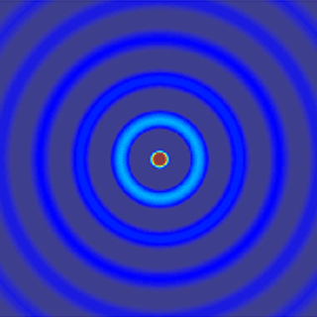
ECE 6341
Spring 2016
Prof. David R. Jackson
ECE Dept.
Notes 10

Slide 2
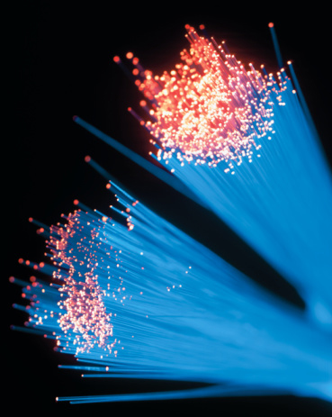
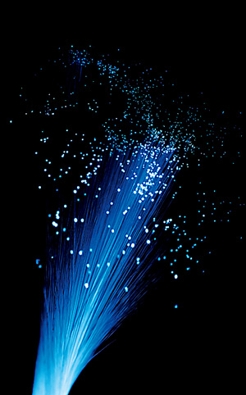
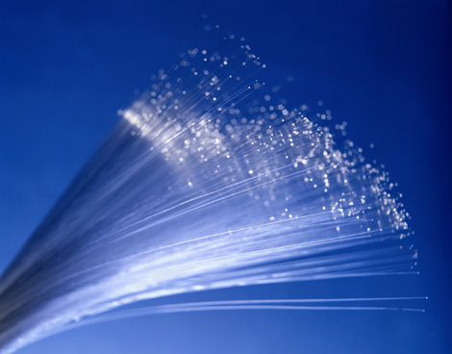
Dielectric Rod
z
a
This serves as a model for a fiber-optic guide.

Slide 3
Fiber Optic Guides
Two types of fiber-optic guides:
1) Single-mode fiber
This fiber carries a single mode (HE₁₁). This requires the fiber diameter to be on the order of a wavelength. It has less loss, dispersion, and signal distortion. It is often used for long-distances (e.g., greater than 1 km). The diameter is typically 8 μm. It requires more expensive electro-optic equipment.
2) Multi-mode fiber
This fiber has a diameter that is large relative to a wavelength (e.g., 10 wavelengths). It operates on the principle of total internal reflection (critical-angle effect). It can handle more power than the single-mode fiber, but has more dispersion. The diameter is typically 50 μm. It is often used for LANs, etc.

Slide 4
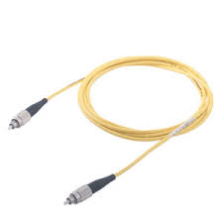
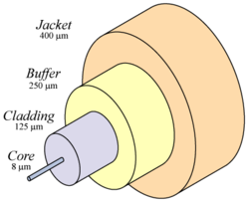
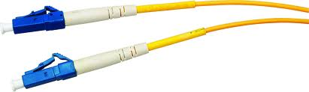
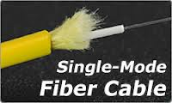
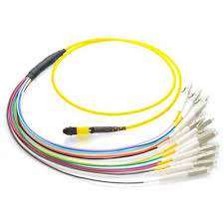
Single-mode Fiber
It usually has a yellow jacket.

Slide 5
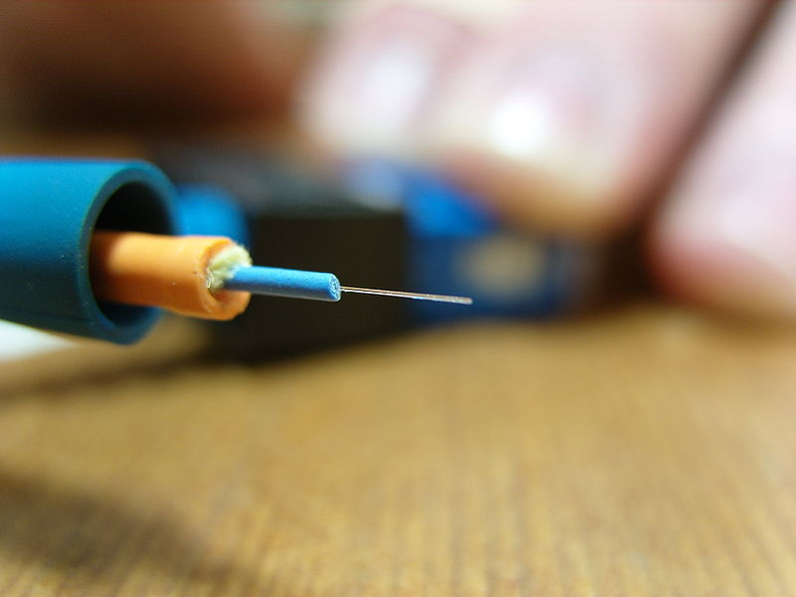
Multi-mode Fiber
A 1.25 Gbit/s multi-mode fiber
http://en.wikipedia.org/wiki/Multi-mode_fiber

Slide 6
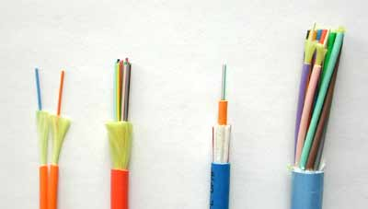
Fiber-optic Cable
Fibers (single-mode or multi-mode) may be bundled together into a “fiber optic cable” that has one or more fibers.
Simplex: single fiber in a cable
Duplex: two fibers in a cable
Cable Types: (L to R): Zipcord, Distribution, Loose Tube, Breakout
http://www.thefoa.org/tech/ref/basic/cable.html

Slide 7
Single-mode Fiber: Operation
Fields decay away from the rod
HE₁₁ mode
A single mode (HE₁₁ mode) propagates on the dielectric rod. The mode is similar to the TM₀ mode on a grounded slab. It has a zero cutoff frequency.

Slide 8
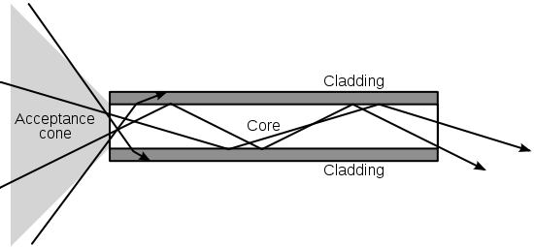
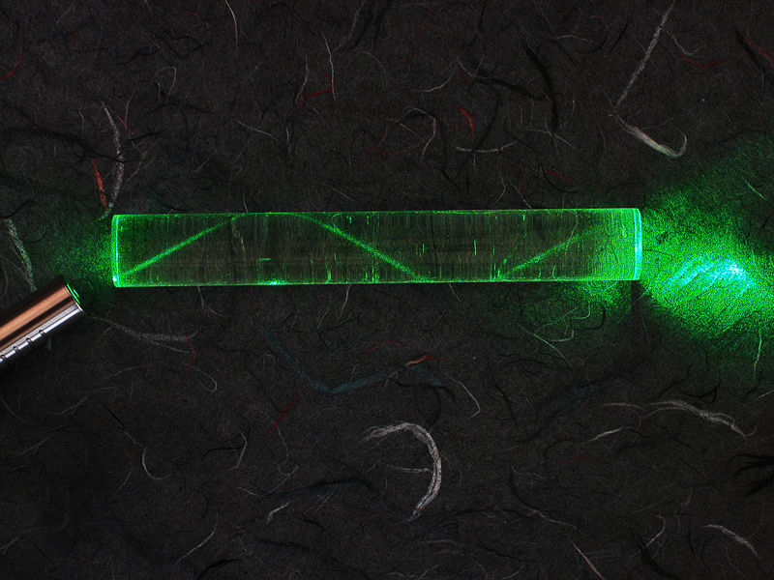
Multi-mode Fiber: Operation
Higher index core region
A multimode fiber can be explained using geometrical optics and internal reflection. The “ray” of light is actually a superposition of many waveguide modes (hence the name “multimode”).
A laser bouncing down an acrylic rod, illustrating the total internal reflection of light in a multi-mode optical fiber
http://en.wikipedia.org/wiki/Optical_fiber

Slide 9
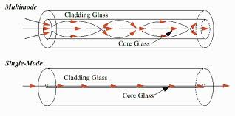
Single-mode vs. Multi-mode Fibers
Graded index

Slide 10
Dielectric Rod
z
0
1
a
Note:
We can have
TE_{0p}, TM_{0p} modes
Modes are hybrid unless
For example, assume TM_{z}:

Slide 11
Dielectric Rod (cont.)
At ρ = a :
so
Hence, for n > 0 we have
(Not true in general!)

Slide 12
Dielectric Rod (cont.)
Representation of potentials inside the rod:
ρ < a:
where
(k_{z} is unknown)

Slide 13
Dielectric Rod (cont.)
To see choice of sin/cos, examine the field components (for example E_{ρ}):
The field E_{ρ} is assumed (arbitrarily) to vary as sin(nφ) for our choice of potentials.
We then have for the field components:

Slide 14
Dielectric Rod (cont.)
Representation of potentials outside the rod:
ρ > a:
Use
where
Note: α_{ρ0} is interpreted as a positive real number in order to have decay radially in the air region, for a bound (non-leaky) mode.

Slide 15
Dielectric Rod (cont.)
Useful identity:
Another useful identity:
K_{n} (x) = Modified Bessel function of the second kind.

Slide 16
Dielectric Rod (cont.)
Modified Bessel function of the second kind

Slide 17
Dielectric Rod (cont.)
The modified Bessel function of the first kind grows exponentially, so we don’t want this one.

Slide 18
Dielectric Rod (cont.)
Hence, we choose

Slide 19
Dielectric Rod (cont.)
Summary of potentials:

Slide 20
Dielectric Rod (cont.)
Match E_{z} , H_{z} , E_{φ} , H_{φ} at ρ = a:
Example:
so

Slide 21
Dielectric Rod (cont.)
To have a non-trivial solution, we require that
k_{z} = unknown (for a given frequency ω)

Slide 22
Dielectric Rod (cont.)
Note:
This is an open structure, so cutoff means the boundary between proper and improper behavior (k_{z} = k₀).
Cutoff frequency:
Set
Then
The unknown is now ω_{c}.

Slide 23
Dielectric Rod (cont.)
Dominant mode (lowest cutoff frequency): HE₁₁ (f_{c} = 0)
Note: The notation HE means that the mode is hybrid, and has both E_{z} and H_{z}, although H_{z} is stronger. (For an EH mode, E_{z} would be stronger.)
The field shape is somewhat similar to the TE₁₁ circular waveguide mode.
The physical properties of the fields are similar to those of the TM₀ surface wave on a slab (For example, at low frequency the field is loosely bound to the rod.)

Slide 24
Dielectric Rod (cont.)
When will the next mode be at cutoff?
This determines the upper frequency limit for the single-mode fiber.
The next mode (i.e., with the next lowest cutoff frequency) is the TM₀₁ mode.
(Recall: For n = 0, the modes are TM_{z} and TE_{z}.)
Cutoff:
The tangential field in the air region at the boundary becomes zero at the cutoff frequency: the rod acts like a circular waveguide with a PEC wall.

Slide 25
Dielectric Rod (cont.)
TM₀₁ mode at cutoff:
or
Hence, to have only the HE₁₁ mode, we have the following frequency restriction:
n₁ = index of refraction of rod

Slide 26
Impedance of Wire
A round wire made of conducting material is examined.
Goal: Determine the impedance per unit length (in the z direction).
a
σ
z
The wire has a conductivity of σ.
We neglect the z variation of the fields inside the wire.
(The wire is short compared with a wavelength.)

Slide 27
Impedance of Wire (cont.)
Inside the wire:
(The field must be finite on the z axis.)
a
σ
z

Slide 28
Impedance of Wire (cont.)
Hence, we have
a
where
σ
z
(skin depth)
We can also write the field as

Slide 29
Impedance of Wire (cont.)
Definition of Kelvin functions:
a
σ
z
Therefore, we can write

Slide 30
Impedance of Wire (cont.)
The current flowing in the wire is
a
σ
z
Hence

Slide 31
Impedance of Wire (cont.)
The internal impedance per unit length is defined as:
a
Hence,
σ
z
Note: The internal impedance accounts for the internal stored energy and power dissipation.

Slide 32
Impedance of Wire (cont.)
We also have the following helpful
integration identity:
a
σ
Hence
z
where

Slide 33
Impedance of Wire (cont.)
Hence, we have
where
a
σ
z

Slide 34
Impedance of Wire (cont.)
At low frequency (a << δ):
a
At high frequency (a >> δ):
σ
z
where

Slide 35
Impedance of Wire (cont.)
Transmission Line Model
An extra impedance per unit length Z_{i} is added to the TL model in order to account for the internal impedance of the conductors.
Note: The form of Z_{i} will depend on the shape of the conductors: we have only analyzed the case of a round wire.
L₀ Δz
R Δz
Z_{i} Δz
C Δz
G Δz
The external inductance per unit length L₀ is calculated assuming perfectly conducting wires.

Slide 36
Impedance of Wire (cont.)
Transmission Line Model
For a twin lead (two wires running parallel) we have:
We assume that the wires are far enough apart so that the current is uniform inside each one.
+
-

