Slide 1
ECE 6341
Spring 2016
Prof. David R. Jackson
ECE Dept.
Notes 14

Slide 2
Addition Theorem
Allows us to “shift the origin” for line sources.
This is useful for solving problems with a line source outside of a cylinder.
y
x
Denote

Slide 3
Addition Theorem (cont.)
y
R
x
This is the exact solution, but it is not in a useful form.

Slide 4
Addition Theorem (cont.)
Assume for simplicity
Tube of current model
y
y
2
2
1
1
x
x
Surface-current:

Slide 5
Addition Theorem (cont.)
Determine A₁:
so
Hence
Using the “tube of current” concept,

Slide 6
Addition Theorem (cont.)
y
The “tube of current” representation
2
1
x

Slide 7
Addition Theorem (cont.)
From previous “tube of current” derivation:

Slide 8
Addition Theorem (cont.)
Therefore, we have
Hence

Slide 9
Addition Theorem (cont.)
For replace
y
y
2
2
1
1
x
x

Slide 10
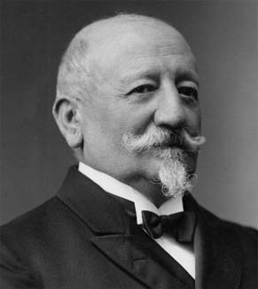
Addition Theorem (cont.)
Comparing with the original expression for the potential of the line current, we have
This is the “Graf addition theorem.”
It also holds if k is replaced with k_{ρ} .
Johann Heinrich Graf
(1852-1918)

Slide 11
Addition Theorem (cont.)
y
x

Slide 12
Scattering From a Line Current
z
a
y
x
TM_{z}:

Slide 13
Scattering From a Line Current (cont.)
(This is only valid for )
Assume
(This is only valid for )

Slide 14
Scattering From a Line Current (cont.)
Boundary Conditions (ρ = a):
Hence
or

Slide 15
Scattering From a Line Current (cont.)
Final result:
z
a
Scattered field
y
x

