Slide 1
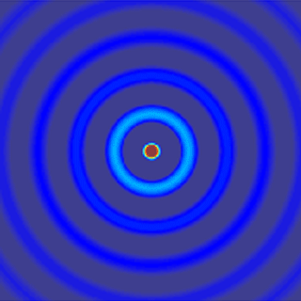
ECE 6341
Spring 2016
Prof. David R. Jackson
ECE Dept.
Notes 27

Slide 2
Scattering by Sphere
z
PEC sphere
y
x
PW

Slide 3
Scattering by Sphere (cont.)
where

Slide 4
Scattering by Sphere (cont.)
Let
where
Examine the field components to determine the boundary conditions.

Slide 5
Scattering by Sphere (cont.)
For example,

Slide 6
Scattering by Sphere (cont.)
Hence

Slide 7
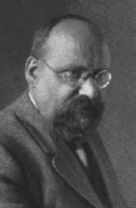
Scattering by Sphere (cont.)
The exact solution to scattering by spherical particles is called the Mie† series solution (first published in 1908).
† Gustav Adolf Feodor Wilhelm Ludwig Mie (Sept. 29, 1869 – Feb. 13, 1957) was a German physicist.
He was the first to publish the solution to scattering by a dielectric sphere.
He received a doctorate degree in mathematics at the age of 22.
http://en.wikipedia.org/wiki/Gustav_Mie

Slide 8
Scattering by Sphere (cont.)
From the TE_{r} / TM_{r} table:
Recall:
Hence, we have

Slide 9
Scattering by Sphere (cont.)
Similarly,
Recall:
Hence, we have

Slide 10
Scattering by Sphere (cont.)
Also,
Recall:
Hence, we have

Slide 11
Summary
Exact Scattered Field

Slide 12
Summary (cont.)
where

Slide 13
Note on Legendre Functions
The associated Legendre functions can be calculated in terms of the regular Legendre functions, if we wish:
so
Harrington notation
And thus
Note: Recurrence formulas can be used to calculate the derivatives of the Legendre polynomials.

Slide 14
Far Field
In the far field we have
So we have

Slide 15
Far Field (cont.)
Exact Scattered Far Field
Note: We can ignore E_{r} in the far field.

Slide 16
Backscattered Field
z
PEC
y
x
Incident
Scattered
From symmetry,

Slide 17
Backscattered Field (cont.)
z
PEC
Note: The backscattered field can be represented in different ways, depending on the angle φ that is chosen.
y
y
x
Choose this one
or

Slide 18
Backscattered Field (cont.)
Set φ = 0:
Next, use
so that

Slide 19
Backscattered Field (cont.)
We then have, letting θ → π
We can also write this as

Slide 20
Backscattered Field (cont.)
Final Backscattered Far Field

Slide 21
Low-Frequency Approximation
Let
Keep the dominant term in the series, which is the n = 1 term
Please see the formulas for d_{n} and e_{n} to verify that lower terms are more dominant.

Slide 22
Low-Frequency Backscattered Field
We thus have
where

Slide 23
Low-Frequency Backscattered Field (cont.)
Hence, we have
We next evaluate the coefficients e₁ and d₁ at low frequency.

Slide 24
Low-Frequency Backscattered Field (cont.)
Examine e₁:
Recall that
so

Slide 25
Low-Frequency Backscattered Field (cont.)
Next, examine the Bessel function terms as x = ka → 0:

Slide 26
Low-Frequency Backscattered Field (cont.)
Also

Slide 27
Low-Frequency Backscattered Field (cont.)
Hence
or

Slide 28
Low-Frequency Backscattered Field (cont.)
so
or
Hence

Slide 29
Low-Frequency Backscattered Field (cont.)
Examine d₁:
As a shortcut, compare with what we just did for e₁:

Slide 30
Low-Frequency Backscattered Field (cont.)
From the previous approximations for e₁, we note that
Hence
Therefore

Slide 31
Low-Frequency Backscattered Field (cont.)
Recall:
and
The total backscattered field is then:
with

Slide 32
Low-Frequency Backscattered Field (cont.)
The total low-frequency backscattered field is then:

Slide 33
Low-Frequency Backscattered Field (cont.)
Final Low-frequency Backscattered Field

Slide 34
Echo Area (Radar Cross Section)
Monostatic RCS
z
Physical interpretation:
y
x
This is the radiated power of an isotropic radiating “black body” disk that absorbs all incident power.
Perfectly absorbing disk

Slide 35
Echo Area (Radar Cross Section) (cont.)
Simplifying, we have

Slide 36
Echo Area (Radar Cross Section) (cont.)
Final Result
For electrically small particles, there is a much stronger scattering from the particles as the size increases.
Scattering from small dielectric or metallic particles is called
“Rayleigh scattering.”

Slide 37
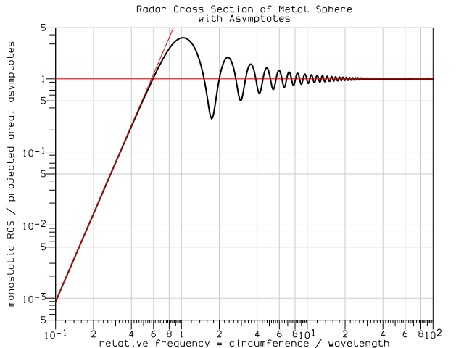
Echo Area (Radar Cross Section) (cont.)
Resonances
High-frequency (geometrical optics) limit
Rayleigh scattering (low frequency)
http://en.wikipedia.org/wiki/Mie_scattering

Slide 38
Echo Area (Radar Cross Section) (cont.)
Result for Dielectric Sphere (derivation omitted)
Extra factor added

Slide 39
Dipole Moment of Particle
Dipole Approximation
The sphere acts as a small radiating dipole in the x direction (the direction of the incident electric field).
The dipole moment that is given by:

Slide 40
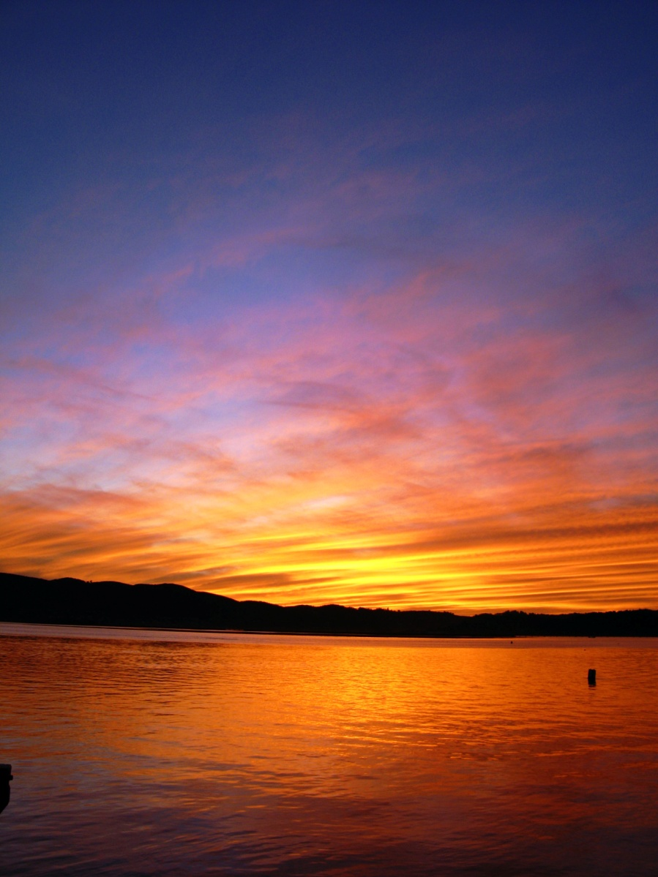
Rayleigh Scattering in the Sky
The change of sky color at sunset (red nearest the sun, blue furthest away) is caused by Rayleigh scattering from atmospheric gas particles which are much smaller than the wavelengths of visible light. The grey/white color of the clouds is caused by Mie scattering by water droplets which are of a comparable size to the wavelengths of visible light.
John Strutt (Lord Rayleigh), “On the transmission of light through an atmosphere containing small particles in suspension, and on the origin of the blue of the sky,” Philosophical Magazine, series 5, vol. 47, pp. 375-394, 1899.
http://en.wikipedia.org/wiki/Mie_scattering

Slide 41
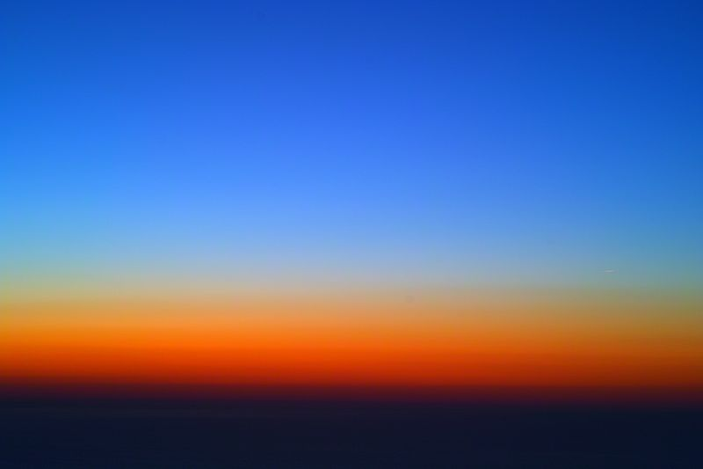
Rayleigh Scattering in the Sky (cont.)
Rayleigh scattering is more evident after sunset. This picture was taken about one hour after sunset at a 500m altitude, looking at the horizon where the sun had set.
http://en.wikipedia.org/wiki/Rayleigh_scattering

Slide 42
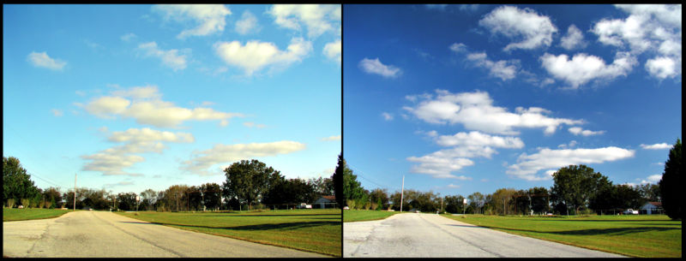
Rayleigh Scattering in the Sky (cont.)
Scattered blue light is polarized. The picture on the right is shot through a polarizing filter which removes light that is linearly polarized in a specific direction
Note: When looking up at the sky at sunset or sunrise, the light scattered by the sky above you will be polarized in a north-south direction. (There is little radiated field from the dipole moment that is vertically polarized since you are looking at the axis of the dipole; therefore the horizontal (north-south) polarization dominates.)
http://en.wikipedia.org/wiki/Rayleigh_scattering

