Slide 1
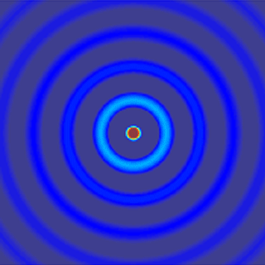
ECE 6341
Spring 2016
Prof. David R. Jackson
ECE Dept.
Notes 40

Slide 2
Microstrip Line
Microstrip Line
I₀
Dominant quasi-TEM mode:
We assume a purely x-directed current and a real wavenumber k_{x0}.
Note: The wavenumber is unknown, but we will solve for it later.

Slide 3
Microstrip Line (cont.)
Fourier transform of current:
Please see the first appendix for the transform of the Maxwell function.
Using the integral representation of the delta-function, we have:

Slide 4
Microstrip Line (cont.)
We then have
z = 0, z′ = 0
Hence we have:

Slide 5
Microstrip Line (cont.)
Integrating over the δ -function, we have:
where we now have

Slide 6
Microstrip Line (cont.)
Enforce EFIE using Galerkin’s method:
The EFIE is enforced on the red line.
y
where
(testing function = basis function)
x
Recall that
Substituting into the EFIE integral, we have

Slide 7
Microstrip Line (cont.)
Since the testing function is the same as the basis function,
Since the Bessel function is an even function,

Slide 8
Microstrip Line (cont.)
Using symmetry, we have
Note:
The Michalski functions are calculated in closed form later.
This is a transcendental equation of the following form:
We have to solve this equation numerically.
Note:

Slide 9
Microstrip Line (cont.)
Branch points:
Hence
Note: The wavenumber k_{z0} causes branch points to arise.

Slide 10
Microstrip Line (cont.)
Poles (k_{y} = k_{yp}):
or

Slide 11
Microstrip Line (cont.)
Branch points:
Poles:
There will be no singularities on the path of integration C, provided

Slide 12
Microstrip Line (cont.)
Note on wavenumber k_{x0}
For a real wavenumber k_{x0}, we must have that
Otherwise, there would be poles on the real axis, and this would correspond to leakage into the TM₀ surface-wave mode of the grounded substrate.
The mode would then be a leaky mode with a complex wavenumber k_{x0}, which contradicts the assumption that the pole is on the real axis.
Hence

Slide 13
Microstrip Line (cont.)
If we wanted to use multiple basis functions, we could consider the following choices:
Fourier-Maxwell Basis Function Expansion:
Chebyshev-Maxwell Basis Function Expansion:

Slide 14
Microstrip Line (cont.)
We next proceed to calculate the Michalski voltage functions explicitly.

Slide 15
Microstrip Line (cont.)

Slide 16
Microstrip Line (cont.)

Slide 17
Microstrip Line (cont.)
At
Hence

Slide 18
Microstrip Line (cont.)
Summary of the transcendental equation for the unknown wavenumber k_{x0}:

Slide 19
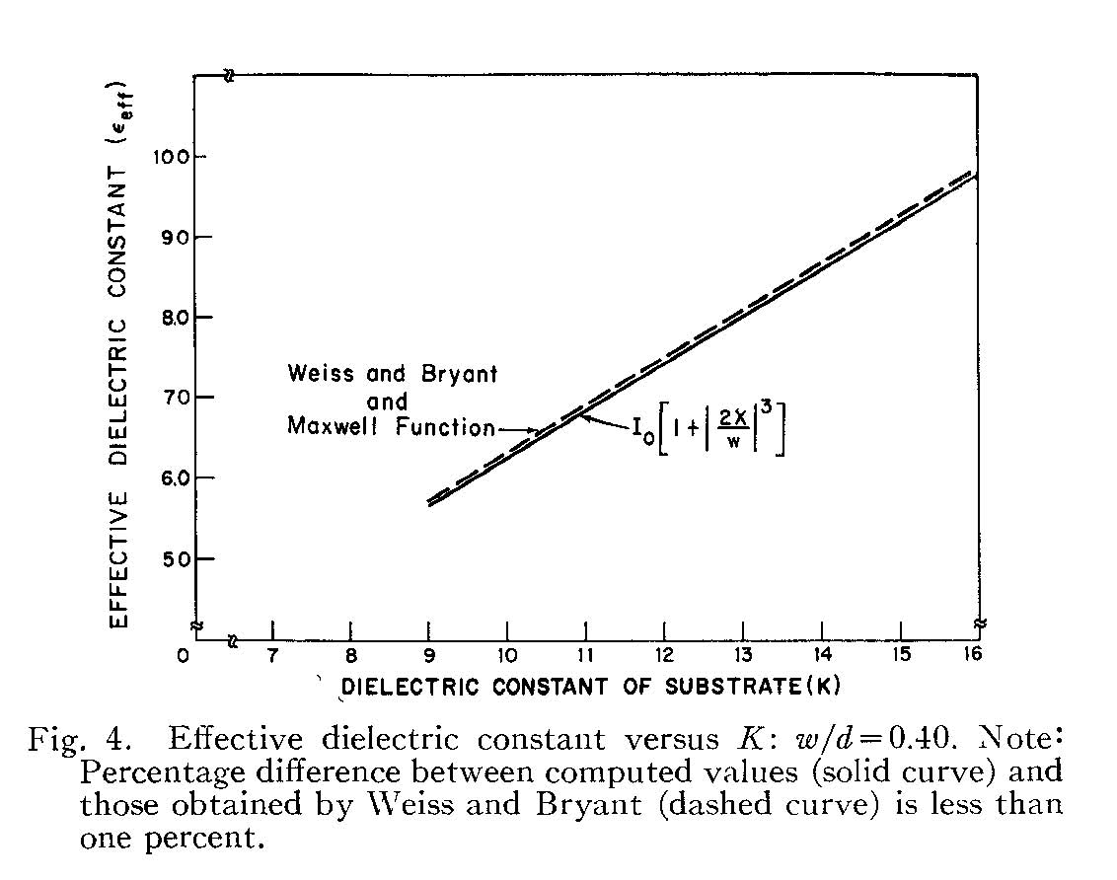
Microstrip Line (cont.)
10.0
Low-frequency results
9.0
8.0
Effective dielectric constant
7.0
w
6.0
h
5.0
Dielectric constant of substrate (ε_{r})
E. J. Denlinger, “A frequency-dependent solution for microstrip transmission lines,” IEEE Trans. Microwave Theory and Techniques, vol. 19, pp. 30-39, Jan. 1971.
Parameters: w/h = 0.40

Slide 20
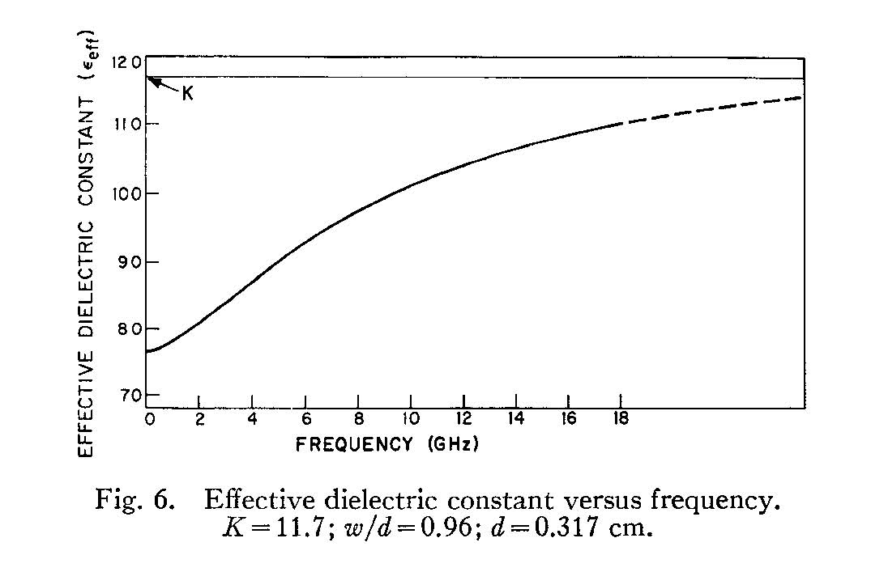
Microstrip Line (cont.)
12.0
11.0
10.0
Effective dielectric constant
9.0
Frequency variation
(dispersion)
w
8.0
h
7.0
Frequency (GHz)
Parameters: ε_{r} = 11.7, w/h = 0.96, h = 0.317 cm
E. J. Denlinger, “A frequency-dependent solution for microstrip transmission lines,” IEEE Trans. Microwave Theory and Techniques, vol. 19, pp. 30-39, Jan. 1971.
Quasi-TEM region

Slide 21
Microstrip Line (cont.)
Characteristic Impedance
1) Quasi-TEM Method
w
w
h
h
Original problem
Equivalent problem (TEM)
We calculate the characteristic impedance of the equivalent homogeneous medium problem.

Slide 22
Microstrip Line (cont.)
Using the equivalent TEM problem:
(The zero subscript denotes the value when using an air substrate.)
w
h
Simple CAD formulas may be used for the Z₀ of an air line.

Slide 23
Microstrip Line (cont.)
2) Voltage-Current Method
z
w
+
y
h
V
-
This is derived in the Appendix.

Slide 24
Microstrip Line (cont.)
Set x and y to zero
Substitute for the transform of E_{z}
Substitute for the transform of the surface current

Slide 25
Microstrip Line (cont.)
Integrate in k_{x}
Switch order of integration
Use symmetry

Slide 26
Microstrip Line (cont.)
The final result is then
where
The F (k_{t}) function is calculated next.

Slide 27
Microstrip Line (cont.)
We first calculate the function

Slide 28
Microstrip Line (cont.)
Because of the short circuit,
At z = 0:
Therefore
Hence

Slide 29
Microstrip Line (cont.)
Hence
or

Slide 30
Microstrip Line (cont.)
Hence
where

Slide 31
Microstrip Line (cont.)
We then have
Hence

Slide 32
Microstrip Line (cont.)
Summary of Voltage-Current Formula:
where

Slide 33
Microstrip Line (cont.)
3) Power-Current Method
z
w
y
h
Note: It is possible to perform the spatial integrations for the power flow in closed form (details are omitted).

Slide 34
Microstrip Line (cont.)
4) Power-Voltage Method
z
w
+
y
h
V
-
Note: It is possible to perform the spatial integrations for the power flow in closed form (details are omitted).

Slide 35
Microstrip Line (cont.)
Comparison of methods:
At low frequency all three methods agree well.
As frequency increases, the VI, PI, and PV methods give a Z₀ that increases with frequency.
The Quasi-TEM method gives a Z₀ that decreases with frequency.
The PI method is usually regarded as being the best one for high frequency (agrees better with measurements).

Slide 36
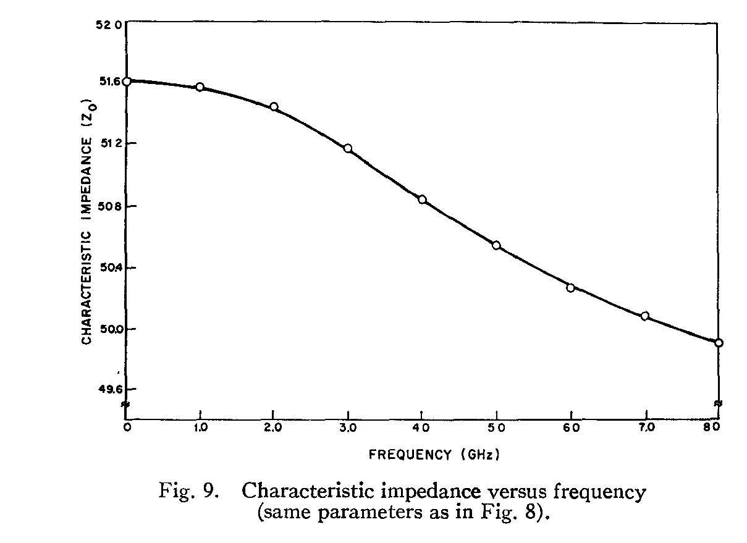
Microstrip Line (cont.)
Quasi-TEM Method
ε_{r} = 15.87, h = 1.016 mm, w/h = 0.543
Note: Z₀ decreases with frequency.
E. J. Denlinger, “A frequency-dependent solution for microstrip transmission lines,” IEEE Trans. Microwave Theory and Techniques, vol. 19, pp. 30-39, Jan. 1971.

Slide 37
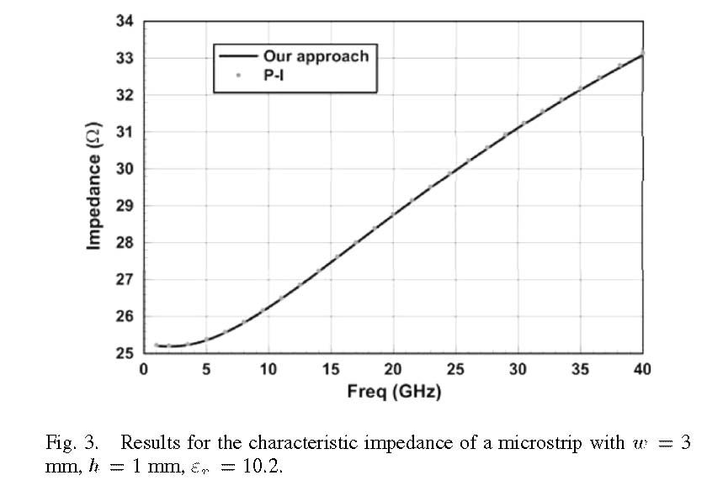
Microstrip Line (cont.)
Note: Z₀ increases with frequency.
F. Mesa and D. R. Jackson, “A novel approach for calculating the characteristic impedance of printed-circuit lines,” IEEE Microwave and Wireless Components Letters, vol. 4, pp. 283-285, April 2005.

Slide 38
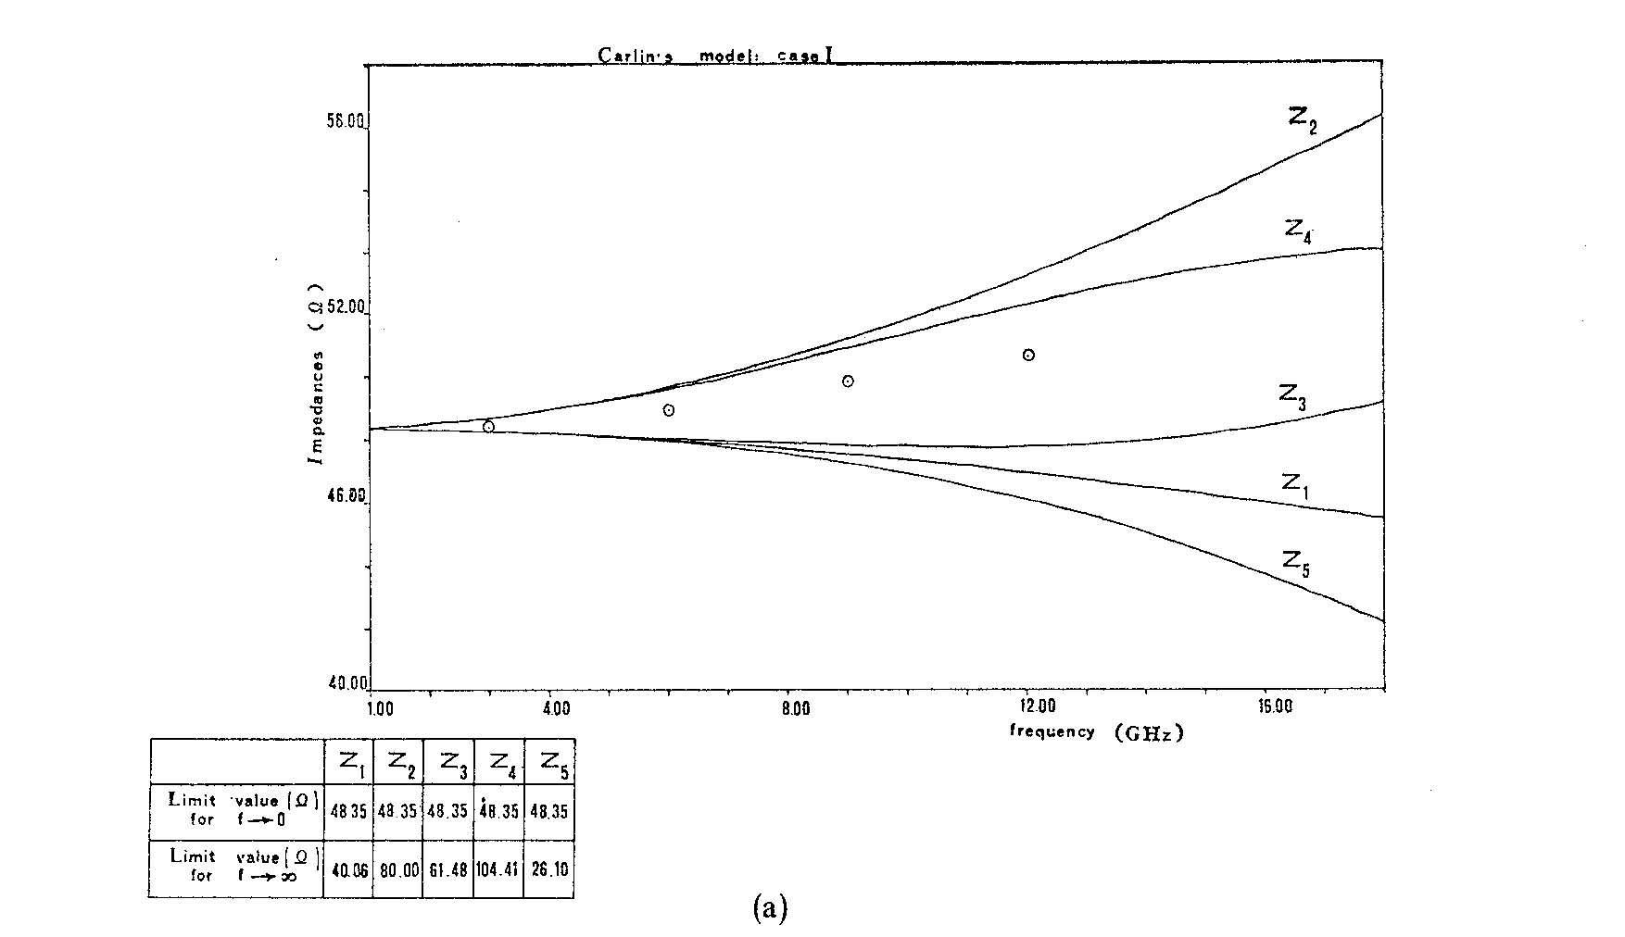
Microstrip Line (cont.)
58
(Circles represent results from another paper.)
VI
Ω
PV
52
PI
46
V ^{e}I
B Bianco, L. Panini, M. Parodi, and S. Ridella, “Some considerations about the frequency dependence of the characteristic impedance of uniform microstrips,” IEEE Trans. Microwave Theory and Techniques, vol. 26, pp. 182-185, March 1978.
PV ^{e}
40
1.0
4.0
8.0
12.0
GHz
16.0
ε_{r} = 10, h = 0.635 mm, w/h = 1
V ^{e} = effective voltage (average taken over different paths).

Slide 39
Appendix: Transform of Maxwell Function
In this appendix we evaluate the transform of the Maxwell function.
From symmetry:

Slide 40
Appendix (cont.)
Next, use the transformation
so that

Slide 41
Appendix (cont.)
We then have
Next, use the following integral identify for the Bessel function:
so that

Slide 42
Appendix (cont.)
Hence, we have

Slide 43
Appendix: Vertical Electric Field
Find E_{z} (x,y,z) inside the substrate for -h < z < 0.

Slide 44
Appendix (cont.)

Slide 45
Appendix (cont.)
Hence
cancels
or
or

Slide 46
Appendix (cont.)
or
For a horizontal electric current source, we then have:
The result is then

