Slide 1
ECE 6341
Spring 2016
Prof. David R. Jackson
ECE Dept.
Notes 41

Slide 2
Patch Antenna
In this set of notes we do the following:
Find the field E_{x} produced by the patch current on the interface
Find the field E_{z} inside the substrate
Find the voltage between the patch and the ground plane
Find the input impedance of the patch (when fed by a probe)
Assume that the patch current has the following form:

Slide 3
Calculate the Field E_{x}
Find
Dominant (1,0) mode:

Slide 4
Field E_{x} (cont.)
Recall that
In this problem

Slide 5
Field E_{x} (cont.)

Slide 6
Field E_{x} (cont.)

Slide 7
Field E_{x} (cont.)

Slide 8
Field E_{x} (cont.)
At z = 0:
Hence

Slide 9
Field E_{x} (cont.)
Hence, we have:

Slide 10
Field E_{x} (cont.)
Taking the inverse Fourier transform, we have

Slide 11
Field E_{z}
Find E_{z} (x,y,z) inside the substrate (-h < z < 0)
Dominant (1,0) mode:

Slide 12
Field E_{z} (cont.)
From Notes 40 we have:

Slide 13
Field E_{z} (cont.)
Hence, in the space domain we have
Note: Only TM_{z} waves contribute to the vertical electric field.
From Notes 40:

Slide 14
Voltage
Find V (x,y) between the patch and the ground plane.
Dominant (1,0) mode:

Slide 15
Voltage (cont.)
Using the result from the previous calculation for E_{z}, we have:
where
From Notes 40:

Slide 16
Input Impedance
Find the input impedance Z_{in} (x₀,y₀) of the probe-fed patch antenna
The probe is viewed as an impressed current.

Slide 17
Input Impedance (cont.)
Set
This is the “Electric Field Integral Equation (EFIE)”

Slide 18
Input Impedance (cont.)
Assume:
A_{x} is an unknown amplitude.
The EFIE is then
Pick a “testing” function T (x,y):
or

Slide 19
Input Impedance (cont.)
Galerkin’s Method:
(The testing function is the same as the basis function.)
Hence, we have:
The solution for the unknown amplitude coefficient A_{x} is then

Slide 20
Input Impedance (cont.)
The input impedance is calculated as:
From linearity, we have
where
From the last example:

Slide 21
Input Impedance (cont.)
Next, we return to the calculation of A_{x}:
From reciprocity:
From the formula for the field E_{x}:

Slide 22
Input Impedance (cont.)
Summary

Slide 23
Input Impedance (cont.)
Converting to polar coordinates, we have:

Slide 24
Input Impedance (cont.)
The path of integration is shown below.
Note: The path must extend to infinity.

Slide 25
Input Impedance (cont.)
Improvement:
Add probe reactance to account for the stored magnetic energy near the metal probe.

Slide 26
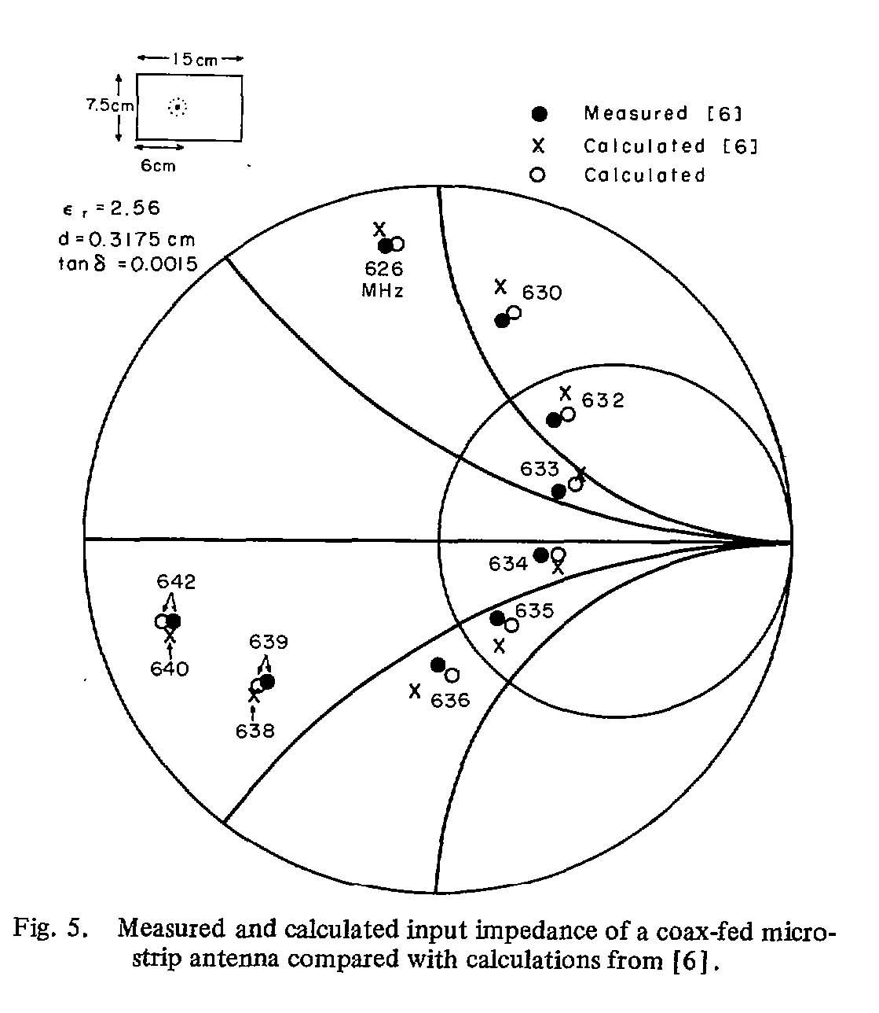
Input Impedance (cont.)
D. M. Pozar, “Input impedance and mutual coupling of rectangular microstrip antennas,” IEEE Trans. Antennas Propagat., vol. AP-30. pp. 1191-1196, Nov. 1982.
[6] E. H. Newman and P. Tulyathan, “Analysis of microstrip antennas using moment methods,” IEEE Trans. Antennas Propagat., vol. AP-29. pp. 47-53, Jan. 1981.

