Slide 1
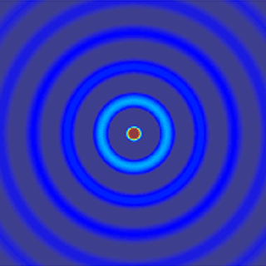
ECE 6341
Spring 2016
Prof. David R. Jackson
ECE Dept.
Notes 43
Notes 42

Slide 2

Sommerfeld Problem
In this set of notes we use SDI theory to solve the classical "Sommerfeld problem" of a vertical dipole over an semi-infinite earth.
Goal: Find E_{z} on the surface of the earth (in the air region).
z
r
x

Slide 3
Sommerfeld Problem (cont.)
Planar vertical electric current (from Notes 39):
(the impressed source current)
For a vertical electric dipole of amplitude I l, we have
Hence
Therefore, we have

Slide 4
Sommerfeld Problem (cont.)
TEN:
+
-
The vertical electric dipole excites TM_{z} waves only.

Slide 5
Vertical Field
Find E_{z} (x,y,z) inside the air region ( z > 0).

Slide 6
Example (cont.)

Slide 7
Example (cont.)
Hence
cancels
or
or

Slide 8
Sommerfeld Problem (cont.)
Hence
We use the Michalski normalized current function:
(The v subscript indicates a 1V series source.)
We need to calculate the Michalski normalized current function at z = 0
(since we want the field on the surface of the earth).

Slide 9
Sommerfeld Problem (cont.)
Calculation of the Michalski normalized current function
+
+
-
-

Slide 10
Sommerfeld Problem (cont.)
+
-
This figure shows how to calculate the Michalski normalized current function: it will be calculated later in these notes.

Slide 11
Sommerfeld Problem (cont.)
Return to the calculation of the field:
Hence we have
or

Slide 12
Sommerfeld Problem (cont.)
Note:
is only a function of
Change to polar coordinates:

Slide 13
Sommerfeld Problem (cont.)
Switch to polar coordinates

Slide 14
Sommerfeld Problem (cont.)
Use
We see from this result that the vertical field of the vertical electric dipole should not vary with angle φ.
Integral identity:

Slide 15
Sommerfeld Problem (cont.)
Hence we have
This is the “Sommerfeld form” of the field.

Slide 16
Sommerfeld Problem (cont.)
We now return to the calculation of the Michalski normalized current function.
+
+
-
-

Slide 17
Sommerfeld Problem (cont.)
+
+
-
-
Here we visualize the transmission line as infinite beyond the voltage source.

Slide 18
Sommerfeld Problem (cont.)
+
+
-
-
Boundary conditions:

Slide 19
Sommerfeld Problem (cont.)
Hence we have

Slide 20
Sommerfeld Problem (cont.)
Substitute the first of these into the second one:
This gives us

Slide 21
Sommerfeld Problem (cont.)
cancels
Hence we have

Slide 22
Sommerfeld Problem (cont.)
For the current we then have
with
Hence
For z = 0:

Slide 23
Sommerfeld Problem (cont.)
We thus have
with
Hence
or

Slide 24
Sommerfeld Problem (cont.)

Slide 25
Sommerfeld Problem (cont.)
Final Result

Slide 26
Sommerfeld Problem (cont.)
Note:
A box height of about 0.05k₀ is a good choice.
Zenneck-wave pole (TM_{z})
(derivation on next slide)
ε_{rc} = complex relative permittivity of the earth (accounting for the conductivity.)

Slide 27
Sommerfeld Problem (cont.)
Zenneck-wave pole (TM_{z})
The TRE is:
Note:
Both vertical wavenumbers
(k_{z0} and k_{z1}) are proper for the Zenneck wave (proof omitted).

Slide 28
Sommerfeld Problem (cont.)
Alternative form
The path is extended to the entire real axis.
We use
(see note 1)
(see note 2)
Transform the H₀⁽¹⁾ term:
Note 1: z is not on the negative real axis.
Note 2: Im(z) is positive.

Slide 29
Sommerfeld Problem (cont.)
Hence we have
This is a convenient form for deforming the path.

Slide 30
Sommerfeld Problem (cont.)
The Zenneck-wave is nonphysical because it is a fast wave, but it is proper. It is not captured when deforming to the ESDP (vertical path from k₀).

Slide 31
Sommerfeld Problem (cont.)
The Riemann surface has four sheets.
Original path C
Top sheet for both k_{z0} and k_{z1}
Bottom sheet for k_{z1}
The ESDP from the branch point at k₁ is usually not important for a lossy earth.
Bottom sheet for k_{z0}
Bottom sheet for both k_{z0} and k_{z1}

Slide 32
Sommerfeld Problem (cont.)
This path deformation makes it appear as if the Zenneck-wave pole is important.

Slide 33
Sommerfeld Problem (cont.)
Throughout much of the 20th century, a controversy raged about the “reality of the Zenneck wave.”
Arnold Sommerfeld predicted a surface-wave like field coming from the residue of the Zenneck-wave pole (1909).
People took measurements and could not find such a wave.
Hermann Weyl solved the problem in a different way and did not get the Zenneck wave (1919).
Some people (Norton, Niessen) blamed it on a sign error that Sommerfeld had made, though Sommerfeld never admitted to a sign error.
Eventually it was realized that there was no sign error (Collin, 2004).
The limitation in Sommerfeld’s original asymptotic analysis (which shows a Zenneck-wave term) is that the pole must be well separated from the branch point – the asymptotic expansion that he used neglects the effects of the pole on the branch point (the saddle point in the steepest-descent plane).
When the asymptotic evaluation of the branch-cut integral around k₀ includes the effects of the pole, it turns out that there is no Zenneck-wave term in the total solution (branch-cut integrals + pole-residue term).
The easiest way to explain the fact that the Zenneck wave is not important far away is that the pole is not captured in deforming to the ESDP paths.

Slide 34
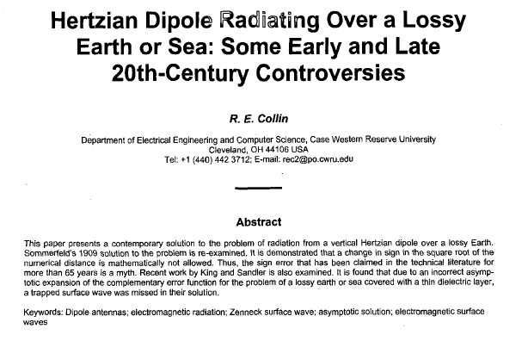
Sommerfeld Problem (cont.)
R. E. Collin, “Hertzian Dipole Radiating Over a Lossy Earth or Sea: Some Early and Late 20th-Century Controversies,” AP-S Magazine, pp. 64-79, April 2004.

Slide 35
Sommerfeld Problem (cont.)
Alternative path
(efficient for large distances ρ)
This choice of path is convenient because it stays on the top sheet, and yet it has fast convergence as the distance ρ increases, due to the Hankel function.

