Slide 1

The Spectral Domain Method
in Electromagnetics
David R. Jackson
University of Houston

Slide 2
Contact Information
David R. Jackson
Dept. of ECE
N308 Engineering Building 1
University of Houston
Houston, TX 77204-4005
Phone: 713-743-4426
Fax: 713-743-4444
Email: djackson@uh.edu

Slide 3
Additional Resources
Some basic references are provided at the end of these viewgraphs.
You are welcome to visit a website that goes along with a course at the University of Houston that discusses (among other things) the spectral domain immittance (SDI) method.
ECE 6341: “Advanced Electromagnetic Waves”
http://courses.egr.uh.edu/ECE/ECE6341/
Note: You are welcome to use anything that you find on this website,
as long as you please acknowledge the source.

Slide 4
Spectral Domain Immittance Method
What is it?
It is a powerful, and systematic method for analyzing
sources and structures in layered media.
Electric or magnetic dipole sources within layered media.
Microstrip and printed antennas.
Phased arrays, FSS structures, planar radomes.
Geophysical problems.
The method was originally developed by Itoh and Menzel in the early 1980s (references are given at the end).

Slide 5
Spectral Domain Immittance Method
Where does the name come from?
S D I
The electric and magnetic fields are modeled in the Fourier transform (spectral) domain.
The horizontal (transverse) electric and magnetic fields are modeled as voltage and current on a transmission line model of the layered structure (called the transverse equivalent network or TEN).
The TEN has transmission lines described by characteristic impedances (or admittances). The word “immitance” means either impedance or admittance.

Slide 6
Purpose of Short Course
To cover the fundamentals of the Spectral Domain Immittance (SDI) method.
To explain the physical principles of the method.
To develop the mathematics of the method.
To develop a systematic “recipe” for applying the method to analyzing different types of sources and structures in layered media.
To illustrate the method with various practical examples.

Slide 7
Outline
Physical derivation of method for planar electric surface currents.
Examples involving planar surface currents:
  Microstrip line
  Microstrip patch current
General derivation (Fourier transforming Maxwell’s equations) that allows for all types of sources to be included in one general derivation.
Examples:
  Vertical dipole over the earth (Sommerfeld problem)
  Slot antenna covered with radome layer (magnetic current)

Slide 8
Outline
Physical derivation of method for planar electric surface currents.
Examples involving planar surface currents:
  Microstrip line
  Microstrip patch current
General derivation (Fourier transforming Maxwell’s equations) that allows for all types of sources to be included in one general derivation.
Examples:
  Vertical dipole over the earth (Sommerfeld problem)
  Slot antenna covered with radome layer (magnetic current)

Slide 9
Fourier Representation of Planar Currents (cont.)
Consider a planar electric surface current in a layered medium
Note: The subscript “s” denotes the source layer

Slide 10
Fourier Representation of Planar Currents (cont.)
A 2D spatial Fourier transform in (x,y) can be used to represent the
finite-size current sheet as a collection (superposition) of
infinite phased current sheets.

Slide 11
Fourier Representation of Planar Currents (cont.)
where

Slide 12
Fourier Representation of Planar Currents (cont.)

Slide 13
Fourier Representation of Planar Currents (cont.)

Slide 14
Fourier Representation of Planar Currents (cont.)
Example
A microstrip patch has a dominant (1,0) mode surface current that is described by

Slide 15
Fourier Representation of Planar Currents (cont.)
Example (cont.)

Slide 16
Fourier Representation of Planar Currents (cont.)
Example (cont.)
Hence

Slide 17
Fourier Representation of Planar Currents (cont.)
Example (cont.)

Slide 18
Fourier Representation of Planar Currents (cont.)
Consider an infinite phased current sheet having some (k_{x}, k_{y}):
This phased current sheet launches a pair of plane waves as shown below:
k_{s}

Slide 19
Fourier Representation of Planar Currents (cont.)
k_{s}
Note: We choose the physical choice where k_{zs} is either positive real or negative imaginary.

Slide 20
Fourier Representation of Planar Currents (cont.)
k_{s}
Goal: Decompose the current into two parts: one that excites only a pair of TM_{z} plane waves, and one that excites only a pair of TE_{z} plane waves.
TM_{z} and TE_{z} waves do not couple at boundaries.

Slide 21
(u,v) Coordinates
Define:
Launching of plane wave by source:

Slide 22
(u,v) Coordinates (cont.)

Slide 23
(u,v) Coordinates (cont.)

Slide 24
TM_{z}-TE_{z} Properties
TM_{z}

Slide 25
TM_{z}-TE_{z} Properties (cont.)
TE_{z}

Slide 26
TM_{z}-TE_{z} Properties (cont.)
Proof of launching property:
Consider the TM_{z} case (u is labeled as x´ for simplicity here).
An infinite medium is considered, since we are only looking at the launching property of the waves.
Exact solution:

Slide 27
TM_{z}-TE_{z} Properties (cont.)
In the general coordinate system:
TM_{z}

Slide 28
TM_{z}-TE_{z} Properties (cont.)
Two cases of interest:

Slide 29
Decomposition of Current
Split general phased current into two parts:
Launches TM_{z}
Launches TE_{z}

Slide 30
Transverse Fields
TM_{z} :
H
E

Slide 31
Transverse Fields (cont.)
TE_{z} :
H
E

Slide 32
Transverse Equivalent Network (TEN)
TEN modeling equations:

Slide 33
TEN (cont.)
Source

Slide 34
TEN (cont.)
Source

Slide 35
Source Model
Phased current sheet inside layered medium

Slide 36
Source Model (cont.)
so
Hence
Also
Hence

Slide 37
Source Model (cont.)
TM_{z} Model:

Slide 38
Source Model (cont.)
TE_{z} Model:
(derivation omitted)

Slide 39
Source Model (cont.)
The transverse fields can then be found from

Slide 40
Source Model (cont.)
Introduce normalized voltage and current functions:
(following the notation of K. A. Michalski)
Then we can write:

Slide 41
Source Model (cont.)
The transverse fields are then expressed as

Slide 42
Example
Find for z ≥ 0 due to a surface current at z = 0,
with
The current is radiating in free space.

Slide 43
Example (cont.)
Decompose current into two parts:

Slide 44
Example (cont.)

Slide 45
Example (cont.)

Slide 46
Example (cont.)
Hence

Slide 47
Example (cont.)
TM_{z} Model
For z > 0:

Slide 48
Example (cont.)
TE_{z} Model
For z > 0:

Slide 49
Example (cont.)
Hence
where

Slide 50
Example (cont.)
Substituting in values, we have:
Hence
or

Slide 51
Finite Source
For a phased current sheet:
Recall that

Slide 52
Finite Source (cont.)
Hence
Note:
Spatial coordinates
Wavenumber plane

Slide 53
TEN Model for
We can also write (from the definition of inverse transform)
Comparing with the previous result, we have
Similarly,
This motivates the following identifications:

Slide 54
TEN Model (cont.)

Slide 55
TEN Model (cont.)

Slide 56
TEN Model (cont.)

Slide 57
Example
Find

Slide 58
Example (cont.)
Hence

Slide 59
Example (cont.)

Slide 60
Dyadic Green’s Function
where
due to the unit-amplitude electric dipole at
From superposition:
We assume here that the currents are located on a planar surface.
where

Slide 61
Dyadic Green’s Function (cont.)
This is recognized as a 2D convolution:
Taking the 2D Fourier transform of both sides,
where

Slide 62
Dyadic Green’s Function (cont.)
Assuming we wish the x component of the electric field due to an x-directed current J_{sx} (x′ , y′ ), we have
In order to indentify , we use

Slide 63
Dyadic Green’s Function (cont.)
Recall that
Hence

Slide 64
Dyadic Green’s Function (cont.)
We the have
The other eight components could be found in a similar way.
(The sources in the TEN that correspond to all possible sources are given on the next slide, and from these we can determine any component of the spectral-domain Green’s function that we wish, for either an electric current or a magnetic current.)

Slide 65
Summary of Results for All Sources
These results are derived later.
Definition of “vertical planar currents”:

Slide 66
Sources used in Modeling
V_{i} = voltage due to 1[A] parallel current source
I_{i} = current due to 1[A] parallel current source
V_{v} = voltage due to 1[V] series voltage source
I_{v} = current due to 1[V] series voltage source
+
-

Slide 67
Sources used in Modeling (cont.)
V_{i} = voltage due to 1[A] parallel current source
I_{i} = current due to 1[A] parallel current source
V_{v} = voltage due to 1[V] series voltage source
I_{v} = current due to 1[V] series voltage source
+
-

Slide 68
Outline
Physical derivation of method for planar electric surface currents.
Examples involving planar surface currents:
  Microstrip line
  Microstrip patch current
General derivation (Fourier transforming Maxwell’s equations) that allows for all types of sources to be included in one general derivation.
Examples:
  Vertical dipole over the earth (Sommerfeld problem)
  Slot antenna covered with radome layer (magnetic current)

Slide 69
Microstrip Line
Microstrip Line
I₀
Dominant quasi-TEM mode:
We assume a purely x-directed current and a real wavenumber k_{x0}.

Slide 70
Microstrip Line (cont.)
Fourier transform of current:

Slide 71
Microstrip Line (cont.)
z = 0, z′ = 0
Hence we have:

Slide 72
Microstrip Line (cont.)
Integrating over the δ -function, we have:
where we now have

Slide 73
Microstrip Line (cont.)
Enforce EFIE using Galerkin’s method:
The EFIE is enforced on the red line.
y
where
(testing function = basis function)
x
Recall that
Substituting into the EFIE integral, we have

Slide 74
Microstrip Line (cont.)
Since the testing function is the same as the basis function,
Since the Bessel function is an even function,

Slide 75
Microstrip Line (cont.)
Using symmetry, we have
This is a transcendental equation of the following form:
Note:

Slide 76
Microstrip Line (cont.)
Branch points:
Hence
Note: The wavenumber k_{z0} causes branch points to arise.

Slide 77
Microstrip Line (cont.)
Poles (k_{y} = k_{yp}):
or

Slide 78
Microstrip Line (cont.)
Branch points:
Poles:

Slide 79
Microstrip Line (cont.)
Note on wavenumber k_{x0}
For a real wavenumber k_{x0}, we must have that
Otherwise, there would be poles on the real axis, and this would correspond to leakage into the TM₀ surface-wave mode of the grounded substrate.
The mode would then be a leaky mode with a complex wavenumber k_{x0}, which contradicts the assumption that the pole is on the real axis.
Hence

Slide 80
Microstrip Line (cont.)
If we wanted to use multiple basis functions, we could consider the following choices:
Fourier-Maxwell Basis Function Expansion:
Chebyshev-Maxwell Basis Function Expansion:

Slide 81
Microstrip Line (cont.)
We next proceed to calculate the
Michalski voltage functions explicitly.

Slide 82
Microstrip Line (cont.)

Slide 83
Microstrip Line (cont.)

Slide 84
Microstrip Line (cont.)
At
Hence

Slide 85
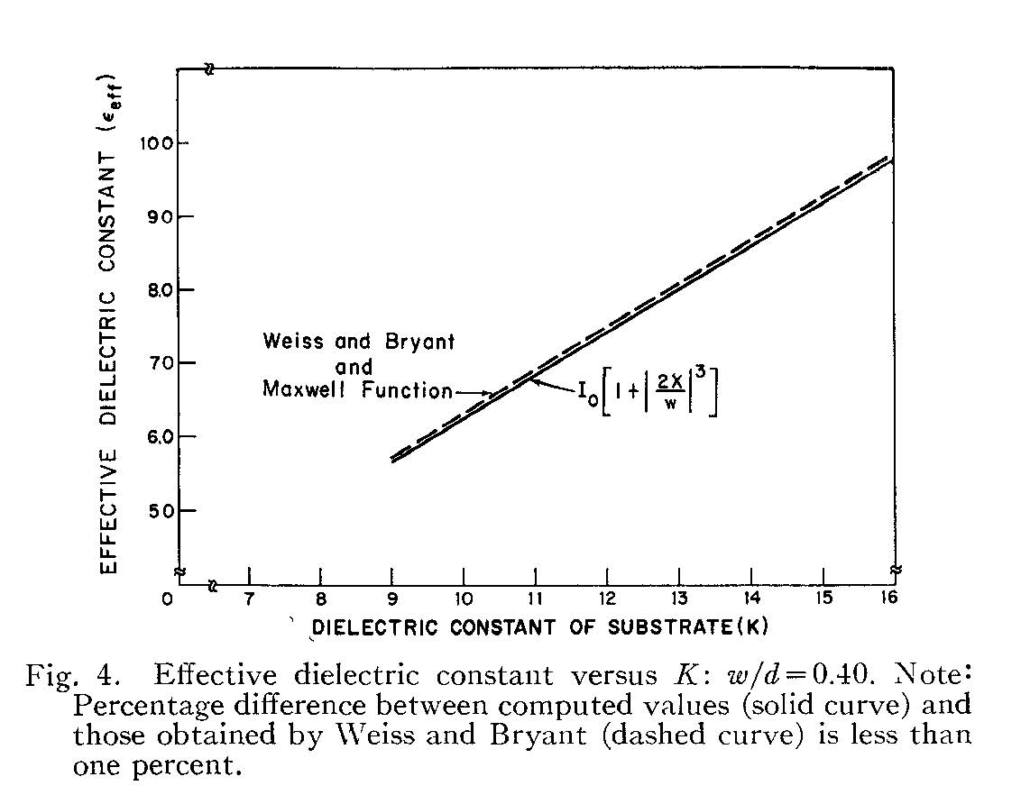
Microstrip Line (cont.)
10.0
Low-frequency results
9.0
8.0
Effective dielectric constant
7.0
w
6.0
h
5.0
Dielectric constant of substrate (ε_{r})
E. J. Denlinger, “A frequency-dependent solution for microstrip transmission lines,” IEEE Trans. Microwave Theory and Techniques, vol. 19, pp. 30-39, Jan. 1971.
Parameters: w/h = 0.40

Slide 86
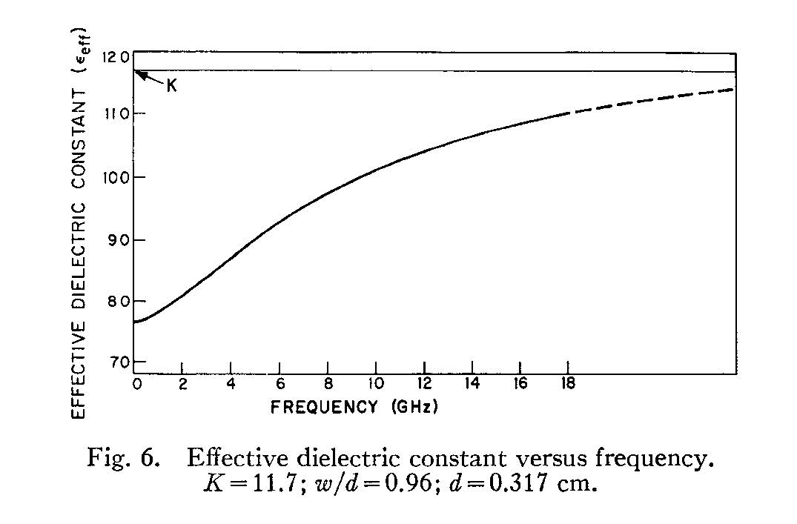
Microstrip Line (cont.)
12.0
ε_{r}
11.0
10.0
Effective dielectric constant
9.0
Frequency variation
w
8.0
h
7.0
Frequency (GHz)
Parameters: ε_{r} = 11.7, w/h = 0.96, h = 0.317 cm
E. J. Denlinger, “A frequency-dependent solution for microstrip transmission lines,” IEEE Trans. Microwave Theory and Techniques, vol. 19, pp. 30-39, Jan. 1971.

Slide 87
Microstrip Line (cont.)
Characteristic Impedance
1) Quasi-TEM Method
w
w
h
h
Original problem
Equivalent problem (TEM)
We calculate the characteristic impedance of the equivalent homogeneous medium problem.

Slide 88
Microstrip Line (cont.)
Using the equivalent TEM problem:
(The zero subscript denotes the value when using an air substrate.)
w
h
Simple CAD formulas may be used for the Z₀ of an air line.

Slide 89
Microstrip Line (cont.)
2) Voltage-Current Method
z
w
+
y
h
V
-
(derived later)

Slide 90
Microstrip Line (cont.)

Slide 91
Microstrip Line (cont.)

Slide 92
Microstrip Line (cont.)
The final result is
where

Slide 93
Microstrip Line (cont.)
We next calculate the function

Slide 94
Microstrip Line (cont.)
Because of the short circuit,
At z = 0:
Therefore
Hence

Slide 95
Microstrip Line (cont.)
Hence
or

Slide 96
Microstrip Line (cont.)
Hence
where

Slide 97
Microstrip Line (cont.)
We then have
Hence

Slide 98
Microstrip Line (cont.)
3) Power-Current Method
z
w
y
h
Note: It is possible to perform the spatial integrations for the power flow in closed form (details are omitted).

Slide 99
Microstrip Line (cont.)
4) Power-Voltage Method
z
w
+
y
h
V
-
Note: It is possible to perform the spatial integrations for the power flow in closed form (details are omitted).

Slide 100
Microstrip Line (cont.)
Comparison of methods:
At low frequency all three methods agree well.
As frequency increases, the VI, PI, and PV methods give a Z₀ that increases with frequency.
The Quasi-TEM method gives a Z₀ that decreases with frequency.
The PI method is usually regarded as being the best one for high frequency (agrees better with measurements).

Slide 101
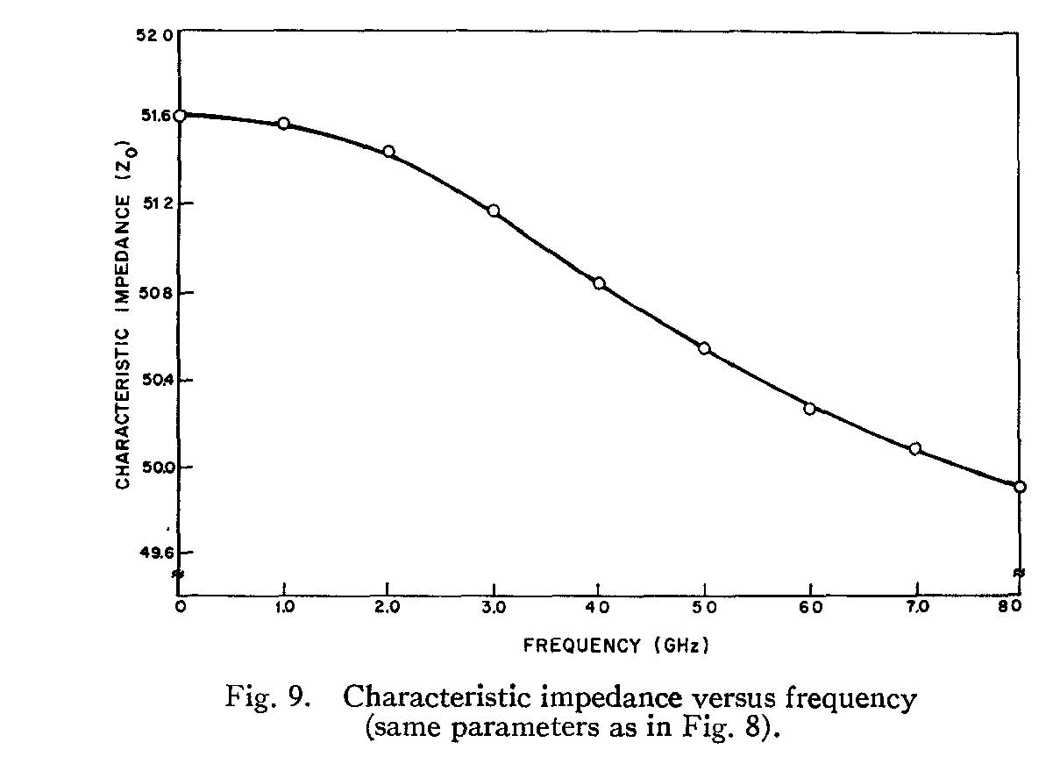
Microstrip Line (cont.)
Quasi-TEM Method
ε_{r} = 15.87, h = 1.016 mm, w/h = 0.543
E. J. Denlinger, “A frequency-dependent solution for microstrip transmission lines,” IEEE Trans. Microwave Theory and Techniques, vol. 19, pp. 30-39, Jan. 1971.

Slide 102
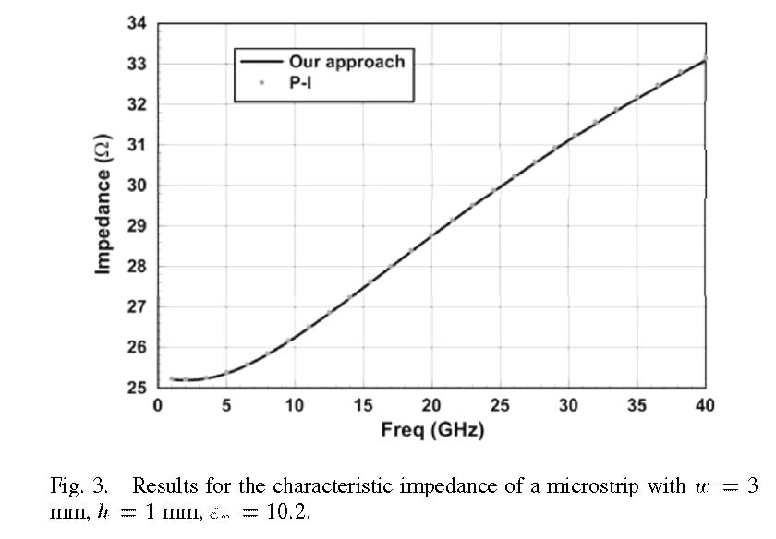
Microstrip Line (cont.)
F. Mesa and D. R. Jackson, “A novel approach for calculating the characteristic impedance of printed-circuit lines,” IEEE Microwave and Wireless Components Letters, vol. 4, pp. 283-285, April 2005.

Slide 103
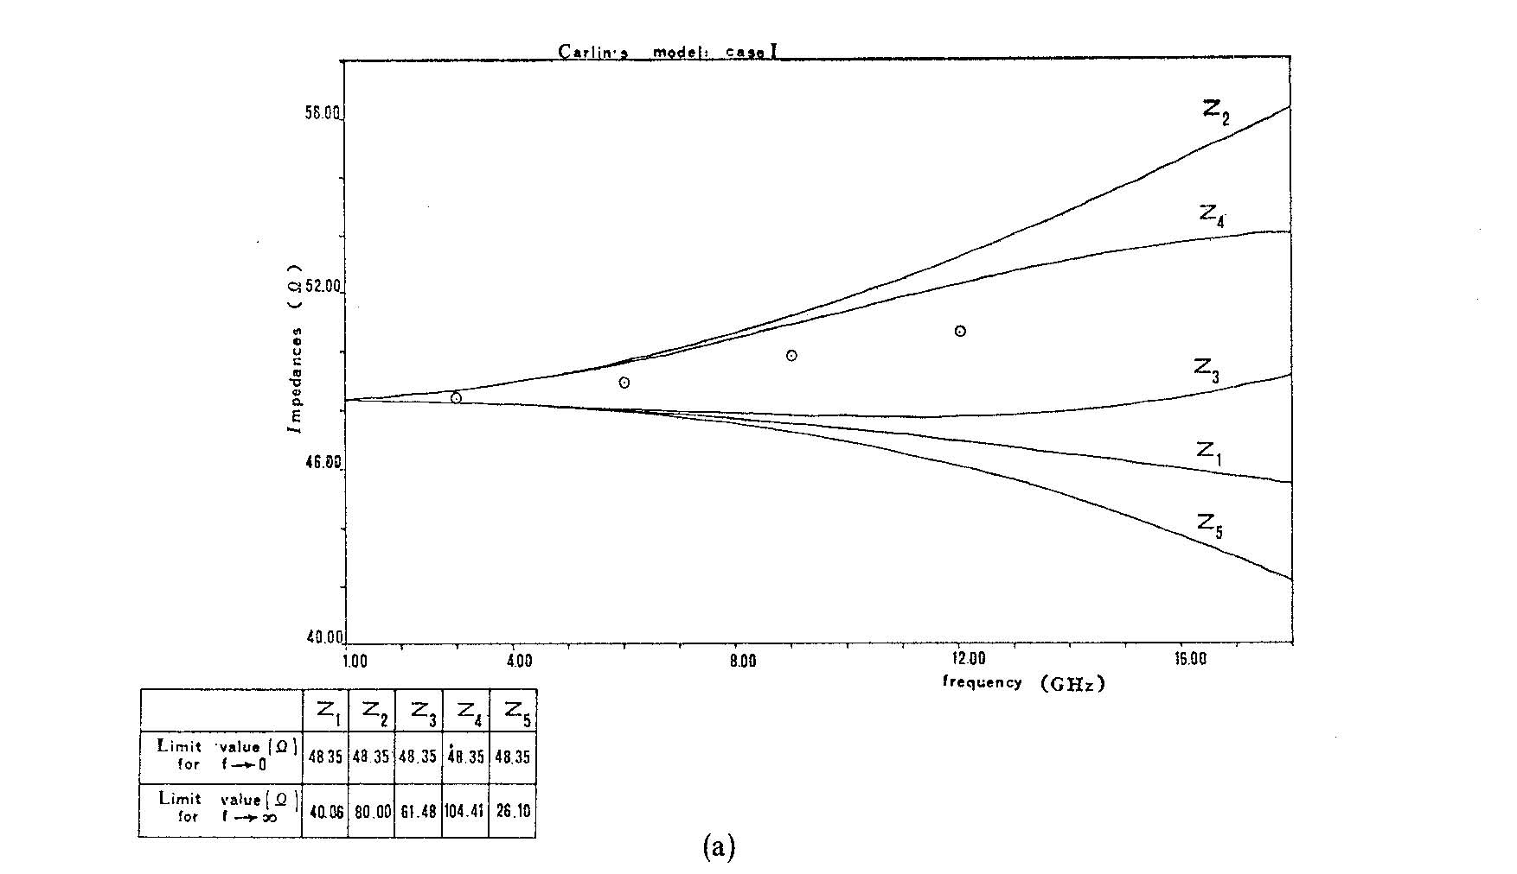
Microstrip Line (cont.)
58
(Circles represent results from another paper.)
VI
Ω
PV
52
PI
46
V ^{e}I
B Bianco, L. Panini, M. Parodi, and S. Ridella, “Some considerations about the frequency dependence of the characteristic impedance of uniform microstrips,” IEEE Trans. Microwave Theory and Techniques, vol. 26, pp. 182-185, March 1978.
PV ^{e}
40
1.0
4.0
8.0
12.0
GHz
16.0
ε_{r} = 10, h = 0.635 mm, w/h = 1
V ^{e} = effective voltage (average taken over different paths).

Slide 104
Outline
Physical derivation of method for planar electric surface currents.
Examples involving planar surface currents:
  Microstrip line
  Microstrip patch current
General derivation (Fourier transforming Maxwell’s equations) that allows for all types of sources to be included in one general derivation.
Examples:
  Vertical dipole over the earth (Sommerfeld problem)
  Slot antenna covered with radome layer (magnetic current)

Slide 105
Patch Antenna Example
Find
Dominant (1,0) mode:

Slide 106
Patch Antenna (cont.)
Recall that
In this problem

Slide 107
Patch Antenna (cont.)

Slide 108
Microstrip Line (cont.)

Slide 109
Microstrip Line (cont.)

Slide 110
Patch Antenna (cont.)
At z = 0:
Hence

Slide 111
Patch Antenna (cont.)
Note:
Hence, we have

Slide 112
Patch Antenna (cont.)
Taking the inverse Fourier transform, we have

Slide 113
Example: Vertical Field
Find E_{z} (x,y,z) inside the substrate for the same patch antenna (-h < z < 0).

Slide 114
Example (cont.)

Slide 115
Example (cont.)
Hence
cancels
or
or

Slide 116
Example (cont.)
or
Hence
The result is then

Slide 117
Example (cont.)
Hence, in the space domain we have
Note: Only TM_{z} waves contribute to the vertical electric field.
On the next page we start calculating the term

Slide 118
Example (cont.)
We next calculate the function

Slide 119
Example (cont.)
Because of the short circuit,
At z = 0:
Therefore
Hence

Slide 120
Example (cont.)
Hence
or
or

Slide 121
Example (cont.)
Hence
where

Slide 122
Radiated Power from Patch
Patch
Lossless substrate and metal

Slide 123
Radiated Power (cont.)
Use Parseval’s Theorem:

Slide 124
Radiated Power (cont.)
Hence
From SDI analysis,
where

Slide 125
Radiated Power (cont.)
We then have
Using symmetry,
Polar coordinates:

Slide 126
Radiated Power (cont.)
Note that
Hence
Note: is analytic but is not. This is a preferable form!

Slide 127
Radiated Power (cont.)
TM₀ pole
Branch point
For real k_{t} we have (proof on next page):
Hence, we can neglect the region
k_{t} > k₀, except possibly for the pole.

Slide 128
Radiated Power (cont.)
Proof of complex property:
Consider the following term (D_{e} is similar):
always imaginary

Slide 129
Space-Wave Power
The region gives the power radiated into space.
The residue contribution gives the power launched into the TM₀ surface wave.

Slide 130
Surface-Wave Power
The pole contribution gives the surface-wave power:
From the residue theorem, we have

Slide 131
Surface-Wave Power (cont.)
The residue of the spectral-domain Green’s function at the TM pole is
Note: This can be calculated in closed form, but the result is omitted here.
where

Slide 132
Surface-Wave Power (cont.)
Since the transform of the current is real (assuming that k_{tp} is real), we have
Since the residue is pure imaginary, we then have

Slide 133
Total Power
The total power may also be calculated directly:
Note: h_{b} = 0.05 k₀ is a good choice for numerical purposes.
h_{b}

Slide 134
Surface-Wave Power: Alternative Method
The surface-wave power may then be calculated from:
This avoids calculating any residues.
Total
h_{b}
Space

Slide 135
Results
Results: Conductor and dielectric losses are neglected
2.2
10.8
ε_{r} = 2.2 or 10.8
W/L = 1.5

Slide 136
Results (cont.)
Results: Accounting for all losses (including conductor and dielectric loss)
ε_{r} = 2.2 or 10.8
W/L = 1.5

Slide 137
Outline
Physical derivation of method for planar electric surface currents.
Examples involving planar surface currents:
  Microstrip line
  Microstrip patch current
General derivation (Fourier transforming Maxwell’s equations) that allows for all types of sources to be included in one general derivation.
Examples:
  Vertical dipole over the earth (Sommerfeld problem)
  Slot antenna covered with radome layer (magnetic current)

Slide 138
Overview of General SDI Derivation
In this part of the notes we derive the SDI formulation using a
more mathematical, but more general, approach
(we directly Fourier transform Maxwell’s equations).
This allows for all possible types of sources (horizontal, vertical, electric, and magnetic) to be treated in one derivation.

Slide 139
General SDI Method
Start with Ampere’s law:
where
Assume a 2D spatial transform:

Slide 140
General SDI Method (cont.)
Hence we have
Next, represent the field as
Note that
Take the components of the transformed Ampere’s equation:

Slide 141
General SDI Method (cont.)
Examine the TM_{z} field:
(Ignore equation)
(1)
(2)

Slide 142
TM_{z} Fields
We wish to eliminate from Eq. (1). To do this, use Faraday’s law:
Take the component of the transformed Faraday’s Law:
Recall:
(3)

Slide 143
TM_{z} Fields (cont.)
Substitute from (1) into (3) to eliminate
(1)
(3)
or

Slide 144
TM_{z} Fields (cont.)
Note that
Hence
(4)

Slide 145
TM_{z} Fields (cont.)
Equations (2) and (4) are the final TM_{z} field modeling equations:

Slide 146
TM_{z} Fields (cont.)
Define TEN modeling equations:
We then have

Slide 147
Telegrapher’s Equation
i⁻
i⁺
+
+
v ⁻
v⁺
-
-
Δz
Allow for distributed sources
so

Slide 148
Telegrapher’s Equation (cont.)
Hence, in the phasor domain,
Also,
so
Hence, we have

Slide 149
Telegrapher’s Equation (cont.)
Compare field equations for TM_{z} fields with TL equations:

Slide 150
Telegrapher’s Equation (cont.)
We then make the following identifications:
Hence
so

Slide 151
Sources: TM_{z}
For the sources we have, for the TM_{z} case:

Slide 152
Sources: TM_{z} (cont.)
Special case: planar horizontal surface current sources:
Assume
Then we have
These correspond to lumped current and voltage sources:
lumped parallel current source
lumped series voltage source

Slide 153
Sources: TM_{z} (cont.)
For a vertical electric current:
Assume
“planar vertical current distribution”
z = 0

Slide 154
Sources: TM_{z} (cont.)
This corresponds to a lumped series voltage source:

Slide 155
Sources: TM_{z} (cont.)
Special case: vertical electric dipole
Hence

Slide 156
TE_{z} Fields
Use duality:
TM_{z}
TE_{z}

Slide 157
TE_{z} (cont.)
Define
We then identify

Slide 158
TE_{z} (cont.)
For the sources, we have
Special case of planar horizontal surface currents:
lumped series voltage source
lumped parallel current source

Slide 159
Sources: TE_{z} (cont.)
For a vertical magnetic current:
Assume
This corresponds to a lumped parallel current source:
Then we have

Slide 160
Sources: TE_{z} (cont.)
Special case: vertical magnetic dipole
Hence

Slide 161
Summary of Modeling Formulas
Results for 3D (volumetric) sources
Horizontal
Vertical
Distributed sources:
either parallel current sources
or series voltage sources

Slide 162
Summary of Modeling Formulas (cont.)
Results for 2D (planar) sources
Horizontal
Vertical
Lumped sources:
either parallel current sources
or series voltage sources

Slide 163
Summary of Modeling Formulas (cont.)
TEN Models
+
-

Slide 164
Summary of Modeling Formulas (cont.)
Michalski functions
+
-

Slide 165
Outline
Physical derivation of method for planar electric surface currents.
Examples involving planar surface currents:
  Microstrip line
  Microstrip patch current
General derivation (Fourier transforming Maxwell’s equations) that allows for all types of sources to be included in one general derivation.
Examples:
  Vertical dipole over the earth (Sommerfeld problem)
  Slot antenna covered with radome layer (magnetic current)

Slide 166

Sommerfeld Problem
In this part of the notes we use SDI theory to solve the classical "Sommerfeld problem" of a vertical dipole over an semi-infinite earth.
Goal: Find E_{z} on the surface of the earth (in the air region).
z
r
x

Slide 167
Sommerfeld Problem (cont.)
Planar vertical electric current :
(the impressed source current)
For a vertical electric dipole of amplitude I l, we have
Hence
Therefore, we have

Slide 168
Sommerfeld Problem (cont.)
TEN:
+
-
The vertical electric dipole excites TM_{z} waves only.

Slide 169
Sommerfeld Problem (cont.)
Find E_{z} (x,y,z) inside the air region ( z > 0):

Slide 170
Sommerfeld Problem (cont.)

Slide 171
Sommerfeld Problem (cont.)
Hence
cancels
or
or

Slide 172
Sommerfeld Problem (cont.)
Hence
We use the Michalski normalized current function:
(The v subscript indicates a 1V series source.)
We need to calculate the Michalski normalized current function at z = 0
(since we want the field on the surface of the earth).

Slide 173
Sommerfeld Problem (cont.)
Calculation of the Michalski normalized current function
+
+
-
-

Slide 174
Sommerfeld Problem (cont.)
+
-
This figure shows how to calculate the Michalski normalized current function: it will be calculated later.

Slide 175
Sommerfeld Problem (cont.)
Return to the calculation of the field:
Hence we have
or

Slide 176
Sommerfeld Problem (cont.)
Note:
is only a function of
Change to polar coordinates:

Slide 177
Sommerfeld Problem (cont.)
Switch to polar coordinates

Slide 178
Sommerfeld Problem (cont.)
Use
We see from this result that the vertical field of the vertical electric dipole should not vary with angle φ.
Integral identity:

Slide 179
Sommerfeld Problem (cont.)
Hence we have
This is the “Sommerfeld form” of the field.

Slide 180
Sommerfeld Problem (cont.)
We now return to the calculation of the Michalski normalized current function.
+
+
-
-

Slide 181
Sommerfeld Problem (cont.)
+
+
-
-
Here we visualize the transmission line as infinite beyond the voltage source.

Slide 182
Sommerfeld Problem (cont.)
+
+
-
-
Boundary conditions:

Slide 183
Sommerfeld Problem (cont.)
Hence we have

Slide 184
Sommerfeld Problem (cont.)
Substitute the first of these into the second one:
This gives us

Slide 185
Sommerfeld Problem (cont.)
cancels
Hence we have

Slide 186
Sommerfeld Problem (cont.)
For the current we then have
with
Hence
For z = 0:

Slide 187
Sommerfeld Problem (cont.)
We thus have
with
Hence
or

Slide 188
Sommerfeld Problem (cont.)
Simplify

Slide 189
Sommerfeld Problem (cont.)
Final Result

Slide 190
Sommerfeld Problem (cont.)
Note: A box height of about 0.05k₀ is a good choice.
Zenneck-wave pole (TM_{z})
(derivation on next slide)
ε_{rc} = complex relative permittivity of the earth (accounting for the conductivity.)

Slide 191
Sommerfeld Problem (cont.)
Zenneck-wave pole (TM_{z})
The TRE is:
Note: Both vertical wavenumbers
(k_{z0} and k_{z1}) are proper.
(Power flows downward in both regions.)

Slide 192
Sommerfeld Problem (cont.)
Alternative form:
The path is extended to the entire real axis.
We use
Transform the H₀⁽¹⁾ term:

Slide 193
Sommerfeld Problem (cont.)
Hence we have
This is a convenient form for deforming the path.

Slide 194
Sommerfeld Problem (cont.)
The Zenneck-wave is nonphysical because it is a fast wave, but it is proper. It is not captured when deforming to the ESDP (vertical path from k₀).

Slide 195
Sommerfeld Problem (cont.)
The Riemann surface has four sheets.
Original path C
Top sheet for both k_{z0} and k_{z1}
Bottom sheet for k_{z1}
The ESDP from the branch point at k₁ is usually not important for a lossy earth.
Bottom sheet for k_{z0}
Bottom sheet for both k_{z0} and k_{z1}

Slide 196
Sommerfeld Problem (cont.)
This path deformation makes it appear as if the Zenneck-wave pole is important.

Slide 197
Sommerfeld Problem (cont.)
Throughout much of the 20th century, a controversy raged about the “reality of the Zenneck wave.”
Arnold Sommerfeld predicted a surface-wave like field coming from the residue of the Zenneck-wave pole (1909).
People took measurements and could not find such a wave.
Hermann Weyl solved the problem in a different way and did not get the Zenneck wave (1919).
Some people (Norton, Niessen) blamed it on a sign error that Sommerfeld had made, though Sommerfeld never admitted to a sign error.
Eventually it was realized that there was no sign error (Collin, 2004).
The limitation in Sommerfeld’s original asymptotic analysis (which shows a Zenneck-wave term) is that the pole must be well separated from the branch point – the asymptotic expansion that he used neglects the effects of the pole on the branch point (the saddle point in the steepest-descent plane).
When the asymptotic evaluation of the branch-cut integral around k₀ includes the effects of the pole, it turns out that there is no Zenneck-wave term in the total solution (branch-cut integrals + pole-residue term).
The easiest way to explain the fact that the Zenneck wave is not important far away is that the pole is not captured in deforming to the ESDP paths.

Slide 198
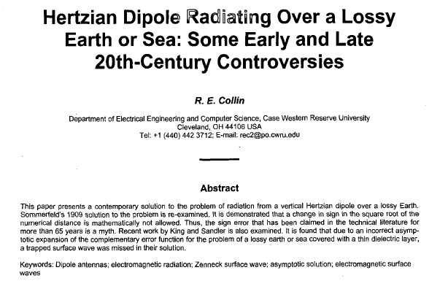
Sommerfeld Problem (cont.)
R. E. Collin, “Hertzian Dipole Radiating Over a Lossy Earth or Sea: Some Early and Late 20th-Century Controversies,” AP-S Magazine, pp. 64-79, April 2004.

Slide 199
Sommerfeld Problem (cont.)
Alternative path
(efficient for large distances ρ)
This choice of path is convenient because it stays on the top sheet, and yet it has fast convergence as the distance ρ increases, due to the Hankel function.

Slide 200
Outline
Physical derivation of method for planar electric surface currents.
Examples involving planar surface currents:
  Microstrip line
  Microstrip patch current
General derivation (Fourier transforming Maxwell’s equations) that allows for all types of sources to be included in one general derivation.
Examples:
  Vertical dipole over the earth (Sommerfeld problem)
  Slot antenna covered with radome layer (magnetic current)

Slide 201
Slot Antenna with Radome
Find
+
-
z
ε_{r}
w
h
y

Slide 202
Slot Antenna with Radome (cont.)
Horizontal

Slide 203
Slot Antenna with Radome (cont.)
Hence
For the slot current we have
We next calculate the Michalski functions.

Slide 204
Slot Antenna with Radome (cont.)
+
-

Slide 205
Slot Antenna with Radome (cont.)
Input impedance of slot:
Therefore
(Parseval’s theorem)

Slide 206
Slot Antenna with Radome (cont.)
Hence, we have
so that

Slide 207
Slot Antenna with Radome (cont.)
Integrating in polar coordinates, and using symmetry to reduce the integration to the first quadrant, we have
with

Slide 208
References
Articles
T. Itoh, “Spectral Domain Immitance Approach for Dispersion Characteristics of Generalized Printed Transmission Lines,” IEEE Trans. Microwave Theory and Techniques, vol. 28, pp. 733–736, July 1980.
T. Itoh and W. Menzel, “A Full-Wave Analysis Method for Open Microstrip Structures,” IEEE Trans. Antennas and Propagation, vol. 29, No. 1, January 1981, pp. 63-68.

Slide 209
References (cont.)
Books
T. Itoh, Planar Transmission Line Structures, IEEE Press, 1987.
T. Itoh, Numerical Techniques for Microwave and Millimeter-Wave Passive Structures, Wiley,1989.
C. Scott, The Spectral Domain Method in Electromagnetics, Artech House, 1989.
D. Mirshekar-Syahkal, Spectral Domain Method for Microwave Integrated Circuits, Research Studies Press, 1990.
A. K. Bhattacharyya, Electromagnetic Fields in Multilayered Structures: Theory and Applications, Artech House, 1994.
C. Nguyen, Analysis Methods for RF, Microwave, and Millimeter-Wave Planar Transmission Line Structures, Wiley, 2001.

