Slide 1
ECE 6345
Spring 2015
Prof. David R. Jackson
ECE Dept.
Notes 26

Slide 2
Overview
In this set of notes we use the spectral-domain method to find the mutual impedance between two rectangular patch antennas.

Slide 3
Geometry

Slide 4
Mutual Impedance Formulation
Assume two arbitrary antennas, to be general.
+
+
-
-
The two-port system is described by a 2×2 Z matrix.

Slide 5
Mutual Impedance Formulation (cont.)
The self impedance Z₁₁ is calculated.
+
+
-
-
(The presence of open-circuited antenna 2 does not significantly affect the input impedance of antenna 1.)

Slide 6
Mutual Impedance Formulation (cont.)
The mutual impedance Z₂₁ is calculated.
+
+
-
-
Note:

Slide 7
Mutual Impedance Formulation (cont.)
The open-circuit voltage V₂ is obtained by integrating the electric field produced from current I₁ over the path C₂.
E₁ = electric field produced by the feed current I₁, in the presence of antenna 1 and antenna 2.
+
-

Slide 8
Mutual Impedance Formulation (cont.)
The open-circuit voltage V₂ is put in the form of a reaction.
+
-

Slide 9
Mutual Impedance Formulation (cont.)
The equivalence principle is used to replace antenna 1 with its surface current.
The field produced by current I₁ exciting antenna 1 is the same as that produced by the current on antenna 1 in free space.
(The antenna current J₁^{ant} is that excited on antenna 1 when it is in the presence of open-circuited antenna 2.)

Slide 10
Mutual Impedance Formulation (cont.)
Reciprocity is invoked, and then the equivalence principle.
The field produced by current I₂ exciting antenna 2 is the same as that produced by the current on antenna 2 in free space.
(The antenna current J₂^{ant} is that excited on antenna 2 when antenna 1 is absent.)

Slide 11
Mutual Impedance Formulation (cont.)
Reciprocity is invoked one more time.
+
-

Slide 12
Mutual Impedance Formulation (cont.)
+
The mutual impedance is then
-

Slide 13
Mutual Impedance Formulation (cont.)
Summary
J₁^{ant} = current on antenna 1,
when excited by current I₁ in the presence of open-circuited antenna 2.
J₂^{ant} = current on antenna 2,
when excited by current I₂ in the absence antenna 1.

Slide 14
Mutual Impedance Between Patches
The two patches are assumed to be identical here.
Assume

Slide 15
Mutual Impedance Between Patches (cont.)
Denote
Then we have
Note: Formulas for Z_{zx} and Z_{xx} were given previously in the analysis of the single patch.
Recall that
Hence

Slide 16
Mutual Impedance Between Patches (cont.)
Calculation of reaction between patch basis functions:
Hence, integrating over the surface of patch 2, we have

Slide 17
Mutual Impedance Between Patches (cont.)
From the Fourier “shifting” theorem, we have
Note: The “1” superscript is dropped henceforth.
Hence we have

Slide 18
Mutual Impedance Between Patches (cont.)
Converting to polar coordinates, we have
Since the integrand is an even function of k_{x} and k_{y}, we can write
Quadrant 1
Quadrant 2
Quadrant 3
Quadrant 4
Note:

Slide 19
Mutual Impedance Between Patches (cont.)
Final form of mutual reaction

Slide 20
Summary

Slide 21
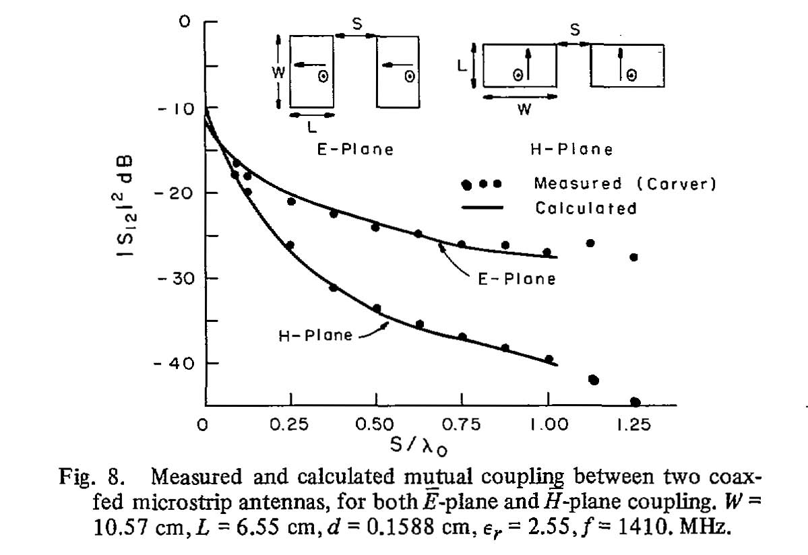
Results
D. M. Pozar, "Input Impedance and mutual coupling of rectangular microstrip antennas,“ IEEE Trans. Antennas Propagat., vol. AP-30. pp. 1191-1196, Nov. 1982.

Slide 22
Components of Mutual Impedance
We can also consider the various components of Z₁₂
Total
Surface-wave = Total – Space-wave
Space-wave (lateral wave)

Slide 23
Components of Mutual Impedance (cont.)
Results for typical patches
Circular patches

