Slide 1
ECE 6345
Spring 2015
Prof. David R. Jackson
ECE Dept.
Notes 3

Slide 2
Overview
This set of notes discusses the Q of a patch, and its different components, as well as the radiation efficiency of the patch.
Define Q and its components: Q_{d}, Q_{c}, Q_{sp}, Q_{sw}
Calculate Q_{d}, Q_{c}, Q_{sp}, Q_{sw}
Calculate the radiation efficiency

Slide 3
Q of the Patch
The patch is allowed to have an arbitrary shape.
Feed
Note: Here ω₀ denotes the real part of the complex resonance frequency (instead of ω₀′).
so

Slide 4
Q of the Patch (cont.)
Hence
or
Note: Combining Q terms is like combining resistors in parallel.
Note: A smaller Q is a more dominant one!

Slide 5
Calculation of Q_{d}
(We have equal time-average stored energies at resonance.)

Slide 6
Calculation of Q_{d} (cont.)
Hence
Therefore
The dielectric Q factor is independent of substrate thickness.

Slide 7
Calculation of Q_{c}
Hence

Slide 8
Calculation of Q_{c} (cont.)
For the stored energy,
where

Slide 9
Calculation of Q_{c} (cont.)
Hence,
Use
so

Slide 10
Calculation of Q_{c} (cont.)
Hence, we have
The conducting Q factor becomes more important as the substrate gets thinner.

Slide 11
Calculation of Q_{sp}
Rectangular Patch:
(The derivation is given later.)

Slide 12
Calculation of Q_{sp} (cont.)
where
The radiation Q factor becomes more important as the substrate gets thicker.

Slide 13
Calculation of Q_{SW}
Surface-wave radiation efficiency:
so
Hence

Slide 14
Calculation of Q_{SW} (cont.)
Now look at the Q’s :
Hence, we have

Slide 15
Calculation of Q_{SW} (cont.)
Hence, we have
For the radiation efficiency, the patch can be approximated by a
horizontal electric dipole at the center of the patch.

Slide 16
Calculation of Q_{SW} (cont.)
where

Slide 17
Calculation of Q_{SW} (cont.)
Hence, we have
This holds for any shape patch
(assuming the HED approximation is accurate).

Slide 18
Comparison of Qs
Q_{sw}
Q_{sp}
Q_{c}
Q_{d}
Q_{c} dominates
Q_{d} dominates
Q_{sp} dominates

Slide 19
Radiation Efficiency
Note that
Hence

Slide 20
Radiation Efficiency (cont.)
Hence
or
or

Slide 21
Radiation Efficiency (cont.)
Also, we can write
where
Define:

Slide 22
Radiation Efficiency (cont.)
Then
where
and

Slide 23
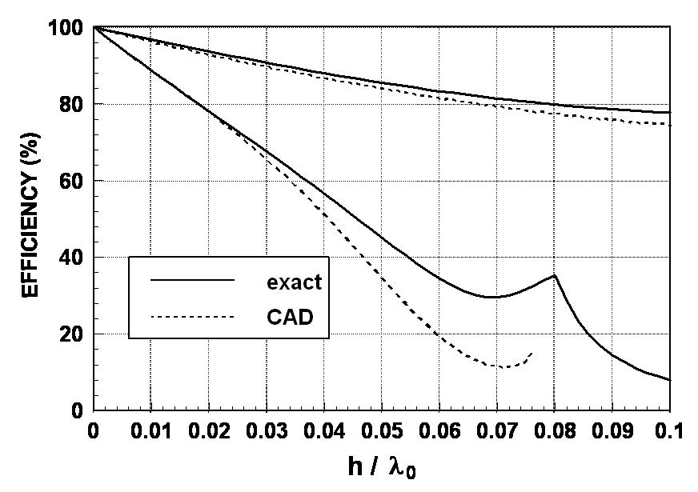
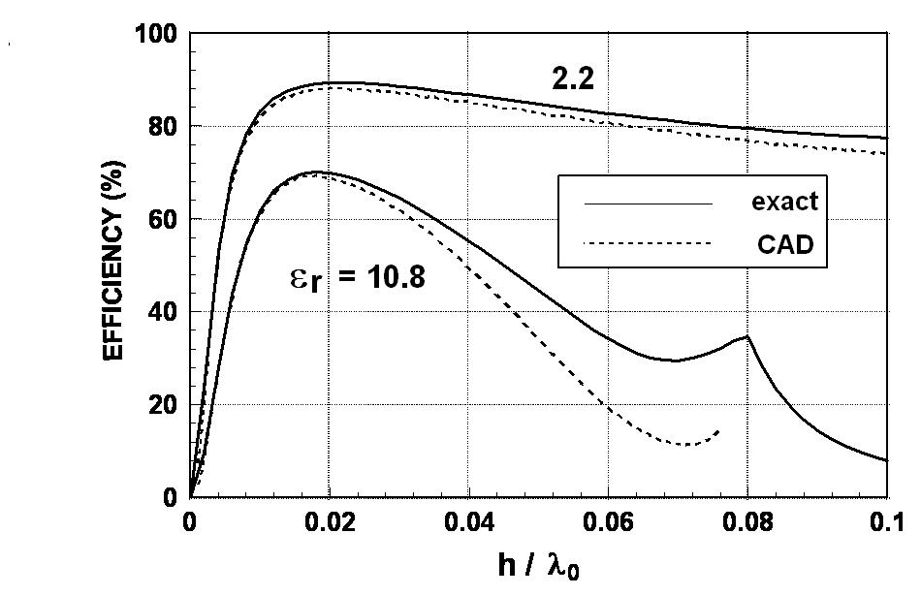
Radiation Efficiency (cont.)
2.2
2.2
10.8
ε_{r} = 10.8

