Slide 1

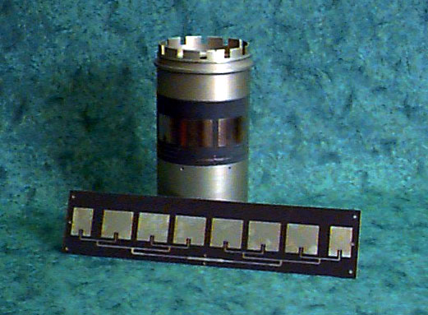
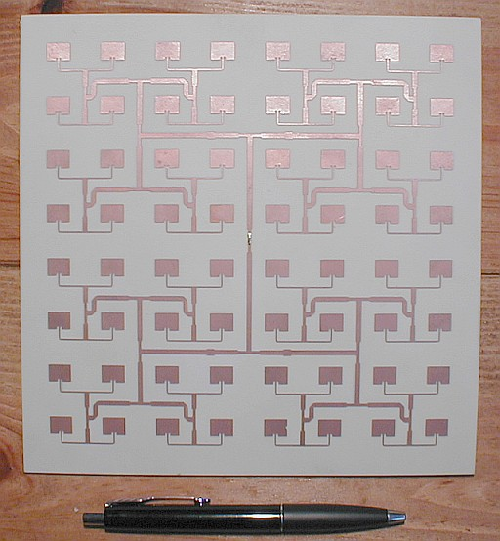
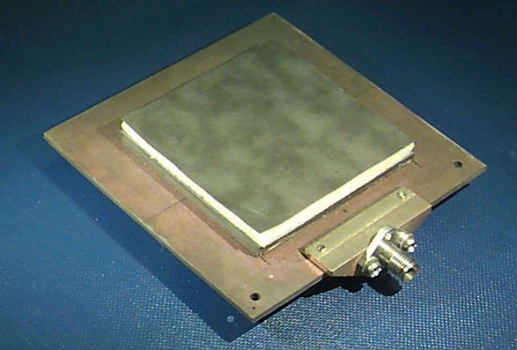
Introduction to Microstrip Antennas
David R. Jackson
Dept. of ECE
University of Houston

Slide 2
Contact Information
David R. Jackson
Dept. of ECE
N308 Engineering Building 1
University of Houston
Houston, TX 77204-4005
Phone: 713-743-4426
Fax: 713-743-4444
Email: djackson@uh.edu

Slide 3
Purpose of Short Course
Provide an introduction to microstrip antennas.
Provide a physical and mathematical basis for understanding how microstrip antennas work.
Provide a physical understanding of the basic physical properties of microstrip antennas.
Provide an overview of some of the recent advances and trends in the area (but not an exhaustive survey – directed towards understanding the fundamental principles).

Slide 4
Additional Resources
Some basic references are provided at the end of these viewgraphs.
You are welcome to visit a website that goes along with a course at the University of Houston on microstrip antennas (PowerPoint viewgraphs from the course may be found there, along with the viewgraphs from this short course).
ECE 6345: Microstrip Antennas
http://courses.egr.uh.edu/ECE/ECE6345/
Note:
You are welcome to use anything that you find on this website,
as long as you please acknowledge the source.

Slide 5
Outline
Overview of microstrip antennas
Feeding methods
Basic principles of operation
General characteristics
CAD Formulas
Input Impedance
Radiation pattern
Circular polarization
Circular patch
Improving bandwidth
Miniaturization
Reducing surface waves and lateral radiation

Slide 6
Notation

Slide 7
Outline
Overview of microstrip antennas
Feeding methods
Basic principles of operation
General characteristics
CAD Formulas
Input Impedance
Radiation pattern
Circular polarization
Circular patch
Improving bandwidth
Miniaturization
Reducing surface waves and lateral radiation

Slide 8
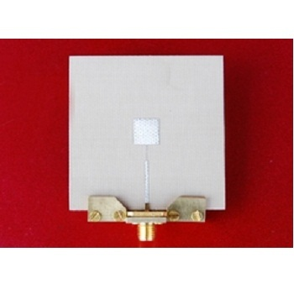
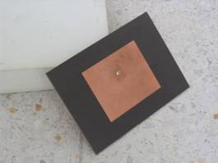
Overview of Microstrip Antennas
Also called “patch antennas”
One of the most useful antennas at microwave frequencies (f > 1 GHz).
It usually consists of a metal “patch” on top of a grounded dielectric substrate.
The patch may be in a variety of shapes, but rectangular and circular are the most common.
Microstrip line feed
Coax feed

Slide 9
Overview of Microstrip Antennas
Common Shapes
Rectangular
Square
Circular
Annular ring
Elliptical
Triangular

Slide 10
Overview of Microstrip Antennas
History
Invented by Bob Munson in 1972 (but earlier work by Dechamps goes back to 1953).
Became popular starting in the 1970s.
G. Deschamps and W. Sichak, “Microstrip Microwave Antennas,” Proc. of Third Symp. on USAF Antenna Research and Development Program, October 18–22, 1953.
R. E. Munson, “Microstrip Phased Array Antennas,” Proc. of Twenty-Second Symp. on USAF Antenna Research and Development Program, October 1972.
R. E. Munson, “Conformal Microstrip Antennas and Microstrip Phased Arrays,” IEEE Trans. Antennas Propagat., vol. AP-22, no. 1 (January 1974): 74–78.

Slide 11
Overview of Microstrip Antennas
Advantages of Microstrip Antennas
Low profile (can even be “conformal,” i.e. flexible to conform to a surface).
Easy to fabricate (use etching and photolithography).
Easy to feed (coaxial cable, microstrip line, etc.).
Easy to incorporate with other microstrip circuit elements and integrate into systems.
Patterns are somewhat hemispherical, with a moderate directivity (about 6-8 dB is typical).
Easy to use in an array to increase the directivity.

Slide 12
Overview of Microstrip Antennas
Disadvantages of Microstrip Antennas
Low bandwidth (but can be improved by a variety of techniques). Bandwidths of a few percent are typical. Bandwidth is roughly proportional to the substrate thickness and inversely proportional to the substrate permittivity.
Efficiency may be lower than with other antennas. Efficiency is limited by conductor and dielectric losses*, and by surface-wave loss**.
Only used at microwave frequencies and above (the substrate becomes too large at lower frequencies).
Cannot handle extremely large amounts of power (dielectric breakdown).
* Conductor and dielectric losses become more severe for thinner substrates.
** Surface-wave losses become more severe for thicker substrates (unless air or foam is used).

Slide 13
Overview of Microstrip Antennas
Applications
Applications include:
Satellite communications
Microwave communications
Cell phone antennas
GPS antennas

Slide 14
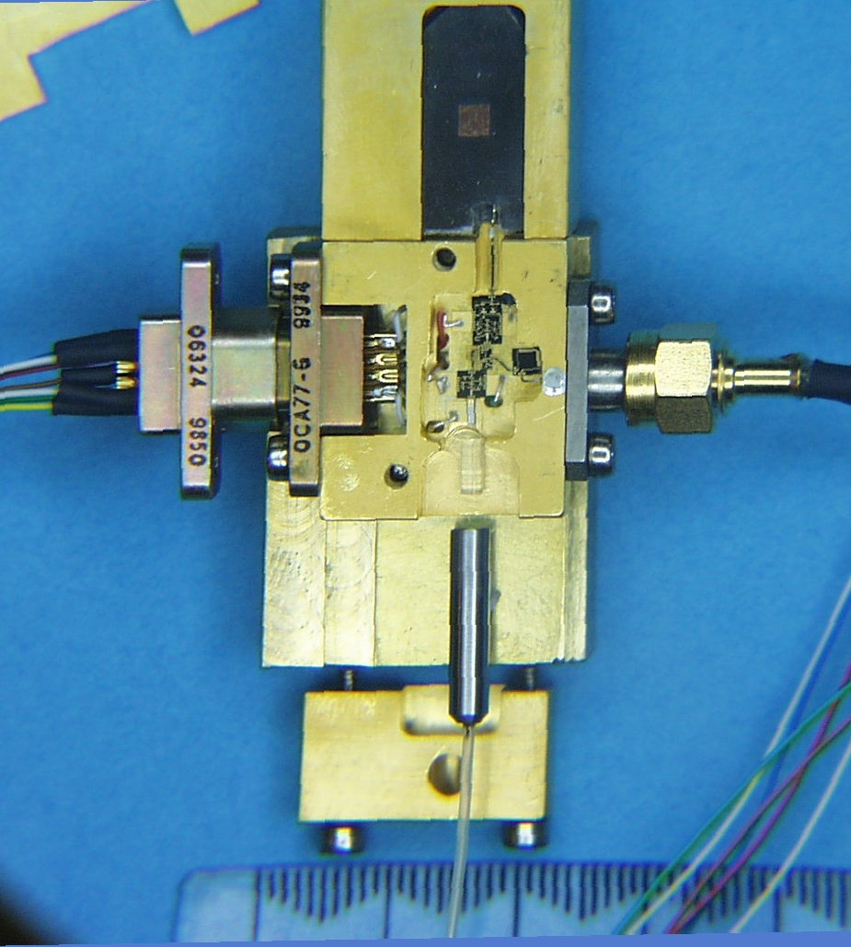
Overview of Microstrip Antennas
Microstrip antenna
Filter
DC supply Micro-D connector
K-connector
LNA
PD
Fiber input with collimating lens
Diplexer
Microstrip Antenna Integrated into a System: HIC Antenna Base-Station for 28-43 GHz
(Photo courtesy of Dr. Rodney B. Waterhouse)

Slide 15
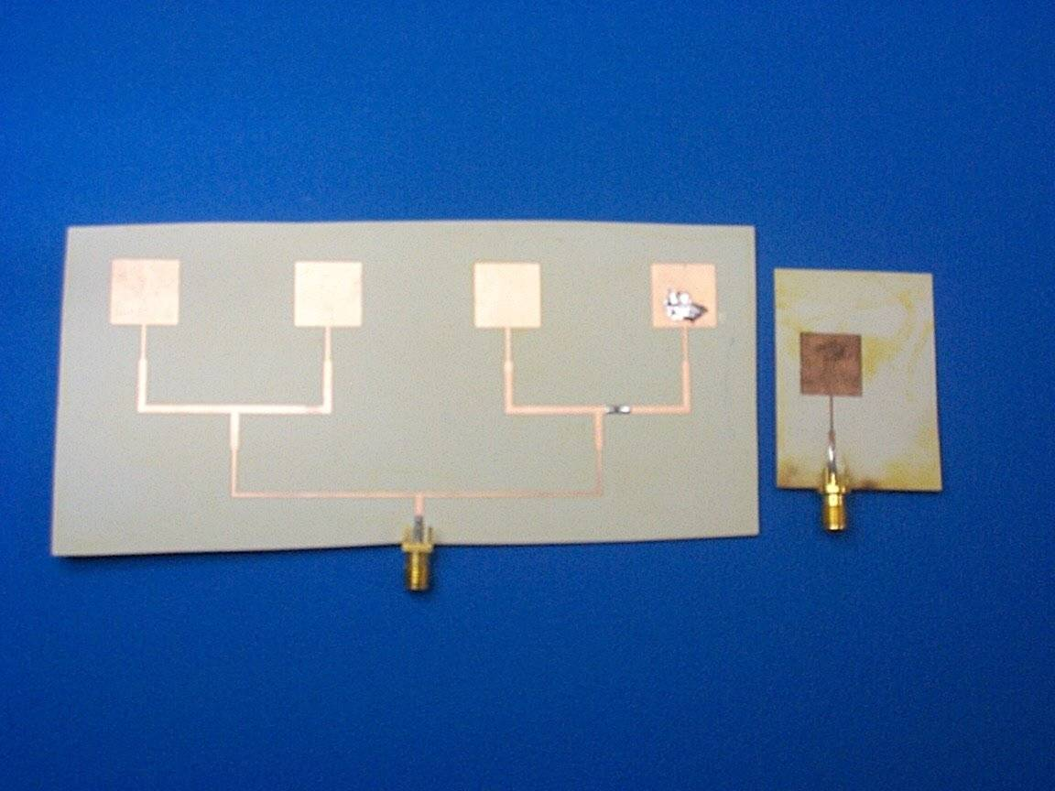
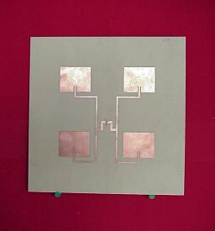
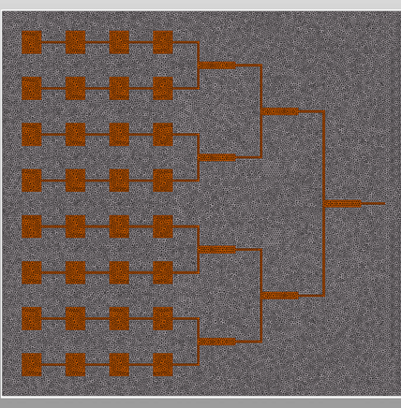
Overview of Microstrip Antennas
Arrays
Linear array (1-D corporate feed)
2×2 array
2-D 8X8 corporate-fed array
4 × 8 corporate-fed / series-fed array

Slide 16
Overview of Microstrip Antennas
Wraparound Array (conformal)
The substrate is so thin that it can be bent to “conform” to the surface.
(Photo courtesy of Dr. Rodney B. Waterhouse)

Slide 17
Overview of Microstrip Antennas
Rectangular patch
Note:
The fields and current are approximately independent of y for the dominant (1,0) mode.
y
W
J_{s}
x
L
h
ε_{r}
Note:
L is the resonant dimension (direction of current flow). The width W is usually chosen to be larger than L (to get higher bandwidth). However, usually W < 2L (to avoid problems with the (0,2) mode).
W = 1.5L is typical.

Slide 18
Overview of Microstrip Antennas
Circular Patch
y
a
x
h
ε_{r}
The location of the feed determines the direction of current flow and hence the polarization of the radiated field.

Slide 19
Outline
Overview of microstrip antennas
Feeding methods
Basic principles of operation
General characteristics
CAD Formulas
Input Impedance
Radiation pattern
Circular polarization
Circular patch
Improving bandwidth
Miniaturization
Reducing surface waves and lateral radiation

Slide 20
Feeding Methods
Some of the more common methods for feeding microstrip antennas are shown.
The feeding methods are illustrated for a rectangular patch,
but the principles apply for circular and other shapes as well.

Slide 21
Feeding Methods
z
Coaxial Feed
x
y
Note:
A feed along the centerline at y = W/2 is the most common
(this minimizes higher-order modes and cross-pol).
Surface current
W
Feed at (x₀, y₀)
x
L

Slide 22
Feeding Methods
Coaxial Feed
z
(The resistance varies as the square of the modal field shape.)
x
Advantages:
Simple
Directly compatible with coaxial cables
Easy to obtain input match by adjusting feed position
y
W
Disadvantages:
Significant probe (feed) radiation for thicker substrates
Significant probe inductance for thicker substrates (limits bandwidth)
Not easily compatible with arrays
x
L

Slide 23
Feeding Methods
Inset Feed
Advantages:
Simple
Allows for planar feeding
Easy to use with arrays
Easy to obtain input match
Microstrip line
Disadvantages:
Significant line radiation for thicker substrates
For deep notches, patch current and radiation pattern may show distortion

Slide 24
Feeding Methods
Inset Feed
An investigation has shown that the resonant input resistance varies as:
x₀
W_{f}
S
W
Less accurate approximation:
L
The coefficients A and B depend on the notch width S but (to a good approximation) not on the line width W_{f} .
Y. Hu, D. R. Jackson, J. T. Williams, and S. A. Long, “Characterization of the Input Impedance of the Inset-Fed Rectangular Microstrip Antenna,” IEEE Trans. Antennas and Propagation, Vol. 56, No. 10, pp. 3314-3318, Oct. 2008.

Slide 25
Feeding Methods
Proximity-coupled Feed
(Electromagnetically-coupled Feed)
Advantages:
Allows for planar feeding
Less line radiation compared to microstrip feed (the line is closer to the ground plane)
Can allow for higher bandwidth (no probe inductance, so substrate can be thicker)
Patch
Microstrip line
Top view
Microstrip
line
Disadvantages:
Requires multilayer fabrication
Alignment is important for input match

Slide 26
Feeding Methods
Gap-coupled Feed
Advantages:
Allows for planar feeding
Can allow for a match even with high edge impedances, where a notch might be too large (e.g., when using a high permittivity substrate)
Gap
Patch
Patch
Microstrip line
Top view
Microstrip
line
Disadvantages:
Requires accurate gap fabrication
Requires full-wave design

Slide 27
Feeding Methods
Aperture-coupled Patch (ACP)
Advantages:
Allows for planar feeding
Feed-line radiation is isolated from patch radiation
Higher bandwidth is possible since probe inductance is eliminated (allowing for a thick substrate), and also a double-resonance can be created
Allows for use of different substrates to optimize antenna and feed-circuit performance
Slot
Top view
Microstrip
line
Patch
Disadvantages:
Requires multilayer fabrication
Alignment is important for input match
Slot
Microstrip line

Slide 28
Outline
Overview of microstrip antennas
Feeding methods
Basic principles of operation
General characteristics
CAD Formulas
Input Impedance
Radiation pattern
Circular polarization
Circular patch
Improving bandwidth
Miniaturization
Reducing surface waves and lateral radiation

Slide 29
Basic Principles of Operation
The basic principles are illustrated here for a rectangular patch, but the principles apply similarly for other patch shapes.
We use the cavity model to explain the operation of the patch antenna.
z
h
PMC
Y. T. Lo, D. Solomon, and W. F. Richards, “Theory and Experiment on Microstrip Antennas,” IEEE Trans. Antennas Propagat., vol. AP-27, no. 3 (March 1979): 137–145.

Slide 30
Basic Principles of Operation
Main Ideas:
The patch acts approximately as a resonant cavity (with perfect electric conductor (PEC) walls on top and bottom, and perfect magnetic conductor (PMC) walls on the edges).
Radiation is accounted for by using an effective loss tangent for the substrate.
In a cavity, only certain modes are allowed to exist, at different resonance frequencies.
If the antenna is excited at a resonance frequency, a strong field is set up inside the cavity, and a strong current on the (bottom) surface of the patch. This produces significant radiation (a good antenna).
z
PMC
h

Slide 31
Basic Principles of Operation
A microstrip antenna can radiate well, even with a thin substrate,
because of resonance.
As the substrate gets thinner the patch current radiates less, due to image cancellation (current and image are separated by 2h).
However, the Q of the resonant cavity mode also increases, making the patch currents stronger at resonance.
These two effects cancel, allowing the patch to radiate well even for thin substrates (though the bandwidth decreases).
z
x

Slide 32
Basic Principles of Operation
Thin Substrate Approximation
On patch and ground plane:
Inside the patch cavity, because of the thin substrate,
the electric field vector is approximately independent of z.
Hence
z
h

Slide 33
Basic Principles of Operation
Thin Substrate Approximation
Magnetic field inside patch cavity:

Slide 34
Basic Principles of Operation
Thin Substrate Approximation
Note:
The magnetic field is purely horizontal.
(The mode is TM_{z}.)
z
h

Slide 35
Basic Principles of Operation
Magnetic-wall Approximation
The patch edge acts as an approximate open circuit.
y
L
or
W
x
PMC
h
h
Actual patch
PMC Model

Slide 36
Basic Principles of Operation
Magnetic-wall Approximation
y
L
W
Hence,
x
h
(Neumann B.C.)
PMC

Slide 37
Basic Principles of Operation
Resonance Frequencies
y
From separation of variables:
W
PMC
(TM_{mn} mode)
x
L
We then have
Note:
We ignore the loss tangent of the substrate for the calculation of the resonance frequencies.
Hence

Slide 38
Basic Principles of Operation
Resonance Frequencies
We thus have
y
W
PMC
Recall that
x
L
Hence

Slide 39
Basic Principles of Operation
Resonance Frequencies
y
Hence
(resonance frequency of (m,n) mode)
W
PMC
where
x
L

Slide 40
Basic Principles of Operation
Dominant (1,0) mode
y
This structure operates as a “fat planar dipole.”
Current
This mode is usually used because the
radiation pattern has a broadside beam.
W
x
L
The current is maximum in the middle of the patch, when plotted along x.
The resonant length L is about 0.5 guided wavelengths in the x direction (see next slide).

Slide 41
Basic Principles of Operation
Resonance Frequency of Dominant (1,0) Mode
The resonance frequency is mainly controlled by the
patch length L and the substrate permittivity.
Approximately, (assuming PMC walls)
This is equivalent to saying that the length L is one-half of a wavelength in the dielectric.
(1,0) mode:
Comment:
A higher substrate permittivity allows for a smaller antenna (miniaturization), but with a lower bandwidth.

Slide 42

Basic Principles of Operation
Resonance Frequency of Dominant Mode
The resonance frequency calculation can be improved by adding a
“fringing length extension” ΔL to each edge of the patch to get an
“effective length” L_{e} .
y
ΔL
ΔL
L
x
L_{e}
Note: Some authors use effective permittivity in this equation.
(This would change the value of L_{e}.)

Slide 43
Basic Principles of Operation
Resonance Frequency of Dominant Mode
Hammerstad formula:
Note:
Even though the Hammerstad formula involves an effective permittivity, we still use the actual substrate permittivity in the resonance frequency formula.

Slide 44
Basic Principles of Operation
Resonance Frequency of Dominant Mode
Note:
This is a good “rule of thumb” to give a quick estimate.

Slide 45
Basic Principles of Operation
f_{N} = f / f₀
Results: Resonance Frequency
ε_{r} = 2.2
The resonance frequency has been normalized by the zero-order value (without fringing).
W/ L = 1.5

Slide 46
Outline
Overview of microstrip antennas
Feeding methods
Basic principles of operation
General characteristics
CAD Formulas
Input Impedance
Radiation pattern
Circular polarization
Circular patch
Improving bandwidth
Miniaturization
Reducing surface waves and lateral radiation

Slide 47
General Characteristics
Bandwidth
The bandwidth is directly proportional to substrate thickness h.
However, if h is greater than about 0.05 λ₀ , the probe inductance (for a coaxial feed) becomes large enough so that matching is difficult – the bandwidth will decrease.
The bandwidth is inversely proportional to ε_{r} (a foam substrate gives a high bandwidth).
The bandwidth of a rectangular patch is proportional to the patch width W (but we need to keep W < 2L ; see the next slide).

Slide 48
General Characteristics
Width Restriction for a Rectangular Patch
f_{c}
W
f₀₁
f₁₀
f₀₂
W = 1.5 L is typical.
L

Slide 49
General Characteristics
Some Bandwidth Observations
For a typical substrate thickness (h /λ₀ = 0.02), and a typical substrate permittivity (ε_{r} = 2.2) the bandwidth is about 3%.
By using a thick foam substrate, bandwidth of about 10% can be achieved.
By using special feeding techniques (aperture coupling) and stacked patches, bandwidths of 100% have been achieved.

Slide 50
General Characteristics
Results: Bandwidth
The discrete data points are measured values.
The solid curves are from a CAD formula (given later).
ε_{r} = 2.2 or 10.8
W/ L = 1.5

Slide 51
General Characteristics
Resonant Input Resistance
The resonant input resistance is fairly independent of the substrate thickness h unless h gets small (the variation is then mainly due to dielectric and conductor loss).
The resonant input resistance is proportional to ε_{r}.
The resonant input resistance is directly controlled by the location of the feed point (maximum at edges x = 0 or x = L, zero at center of patch).
y
(x₀, y₀)
W
L
L
x

Slide 52
General Characteristics
Resonant Input Resistance (cont.)
Note:
The patch is usually fed along the centerline (y₀ = W / 2)
to maintain symmetry and thus minimize excitation of undesirable modes
(which cause cross-pol).
y
Desired mode: (1,0)
Feed: (x₀, y₀)
W
x
L

Slide 53
General Characteristics
Resonant Input Resistance (cont.)
For a given mode, it can be shown that the resonant input resistance is proportional to the square of the cavity-mode field at the feed point.
This is seen from the cavity-model eigenfunction analysis
(please see the reference).
y
(x₀, y₀)
For (1,0) mode:
W
x
L
Y. T. Lo, D. Solomon, and W. F. Richards, “Theory and Experiment on Microstrip Antennas,” IEEE Trans. Antennas Propagat., vol. AP-27, no. 3 (March 1979): 137–145.

Slide 54
General Characteristics
Resonant Input Resistance (cont.)
y
Hence, for (1,0) mode:
(x₀, y₀)
W
x
L
The value of R_{edge} depends strongly on the substrate permittivity
(it is proportional to the permittivity).
For a typical patch, it is often in the range of 100-200 Ohms.

Slide 55
General Characteristics
Results: Resonant Input Resistance
The solid curves are from a CAD formula (given later.)
y₀ = W/2
x₀ = L/4
Region where loss is important
y
(x₀, y₀)
W
L
x
ε_{r} = 2.2 or 10.8
W/L = 1.5

Slide 56
General Characteristics
Radiation Efficiency
Radiation efficiency is the ratio of power radiated into space, to the total input power.
The radiation efficiency is less than 100% due to
Conductor loss
Dielectric loss
Surface-wave excitation*
*assuming the substrate is infinite

Slide 57
General Characteristics
Radiation Efficiency (cont.)
y
TM₀
surface wave
J_{s}
x
cos (φ) pattern

Slide 58
General Characteristics
Radiation Efficiency (cont.)
Hence,
P_{r} = radiated power
P_{c} = power dissipated by conductors
P_{tot} = total input power
P_{d} = power dissipated by dielectric
P_{sw} = power launched into surface wave

Slide 59
General Characteristics
Radiation Efficiency (cont.)
Some observations:
Conductor and dielectric loss is more important for thinner substrates (the Q of the cavity is higher, and thus the resonance is more seriously affected by loss).
Conductor loss increases with frequency (proportional to f ^{1/2}) due to the skin effect. It can be very serious at millimeter-wave frequencies.
Conductor loss is usually more important than dielectric loss for typical substrate thicknesses and loss tangents.
R_{s} is the surface resistance of the metal. The skin depth of the metal is δ.

Slide 60
General Characteristics
Radiation Efficiency (cont.)
Surface-wave power is more important for thicker substrates or for higher-substrate permittivities. (The surface-wave power can be minimized by using a thin substrate or a foam substrate.)
For a foam substrate, a high radiation efficiency is obtained by making the substrate thicker (minimizing the conductor and dielectric losses). There is no surface-wave power to worry about.
For a typical substrate such as ε_{r} = 2.2, the radiation efficiency is maximum for h / λ₀ ≈ 0.02.

Slide 61
General Characteristics
Results: Efficiency (Conductor and dielectric losses are neglected.)
2.2
10.8
ε_{r} = 2.2 or 10.8
W/L = 1.5
Note: CAD plot uses the Pozar formula (given later).

Slide 62
General Characteristics
Results: Efficiency (All losses are accounted for.)
ε_{r} = 2.2 or 10.8
W/L = 1.5
Note: CAD plot uses the Pozar formula (given later).

Slide 63
General Characteristics
Radiation Pattern
y
E-plane: co-pol is E_{θ}
L
H-plane: co-pol is E_{φ}
J_{s}
W
x
E plane
Probe
Note:
For radiation patterns, it is usually more convenient to place the origin at the middle of the patch
(this keeps the formulas as simple as possible).
H plane

Slide 64
General Characteristics
Radiation Patterns (cont.)
Comments on radiation patterns:
The E-plane pattern is typically broader than the H-plane pattern.
The truncation of the ground plane will cause edge diffraction, which tends to degrade the pattern by introducing:
Rippling in the forward direction
Back-radiation
Pattern distortion is more severe in the E-plane, due to the angle dependence of the vertical polarization E_{θ} on the ground plane.
(It varies as cos (φ)).

Slide 65
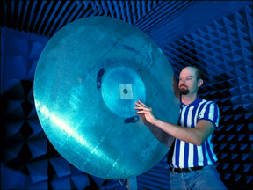
General Characteristics
Radiation Patterns
Edge diffraction is the most serious in the E plane.
y
Space wave
L
J_{s}
W
E plane
x
H plane

Slide 66
General Characteristics
Radiation Patterns
E-plane pattern
Red: infinite substrate and ground plane
Blue: 1 meter ground plane
Note:
The E-plane pattern “tucks in” and tends to zero at the horizon due to the presence of the infinite substrate.

Slide 67
General Characteristics
Radiation Patterns
H-plane pattern
Red: infinite substrate and ground plane
Blue: 1 meter ground plane

Slide 68
General Characteristics
Directivity
The directivity is fairly insensitive to the substrate thickness.
The directivity is higher for lower permittivity, because the patch is larger.

Slide 69
General Characteristics
Results: Directivity (relative to isotropic)
ε_{r} = 2.2 or 10.8
W/ L = 1.5

Slide 70
Outline
Overview of microstrip antennas
Feeding methods
Basic principles of operation
General characteristics
CAD Formulas
Input Impedance
Radiation pattern
Circular polarization
Circular patch
Improving bandwidth
Miniaturization
Reducing surface waves and lateral radiation

Slide 71
CAD Formulas
CAD formulas for the important properties of the rectangular microstrip antenna will be shown.
Radiation efficiency
Bandwidth (Q)
Resonant input resistance
Directivity
D. R. Jackson, “Microstrip Antennas,” Chapter 7 of Antenna Engineering Handbook, 5th Ed., J. L. Volakis, Editor, McGraw Hill, 2019.
D. R. Jackson, S. A. Long, J. T. Williams, and V. B. Davis, “Computer-Aided Design of Rectangular Microstrip Antennas,” Ch. 5 of Advances in Microstrip and Printed Antennas, K. F. Lee and W. Chen, Eds., John Wiley, 1997.
D. R. Jackson and N. G. Alexopoulos, “Simple Approximate Formulas for Input Resistance, Bandwidth, and Efficiency of a Resonant Rectangular Patch,” IEEE Trans. Antennas and Propagation, Vol. 39, pp. 407-410, March 1991.

Slide 72
CAD Formulas
Radiation Efficiency
Comment:
The efficiency becomes small as the substrate gets thin,
if there is dielectric or conductor loss.
where
Note: “hed” refers to a unit-amplitude horizontal electric dipole.

Slide 73
CAD Formulas
Radiation Efficiency (cont.)
where
Note: “hed” refers to a unit-amplitude horizontal electric dipole.
Note: When we say “unit amplitude” here, we assume peak (not RMS) values.

Slide 74
CAD Formulas
Radiation Efficiency (cont.)
Hence, we have
Physically, this term is the radiation efficiency of a
horizontal electric dipole (hed) on top of the substrate.

Slide 75
CAD Formulas
Radiation Efficiency (cont.)
The constants are defined as follows:

Slide 76
CAD Formulas
Improved formula for HED surface-wave power (due to Pozar)
Note: x₀ in this formula is not the feed location!
D. M. Pozar, “Rigorous Closed-Form Expressions for the Surface-Wave Loss of Printed Antennas,” Electronics Letters, vol. 26, pp. 954-956, June 1990.
Note: The above formula for the surface-wave power is different from that given in Pozar’s paper by a factor of 2, since Pozar used RMS instead of peak values.

Slide 77
CAD Formulas
Bandwidth
Comments:
For a lossless patch, the bandwidth is approximately proportional to the patch width and to the substrate thickness. It is inversely proportional to the substrate permittivity.
For very thin substrates the bandwidth will increase for a lossy patch, but as the expense of efficiency.
BW is defined from the frequency limits f₁ and f₂ at which SWR = 2.0.
(multiply by 100 if you want to get %)

Slide 78
CAD Formulas
Quality Factor Q

Slide 79
CAD Formulas
Q Components
The constants p and c₁ were defined previously.

Slide 80
CAD Formulas
Resonant Input Resistance
Probe-feed Patch
Comments:
For a lossless patch, the resonant resistance is approximately independent of the substrate thickness. For a lossy patch it tends to zero as the substrate gets very thin. For a lossless patch it is inversely proportional to the square of the patch width and it is proportional to the substrate permittivity.

Slide 81
CAD Formulas
Approximate CAD formula for probe (feed) reactance (in Ohms)
a = probe radius
h = probe height
This is based on an infinite parallel-plate model.
(Euler’s constant)

Slide 82
CAD Formulas
Observations:
Feed (probe) reactance increases proportionally with substrate thickness h.
Feed reactance increases for smaller probe radius.
Important point:
If the substrate gets too thick, the probe reactance will make it difficult to get an input match, and the bandwidth will suffer.
(Compensating techniques will be discussed later.)

Slide 83
CAD Formulas
Results: Probe Reactance (X_{f} =X_{p}= ωL_{p})
Rectangular patch
ε_{r} = 2.2
y
W/L = 1.5
Note: “exact” means the cavity model with all infinite modes.
(x₀, y₀)
W
h = 0.0254 λ₀
L
L
x
a = 0.5 mm
Center
Edge
The normalized feed location ratio x_{r} is zero at the center of the patch (x = L/2), and is 1.0 at the patch edge (x = L).
x_{r} = 2 ( x₀ / L) - 1

Slide 84
CAD Formulas
Directivity
where
The constants p and c₁ were defined previously.

Slide 85
CAD Formulas
Directivity (cont.)
For thin substrates:
(The directivity is essentially independent of the substrate thickness.)

Slide 86
Outline
Overview of microstrip antennas
Feeding methods
Basic principles of operation
General characteristics
CAD Formulas
Input Impedance
Radiation pattern
Circular polarization
Circular patch
Improving bandwidth
Miniaturization
Reducing surface waves and lateral radiation

Slide 87
Input Impedance
Various models have been proposed over the years for calculating the
input impedance of a microstrip patch antenna.
Transmission line model
  The first model introduced
  Very simple
Cavity model (eigenfunction expansion)
  Simple yet accurate for thin substrates
  Gives physical insight into operation
CAD circuit model
  Extremely simple and almost as accurate as the cavity model
Spectral-domain method
  More challenging to implement
  Accounts rigorously for both radiation and surface-wave excitation
Commercial software
  Very accurate
  Can be time consuming

Slide 88
Input Impedance
Comparison of the Three Simplest Models
CAD Circuit model of patch
Transmission line model of patch
Cavity model (eigenfunction expansion) of patch
Results for a typical patch show that the first three methods agree very well, provided the correct Q is used and the probe inductance is accounted for.

Slide 89
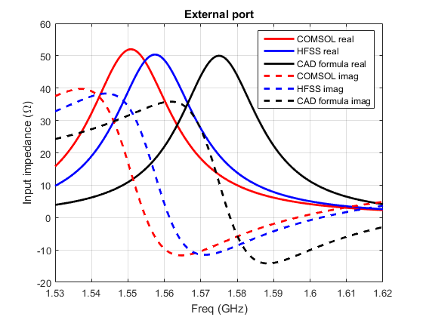
Input Impedance
Comparison of CAD with Full-Wave
Results from full-wave analysis agree well with the simple CAD circuit model, except for a shift in resonance frequency.

Slide 90
Input Impedance
CAD Circuit Model for Input Impedance
The circuit model discussed assumes a probe feed.
Other circuit models exist for other types of feeds.
Note:
The mathematical justification of the CAD circuit model comes from a cavity-model eigenfunction analysis.
Y. T. Lo, D. Solomon, and W. F. Richards, “Theory and Experiment on Microstrip Antennas,” IEEE Trans. Antennas Propagat., vol. AP-27, no. 3 (March 1979): 137–145.

Slide 91
Input Impedance
Probe-fed Patch
Near the resonance frequency, the patch cavity can be approximately modeled as a resonant RLC circuit.
The resistance R accounts for radiation and losses.
A probe inductance L_{p} is added in series, to account for the “probe inductance” of a probe feed.
Probe
Patch cavity
L
L_{p}
Z_{in}
R
C

Slide 92
Input Impedance
BW is defined here by SWR < 2.0 when the RLC circuit is fed by a matched line (Z₀ = R).
L
L_{p}
Z_{in}
R
C

Slide 93
Input Impedance
R is the input resistance at the resonance of the patch cavity
(the frequency that maximizes R_{in}).
L_{p}
(resonance of RLC circuit)
L
C
R

Slide 94
Input Impedance
The input resistance is determined once we know four parameters:
CAD formulas for all of these four parameters have been given earlier.
f₀: the resonance frequency of the patch cavity
R: the input resistance at the cavity resonance frequency f₀
Q: the quality factor of the patch cavity
L_{p}: the probe inductance
L_{p}
(R, f₀, Q)
L
C
Z_{in}
R

Slide 95
Input Impedance
Typical plot of input impedance
Without probe inductance
With probe inductance

Slide 96
Input Impedance
Results: Input Resistance vs. Frequency
Note: “exact” means the cavity model will all infinite modes.
Rectangular patch
Frequency where the input resistance is maximum (f₀):
R_{in} = R
ε_{r} = 2.2
W/L = 1.5
L = 3.0 cm

Slide 97
Input Impedance
Results: Input Reactance vs. Frequency
Frequency where the input resistance is maximum (f₀)
Note: “exact” means the cavity model will all infinite modes.
Rectangular patch
X_{p}
Shift due to probe reactance
Frequency where the input impedance is real
ε_{r} = 2.2
W/L = 1.5
L = 3.0 cm

Slide 98
Input Impedance
Optimization to get exactly 50 Ω at the desired resonance frequency:
Vary the length L first until you find the value that gives an input reactance of zero at the desired frequency.
Then adjust the feed position x₀ to make the real part of the input impedance 50 Ω at this frequency.

Slide 99
Design Example
Design a probe-fed rectangular patch antenna on a substrate having a relative permittivity of 2.33 and a thickness of 62 mils (0.1575 cm). (This is Rogers RT Duroid 5870.) Choose an aspect ratio of W / L = 1.5. The patch should resonate at the operating frequency of 1.575 GHz (the GPS L1 frequency). Ignore the probe inductance in your design, but account for fringing at the patch edges when you determine the dimensions. At the operating frequency the input impedance should be 50 Ω (ignoring the probe inductance). Assume an SMA connector is used to feed the patch along the centerline (at y = W / 2), and that the inner conductor of the SMA connector has a radius of 0.635 mm. The copper patch and ground plane have a conductivity of σ = 3.0 ×10⁷ S/m and the dielectric substrate has a loss tangent of tanδ = 0.001.
1) Calculate the following:
  The final patch dimensions L and W (in cm)
  The feed location x₀ (distance of the feed from the closest patch edge, in cm)
  The bandwidth of the antenna (SWR < 2 definition, expressed in percent)
  The radiation efficiency of the antenna (accounting for conductor, dielectric, and surface-wave loss, and expressed in percent)
  The probe reactance X_{p} at the operating frequency (in Ω)
  The expected complex input impedance (in Ω) at the operating frequency, accounting for the probe inductance
  Directivity
  Gain

Slide 100
Design Example
Continued
  2) Find (f₀, R, X_{p}, and Q) and plot the input impedance vs. frequency using the CAD circuit model.
  3) Keep W/L = 1.5, but now vary the length L of the patch and the feed position x₀ until you find the value that makes the input impedance exactly 50+j(0) Ω at 1.575 GHz.

Slide 101
Design Example
Results
Part 1
y
Results from the CAD formulas:
Feed at (x₀, y₀)
  1) L = 6.071 cm, W = 9.106 cm
  2) x₀ = 1.832 cm
  3) BW = 1.23%
  4) e_{r} = 82.9%
  5) X_{p} = 11.1 Ω
  6) Z_{in} = 50.0 + j(11.1) Ω
  7) D = 5.85 (7.67 dB)
  8) G = (D)(e_{r}) = 4.85 (6.86 dB)
y₀ = W/2
W
x
L

Slide 102
Design Example
Part 2
Results
Results from the CAD formulas:
f₀ = 1.575 ×10⁹ Hz
R = 50 Ω
Q = 57.5
X_{p} = 11.1 Ω
R_{in}
y
Ω
Feed at (x₀, y₀)
X_{in}
y₀ = W/2
W
x
L
f (GHz)

Slide 103
Design Example
Results
Part 3
After optimization:
L = 6.083 cm
x₀ = 1.800 cm
Ω
At 1.575 GHz
y
Feed at (x₀, y₀)
y₀ = W/2
W
f (GHz)
x
Note:
L

Slide 104
Outline
Overview of microstrip antennas
Feeding methods
Basic principles of operation
General characteristics
CAD Formulas
Input Impedance
Radiation pattern
Circular polarization
Circular patch
Improving bandwidth
Miniaturization
Reducing surface waves and lateral radiation

Slide 105
Radiation Pattern
There are two models often used for calculating the radiation pattern:
Electric current model
Magnetic current model
Note:
The origin is placed at the center of the patch,
at the top of the substrate, for the pattern calculations.
Patch
Probe
Coax feed

Slide 106
Radiation Pattern
Electric current model:
We keep the physical currents flowing on the patch (and feed).
Patch
Probe
Coax feed

Slide 107
Radiation Pattern
Magnetic current model:
We apply the equivalence principle and invoke the (approximate) PMC condition
at the edges.
Equivalence surface
Patch
Probe
Coax feed
The equivalent surface current is approximately zero on the top surface (weak fields) and the sides (PMC). We can ignore it on the ground plane (it does not radiate).

Slide 108
Radiation Pattern
Theorem
The electric and magnetic models yield identical patterns
at the resonance frequency of the cavity mode.
Assumption:
The electric and magnetic current models are based on the fields of a single cavity mode, corresponding to an ideal cavity with PMC walls.
D. R. Jackson and J. T. Williams, “A Comparison of CAD Models for Radiation from Rectangular Microstrip Patches,” Intl. Journal of Microwave and Millimeter-Wave Computer Aided Design, vol. 1, no. 2, pp. 236-248, April 1991.

Slide 109
Radiation Pattern
Comments on the Substrate Effects
The substrate can be neglected to simplify the far-field calculation.
When considering the substrate, it is most convenient to assume an infinite substrate (in order to obtain a closed-form solution).
Reciprocity can be used to calculate the far-field pattern of electric or magnetic current sources inside of an infinite layered structure.
When an infinite substrate is assumed, the far-field pattern always goes to zero at the horizon.
D. R. Jackson and J. T. Williams, “A Comparison of CAD Models for Radiation from Rectangular Microstrip Patches,” Intl. Journal of Microwave and Millimeter-Wave Computer Aided Design, vol. 1, no. 2, pp. 236-248, April 1991.

Slide 110
Radiation Pattern
Comments on the Two Models
For the rectangular patch, the electric current model is the simplest since there is only one electric surface current (as opposed to four edges).
For the rectangular patch, the magnetic current model allows us to classify the “radiating” and “nonradiating” edges.
y
“Radiating edges”
Note:
On the nonradiating edges, the magnetic currents are in opposite directions across the centerline (x = 0).
W
x
L
“Nonradiating edges”

Slide 111
Radiation Pattern
Rectangular Patch Pattern Formula
(The formula is based on the electric current model.)
L
x
h
Infinite ground plane and substrate
H-plane
The origin is at the center of the patch.
y
(1,0) mode
W
x
E-plane
The probe is on the x axis.
L

Slide 112
Radiation Pattern
The far-field pattern can be determined by reciprocity.
y
W
x
The “hex” pattern is for a
horizontal electric dipole in the x direction,
sitting on top of the substrate.
L
D. R. Jackson and J. T. Williams, “A Comparison of CAD Models for Radiation from Rectangular Microstrip Patches,” Intl. Journal of Microwave and Millimeter-Wave Computer Aided Design, vol. 1, no. 2, pp. 236-248, April 1991.

Slide 113
Radiation Pattern
where
Note: To account for lossy substrate, use

Slide 114
Outline
Overview of microstrip antennas
Feeding methods
Basic principles of operation
General characteristics
CAD Formulas
Radiation pattern
Input Impedance
Circular polarization
Circular patch
Improving bandwidth
Miniaturization
Reducing surface waves and lateral radiation

Slide 115
Circular Polarization
Three main techniques:
Single feed with “nearly degenerate” eigenmodes (compact but small CP bandwidth).
Dual feed with delay line or 90º hybrid phase shifter (broader CP bandwidth but uses more space).
Synchronous subarray technique (produces high-quality CP due to cancellation effect, but requires even more space).
The techniques will be illustrated with a rectangular patch.

Slide 116
Circular Polarization
Single Feed Method
The feed is on the diagonal.
The patch is nearly
(but not exactly) square.
(0,1)
W
(1,0)
L
Basic principle: The two dominant modes (1,0) and (0,1) are excited with equal amplitude, but with a ±45º phase.

Slide 117
Circular Polarization
Design equations:
y
The optimum CP frequency is the average of the x and y resonance frequencies.
(0,1)
W
(SWR < 2 )
(1,0)
x
Top sign for LHCP, bottom sign for RHCP.
L
The frequency f_{CP} is also the resonance frequency:
The resonant input resistance of the CP patch at f_{CP} is the same as what a linearly-polarized patch fed at the same position would be.

Slide 118
Circular Polarization
Other Variations
Note: Diagonal modes are used as degenerate modes
y
y
L
L
x
x
L
L
Patch with slot
Patch with truncated corners

Slide 119
Circular Polarization
Here we compare bandwidths (impedance and axial-ratio):
Linearly-polarized (LP) patch:
Circularly-polarized (CP) single-feed patch:
The axial-ratio bandwidth is small when using the single-feed method.
W. L. Langston and D. R. Jackson, “Impedance, Axial-Ratio, and Receive-Power Bandwidths of Microstrip Antennas,” IEEE Trans. Antennas and Propagation, vol. 52, pp. 2769-2773, Oct. 2004.

Slide 120
Circular Polarization
Dual-Feed Method
y
RHCP
Phase shift realized with delay line:
L
P
L
x
P+λ_{g}/4

Slide 121
Circular Polarization
Phase shift realized with 90º quadrature hybrid (branchline coupler)
y
RHCP
L
Feed
λ_{g}/4
50 Ohm load
L
λ_{g}/4
x
This gives us a higher bandwidth than the simple power divider,
but requires a load resistor.

Slide 122
Circular Polarization
Synchronous Rotation
Multiple elements are rotated in space and fed with phase shifts.
-180º
-90º
-270º
0º
Because of symmetry, radiation from higher-order modes (or probes)
tends to be reduced, resulting in good cross-pol.

Slide 123
Outline
Overview of microstrip antennas
Feeding methods
Basic principles of operation
General characteristics
CAD Formulas
Input Impedance
Radiation pattern
Circular polarization
Circular patch
Improving bandwidth
Miniaturization
Reducing surface waves and lateral radiation

Slide 124
Circular Patch
y
a
x
h
ε_{r}

Slide 125
Circular Patch
Resonance Frequency
From separation of variables:
a
PMC
J_{m} = Bessel function of first kind, order m.

Slide 126
Circular Patch
Resonance Frequency
a
PMC
This gives us
(n^{th} root of J_{m}′ Bessel function)

Slide 127
Circular Patch
Resonance Frequency
Table of values for
n / m | 0 | 1 | 2 | 3 | 4 | 5
1 | 3.832 | 1.841 | 3.054 | 4.201 | 5.317 | 5.416
2 | 7.016 | 5.331 | 6.706 | 8.015 | 9.282 | 10.520
3 | 10.173 | 8.536 | 9.969 | 11.346 | 12.682 | 13.987
Dominant mode: TM₁₁

Slide 128
Circular Patch
Dominant mode: TM₁₁
y
y
a
x
x
Circular patch
Square patch
W = L
The circular patch is somewhat similar to a square patch.

Slide 129
Circular Patch
Fringing extension
a
PMC
a + Δa
“Long/Shen Formula”:
or
L. C. Shen, S. A. Long, M. Allerding, and M. Walton, "Resonant Frequency of a Circular Disk Printed-Circuit Antenna," IEEE Trans. Antennas and Propagation, vol. 25, pp. 595-596, July 1977.

Slide 130
Circular Patch
Patterns
(The patterns are based on the magnetic current model.)
2a
x
h
Infinite GP and substrate
H-plane
y
The origin is at the center of the patch.
x
E-plane
a
The probe is on the x axis.
In patch cavity:
(The edge voltage has a maximum of one volt.)

Slide 131
Circular Patch
Patterns
where
Note: To account for lossy substrate, use

Slide 132
Circular Patch
Input Resistance
a

Slide 133
Circular Patch
Input Resistance (cont.)
where
e_{r} = radiation efficiency
P_{sp} = power radiated into space by circular patch with maximum edge voltage of one volt.

Slide 134
Circular Patch
Input Resistance (cont.)
CAD Formula:

Slide 135
Outline
Overview of microstrip antennas
Feeding methods
Basic principles of operation
General characteristics
CAD Formulas
Input Impedance
Radiation pattern
Circular polarization
Circular patch
Improving bandwidth
Miniaturization
Reducing surface waves and lateral radiation

Slide 136
Improving Bandwidth
Some of the techniques that have been successfully developed are illustrated here.
The literature may be consulted for additional designs and variations.

Slide 137
Improving Bandwidth
Probe Compensation
L-shaped probe:
As the substrate thickness increases the probe inductance limits the bandwidth – so we compensate for it.
Top view
Capacitive “top hat” on probe:

Slide 138
Improving Bandwidth
SSFIP: Strip Slot Foam Inverted Patch (a version of the ACP).
Bandwidths greater than 25% have been achieved.
Increased bandwidth is due to the thick foam substrate and also a dual-tuned resonance (patch+slot).
Note: There is no probe inductance to worry about here.
Patch substrate
Patch
Foam
Microstrip substrate
Microstrip line
Slot
J.-F. Zürcher and F. E. Gardiol, Broadband Patch Antennas, Artech House, Norwood, MA, 1995.

Slide 139
Improving Bandwidth
Stacked Patches
Bandwidth increase is due to thick low-permittivity antenna substrates and a dual or triple-tuned resonance.
Bandwidths of 25% have been achieved using a probe feed.
Bandwidths of 100% have been achieved using an ACP feed.
Patch substrates
Coupling patch
Top Patch
Microstrip substrate
Microstrip line
Slot

Slide 140

Improving Bandwidth
Stacked Patches
Stacked patch with ACP feed
Bandwidth (S₁₁ = -10 dB) is about 100%
(Photo courtesy of Dr. Rodney B. Waterhouse)

Slide 141
Improving Bandwidth
Stacked Patches
Stacked patch with ACP feed
Two extra loops are observed on the Smith chart.
(Photo courtesy of Dr. Rodney B. Waterhouse)

Slide 142
Improving Bandwidth
Parasitic Patches
Radiating Edges Gap Coupled Microstrip Antennas (REGCOMA).
Mush of this work was pioneered by K. C. Gupta.
Non-Radiating Edges Gap Coupled Microstrip Antennas (NEGCOMA)
Four-Edges Gap Coupled Microstrip Antennas (FEGCOMA)
Bandwidth improvement factor:
REGCOMA: 3.0, NEGCOMA: 3.0, FEGCOMA: 5.0?

Slide 143
Improving Bandwidth
Direct-Coupled Patches
Radiating Edges Direct Coupled Microstrip Antennas (REDCOMA).
Non-Radiating Edges Direct Coupled Microstrip Antennas (NEDCOMA)
Four-Edges Direct Coupled Microstrip Antennas (FEDCOMA)
Bandwidth improvement factor:
REDCOMA: 5.0, NEDCOMA: 5.0, FEDCOMA: 7.0

Slide 144
Improving Bandwidth
U-Shaped Slot
The introduction of a U-shaped slot can give a significant bandwidth (10%-40%).
(This is due to a double resonance effect, with two different modes.)
“Single Layer Single Patch Wideband Microstrip Antenna,” T. Huynh and K. F. Lee, Electronics Letters, Vol. 31, No. 16, pp. 1310-1312, 1986.

Slide 145
Improving Bandwidth
Double U-Slot
A 44% bandwidth was achieved.
Y. X. Guo, K. M. Luk, and Y. L. Chow, “Double U-Slot Rectangular Patch Antenna,” Electronics Letters, Vol. 34, No. 19, pp. 1805-1806, 1998.

Slide 146
Improving Bandwidth
E Patch
A modification of the U-slot patch.
A bandwidth of 34% was achieved (40% using a capacitive “washer” to compensate for the probe inductance).
B. L. Ooi and Q. Shen, “A Novel E-shaped Broadband Microstrip Patch Antenna,” Microwave and Optical Technology Letters, vol. 27, No. 5, pp. 348-352, 2000.

Slide 147
Multi-Band Antennas
A multi-band antenna is sometimes more desirable than a broadband antenna, if multiple narrow-band channels are to be covered.
General Principle:
Introduce multiple resonance paths into the antenna.

Slide 148
Multi-Band Antennas
Low-band
Low-band
Feed
High-band
Feed
Low-band
High-band
Dual-band E patch
Dual-band patch with parasitic strip

Slide 149
Outline
Overview of microstrip antennas
Feeding methods
Basic principles of operation
General characteristics
CAD Formulas
Radiation pattern
Input Impedance
Circular polarization
Circular patch
Improving bandwidth
Miniaturization
Reducing surface waves and lateral radiation

Slide 150
Miniaturization
High Permittivity
Quarter-Wave Patch
PIFA
Capacitive Loading
Slots
Meandering
Note: Miniaturization usually comes at a price of reduced bandwidth!
Usually, bandwidth is proportional to the volume of the patch cavity,
as we will see in the examples.

Slide 151
Miniaturization
High Permittivity
Size reduction
W
(Same aspect ratio)
L
The smaller patch has about one-fourth the bandwidth of the original patch.
(Bandwidth is inversely proportional to the permittivity.)

Slide 152
Miniaturization
Quarter-Wave patch
E_{z} = 0
Short-circuit vias
W
W
L
The new patch has about one-half the bandwidth of the original patch.
Neglecting losses:
Note: 1/2 of the radiating magnetic current

Slide 153
Miniaturization
Smaller Quarter-Wave patch
A quarter-wave patch with the same aspect ratio W/L as the original patch
E_{z} = 0
Short-circuit vias
Width reduction
W
W
L
The new patch has about one-half the bandwidth of the original quarter-wave patch, and hence one-fourth the bandwidth of the regular patch.
(Bandwidth is proportional to the patch width.)

Slide 154
Miniaturization
Quarter-Wave Patch with Fewer Vias
Use fewer vias
W
W
Fewer vias actually gives more miniaturization!
(The edge has a larger inductive impedance: explained on the next slide.)

Slide 155
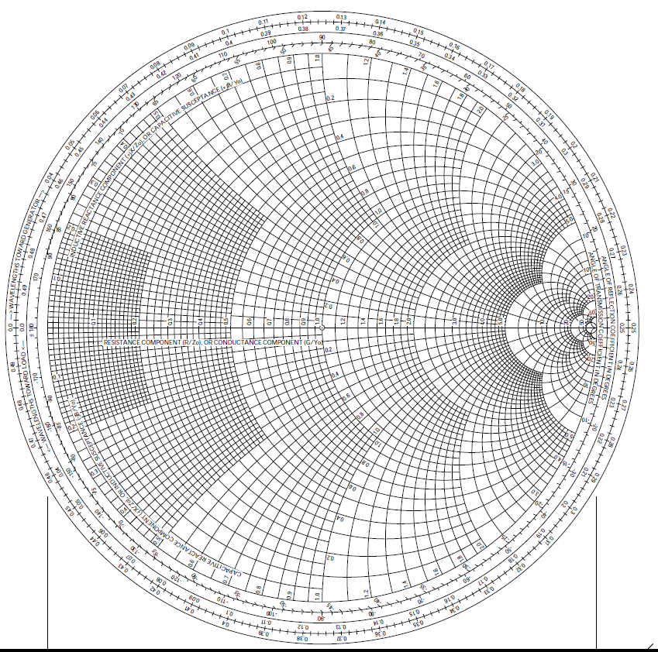
Miniaturization
Quarter-Wave Patch with Fewer Vias
Inductance
Short
Open
The Smith chart provides a simple explanation for the length reduction.

Slide 156
Miniaturization
Planar Inverted F (PIFA)
Feed
Shorting strip or via
Top view
A single shorting strip or via is used.
This antenna can be viewed as a limiting case of the via-loaded patch,
or as an LC resonator.

Slide 157
Miniaturization
PIFA with Capacitive Loading
Feed
Shorting plate
Top view
The capacitive loading allows for the length of the PIFA to be reduced.

Slide 158
Miniaturization
Circular Patch Loaded with Vias
Feed
c
2a
b
Patch
Metal vias
The patch has a monopole-like pattern
The patch operates in the (0,0) mode, as an LC resonator
(Hao Xu Ph.D. dissertation, University of Houston, 2006)

Slide 159
Miniaturization
Circular Patch Loaded with Vias
Example: Circular Patch Loaded with 2 Vias
Unloaded: resonance frequency = 5.32 GHz.
(Miniaturization factor = 4.8)

Slide 160
Miniaturization
Slotted Patch
Top view
0º
±90º
Linear
CP
The slot forces the current to flow through a longer path,
increasing the effective dimensions of the patch.

Slide 161
Miniaturization
Meandering
Via
Feed
Feed
Via
Meandered quarter-wave patch
Meandered PIFA
Meandering forces the current to flow through a longer path, increasing the effective dimensions of the patch.
Meandering also increases the capacitance of the PIFA line.

Slide 162
Outline
Overview of microstrip antennas
Feeding methods
Basic principles of operation
General characteristics
CAD Formulas
Input Impedance
Radiation pattern
Circular polarization
Circular patch
Improving bandwidth
Miniaturization
Reducing surface waves and lateral radiation

Slide 163


Reducing Surface and Lateral Waves
Reduced Surface Wave (RSW) Antenna
z
Feed
b
Shorted annular ring
ρ₀
ρ
a
o
x
a
b
h
Ground plane
Feed
SIDE VIEW
TOP VIEW
  D. R. Jackson, J. T. Williams, A. K. Bhattacharyya, R. Smith, S. J. Buchheit, and S. A. Long,
  “Microstrip Patch Designs that do Not Excite Surface Waves,” IEEE Trans. Antennas Propagat.,
  vol. 41, No 8, pp. 1026-1037, August 1993.

Slide 164
Reducing Surface and Lateral Waves
Reducing surface-wave excitation and lateral radiation reduces edge diffraction and mutual coupling.
Edge diffraction degrades the radiation pattern on a finite ground plane.
Mutual coupling causes an desirable coupling between antennas.

Slide 165
Reducing Surface and Lateral Waves
Reducing surface-wave excitation and lateral radiation reduces edge diffraction.
Space-wave radiation (desired)
Lateral radiation (undesired)
Diffracted field at edge
Surface waves (undesired)

Slide 166
Reducing Surface and Lateral Waves
y
Reducing the Surface Wave Excitation
TM₁₁ mode:
a
x
At edge:

Slide 167
Reducing Surface and Lateral Waves
y
Substrate
a
x
Surface-Wave Excitation:
(z > h)
Set

Slide 168
Reducing Surface and Lateral Waves
y
Substrate
a
x
For TM₁₁ mode:
Hence
Patch resonance:
Note:
The RSW patch is too big to be resonant.

Slide 169
Reducing Surface and Lateral Waves
z
Feed
b
Shorted annular ring
ρ₀
ρ
a
o
x
a
b
h
Ground plane
Feed
SIDE VIEW
TOP VIEW
The radius a is chosen to make the patch resonant:

Slide 170
Reducing Surface and Lateral Waves
Reducing the Lateral Radiation
y
Ground plane
a
x
Assume no substrate outside of patch
(or very thin substrate):
Space-Wave Field:
(z = h)
Set

Slide 171
Reducing Surface and Lateral Waves
y
Substrate
For a thin substrate:
a
x
The same design reduces both surface-wave fields and lateral-radiation fields.
Note: The diameter of the RSW antenna is found from
Note:
The size is approximately independent of the permittivity (the patch cannot be miniaturized by choosing a higher permittivity!).

Slide 172
Reducing Surface and Lateral Waves
E-plane Radiation Patterns
Measurements were taken on a 1 m diameter circular ground plane at 1.575 GHz.
Measurement
Theory (infinite GP)
Conventional
RSW

Slide 173
Reducing Surface and Lateral Waves
Reducing surface-wave excitation and lateral radiation reduces mutual coupling.
Space-wave radiation
Lateral radiation
Surface waves

Slide 174
Reducing Surface and Lateral Waves
Reducing surface-wave excitation and lateral radiation reduces mutual coupling.
E-plane
1/r
1/r³
“Mutual Coupling Between Reduced Surface-Wave Microstrip Antennas,” M. A. Khayat, J. T. Williams, D. R. Jackson, and S. A. Long, IEEE Trans. Antennas and Propagation, Vol. 48, pp. 1581-1593, Oct. 2000.

Slide 175
References
General references about microstrip antennas:
Microstrip Patch Antennas, K. F. Fong Lee and K. M. Luk, Imperial College Press, 2011.
Microstrip and Patch Antennas Design, 2nd Ed., R. Bancroft, Scitech Publishing, 2009.
Microstrip Patch Antennas: A Designer’s Guide, R. B. Waterhouse, Kluwer Academic Publishers, 2003.
Microstrip Antenna Design Handbook, R. Garg, P. Bhartia, I. J. Bahl, and A. Ittipiboon, Editors, Artech House, 2001.
Advances in Microstrip and Printed Antennas, K. F. Lee, Editor, John Wiley, 1997.

Slide 176
References (cont.)
General references about microstrip antennas (cont.):
CAD of Microstrip Antennas for Wireless Applications, R. A. Sainati, Artech House, 1996.
Microstrip Antennas: The Analysis and Design of Microstrip Antennas and Arrays, D. M. Pozar and D. H. Schaubert, Editors, Wiley/IEEE Press, 1995.
Millimeter-Wave Microstrip and Printed Circuit Antennas, P. Bhartia, Artech House, 1991.
The Handbook of Microstrip Antennas (two volume set), J. R. James and P. S. Hall, INSPEC, 1989.
Microstrip Antenna Theory and Design, J. R. James, P. S. Hall, and C. Wood, INSPEC/IEE, 1981.

Slide 177
References (cont.)
More information about the CAD formulas presented here for the rectangular patch may be found in:
Microstrip Antennas, D. R. Jackson, Ch. 7 of Antenna Engineering Handbook, J. L. Volakis, Editor, McGraw Hill, 2007.
Computer-Aided Design of Rectangular Microstrip Antennas, D. R. Jackson, S. A. Long, J. T. Williams, and V. B. Davis, Ch. 5 of Advances in Microstrip and Printed Antennas, K. F. Lee, Editor, John Wiley, 1997.

Slide 178
References (cont.)
References devoted to broadband microstrip antennas:
Compact and Broadband Microstrip Antennas, K.-L. Wong, John Wiley, 2003.
Broadband Microstrip Antennas, G. Kumar and K. P. Ray, Artech House, 2002.
Broadband Patch Antennas, J.-F. Zürcher and F. E. Gardiol, Artech House, 1995.

Slide 179
The End

